Slide 1
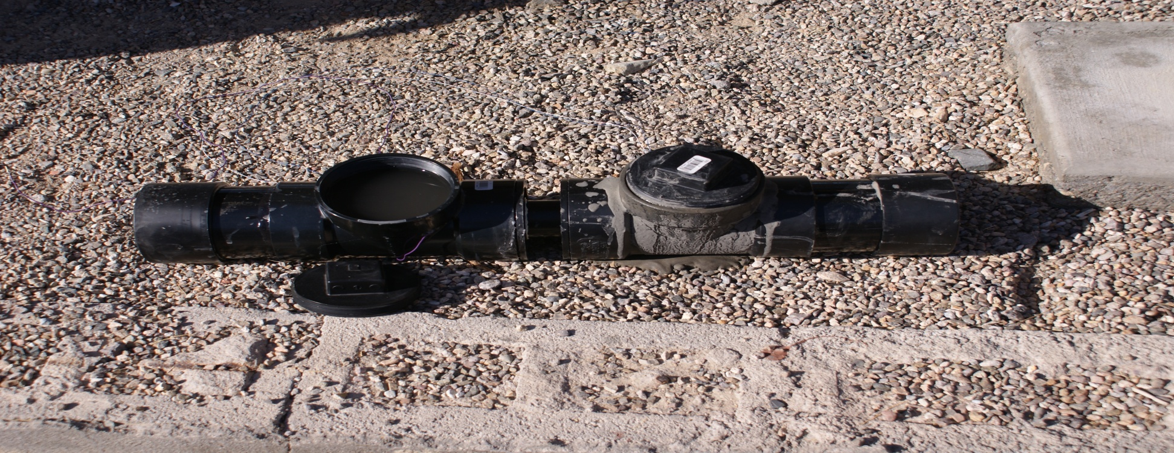
The Bug Battery
Cal State San Bernardino
Keith Schubert, Jane, Ernesto Gomez, and Blake

Slide 2
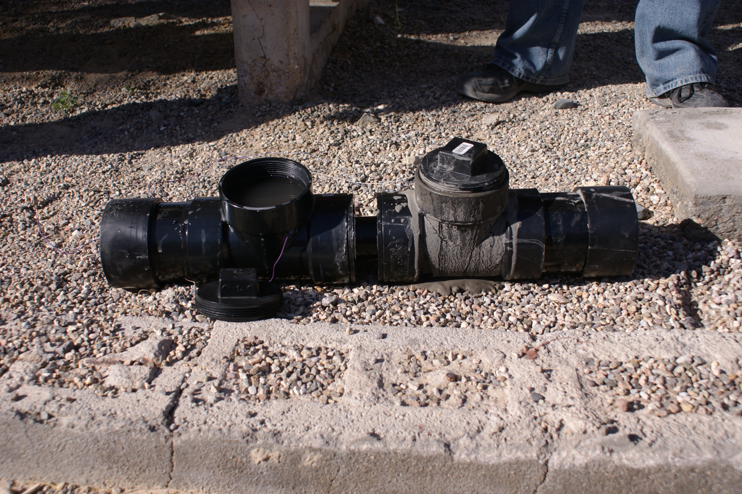
The Bug Battery General Parts
Anaerobic Chamber
Aerobic Chamber
Salt Bridge
PVC pipe
Electrons (e-) flow from negative to positive

Slide 3
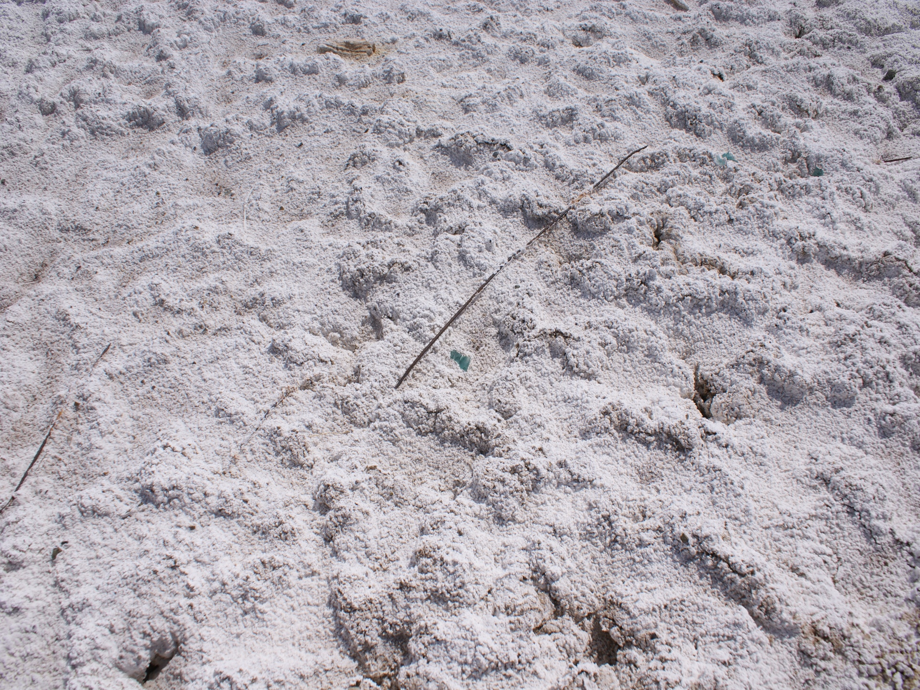
Building the Salt bridge
This is the ion source for the anaerobic chamber. The salt “bridge” allows the flow of ions between the chambers. The aerobic chamber provides a potential gradient
increasing the ion capacity of the bridge.
1:1 ratio of Salt to Jell-O
2 inch pipe
Allow to set for about 1 day

Slide 4
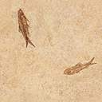
Collecting the organisms
Anaerobic (anode -)
Anaerobic organisms survive in areas with no oxygen. Fine grained sediments such as mud do not allow enough bubbles and oxygen to reach the organisms. Generally organisms at the bottom of lakes and ponds are anaerobic. Anaerobics reduce the environment as they metabololize.
Aerobic (cathode +)
Aerobic organisms require oxygen to survive. They live in the water column and other oxygen rich environments.

Slide 5
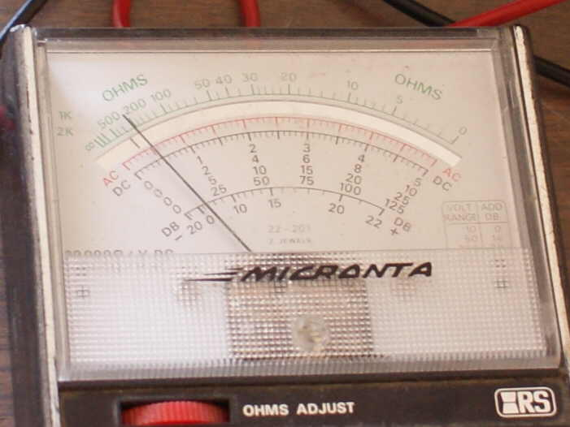
Help the anaerobic organisms metabolize faster
The voltmeter reads the difference between the anaerobic and aerobic chambers.
This provides low (1 milli-amp) continuous power that is not weather dependent and practically maintenance free

Slide 6
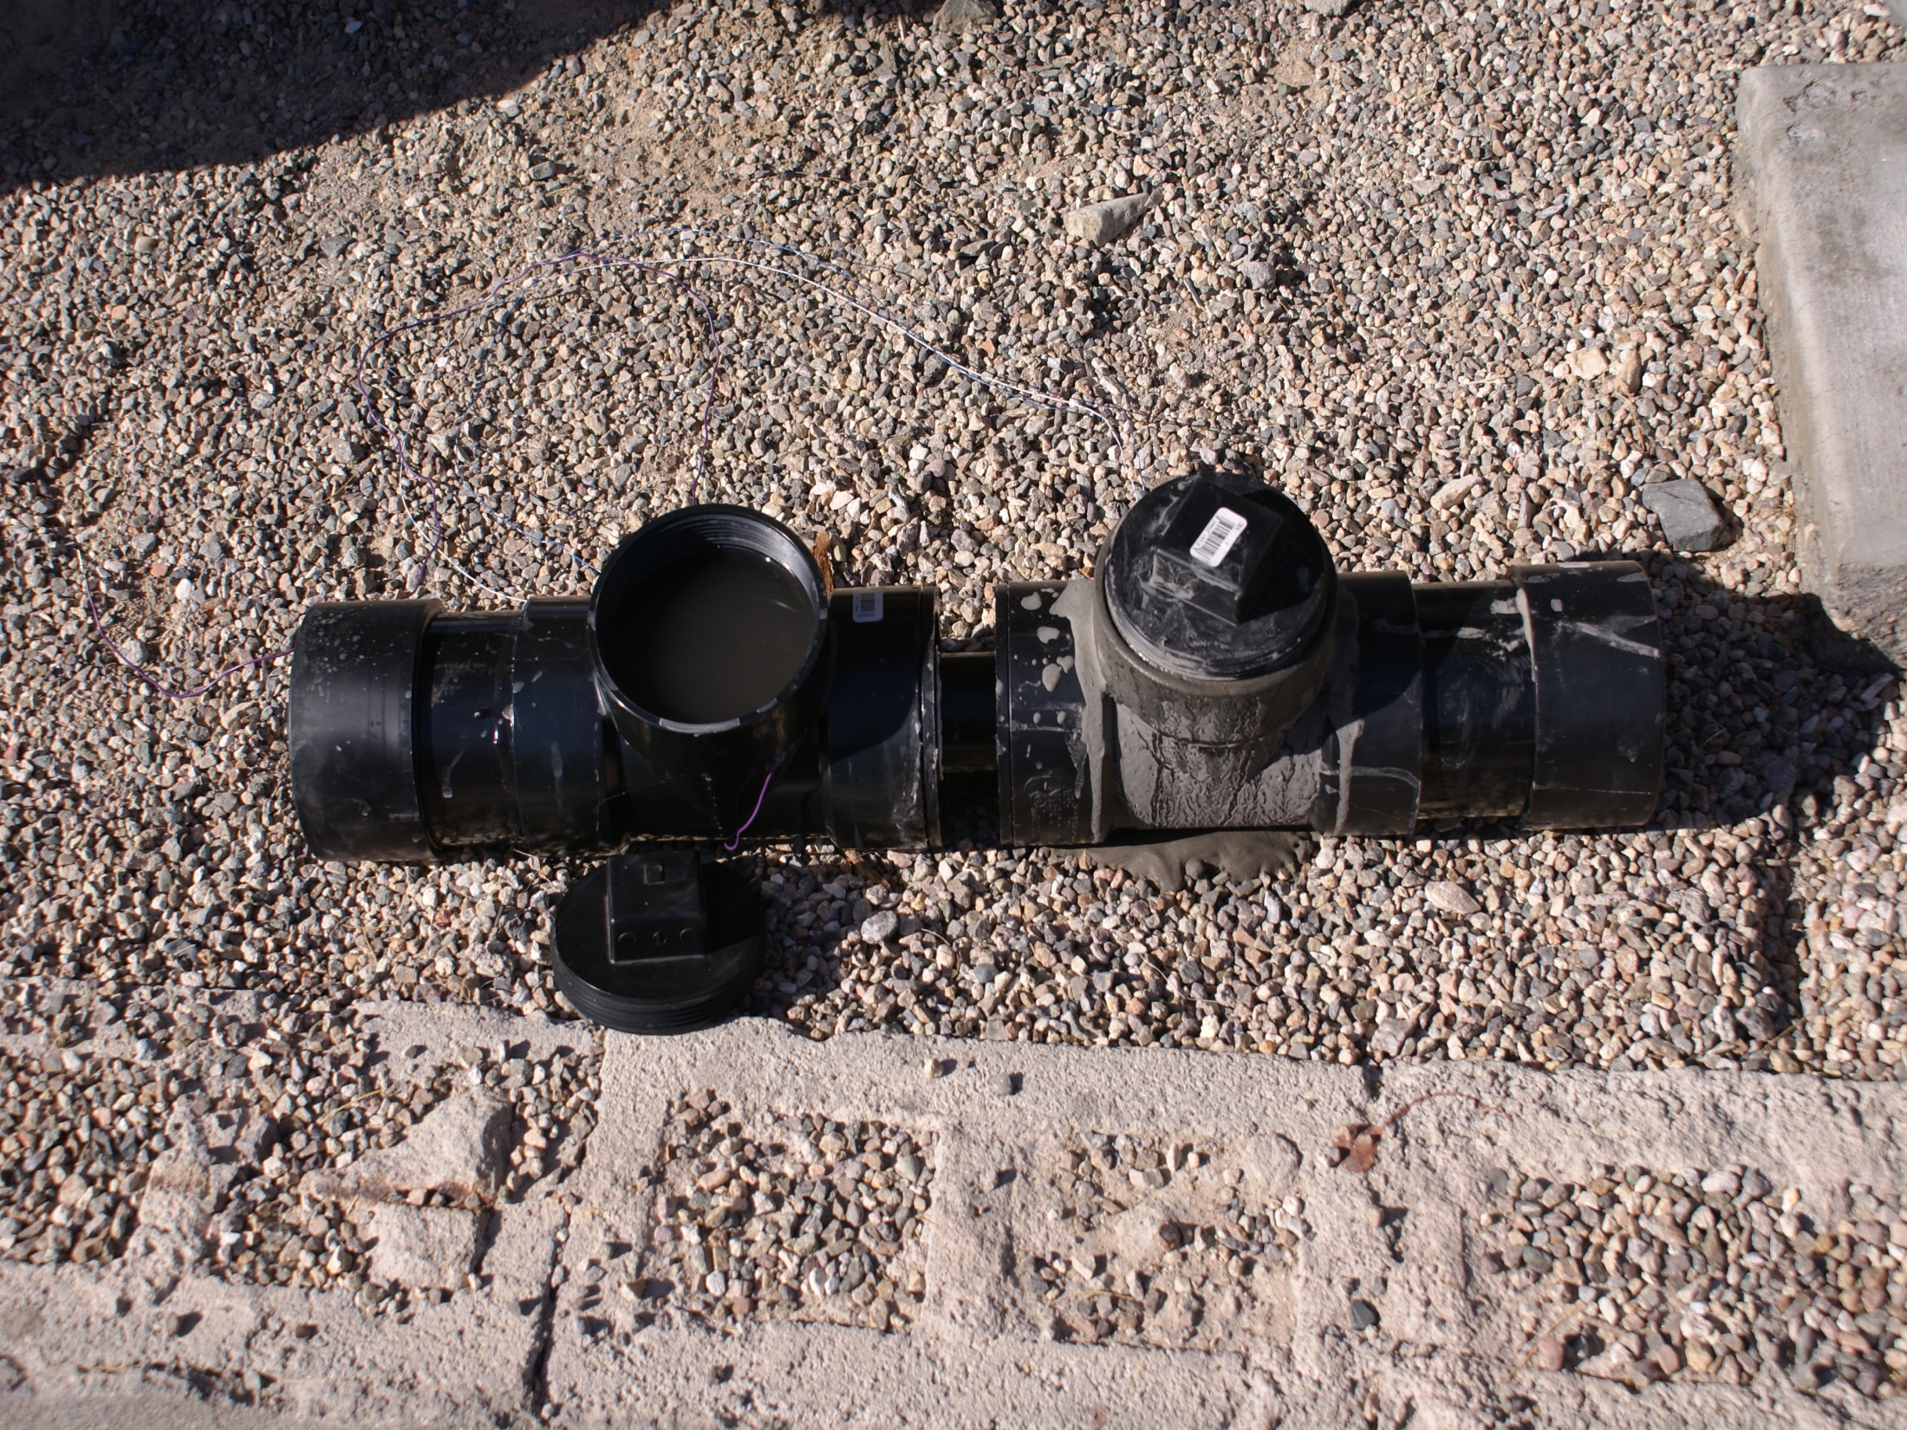
The Resources
Supply List (all under $50 dollars)
2 inch PVC pipe (for ion transport)
Jello (for sticking salt to)
Salt (ion source)
4 inch PVC Pipe (normally used for toilets)
Anaerobic organisms (mud in this case)
Aerobic organisms(water from no fish pond)
Graphite (carpenters pencils) e⁻ source
3 wires (ground, anaerobic, aerobic)
Hot Glue Gun and sticks
Blow dryer
Time
15 min for salt bridge construction
1 day wait time for bridge to harden
2 to 3 hours to complete the battery

Slide 7
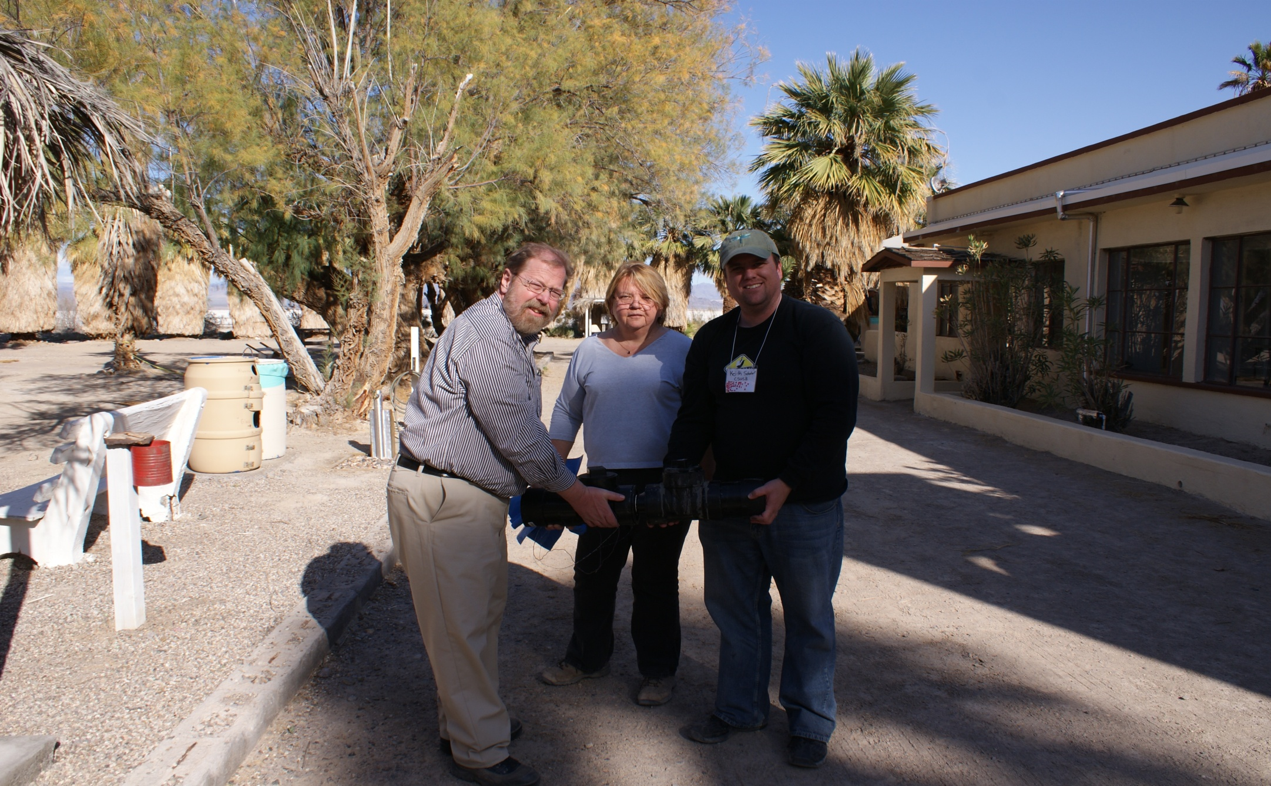
Thank You

