Slide 1
Church History
The first millennia

Slide 2
The first Century
3 Chief Church Fathers
  Polycarp
  Ignatius
  Clement
  Papias
Writings
  Didache
  Shepherd of Hermas
Major Issues
  Roman pressures

Slide 3
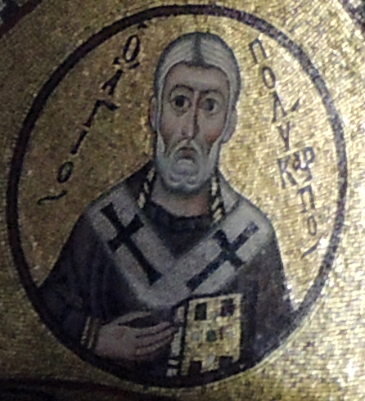
Polycarp
69-155
Disciple of John
Name means much fruit (big evangelist)
Bishop of Smyrna
Discipled Irenaeus (Bishop of Lyons)
Martyrdom of Polycarp
  "Swear by the fortune of Cæsar; think better of the matter; say, Away with the godless men." But Polycarp regarded with a sad countenance the whole multitude of lawless heathen in the theatre; and waving his hand towards them, groaned, and looking up to Heaven said, "Away with the godless men." And when the Governor urged him further, and said, "Swear, and I will dismiss thee; revile Christ;" Polycarp replied; "Eighty and six years have I been his servant, and he hath wronged me in nothing, and how can I blaspheme my King and my Saviour." And on his pressing him again, saying, "Swear by the fortune of Cæsar," Polycarp replied; "If ye vainly suppose that I shall swear by Cæsar's fortune, as ye call it, pretending to be ignorant of my real character, let me tell you plainly, I am a Christian; and if ye wish to hear the Christian doctrine, appoint me a time, and hear me."

Slide 4
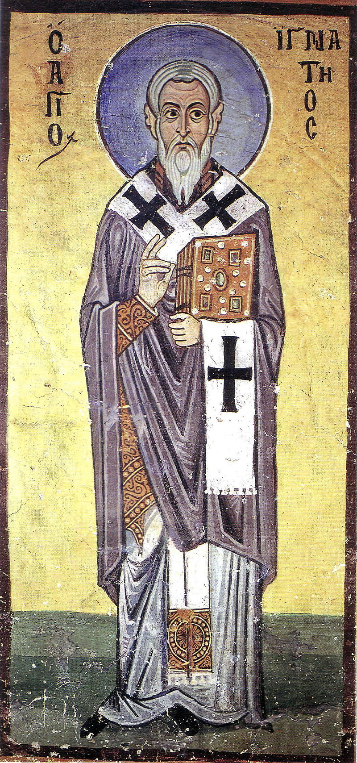
Ignatius of Antioch
? – 108/140 in Rome
Disciple of John
Name relates to fire
Bishop of Antioch
Known to have taught the deity of Christ
7 epistles, but they are contested
  John Calvin called the epistles "rubbish published under Ignatius' name".
  Irenaeus in his Against Heresies V,28:4 cites a passage found in the Epistle of Ignatius to the Romans almost verbatim, but claims it was "said" by "someone of our[ people]"

Slide 5
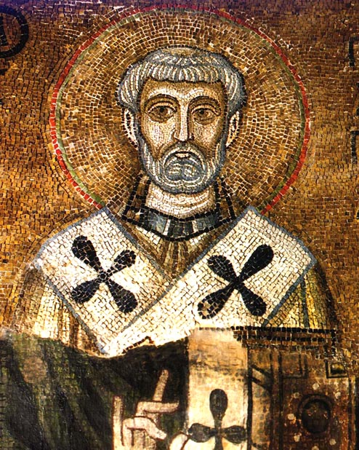
Clement of Rome
?-100
Connected to Peter sometimes Paul
Bishop of Rome
Martyred in Chersonesos (near modern Sevastopol) under Trajan, tied to an anchor and drowned
1 Clement:
  In the time of this Clement, no small dissension having occurred among the brethren at Corinth, the Church in Rome dispatched a most powerful letter to the Corinthians, exhorting them to peace, renewing their faith, and declaring the tradition which it had lately received from the apostles, proclaiming the one God, omnipotent, the Maker of heaven and earth, the Creator of man, who brought on the deluge, and called Abraham, who led the people from the land of Egypt, spoke with Moses, set forth the law, sent the prophets, and who has prepared fire for the devil and his angels. From this document, whosoever chooses to do so, may learn that He, the Father of our Lord Jesus Christ, was preached by the Churches, and may also understand the apostolic tradition of the Church, since this Epistle is of older date than these men who are now propagating falsehood, and who conjure into existence another god beyond the Creator and the Maker of all existing things. — St. Irenaeus, Against Heresies III, Chapter 3:3
  "the Church of God which sojourneth in Rome to the Church of God which sojourneth in Corinth"
  And so we, having been called through His will in Christ Jesus, are not justified through ourselves or through our own wisdom or understanding or piety or works which we wrought in holiness of heart, but through faith, whereby the Almighty God justified all men that have been from the beginning; to whom be the glory for ever and ever. Amen. (1 Clement 32:4)

Slide 6
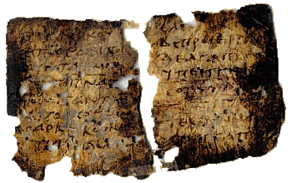
Didache
The Lord’s Teaching Through the Twelve Apostles to the Nations
Usually dated to 1st Century
Chapter 7. Concerning Baptism. And concerning baptism, baptize this way: Having first said all these things, baptize into the name of the Father, and of the Son, and of the Holy Spirit, in living water. But if you have no living water, baptize into other water; and if you cannot do so in cold water, do so in warm. But if you have neither, pour out water three times upon the head into the name of Father and Son and Holy Spirit. But before the baptism let the baptizer fast, and the baptized, and whoever else can; but you shall order the baptized to fast one or two days before.

Slide 7
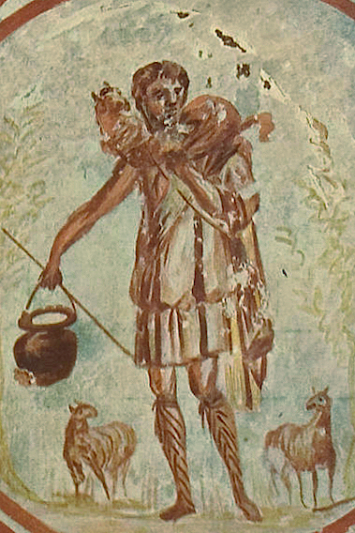
Shepherd of Hermas
5 visions
12 mandates
10 similitudes
Romans 16:14:
  Greet Asyncritus, Phlegon, Hermes, Patrobas, Hermas and the brethren with them.
Reference to a Clement

Slide 8
Roman Oppression
Nero
Domitian
Trajan
Pliny’s Letter
  For the moment this is the line I have taken with all persons brought before me on the charge of being Christians. I have asked them in person if they are Christians, and if they admit it, I repeat the question a second and third time, with a warning of the punishment awaiting them. If they persist, I order them to be led away for execution; for, whatever the nature of their admission, I am convinced that their stubbornness and unshakeable obstinacy ought not to go unpunished. There have been others similarly fanatical who are Roman citizens. I have entered them on the list of persons to be sent to Rome for trial.

