Slide 1
Church History
The first millennia

Slide 2
The Fifth Century
Church Fathers
  Augustine of Hippo (354-450)
  Cyril of Alexandria (378-444)
  Patrick
Writings
  City of God
  Confessions
Councils
  Council of Ephesus (431) Theotokos, condemns Pelagianism
  Council of Chalcedon (451) hypostatic union
Major Issues
  Heresy – Christological Heresies, Pelagianism, Semi-Pelagianism
  Fall of the West (410, 476)

Slide 3
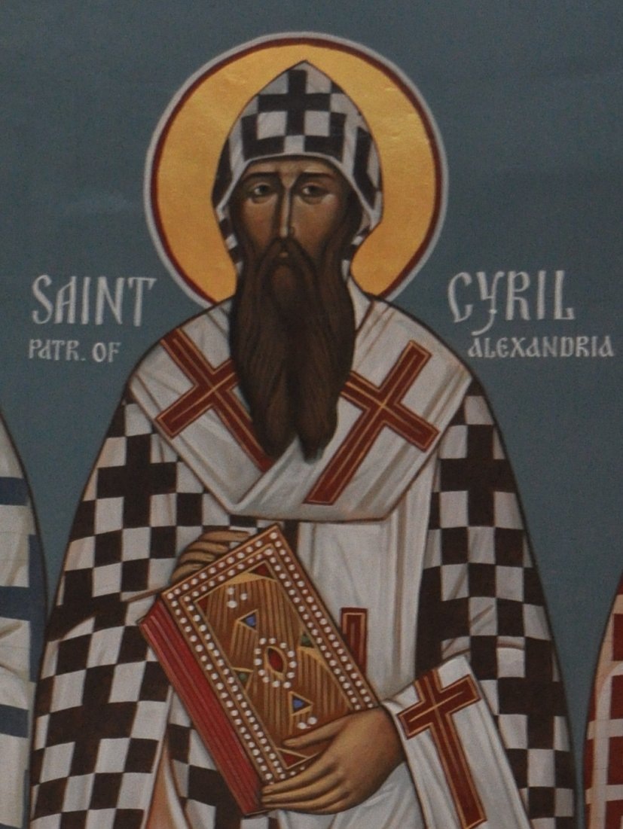
Cyril of Alexandria
(c. 378 – 444)
Bishop of Alexandria at its height of influence/power
wrote extensively
  Commentaries
  Against heresies like Arianism
  On Trinity, Christ is One
Central figure at Council of Ephesus in 431
  Vs. Nestorius as Archbishop of Constantinople
Against Prefect Orestes (a Christian Roman Governor)
  Orestes edict against shows
    Hierax was publicly beaten
    Threats between Jews and Christians
    Christian nighttime massacre
    Banish of Jews
  Monks riot
  Murder of Hypatia by Christians (possibly Parabalani)

Slide 4
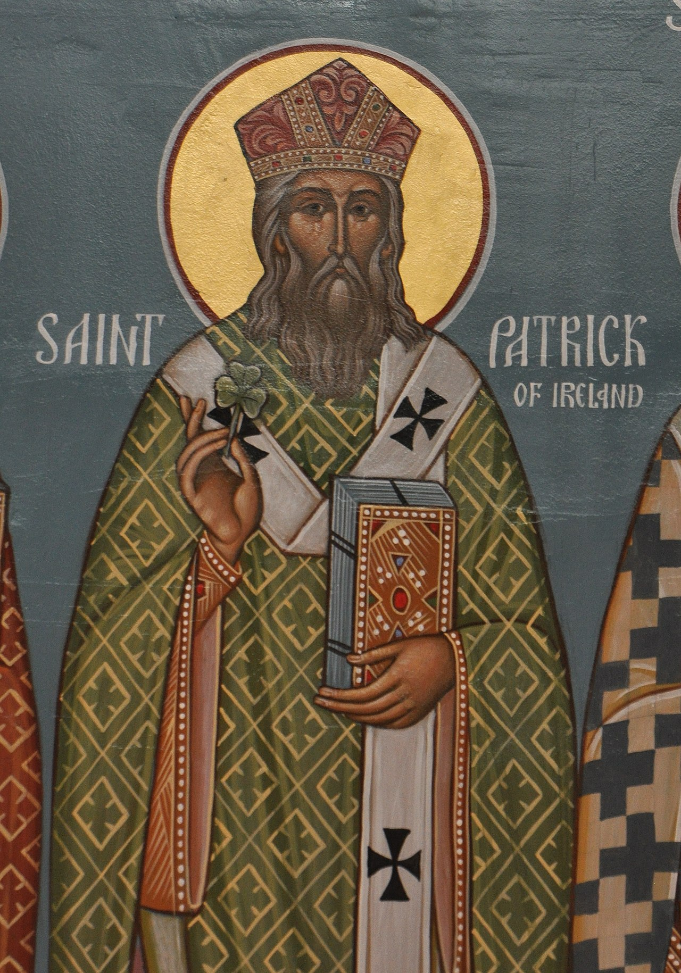
Patrick
Dates uncertain, birth 360-400 death 457-492
  Mix of Old Latin and Vulgate quotes
  Roman rule end, invasions
Likely born in Scotland
Captured as a slave by the Irish at 16
Slave for 6 years, then escaped
Eventually returned as missionary

Slide 5
Pelagius
British/Celtic Monk
  Moved to Rome around 380
  Austere
  Denied Original Sin (Man Good)
  Emphasized human ability and choice
  Bothered by Augustine’s statement in Confessions: “Give what you command and command what you will”
  Condemned in Council of Carthage 418
  Grace to Pelagius:
    given free will
    law, gospel, example of Jesus
    Revelation of rewards
    Forgiveness of sins in Baptism
  Condemned in Council of Ephesus 431
Semi-Pelagianism
  John Cassian
  Man is depraved but not totally
    Sick/dying but not dead
    We can cooperate with God’s grace on our own
    Salvation is initially an act of free will
  Condemned at Council of Orange (529)
Scriptures to contemplate
  Romans 3:10-18
  John 6:35-44
  Ephesians 1:3-14
  Ephesians 2:1-10
  Romans 5
  Romans 8:28-30
  Romans 9

Slide 6
Fall of Rome
Loss of Britian
Loss of parts of Gaul and Hispania
Sack of Rome in 410 by Visigoths
  Accusations by pagans against Christians
  Shock Romans
Barbarian settlements
Losses in Africa to Vandals
Atilla the Hun
Majorian, Ricimer
Odacer deposes Romulus in 476
Augustine writes City of God (~1,100 pages)
  Heavenly city – New Jerusalem
  Earthly city (city of man) vs Heavenly city
  Critique of pagan religion (Books 1-5)
  Critique of pagan philosophy (Books 6-10)
  Origins of cities (Books 11-14)
  History between cities (Books 15-18)
  Destinies of cities (Books 19-22)
  Suffering of the righteous
  Existence of evil
  Free will, sovereignty, omniscience, original sin

