Slide 1
Church History
The first millennia

Slide 2
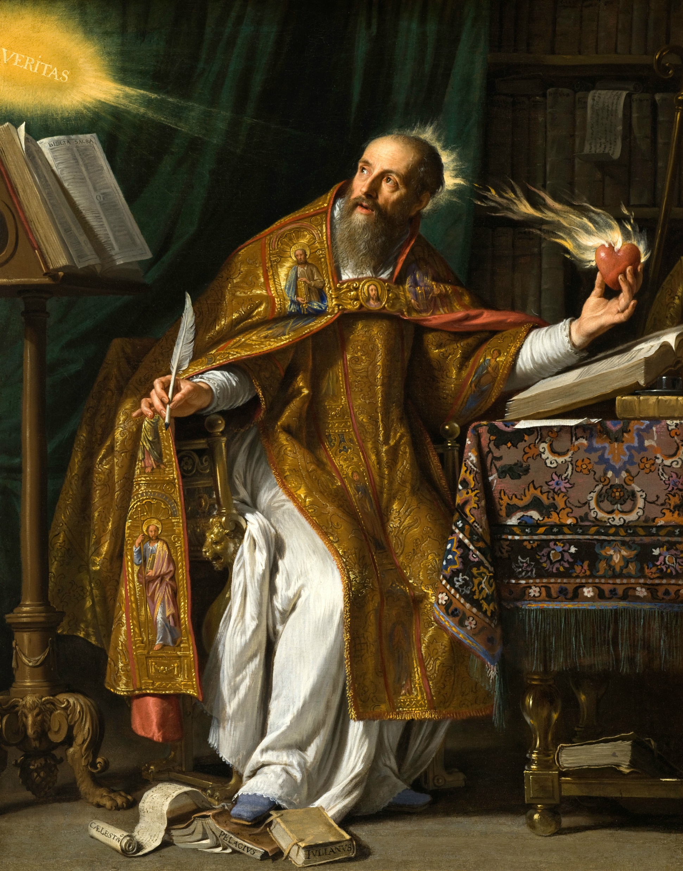
Augustin of Hippo
13 November 354 – 28 August 430
Bishop of Hippo
Family: Aurelius, upper class (honestiores – honorable men)
  Father (Patrick) was Roman Pagan
  Mother (Monica) was Berber Christian
At 11 went to school in Madaurus
At 17 went to Carthage
  Hedonism then Manichaeanism
Taught in Thagaste, Carthage, then Rome
Left Manichaeanism
At 30, he was sent to the imperial court at Milan to teach philosophy
Met Ambrose of Milan

Slide 3
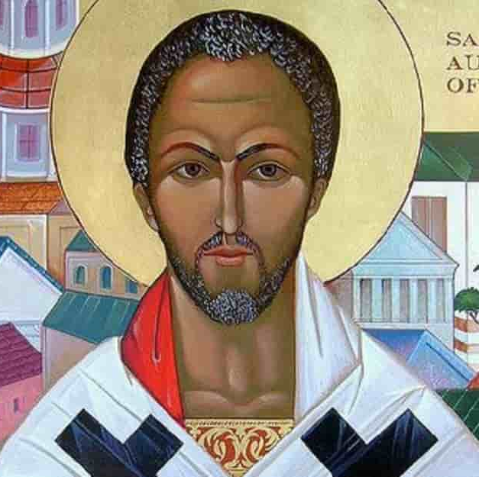
Writings
City of God
On Christian Doctrine
Confessions
He wrote more than 5 million words
Complete works 12,365 pages

Slide 4
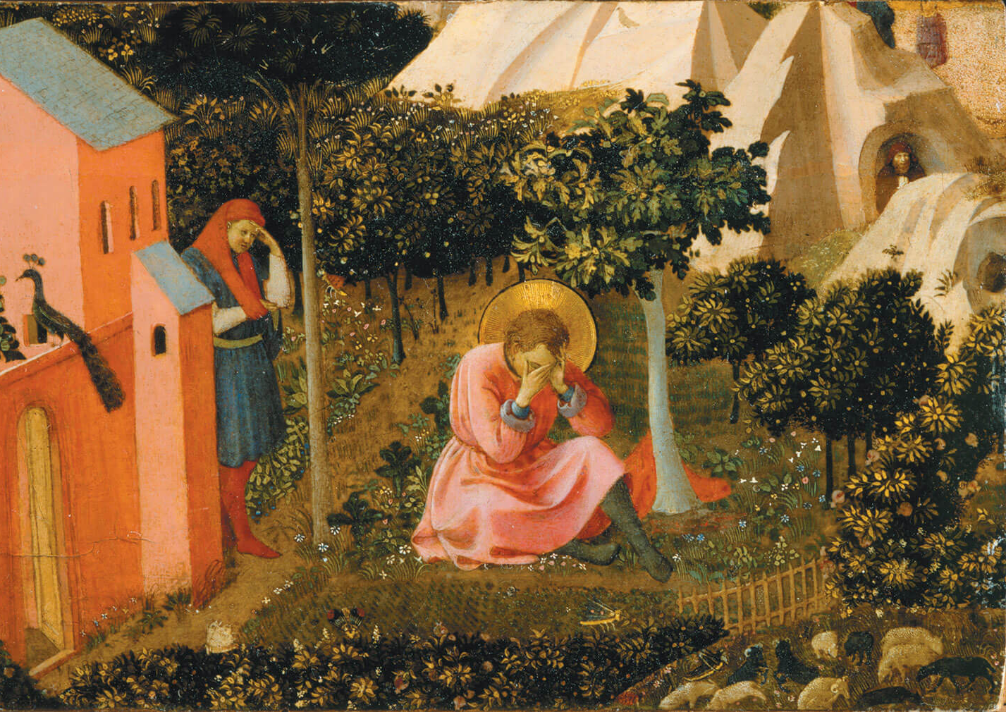
Teachings
Trinity
  Filioque
  Outside time
Predestination
Original Sin
Just War Theory

Slide 5
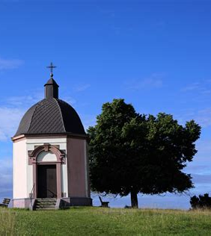
Book 1, chapter 1
Great art Thou, O Lord, and greatly to be praised; great is Thy power, and Thy wisdom infinite. And Thee would man praise; man, but a particle of Thy creation; man, that bears about him his mortality, the witness of his sin, the witness that Thou resistest the proud: yet would man praise Thee; he, but a particle of Thy creation. Thou awakest us to delight in Thy praise; for Thou madest us for Thyself, and our heart is restless, until it repose in Thee. Grant me, Lord, to know and understand which is first, to call on Thee or to praise Thee? and, again, to know Thee or to call on Thee? for who can call on Thee, not knowing Thee? for he that knoweth Thee not, may call on Thee as other than Thou art. Or, is it rather, that we call on Thee that we may know Thee? but how shall they call on Him in whom they have not believed? or how shall they believe without a preacher? and they that seek the Lord shall praise Him: for they that seek shall find Him, and they that find shall praise Him. I will seek Thee, Lord, by calling on Thee; and will call on Thee, believing in Thee; for to us hast Thou been preached. My faith, Lord, shall call on Thee, which Thou hast given me, wherewith Thou hast inspired me, through the Incarnation of Thy Son, through the ministry of the Preacher.

Slide 6
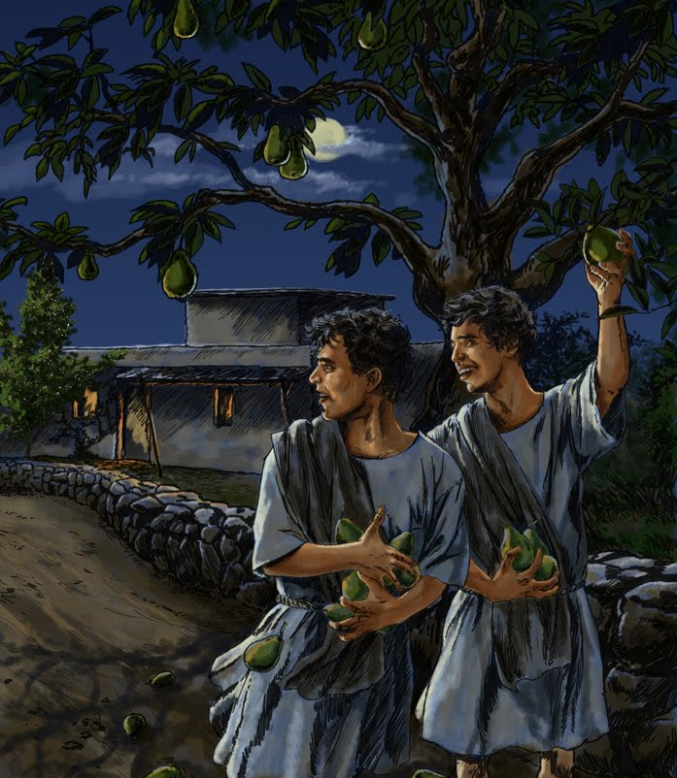
Book 2, chapter 4
Theft is punished by Thy law, O Lord, and by the law written in men's hearts, which iniquity itself cannot blot out. For what thief will suffer a thief? Even a rich thief will not suffer him who is driven to it by want. Yet had I a desire to commit robbery, and did so, compelled neither by hunger, nor poverty, through a distaste for well-doing, and a lustiness of iniquity. For I pilfered that of which I had already sufficient, and much better. Nor did I desire to enjoy what I pilfered, but the theft and sin itself. There was a pear-tree close to our vineyard, heavily laden with fruit, which was tempting neither for its colour nor its flavour. To shake and rob this some of us wanton young fellows went, late one night (having, according to our disgraceful habit, prolonged our games in the streets until then), and carried away great loads, not to eat ourselves, but to fling to the very swine, having only eaten some of them; and to do this pleased us all the more because it was not permitted. Behold my heart, O my God; behold my heart, which Thou hadst pity upon when in the bottomless pit. Behold, now, let my heart tell Thee what it was seeking there, that I should be gratuitously wanton, having no inducement to evil but the evil itself. It was foul, and I loved it. I loved to perish. I loved my own error--not that for which I erred, but the error itself. Base soul, falling from Thy firmament to utter destruction--not seeking aught through the shame but the shame itself!

Slide 7

Book 10
Late have I loved you, O Beauty ever ancient, ever new, late have I loved you! You were within me, but I was outside, and it was there that I searched for you. In my unloveliness I plunged into the lovely things which you created. You were with me, but I was not with you. Created things kept me from you; yet if they had not been in you they would have not been at all. You called, you shouted, and you broke through my deafness. You flashed, you shone, and you dispelled my blindness. You breathed your fragrance on me; I drew in breath and now I pant for you. I have tasted you, now I hunger and thirst for more. You touched me, and I burned for your peace.

Slide 8
Other Great Quotes
You use all, whether we know it or not, for purposes known only to you. - Confessions
Nothing sets us free save the grace of God through Jesus Christ, our Lord. We are in bondage to sin, and our only hope of redemption is the grace of God through the work of Christ. - Confessions
Whoever is happy has God. – On the happy life
There we shall rest and see, see and love, love and praise. – City of God

Slide 9
On Christian Doctrine
Book 1: General view of subjects of Scripture
  Discovery (first half), expression (second half) of the true sense of Scripture
  Things: Enjoyed (only God) vs Used (everything else)
Book 2: Signs
  Natural and conventional
  Words as conventional signs
    Difficulty interpreting unknown and ambiguous
    Unkown signs main part of this book
    Direct or figurative
      Learn Greek and Hebrew
      Compare translations
      Interpret figurative expression
      Knowledge of things and words
      Knowledge from heathen (science, art) can be useful
Book 3
  Ambiguous signs (direct or figurative)
  ambiguity may arise from the punctuation, the pronunciation, or the doubtful signification of the words, and is to be resolved by attention to the context, a comparison of translations, or a reference to the original tongue
  figurative signs we need to guard against two mistakes
  1. the interpreting literal expressions figuratively; 2. the interpreting figurative expressions literally
  literal or figurative; the general rule being, that whatever can be shown to be in its literal sense inconsistent either with purity of life or correctness of doctrine must be taken figuratively
  He then goes on to lay down rules for the interpretation of expressions which have been proved to be figurative; the general principle being, that no interpretation can be true which does not promote the love of God and the love of man.
Book 4 (part 2 of work)
  Rhetoric & oratory

