Slide 1
Church History
The first millennia

Slide 2
6th Century
Boethius (c. 480-524) Last classical philosopher and First Medieval philosopher
Dionysius Exiguus (d. c. 550) introduced the method of dating years. He began with year one as the year of Jesus' birth. Later archaeologists realized that he was wrong by 4-7 years, which makes the birth of Jesus between 4-7 BC.
Justinian (482-565) Emperor in East, called the last Roman Emperor
Gregory the Great (540-604), Bishop of Rome
Isidore of Seville (c. 560 – 636) "the last scholar of the ancient world“
570 Muhammad, the founder of Islam, was born in Mecca in present-day Saudi Arabia.
589 At the Third Council of Toledo in this year, the Filioque clause was added to the Nicene Creed.

Slide 3
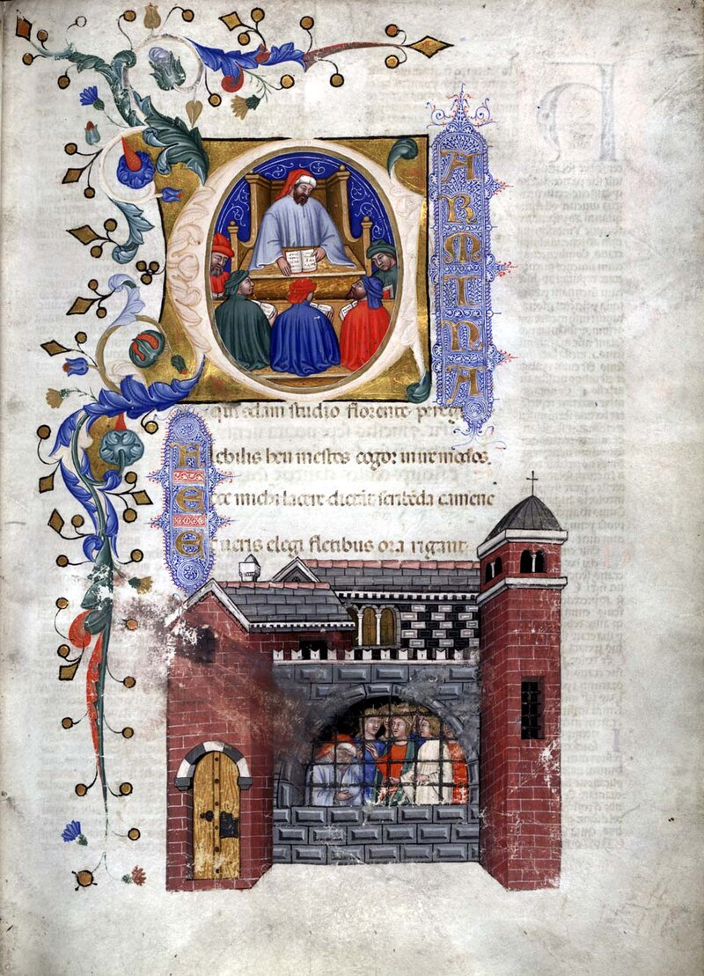
Boethius
Born 480 in Rome
Died 524 in Pavia
  Executed by Theodoric
Served as senator, consul, advisor, chief judge
Mainly a classical philosopher
  Revived Aristotle and Cicero
  Stoicism
  Neoplatonism
  Mathematics (arithmetic, music, geometry)
  Saved classic works of philosophy
  Reconcile classic philosophy with Christianity
Writings
  Consolation of Philosophy
  On the Trinity

Slide 4
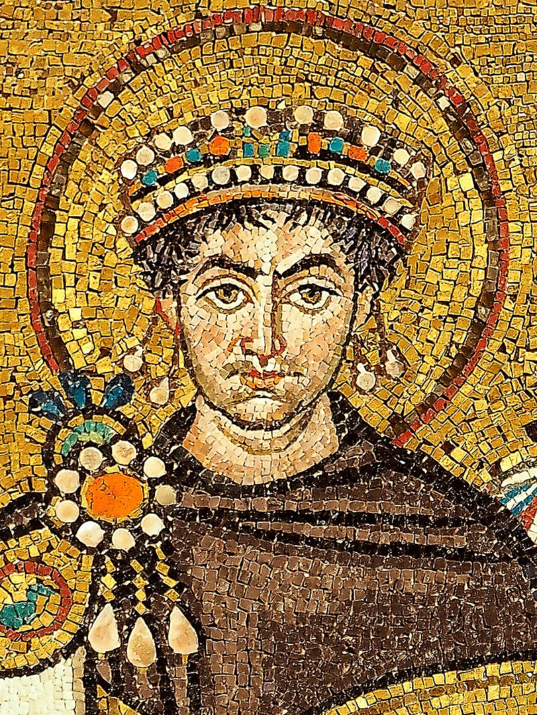
Justinian
482-565
Born peasant in Tauresium, Dardania (N. Macedonia)
Married Theodora, circus performer
Moral reforms, unify Christianity
  Closed Neoplatonic academy (Plato’s academy was destroyed by Sulla in 86BC)
  Stopped worship of Egyptian gods
  Sent missionaries to Nabateans, and Yemen
Nika riots (Belisarius)
Hagia Sophia
Wars with Sassanids/Persians
“reconquest” of west
Natural disasters
  Year of darkness in 536
  Bubonic plague in 542
  Beirut earthquake in 551

Slide 5
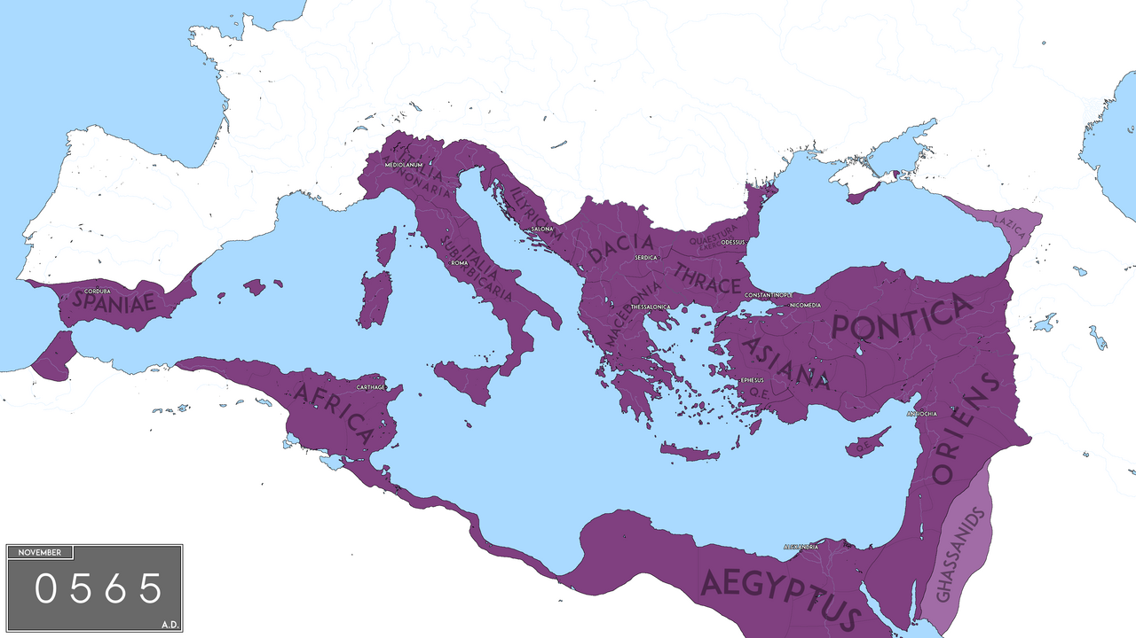

Slide 6
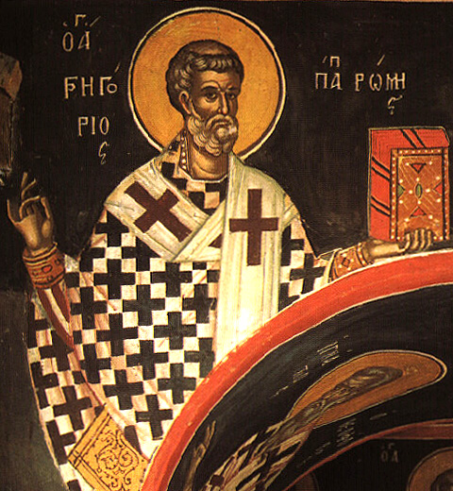
Gregory
540-604
Influenced by Augustine, Jerome, John Cassian, Desert Fathers
More interested in being a Benedictine monk
  Founded St. Andrew’s Monastery on family land
Gregorian Chant
Eager for missions
  Sent 596, Augustine to Kent (2x) established Canterbury
Very interested in music (Gregorian Chant)
Wrote several commentaries, and a work on pastoral care – bishops as pastors of the flock, heavy on good preaching
854 letters
  In one, a lady asked for prayers for her assurance of salvation, and he replied he prayed she didn’t get it, so it would motivate her to work harder
Theology (grace+)
  Emphasize sacraments – mystical view – particularly Eucharist
  Purgatory
  Prays for the dead
  Enumerated 7 deadly sins and 7 heavenly virtues
    Pride, greed, lust, envy, gluttony, wrath, sloth
    Humility, charity, chastity, gratitude, temperance, patience, diligence

Slide 7
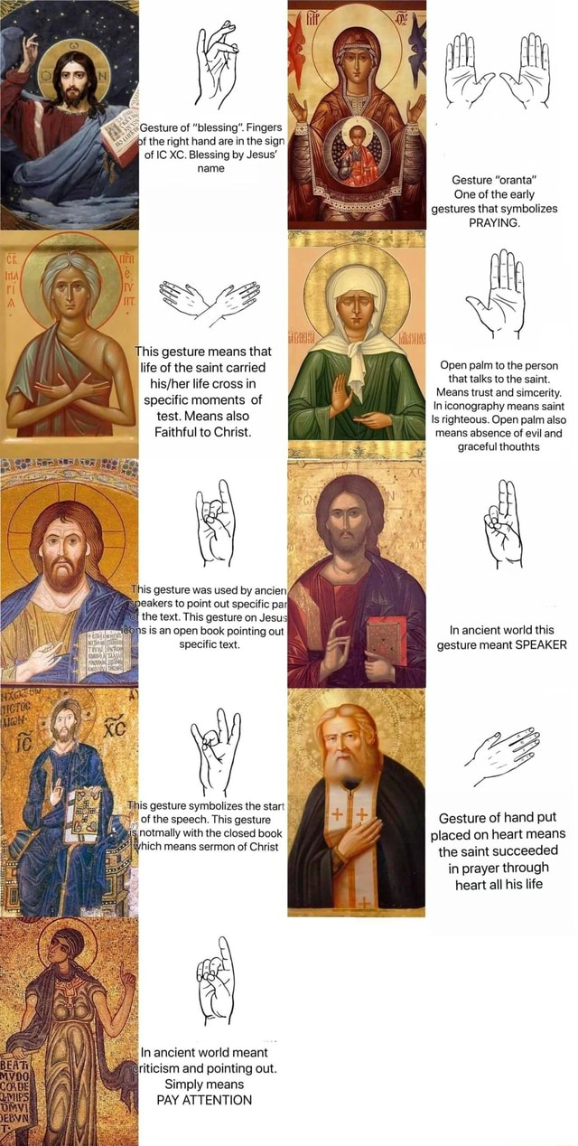
Partial List of
Hand gesture meaning in Christian Icons

