Slide 1
Church History
The first millennia

Slide 2
7th-10th Centuries East
People
  Maximus the Confessor 580-662
  John of Damascus 675-749
  Alopen enters China 635 AD (Tang Dynasty 618-907)
  Vladimir I the great, converts
Events
  Rise of Islam
  Al-Khwarizmi c. 780 – c. 850 writes
    Book of Indian computationAl-Jabr (The Compendious Book on Calculation by Completion and Balancing)

Slide 3
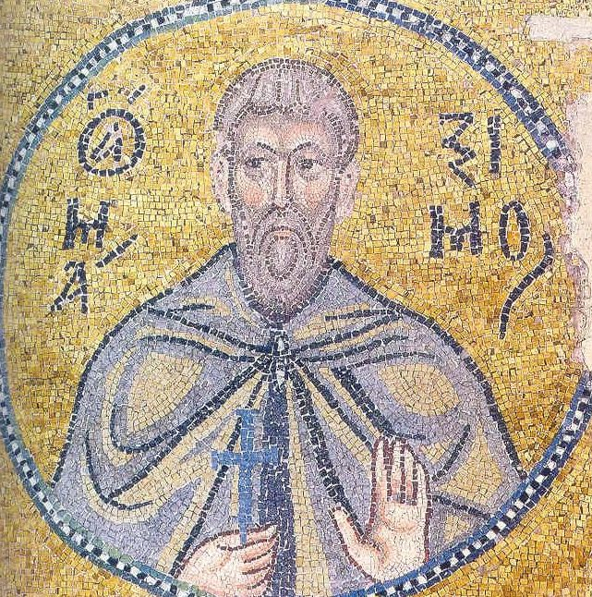
Maximus the Confessor
Aka Maximus the Theologian and Maximus of Constantinople
c. 580 – 662
Christian monk, theologian, and scholar
Civil servant & Protoasekretis of the Byzantine Emperor Heraclius
Entered monastic life
Fled to Carthage when Sassanids invaded Anatolia
Studied under Sophronius of Jerusalem
Studied Gregory of Nazianzus (Cappadocian & Holy Hierarch)
Debating Pyrrhus over Monothelitism, Pyrrhus recanted, both went to Lateran Council in 649.
Constans II 641-668 was Monothelite and had him and Roman Pope Martin arrested in 653. Tried and exiled twice, ultimately had his tongue cut out and right hand cut off (not able to speak or right) and died soon after in exile.
His Life of the Virgin is thought to be the earliest complete biography of Mary, the mother of Jesus.

Slide 4
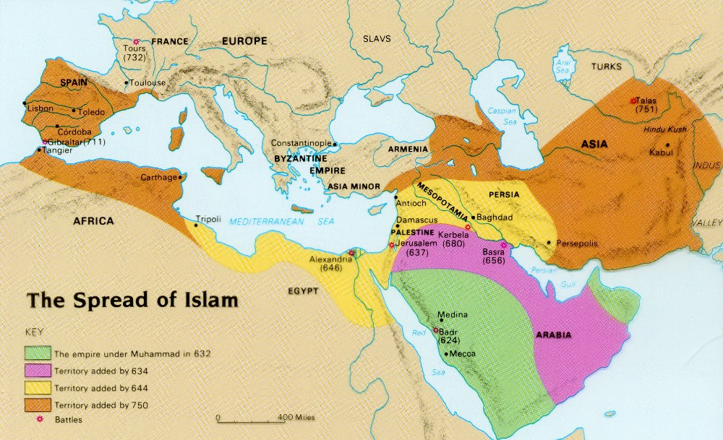
(622)

Slide 5
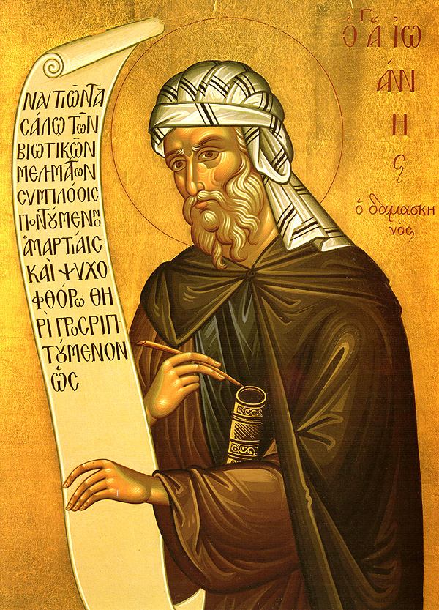
John of Damascus
675/676 - 4 December AD 749
Damascus - monastery, Mar Saba, near Jerusalem
polymath (law, theology, philosophy, music)
By-name of Chrysorroas (streaming with gold/the golden speaker)
Early opposition to Islam

Slide 6
Heresy of the Ishmaelites
Muhammad had a "seeming show of piety,"
Muhammad taught Arianism instead of Christianity
Early version of Islamic Dilemma
read & criticize the Quran for saying
  The Virgin Mary was the sister of Moses and Aaron, according to Surah Maryam (19:28):
    “O sister of Aaron! Your father was not a man of evil, nor was your mother unchaste!”
  Jesus was not crucified but brought alive into heaven according to Surah An-Nisa (4:157–158):
    “And [for] their saying, ‘Indeed, we have killed the Messiah, Jesus, the son of Mary, the messenger of Allah. But they did not kill him, nor did they crucify him — but [it was] made to appear to them. And indeed, those who differ over it are in doubt about it. They have no knowledge of it except the following of assumption. And they did not kill him, for certain. Rather, Allah raised him to Himself. And ever is Allah Exalted in Might and Wise.”

Slide 7
Heresy of the Ishmaelites
Muslim claim that the Old Testament passages about Jesus' coming is misinterpreted or Jews edited the Old Testament so as to deceive Christians
Accused John of idol worship for venerating the Cross and worshipping Jesus.
  Muslims kiss the black stone in Mecca
  Quran acknowledges Jesus is the Word of God and Spirit (4:171/169). John notes that the word and the spirit are inseparable from that in which they exist and if the Word of God has always existed in God, then the Word must be God
Final arguments:
  Islam permits polygamy
  Muhammad committed adultery with a companion's wife before outlawing adultery
  Quran is filled with stories,
    She-Camel of God
    God giving Jesus an "incorruptible table."
Asked Muslims for witnesses to testify that Muhammad received the Quran from God
  Moses received the Torah from God in the presence of the Israelites
    Islamic law mandates that a Muslim can only marry and do trade in the presence of witnesses
  Biblical prophets and verses foretold Muhammad 's coming
    Jesus was foretold by the prophets and whole Old Testament.
  Muslims answered that Muhammad received the Quran in his sleep
  John replied
    “Then we jokingly say to them that, as long as he received the book in his sleep and did not actually sense the operation”
    “You're spinning me dreams”

