Slide 1
Church History
The first millennia

Slide 2
7th-10th Centuries West
People
  Venerable Bede (673-735)
  Boniface 675 AD - 754 AD
  Charlemagne (748-814)
Events
  Rise of Islam

Slide 3
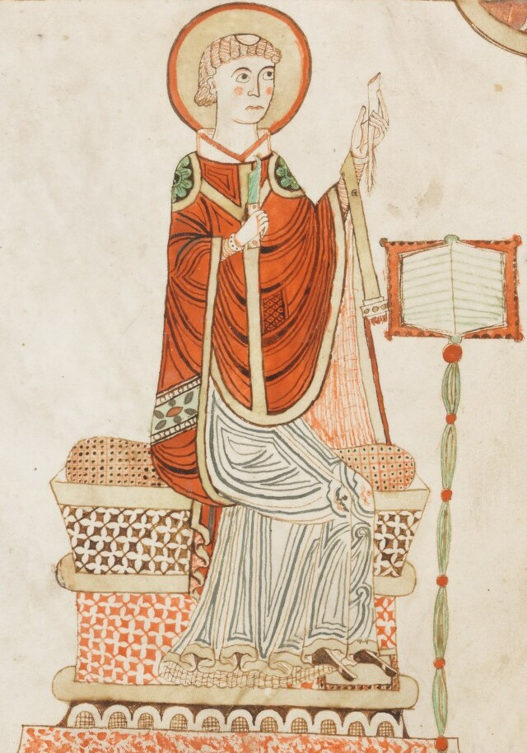
Venerable Bede
Born 673, Kingdom of Northumbria
Died 735 (age 61 or 62)
Probably married (twice mentions wife)
Early interest in dating Resurrection/Pasca
  Big issue in England since Celtic and Roman church dates differed
Wrote over 60 works (first for class use)
  Ecclesiastical History of the English People
  On the Reckoning of Time
    Included description of spherical earth and effect on daylight and moon observations.
    Effect of moon on tides
  On the Nature of Things
  Many exegetical Biblical commentaries
  Homilies to explain theology for major Christian seasons (and some events)
His dating of earth picked up later by Bishop Usher

Slide 4
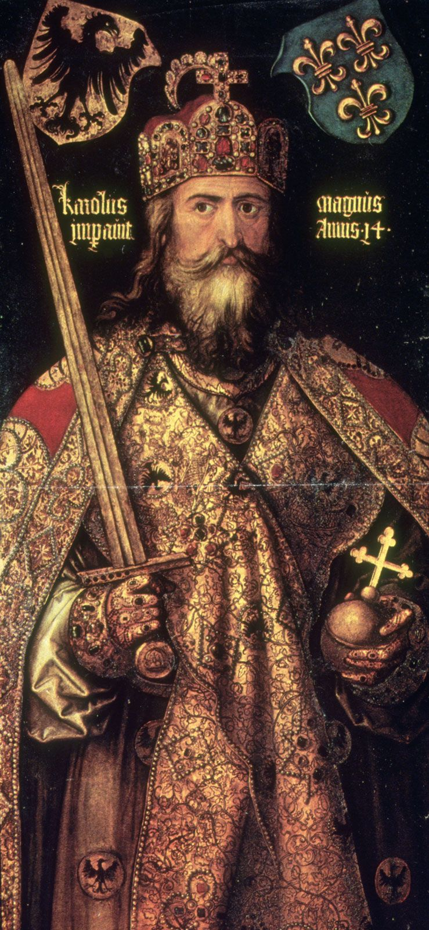
Charlemagne
Grandson of Charles Martel (the hammer)
  Stopped Umayyyad Caliphate at Tours/Poitiers
Son of Peppin “the short”
Brought Alcuin to teach

