Slide 1
Church History
The second millennium

Slide 2
11th Century
People
  Anselm
Music
  It was also within the walls of the Gothic cathedrals that a new song would rise upward, as near 1000 A.D. Western music made its most important leap forward when, in the schools of Leonin and Perotin at Notre Dame, monophonic chant was replaced by polyphony.⁶³ As church music passed from chant to sequence to trope to motet in the two centuries after 1000, hymnody in its modern form began to take shape. According to this essayist’s count, fourteen texts and eleven tunes from this time period still echo in WELS churches from the pages of our new hymnal, and we are the better for it.
Events
  William the Conqueror takes England
  Viking Invasions
  Investiture Controversy
  Filioque – 1054
  First and Iberian Crusade (1095)
Notes:
~1000 A.D. Western music made its most important leap forward when, in the schools of Leonin and Perotin at Notre Dame, monophonic chant was replaced by polyphony.
church music passed from chant to sequence to trope to motet in the two centuries after 1000, hymnody in its modern form began to take shape. According to this essayist’s count, fourteen texts and eleven tunes from this time period such as “Oh Come, Oh Come, Emmanuel”(CW 23); “O Sacred Head Now Wounded” (CW 105) and “O Jesus, King Most Wonderful” (CW 373)--both hymns attributed to Bernard of Clairvaux; “Jerusalem the Golden” (CW 214 - Bernard of Cluny); “Christ is Arisen” (CW 144); “Christ the Lord is Risen Today; Alleluia!” (CW 150). Also, a few hymn texts/tunes that Luther adapted: CW 161, 266, 534, 285, 190.

Slide 3
Great Schism 1054
Papal Supremacy
Filioque Controversy
Experience vs Philosophy
Liturgical Differences
  leavened versus unleavened
Roman Empire's capital
Iconoclast Controversy
Power struggles
1053, Patriarch Michael I Cerularius closed Latin churches in Constantinople
Pope Leo IX (through Cardinal Humbert) excommunicated Patriarch Cerularius who responded in kind

Slide 4
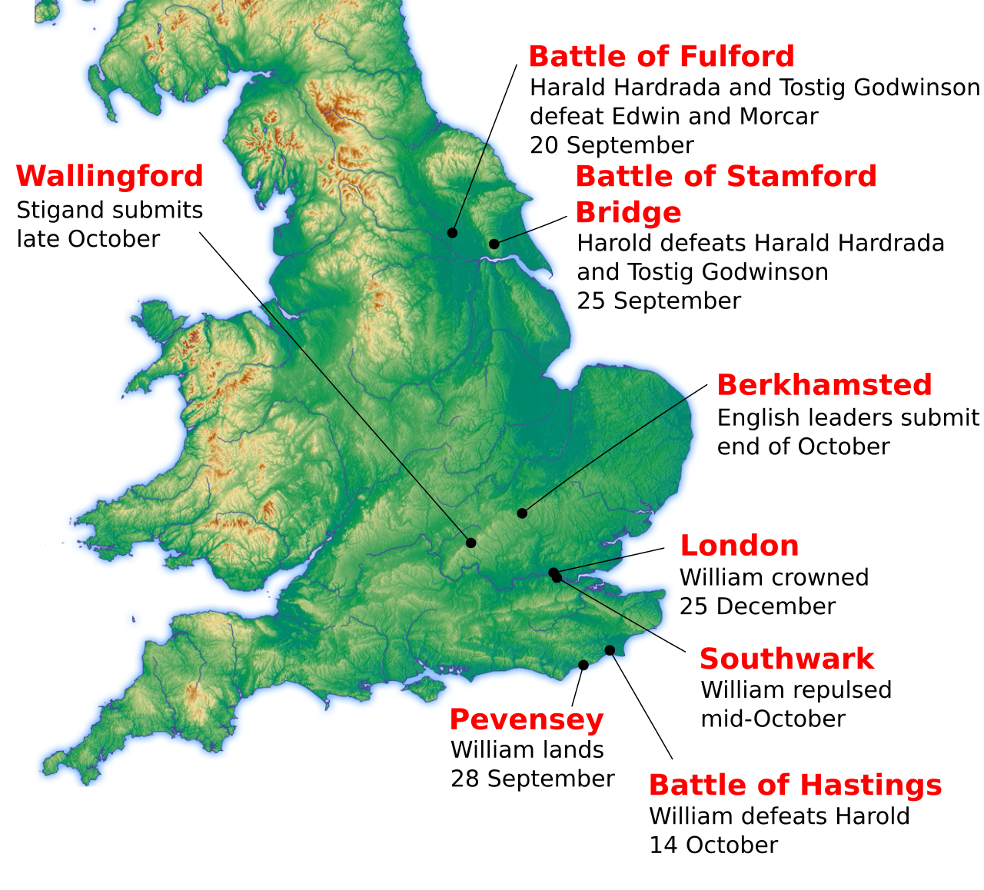
Norman Conquest
1066

Slide 5
Investiture Controversy (1076-1122)
Who installs new bishops?
  Pope Gregory VII and Henry IV
  Pope Paschal II and Henry I (1103-1107)
Power struggles
  Pope v. emperor (Charlemagne)
  East v. West
1076Henry IV got bishops to excommunicate Gregory
1076 Gregory excommunicated Henry
1077 Rudolf of Swabia
1077 Henry’s Walk to Canossa
1103 English Investiture
1107 Concordant of London
1122Concordat of Worms
bishops to swear an oath of fealty to the secular monarch
selection by the church
the church to invest bishops
  sacred authority
  ring and staff

Slide 6
Saint Anselm of Canterbury
Saint Anselm (1033-1109)
  Italian Benedictine monk, theologian
  Archbishop of Canterbury from 1093 to 1109
  Doctor of the Church.
“faith seeking understanding”
Ontological Argument
Scholasticism
Satisfaction theory of atonement
Books:
  Cur Deus Homo
  Monologion
  Proslogion

Slide 7
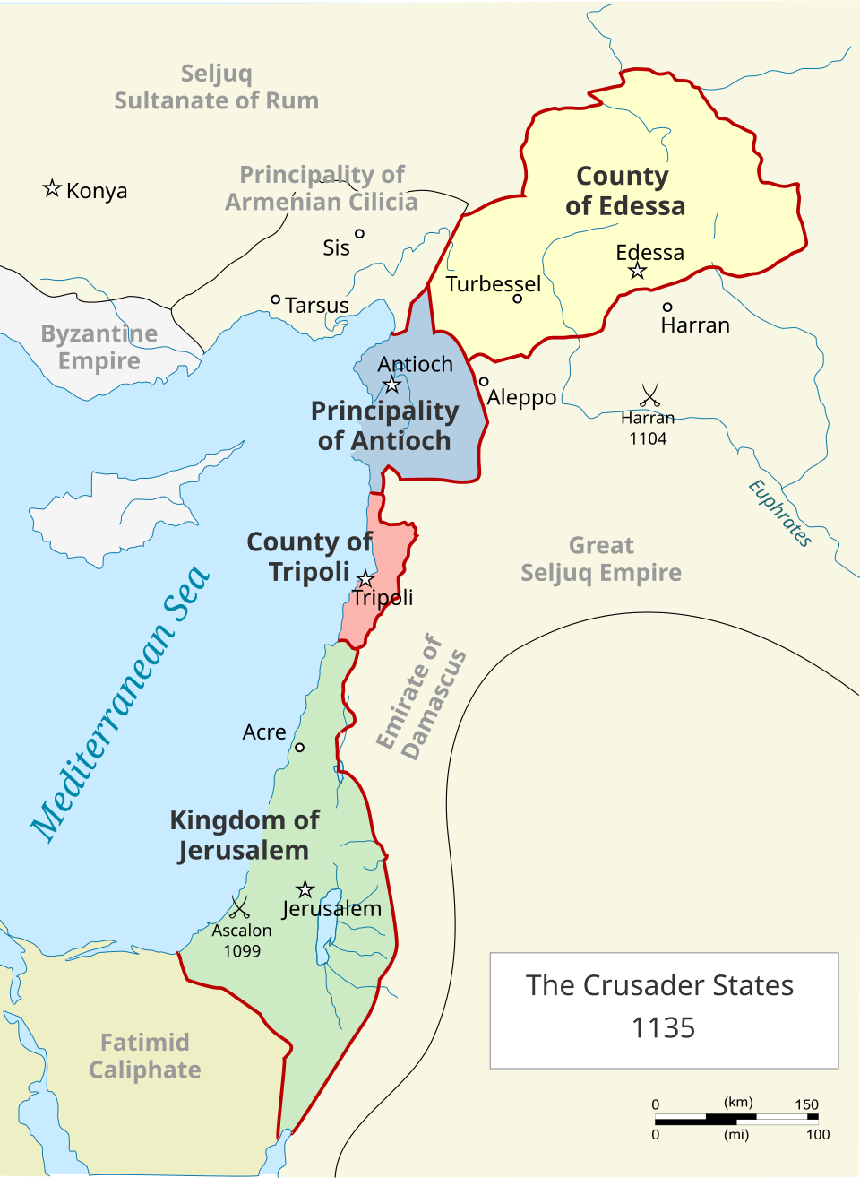
First Crusade (1095-1099)
Council of Clermont
  Pope Urban II
People’s Crusade 1096
Princes’ crusade 1096
Nicaea 1097
  Captured by Turks in 1081
Battle of Dorylaeum 1097
Antioch 1097-1099
Jerusalem 1099
Battle of Ascalon 1099

