Slide 1
Church History
The second millennium

Slide 2
12th Century
People
  Peter Waldo
  Peter Abelard
  Peter Lombard
  Peter the Venerable
  Bernard of Clairvaux
  Innocent III
Events
  2nd and 3rd Crusades
  Notre-Dame de Paris Cathedral started 1163, completed 1260
  Universities (Bologna)

Slide 3
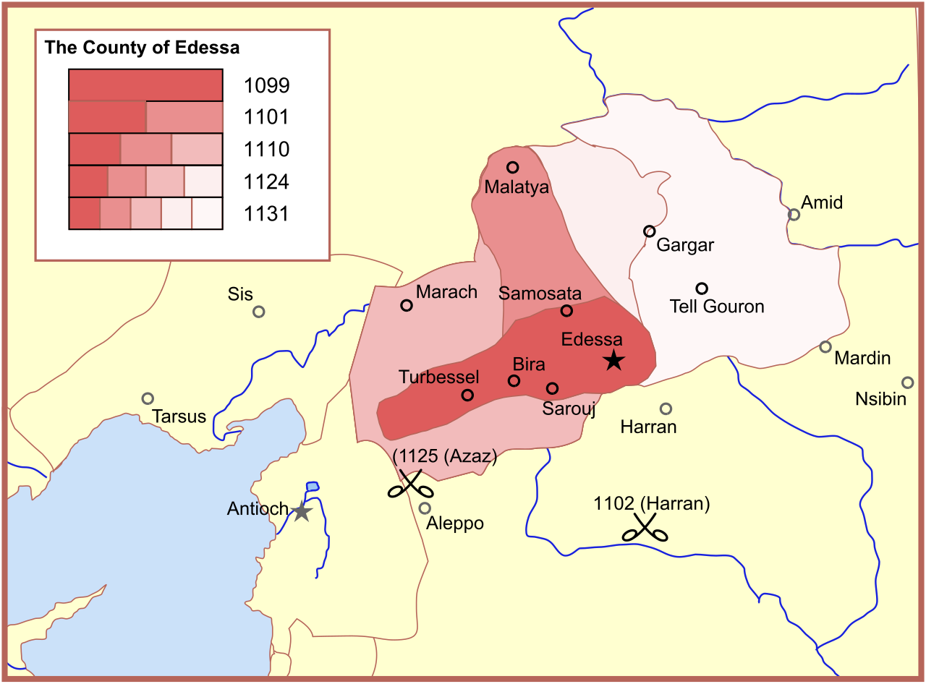
Edessa and 2nd Crusade
Armenian Orthodox people
Thoros (Greek Orthodox) former Byzantine officer
Baldwin made adopted son, married daughter, count
Expanded through 1131
1144 AD Fall of Edessa
  Zengi, Seljuq prince
1147-1149 AD Second Crusade
  Tried to capture Damascus
  Leadership issues

Slide 4
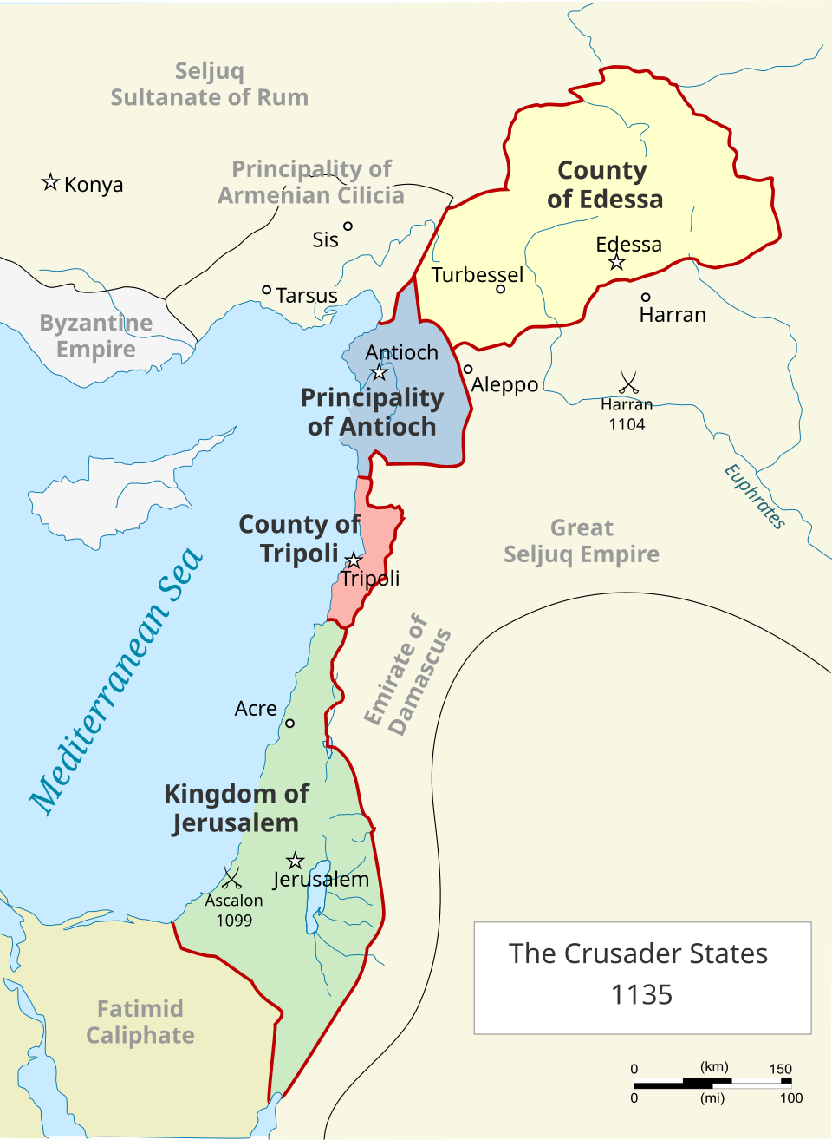
Kingdom of Jerusalem
Baldwin IV (Leper King) 1174-85
1174 AD Salah ad-Din Yusuf ibn Ayyub (Saladin) takes Egypt
1177 AD Saladin takes Syria
1177 Battle of Montgisard
Guy of Lusignan marries Sibylla
  Supported by Court faction
    Raynald of Chatillon, Gerard of Ridefort
  Opposed by Nobles’ faction
    Raymond III of Tripoli, Humphrey IV of Toron
1182 Battle of LeForbelet
1183 Relieve siege of Kerak
By Amitchell125 - Own work, CC BY-SA 4.0, https://commons.wikimedia.org/w/index.php?curid=103890901

Slide 5
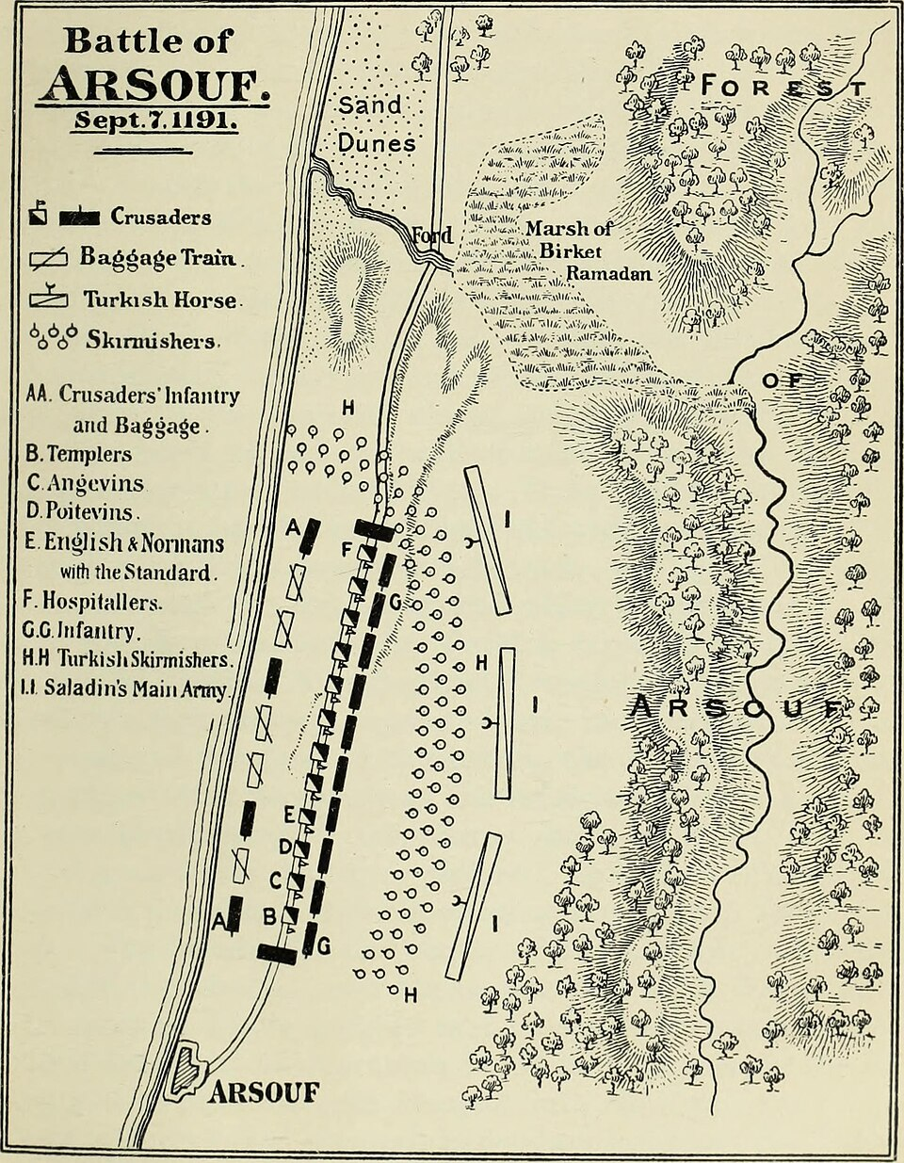
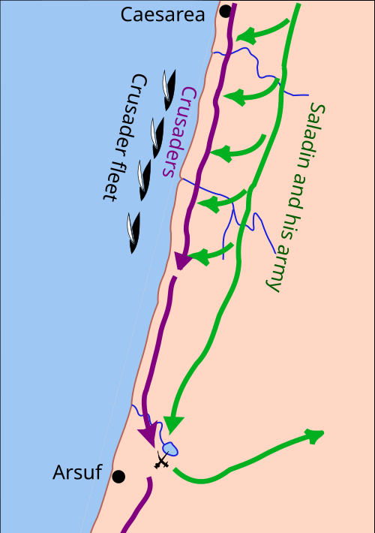
Fall of Jerusalem and 3rd Crusade
1187 AD Battle of Cresson
1187 AD Battle of Hattin
1189-1192 AD Third Crusade
  Phillip II, Richard I, Frederick Barbarossa
  Acre
  Battle of Arsuf
  Treaty of Jaffa

Slide 6
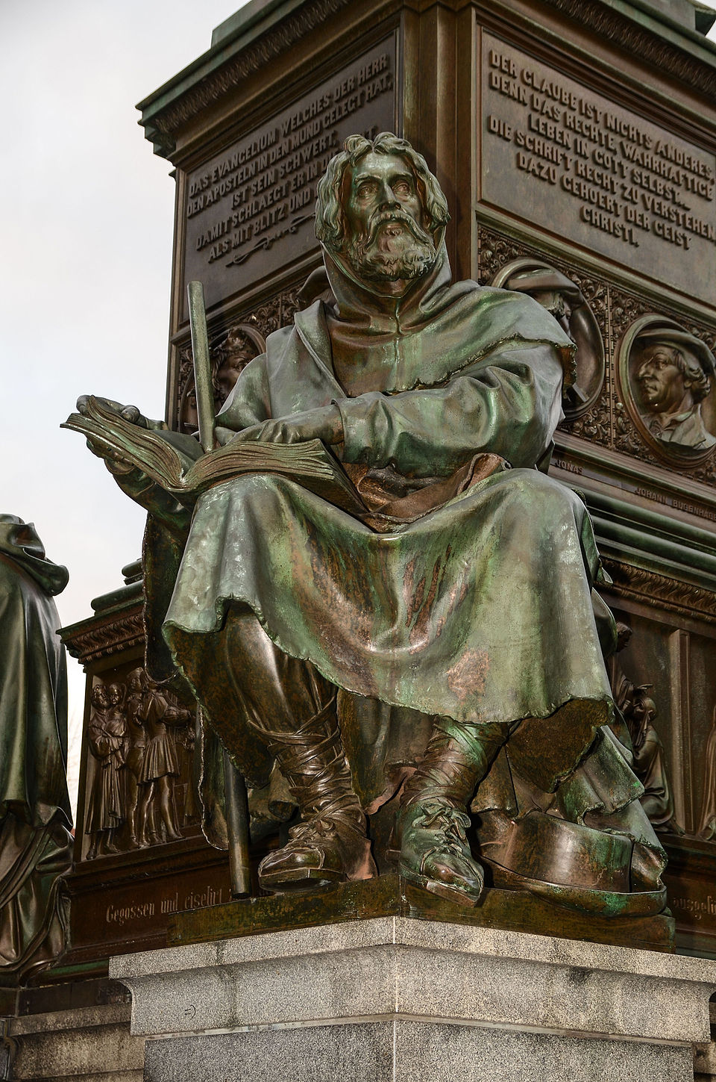
Peter Waldo
1140-1205
Waldensians (1170-1177) (1144?)
Poverty & purity
Lay preaching
Priesthood of all believers
Gospel in people’s language
Reject purgatory & transubstantiation
Condemned in 3rd Lateran Council 1179
By Alexander Hoernigk - Own work, CC BY 3.0, https://commons.wikimedia.org/w/index.php?curid=47155297

Slide 7
Peter Abelard
1079-1142, French Scholatic (wife: Heloise)
  Conceptualism
  subjective intention in morality
  Aristotelian
  Coined “Theology”
  Moral influence theory of atonement
    Opposed by Bernard of Clairvaux
    “Jesus died as the demonstration of God’s Love”
  Limbo for infants
  Sabelian view of Trinity condemned and forced to throw in fire
Works: Sic et non (yes and no), Ethica/Scito te ipsum(know thyself)
Protected by Peter the Venerable at end of life

