Slide 1
Church History
The second millennium

Slide 2
13th Century
Events
  Many Crusades
  C.1205 Stephen Langton divides Bible into chapters
  Magna Carta 1215
  William of Rubruck travels to Mongol capital 1253
  William of Moerbeke translates classical Greek philosophical texts 1259-1271
  Marco Polo travels to China 1271
  1206 start of Mongol Empire
    Genghis Khan -1227
    Kublia Khan rules over largest empire ever 1280(China through East Europe)
  1289 John of Monte Corvino travels to India and China
  1296-1328 First War of Scottish Independence
  1298 Chinese develope first cannon
  1299 Ottoman Empire started
People
  Dominic de Guzman (1170-1221)
  Francis of Assisi (1181-1226)
  Alexander of Hales (1185-1245)
  Albertus Magnus (1200-1280)
  Roger Bacon (1219-1292)
  Bonaventure (1221-1274)
  Thomas Acquinas (1225-1274)
  Duns Scotus (1265-1308)
  William of Ockham (1287-1347)

Slide 3
Dominic and
Dominicans
Francis and
Franciscans
1216
Black Friars
Preaching and teaching
Thomas Aquinas, Albertus Magnus
Rosary
1209
Grey Friars (also brown)
Poverty and service
Many similarities to Waldensians
  Protestant societies
Alexander of Hales, Bonaventure, John Duns Scotus, Roger Bacon
Stigmata

Slide 4
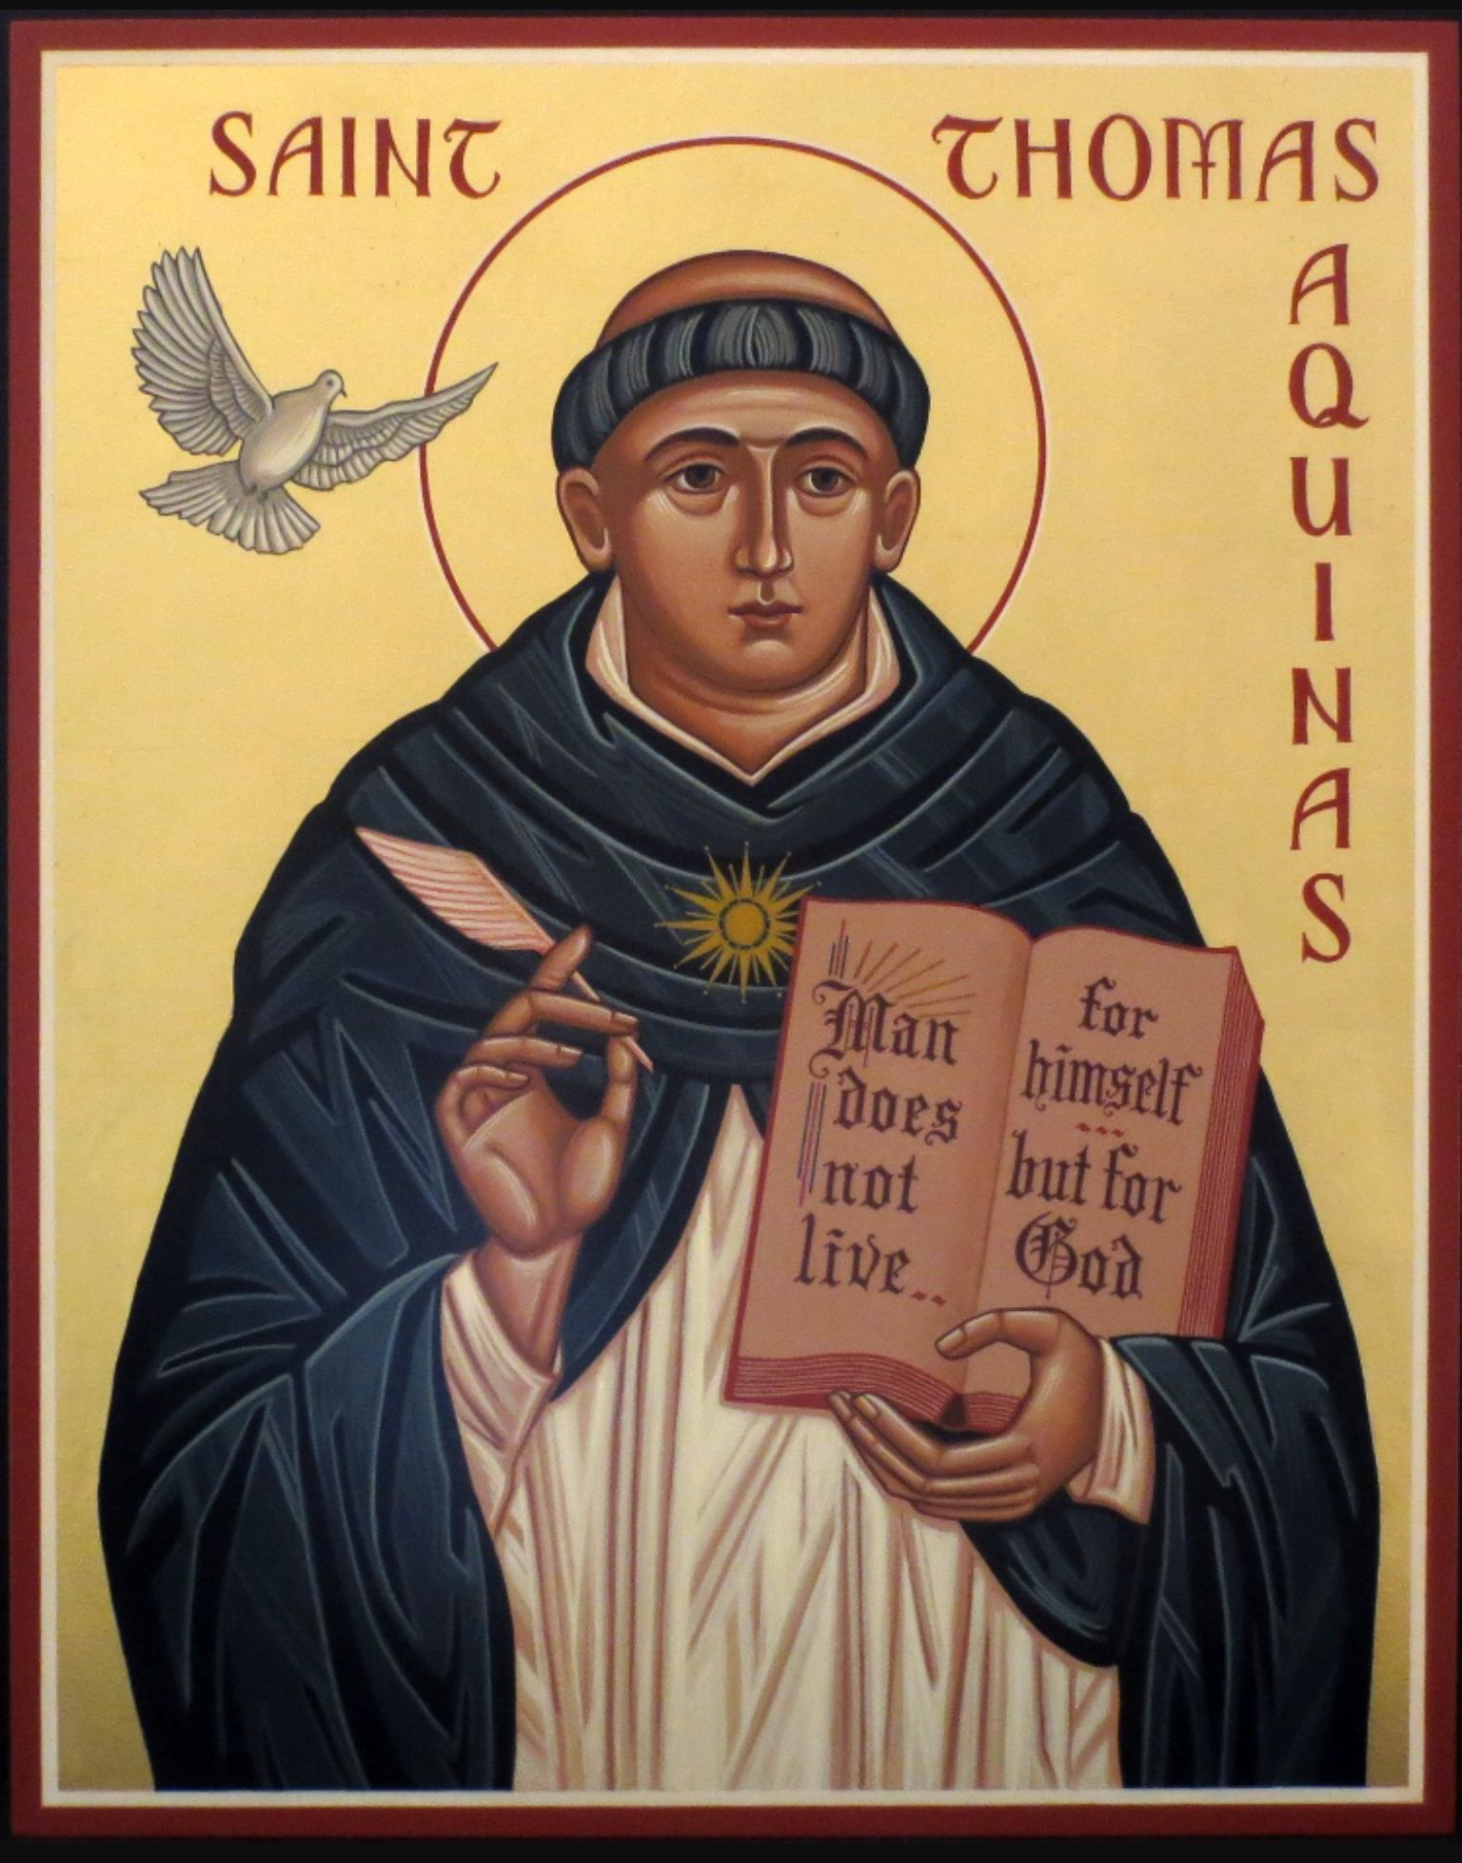
Thomas Aquinas
1225-1274, Dominican friar
Prominent family in Sicily
Angelic Doctor “Dumb Ox”
Natural Theology
5 ways (arguments) for knowing God
  Change (unmoved mover)
  Causality (uncaused cause, or 1st cause) Cosmological
  Continency (necessary being)
  Perfection (ultimate standard) Ontological of Anselm
  Purpose (grand designer) Teleological, Intelligent design, fine tuning, irreducible complexity
Thomism
  Free will & Predestination
    ... just as by moving natural causes [God] does not prevent their acts being natural, so by moving voluntary causes He does not deprive their actions of being voluntary: but rather is He the cause of this very thing in them; for He operates in each thing according to its own nature.
    — Summa, I., Q.83, art.1.
  Aristitelian causes (material, formal, efficient, final)
  Being (realist) “that which is” divided into substance and accidents
  Predication – univocality, analogy, equivocation
  Aristotelian synthesis
Summa Theologica

Slide 5
Crusades
4th Crusade 1202-1204
Goal Jerusalem
Siege Zara
Sack of Constantinople
5th Crusade 1217-1221
  Launched by 4th Lateran
  Francis Assisi preaches to Egyptian Leader 1219
6th Crusade 1228
  Frederick II negotiates peace with Malik al-Kamil (Saladin’s nephew) the Sultan of Egypt giving him Jerusalem
Almost no fighting
1244 Muslims fleeing Mongol Army concure Jerusalem and kill all Christians
7th Crusade Louix IX attacks Egypt 1249-1250
1261 Empire of Nicea retakes Constantinople
1263 Egypt captures Nazareth
1265 Egypt captures Antioch
8th Crusade planned to take Tunisia then Egypt, Louis IX dies before start and it ends
1291 Egypt captures Acre – ends Crusader presence in Middle East
Albigensian/Cathar Crusade 1209-1229
  Southern France vs. gnostic dualists
Children’s Crusade 1212
  Unofficial
  Peaceful conversion goal
  Germany and France
  Never reached Holy Land
  Shipwreak off Sardinia
  Possibly some sold as slaves in Tunisia
  1236 Codoba taken from Moors

Slide 6
4th Lateran 1215
Innocent III, over 400 bishops (71 were cardinals or archbishops), over 800 Priors
Combat Heresy
  Procedures against heretics and protectors (Cannon 3)
    Confiscation of Raymond IV count of Toulouse’s land
      Toleration of Cathars
  Joachimism – Franciscans who believed church replaced by monastic rule (Cannon 2)
  Persecution of Jews (Cannons 67-70)
    Innocent III opposed Talmud
    Conflict on Crusades
Church Reform
  Transubstantiation (Cannon 1)
  Calling Orthodox Church to reunite (Cannon 4)
  Clergy reforms of behavior (Cannons 14-18)
  Annual confession required, not revealed (Cannon 21)
  Doctors required to call priest before prescribing medicine
  Church leader selection (Cannons 23-31)
  Restrictions on clergy charges (Cannons 32-34, 63)
  Legal considerations (Cannons 35-42)
  Role of laity (Cannons 43-45)
  Misuse of money (Cannons 46, 53, 54, 63-67)
Crusading
  Recover holy land (Cannon 71)

