Slide 1
Church History
The second millennium

Slide 2
14th Century
Events
  Hundred Years war starts 1337-1453
    Edwardian War (1337–1360), the Caroline War (1369–1389), and the Lancastrian War (1415–1453)
  Black Death1346 to 1353
  Muslim rule in Spain reduced to Granada 1360
  Black death returns 1361
  Bishop of Quanzhou, China killed by people 1362
  Ming Dynasty founded overthows Mongol Yuan Dynasty 1368
  Great Western Schism 1378-1417
  Wycliffe’s Bible 1380
  Peasant’s Revolt 1381
  Portugal free from Spain 1385
  Chaucer’s The Canterbury Tales 1387-1400
  Union of Kalamar (Sweden captures Denmark & Norway)1397
People
  William Occam (1287-1347)
  John Wycliffe (1328-1384)
  Jan Hus (1369-1415)
Events
  William Wallace killed 1305
  Robert de Bruce becomes king of Scotland 1306
  Dante’s Divine Comedy 1307
  Babylonian Captivity of Papacy (Clement moves to Avignon) 1309-1376
  Bannockburn 1314
  Fortress of Bursa captured, city made Ottoman Capitol 1326

Slide 3
Antipopes
There have been 43 Antipopes between 199 AD and 1449 AD
Many antipopes today: 45 since 1900
Major periods:
  Political Battles with Holy Roman Emperor
    963- 1330 19 Antipopes
    Also many Antikings
  Battle with France
    Avignon Antipopes (3) 1378-1429 Clement VII, Benedict XIII, Clement VIII
    Pisan Antipopes (2) 1409-1415, Alexander V, John XXII
    Alternate Avignon line (2) 1424-1437, both called Benedict XIV
  Council of Basel
    Felix V (1439-1449)

Slide 4
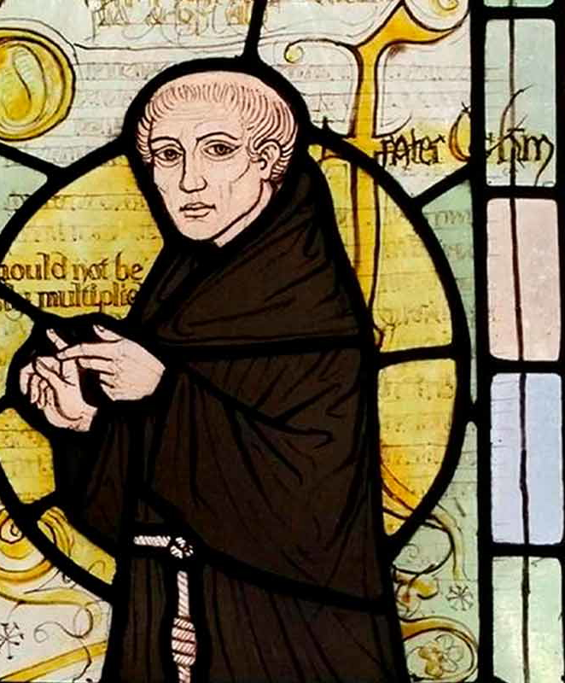
William of Ockham
1287-1347
fideism
Occam’s Razor – efficient reason
Logic – DeMorgan’s Law, ternary logic, and empty terms
Time – only God is eternal, rejected aevum time
Separation of church and state
Voluntary poverty
Volunteerism

Slide 5
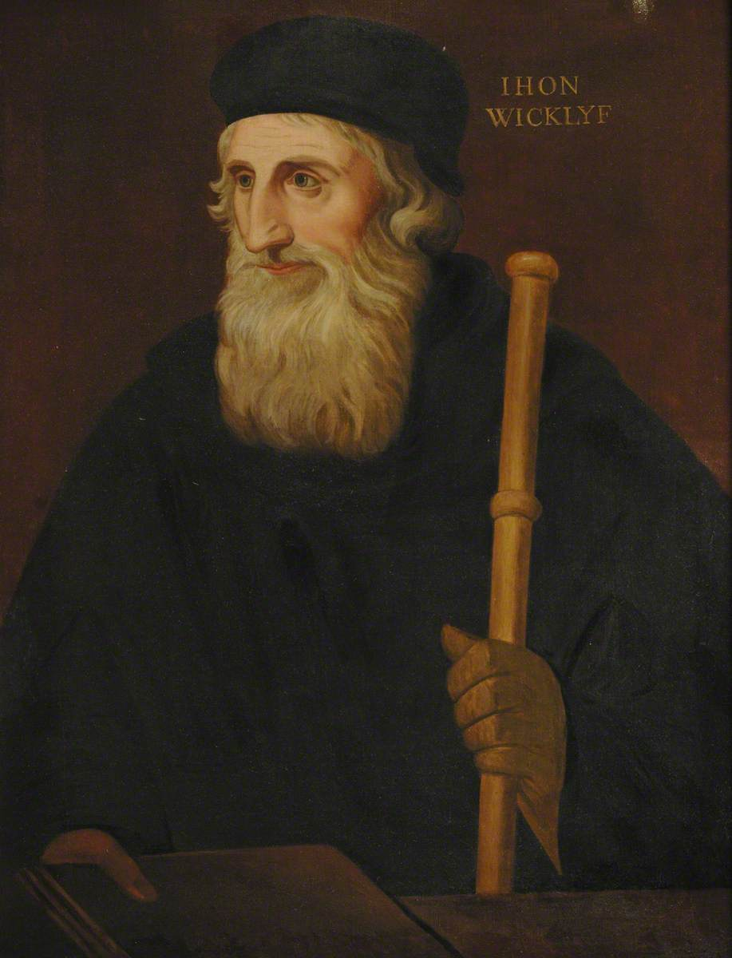
John Wycliffe
1328-1384 (Dec 31)
Scripture only authoritative, reliable guide to the truth about God
The church was too wealthy and corrupt
Need poor preachers to teach the gospel and help people
Praying to saints is idolatry
Opposed transubstantiation, believed in real presence
Hard to know his exact role in translation beyond leading
  Likely Wycliff did parts or all of NT
  Nicholas of Hereford (?-1420) did OT (ordained as priest in 1370)

Slide 6
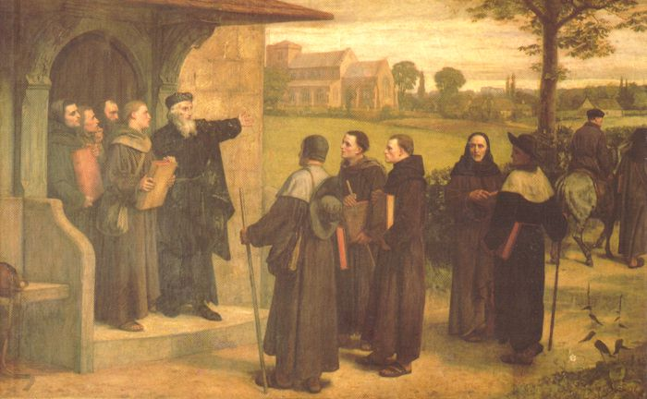
The Twelve Conclusions of the Lollards
State of The Church
The Priesthood
Clerical Celibacy
Transubstantiation
Exorcisms and Hallowings
Clerics in Secular Offices:
Prayers for the Dead
Pilgrimages
Confession
War, Battle, and Crusades
Female Vows of Continence and Abortion
Arts and Crafts

Slide 7
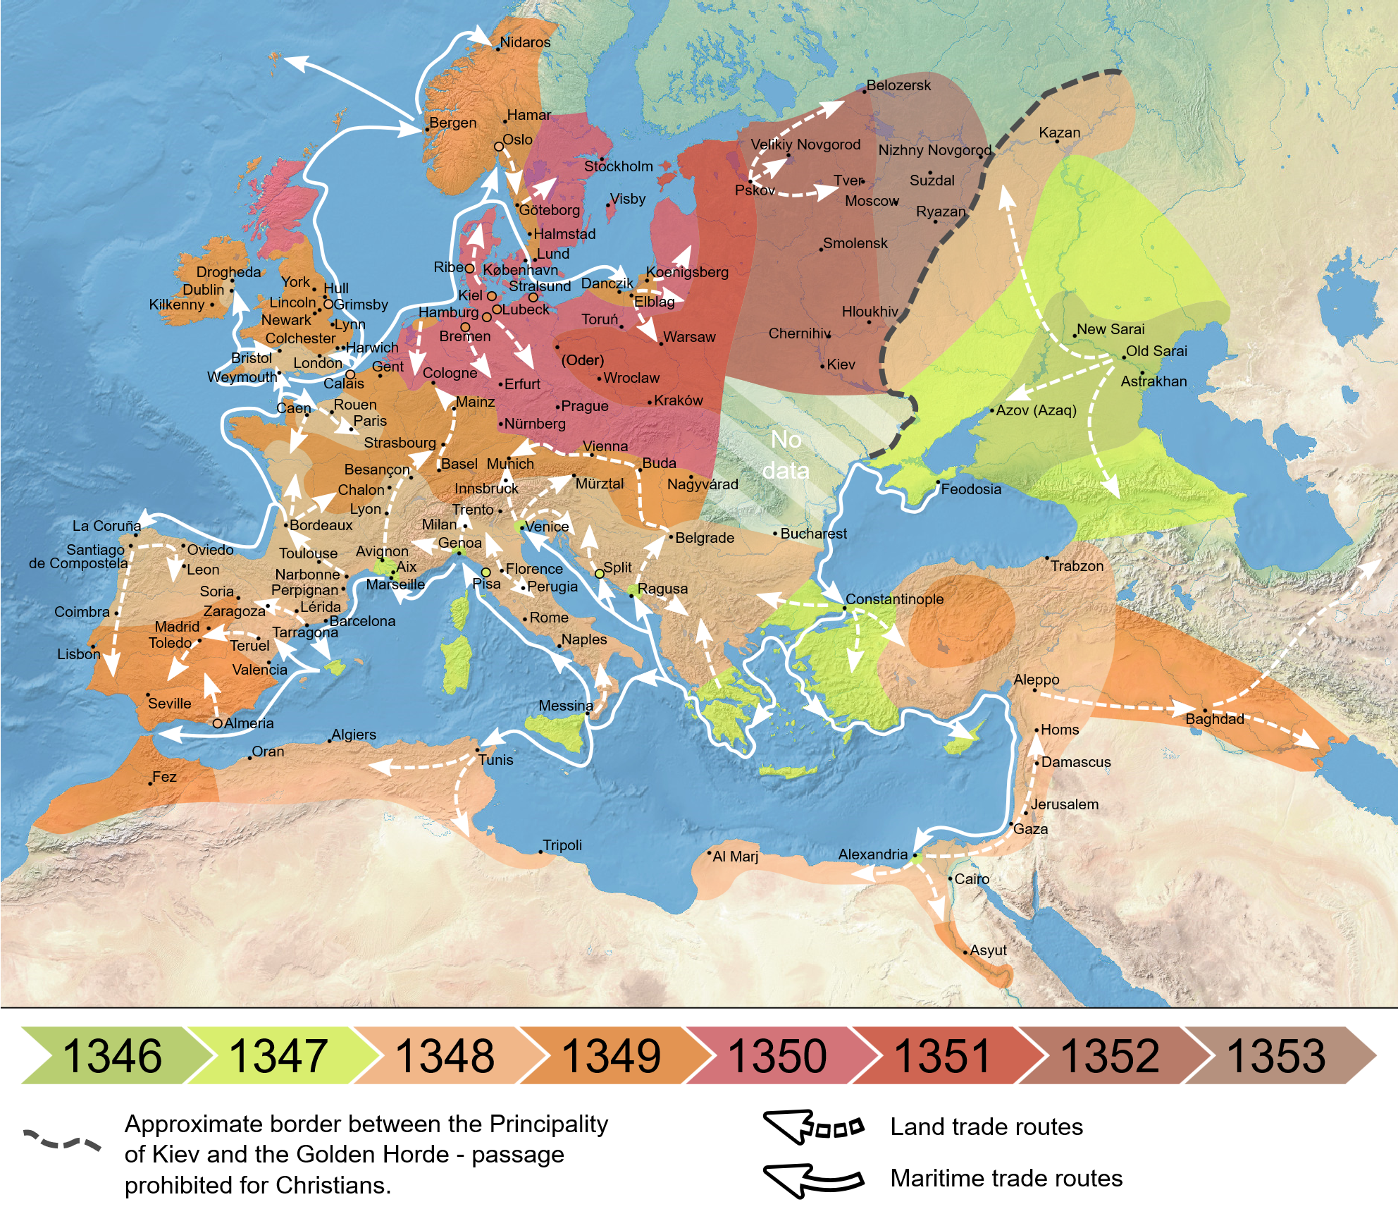
Black Death
1346-1353
~50 million people die
Around 50% of population
First reported at Siege of Caffa (Genoese colony) in Crimea by Golden Horde
Yersina Pestis (bubonic plague)
Spread by rats in grain
By Flappiefh - Own work from:Natural Earth ;Cesana, D.; Benedictow O.J., Bianucci R. (2017). "The origin and early spread of the Black Death in Italy: first evidence of plague victims from 14th-century Liguria (northern Italy)". Anthropological Science 125 (1): 15–24. DOI:10.1537/ase.161011. ISSN 0918-7960. (page 17), CC BY-SA 4.0, https://commons.wikimedia.org/w/index.php?curid=66468361

Slide 8
