Slide 1
Church History
The second millennium

Slide 2
15th Century
Events
  Agincourt 1415
  1420s-1430s: Portuguese exploration of west Africa begins in earnest; leads to the spread of Catholicism in Africa; also eventually leads to the establishment of the trans-Atlantic slave trade
  Gutenburg Printing press 1440
    Bible 1455
  Byzantine Empire falls, Constantinople captured 1453
  War of Roses 1455 to 1485/7
    Red (Lancaster) v. White(York)
    Tudors unite both (Lancaster branch marries York)
  1480s-1490s: Portuguese and Italian Catholic missionaries travel extensively throughout Sub-Saharan Africa
  1491: Portuguese missionaries come to the Kongo Kingdom; King Nzinga converts to Catholicism and is baptized
  The kingdom of Spain founded 1479
    Ferdinand of Aragon and Isabella of Castile.
    Spanish Inquisition 1478
    Alhambra Decree 1492 expels Jews
    Reconquista finished 1492
    Columbus 1492
  Inter caetera bull 1493
  Spanish Catholic missionaries arrive in various parts of the Caribbean 1494-1499
  Portuguese Catholic missionaries arrive in India1497
  Portuguese Catholic missionaries arrived at Zanzibar and Tanzania 1499
People
  Jan Hus (1369-1415)
  Thomas à Kempis (1380-1471) The Imitation of Christ
  Henry the Navigator (1394-1460)
  Joan of Arc (1412-1431)
  Thomas Malory (1416-1471) L’ Morte D’Arthur
  Leonardo da Vinci (1452-1519)
  Desiderius Erasmus(1466-1536)
  Nicolaus Machiavelli (1469-1527)
  Copernicus (1473-1543)
  Michelangelo (1475-1564)
  Raffaello (1483-1520)
  Martin Luther (1483-1546)
  Huldrych Zwingli (1484-1531)
  William Tyndale (1494-1536)

Slide 3
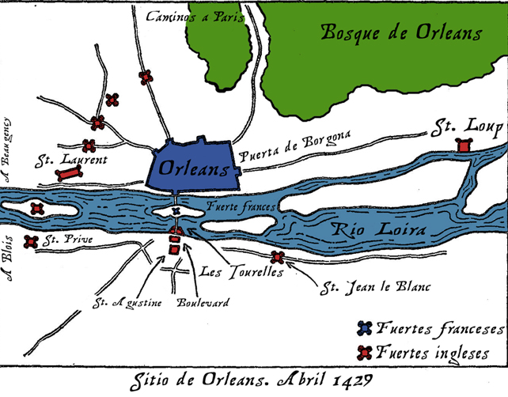
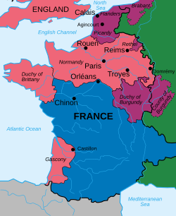
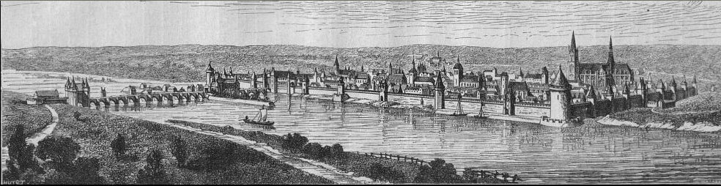
100 years war – Joan of Arc
Treaty of Troyes 1420
  Henry V marries Catherine
  Next in line for throne
Siege of Orléans (12 October 1428– 8 May 1429)

Slide 4
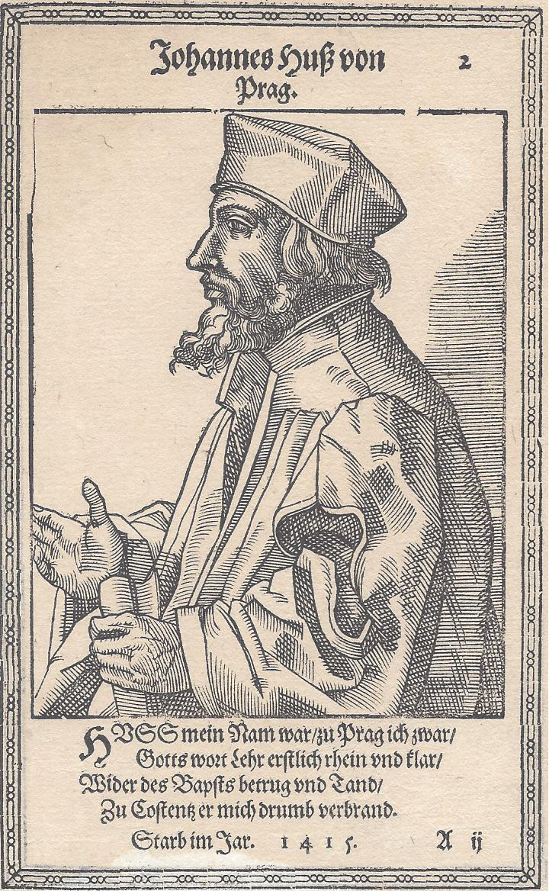
Jan Hus
1369-1415 Czech
Bohemian Reformation
  no pope can use the sword rather pray for his enemies and bless those who curse him
  man obtains forgiveness of sins by true repentance, not money.
  October 18, 1412, Hus appealed to Jesus Christ as the supreme judge
Council of Constance 1414-1418
  Given letter of indemnity
  “You are now going to burn a goose, but in a century you will have a swan which you can neither roast nor boil.”
Hussite Wars (1419–1434)
  Joan of Arc thread to lead a crusading army in 1430 but English capture stopped
Modern Churches
  Moravian church
  Unity of Bretheren 1800’s church (Texas)
  Czechoslovak Hussite Church since WWI
By Christoph Murer 1587 - Selbstgefertigter Scan eines Holzschnitts aus eigenem Bildarchiv, Public Domain, https://commons.wikimedia.org/w/index.php?curid=32617482

