Slide 1
Church History
The second millennium

Slide 2
16th Century Part 1
Events
  1500 Cabral discovers Brazil
  1509 Henry VIII became king of England
  1516 Erasmus publishes the Greek New Testament
  1517 Martin Luther posts his 95 Theses in Wittenburg; sparked the Protestant Reformation
  1518 Ulrich Zwingli comes to Zurich
  1520 Martin Luther’s The Babylonian Captivity of The Church
  1521 Diet of Worms
  1521 Spain colonizes the Philippines
  1521 Spanish conquer Aztecs
  1522 Ferdinand Magellan circumnavigates the Earth
  1526 Battle of Mohács
  1529 First Seige of Vienna
  1533 Spanish conquered the Incas
  1534 Jacques Cartier, French colonization of North American
  1522 Martin Luther’s German New Testament published
  1525 William Tyndale completes his English Bible
  1524-1525 German Peasants’ War
  1529 Marburg Colloquy
  1532 William Farel goes to Geneva
  1534 Ignatius of Loyola founds Jesuits; Counter-Reformation
  1534 Act of Supremacy passed in England
  1535 Martin Luther’s commentary on Galatians
People (1st gen reformers)
  Martin Luther (1483-1546)
  Ulrich Zwingli (1484-1531)
  William Farel (1489-1565)
  Martin Bucer (1491-1551)
  Philip Melanchthon (1497-1560)
  Frederick III, Elector of Saxony (1463-1525)

Slide 3
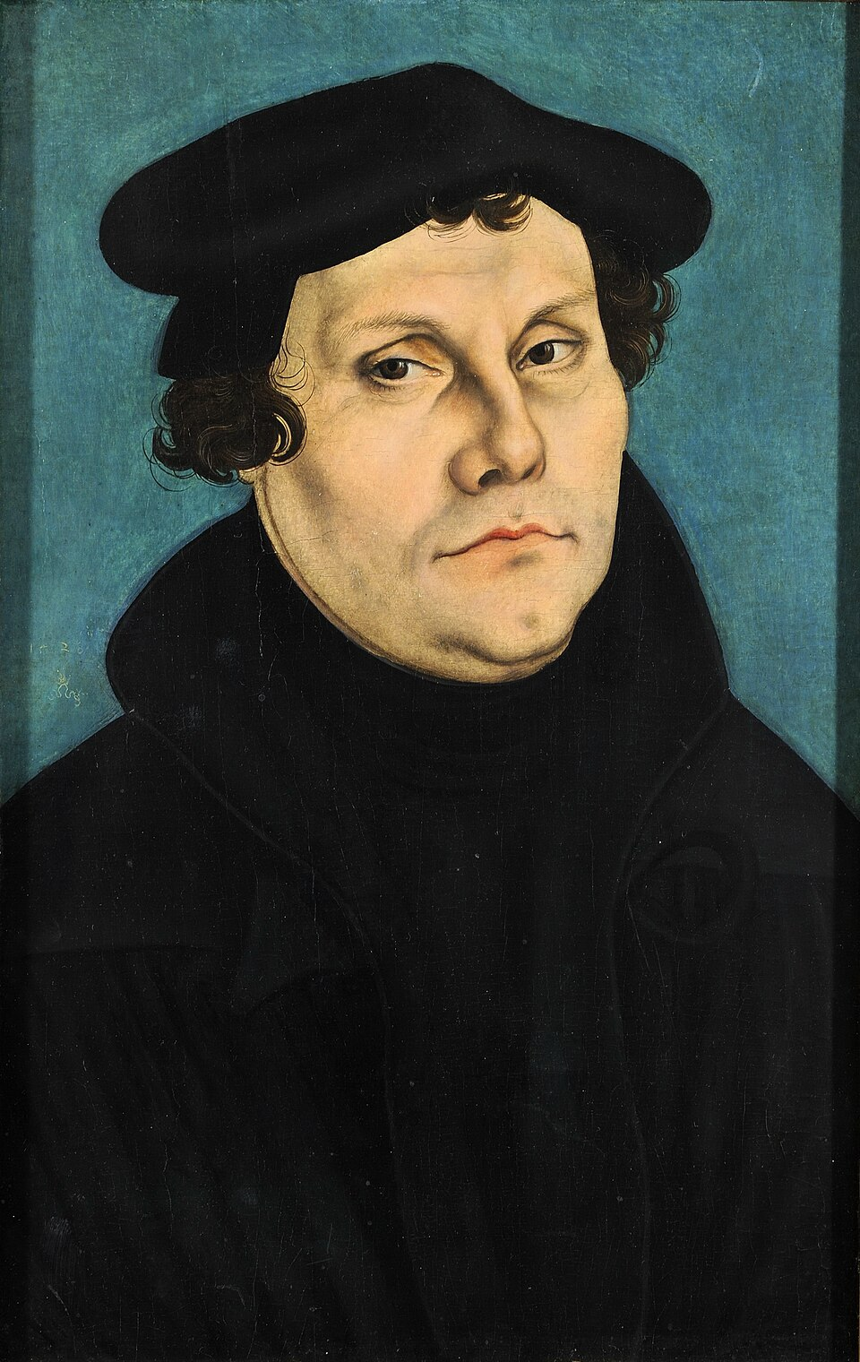
Martin Luther 1483-1546
1505 Thunderstorm & Saint Anne
1507 Ordained, 1st mass
1513 begins lectures on the Psalms
1515 begins lectures on Romans
1516 begins lectures on Galatians; Tetzel sent to Germany
1517 begins lectures on Hebrews, 95 theses
1519 debate with Eck, denies supreme authority of pope & councils
1520 - Papal bull Exsurge Domine writes To the Christian Nobility, On the Babylonian Captivity of the Church, The Freedom of a Christian
1521 Diet of worms, Wartburg Castle begin NT
1522 Returns Wittenburg, finish NT
1525 Vs. Karlstadt & Munster; marries Katherine von Bora; writes Against the Robbing and Murdering Hordes, Bondage of Will
1526 Vs Zwinglip
1527 Plague in Wittenberg, “A Mighty Fortress is our God”
1529 Marburg Colloquy, Larger and Shorter Catechism
1530 Diet of Augsburg and Augsburg confesion
1534 Complete Bible
1536 Wittenberg Concord

Slide 4
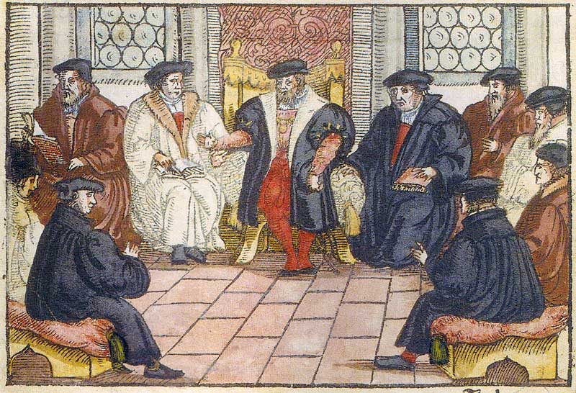
Marburg Colloquy & Wittenberg Concord
Lutheran
Martin Luther
Philipp Melanchthon
Justas Jonas
Stephan Agricola
Andreas Osiander
Reformed
Ulrich Zwingli
Martin Bucer
Casper Hedio
Martin Luther
Philipp Melanchthon
Johannes Bugenhagen
Justus Jonas
Caspar Cruciger
Justus Menius
Friedrich Myconius
Urban Rhegius
George Spalatin
Martin Bucer
Wolfgang Capito
Matthäus Alber
Martin Frecht
Jakob Otter
Wolfgang Musculus

Slide 5
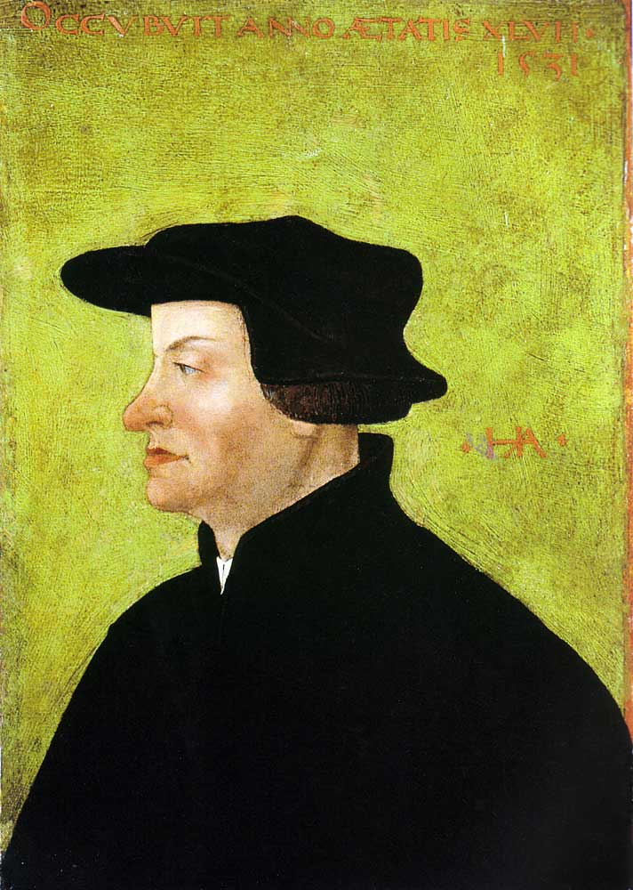
Ulrich Zwingli (Swiss Reformer)
1484-1531
1506 Magister, ordained, first mass
1519 Zurich; reject veneration; questions unbaptized infants as damned, power of excommunication, tithing required
1522 Affair of the Sausages, petitioned for priests to marry
1523 Iconoclastic activities, Eucharist
1525 Anabaptist clashes
1526 Baden disputation w/ Eck
1527 Execution of Felix Manz
1529, First Kappel War; Marburg Colloquy

Slide 6
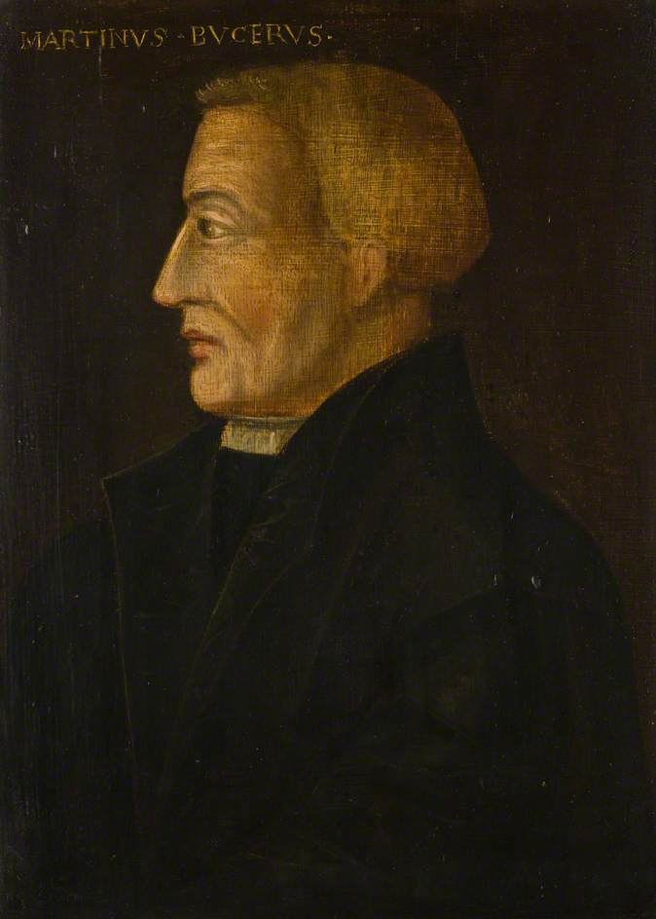
Martin Bucer (1491-1551)
1507 joined Dominicans
1518 heard Luther
1521 released from Dominicans
1523 Helped by Matthew Zell Strasbourg
1524 Dialogue w/ Luther & Zwingli
1530 tetrapolitan confession
1536 First Helvetic Confession w/ Heinrich Bulinger and others
1546 Schmalkaldic War
1547 Augsburg Interim
1549 Exile in England

