Slide 1
Church History
The second millennium

Slide 2
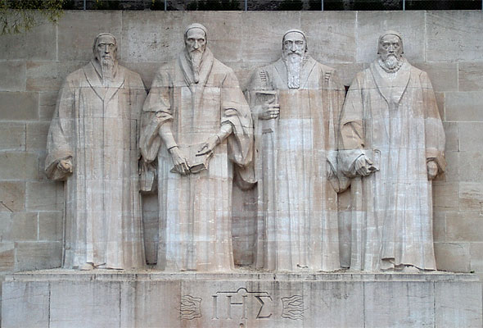
16th Century Part 2
1536: John Calvin publishes his first edition of The Institutes of the Christian Religion
1536: William Tyndale strangled to death and his body burned at the stake;
1536: Menno Simons baptized as an Anabaptist
1536: John Calvin stops in Geneva while traveling to Strasbourg; William Farel convinces Calvin to stay in Geneva
1538: Calvin expelled from Geneva, goes to Strasbourg
1540: Calvin publishes his Commentary on Romans
1541: Calvin returns to Geneva, pastored there in the city for next 23+ years until his death in 1564
1545: Council of Trent begins
1553: Michael Servetus burned at the stake in Geneva for heresy
1555: Peace of Augsburg signed
1562 Massacre of Vassay; start French Wars of Religion
1563: Heidelberg Catechism published
c.1570s: Early formations of the English “Separatists” movement
1572: St. Bartholomew’s Day Massacre in France ~30,000 Huguenots (French Calvinists) were killed
1580: Book of Concord published1598
1582 Gregorian Calendar
1598 Edict of Nantes (Henry IV)
1620-1622 First Huguenot Rebellion
1625-1626 Second Huguenot Rebellion
1627-1629 Third Huguenot Rebellion & Anglo-French War
1685 Edict of Fontainebleau (undo Nantes)
1787 Edict of Tolerance
People
  William Farel (1489-1565)
  John Calvin (1509-1564)
  Theodore Beza (1519-1605)
  John Knox (1514–1572)

Slide 3
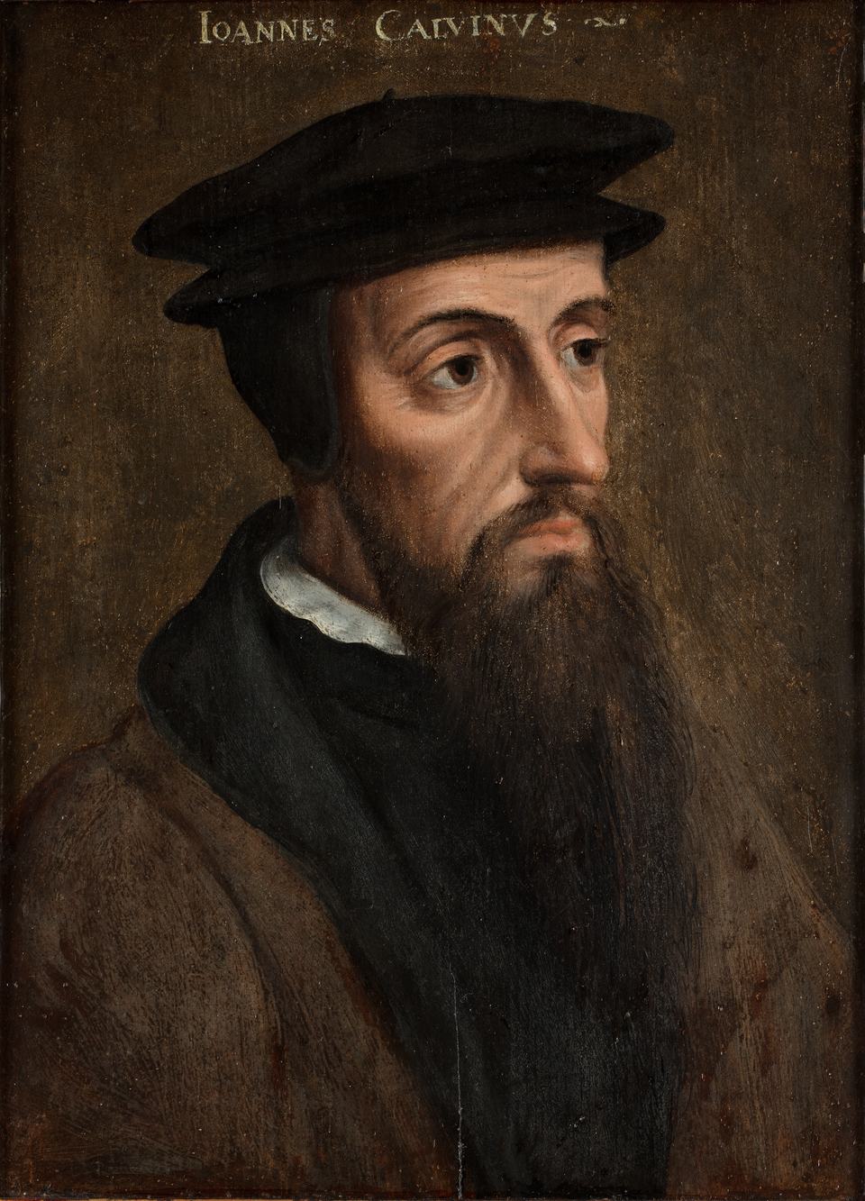
John Calvin (1509-1564)
Father wanted him to be a priest, then Lawyer.
1533 became protestant
1535 went into hiding, moved Basel
1536 Institutes
William Farel started preaching in Geneva 1532 and by 1536 Geneva went Protestant
1536-38, 41-64 served in Geneva (3 yrs in Strasbourg)
1550s-1560s: John Calvin sends church planting missionaries to other regions in Europe; by 1562 more than 2,000 churches were planted in France alone, and many more in Italy, the Netherlands, Hungary, Poland, and Rhineland
1557: John Calvin sends missionaries from Geneva to Brazil
Theology
  Holy Spirit
  Penal Substitution (ransom, satisfaction)
  Holiness
  Solas
  5 points

Slide 4
Council of Trent & Counter-Reformation
1540 Jesuits & Ignatius of Loyola
Council Objectives:
  To condemn the principles and doctrines of Protestantism and to clarify the doctrines of the Catholic Church on all disputed points.
  To effect a reformation in discipline or administration.
1545–1549 (Paul III), 1551–1552 (Julius III), 1562–1563 (Pius IV)
Decrees:
  Add Deuterocanonical books
  Vulgate is authoritative text
  Justification by human cooperation with divine grace (Synergism)
  Stepped back from Augustine on Original Sin
  Sola Fide is “vain confidence”
  Mortal Sins
  Clarify 7 sacraments (baptism, confirmation, eucharist, reconciliation, anointing of the sick, holy orders, matrimony) from 1274 Lyons

