Slide 1
Church History III
The second millennium

Slide 2
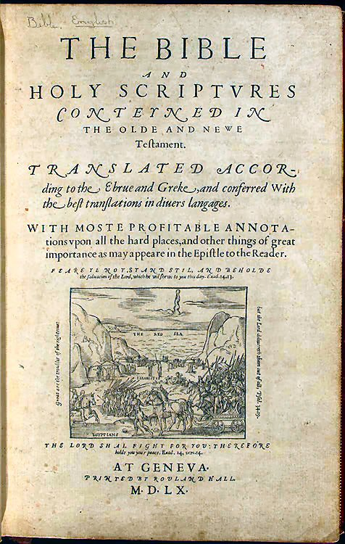
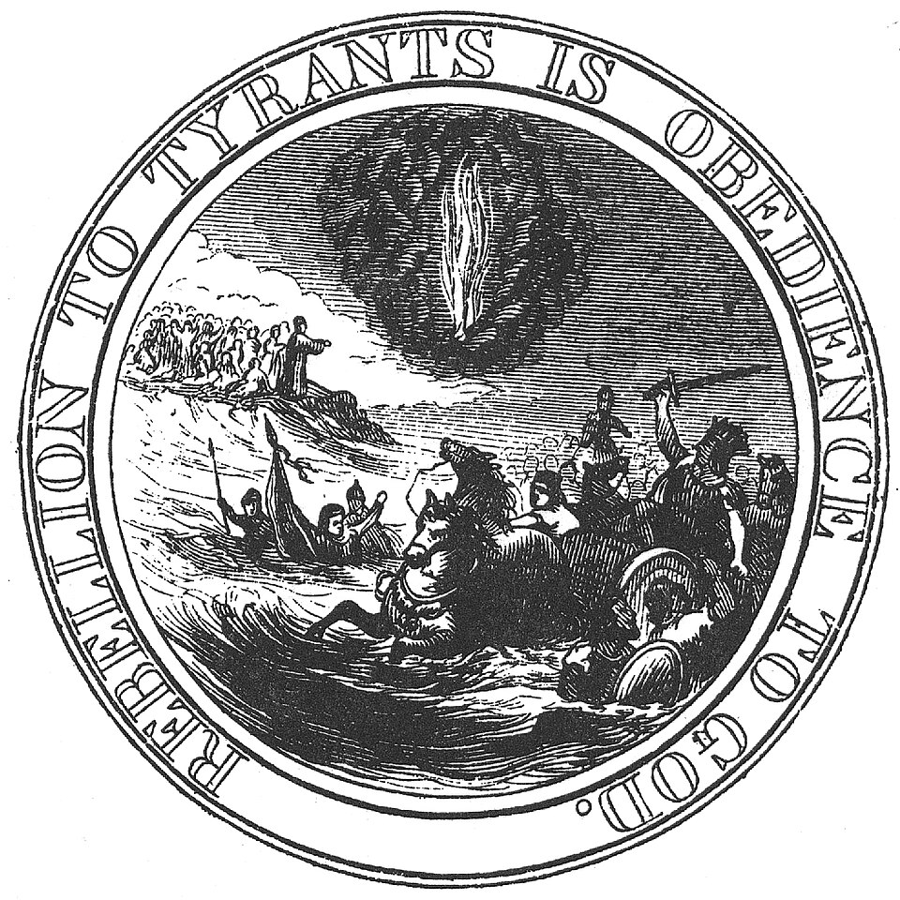

Slide 3
16th Century England
Events
  1522-1535 Tyndale Bible
  1533 Henry VIII marries Anne Boleyn (Elizabeth born)
  1534 Act of Supremacy
  1535 Coverdale Bible
  1535,1539 1st and 2nd suppression act which accomplished the Dissolution of the monasteries (1536-1541)
  1536 William Tyndale strangled to death and his body burned
  1537 Matthew Bible
  1539 Great Bible
  1539 Taverner’s Bible
  1547 January 28th -King Henry VIII died
  1547 Edward VI became king of England
  1549: Thomas Cranmer publishes the Book of Common Prayer in England (revised in 1662)
  1554 Edward’s death & dispute over succession. Mary was Catholic, Lady Jane Grey was Queen (9 days). Mary took London and Jane was taken to the tower and executed at 17.
  1553 Mary I (Bloody Mary) became queen of England
  1558 Elizabeth I became queen of England
  1559: John Knox returns to Scotland , founds Presbyterian Church
  1560 Geneva Bible
  c.1560s: The epithet “Puritans” began to be used to describe any person in England who believed the Church of England needed more purity (not reformed enough)
  1563: Foxe’s Book of Martyrs published
  1563: First text of the 39 Articles issued
  1568 Bishops Bible
  1568-1648 80-year war (Netherlands independence from Spain)
  c.1570s: Early formations of the English “Separatists” movement
  1582 Gregorian Calendar
  1582 Douay–Rheims Bible (counter-reformation)
  1587: Mary Stuart executed
  1588 Spanish Armada
  1590 microscope invented (Zacharias Janssen)
  1596 toilet invented (Sir John Harington, an English courtier and the godson of Queen Elizabeth I)
People
  Thomas Cromwell (1485-1540)
  Hugh Latimer (1487-1555)
  Thomas Cranmer (1489-1556)
  Patrick Hamilton (1504-1528)
  George Wishart (1513-1546)
  John Knox (1514–1572)
  Mary I (1516-1558)
  Elizabeth I (1533-1603)
  Lady Jane Grey (1536-1554)
  Mary, Queen of Scots (1542-1587)
  Galileo Galilei (1564-1642)
  Michel de Montaigne (1533-1592) humanist, essays
  William Shakespeare (1564-1616)
  Oliver Cromwell (1599-1658)

Slide 4
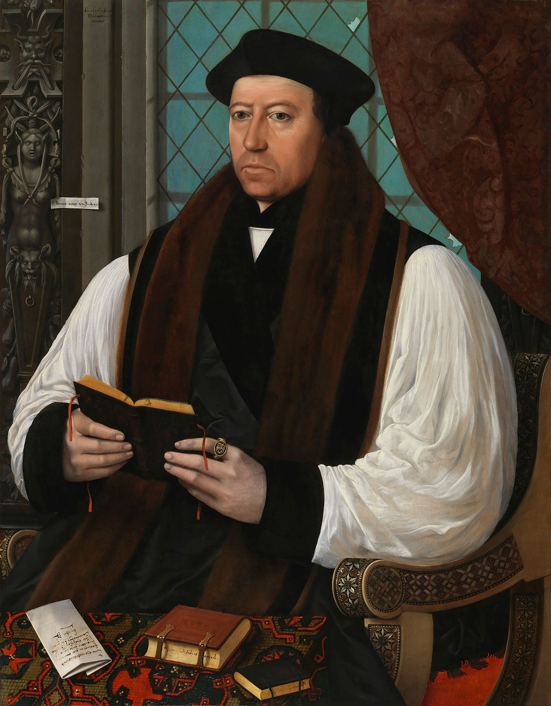
Thomas Cranmer (1489-1556)
Royal supremacy
Built case for Henry VIII divorce/annulment from Catherine of Aragon
1533-1555 Archbishop of Canterbury
  Doctrinal & liturgical structure for reformed Church of England
    Two edition of the Book of Common Prayer
    Liturgy of English Church
Imprisoned for over 2 years
  Made recantations
  Mary I pushed for execution of treason
  Burned at the stake
  Thrust his right hand in the fire first condemning his hand for signing the recantations and thus undoing the recantations
Articles
  10 articles 1536 mild, protestant/Lutheran position
    Scripture + 3 creeds, baptism necessary, penance, real presence, justification by Christ’s merits- good work necessary, images useful, saints honored and further prayers, saints intercessors,, ceremonies mystic significance, prayers dead useful papal pardons aren’t
  6 articles 1539 “whip of 6 strings”
  Kings book 1543 Return to more Catholic views
  42 articles 1552 Very Calvinistic
  39 articles 1771 Mary’s moderate view
    Trinity, Christ, descent to Hell/Resurrection, Holy Ghost, Scripture, Old Testament, Original Sin, Free will, justification, good works, etc.

Slide 5
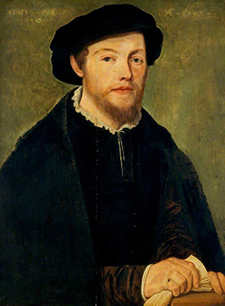
George Wishart (1513-1546)
Graduated Leuven 1531
Translated First Helvetic Confession to English
Taught Greek in Montrose, heresy charges by Bishop of Brechin
Charges by Cromwell and Cranmer
Corpus Christi College, Cambridge
Influenced by Calvin and Zwingli
Preached in Montrose, Dundee, Ayrshire in 1544-1545
  True church where Word of God is faithfully preached and baptism and Lord’s supper rightly administered
  Rejected transubstantiation & confession
  Taught predestination
Cardinal Beaton had him arrested, tried, hanged then burned
  John Knox acted as bodyguard
  "Nay, return to your bairns and God bless you. One is sufficient for a sacrifice."
Uproar over his death caused 5 men to assassinate Beaton 3 months later and hold up in castle

Slide 6
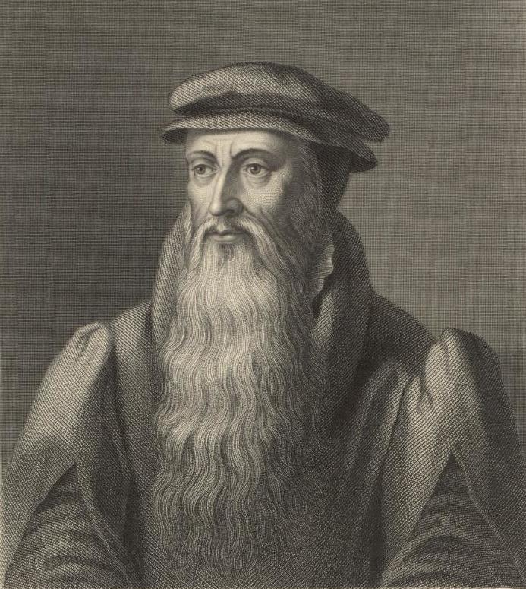
John Knox (1514-1572)
Influenced by Hamilton & Wishart
Strongly opposed Idolatry
Took tutees to St Andrews Castle 1547
  Preached Sola Fide
Arrested by Mary of Guise
  French galley slave1547-1549
  Attempt to convert him back
1549 Exile to England
  Edward VI chaplain
  Mary I exiled 1554
Geneva (Calvin) 1554-1559
  reformed doctrine
  Presbyterian polity
  Frankfurt head English refugee church 1554-1555
  Edinburgh Trial 1556 (impressed William Keith)
  Letter to Mary of Guise (Queen Regent)
1558 The first blast of the trumpet against the monstruous (unnatural) regiment of Women
1559 Return to Scotland – Edinburgh, Dundee, Perth, St. Andrews
1559-1565 5 vol History of Reformation in Scotland
1572 St. Bartholomew’s Day Massacre

Slide 7
Elizabethian Puritans
Part of Separatists, and still a very broad group
Negative term applied to them
Elizabeth I reign 1558-1603
  1559-1563 Elizabethian Religious Settlement
  Edwardian book of common prayer and ordinal revived
  Viewed by many protestants as first step, but Elizabeth viewed as final
  Vestment controversy
    clerical attire- surplice & cap vs
    Black academic attire
Church government issues in 1570’s
  1570 Puritan leader Thomas Cartwright deprived of teaching post at Cambridge for criticizing Anglican liturgy and government

