Slide 1
Church History
The second millennium

Slide 2
17th Century (A)
Events
  1585-1590 Roanoke
  1603 Elizabeth I dies
  1605 Gunpowder Plot/Jesuit Treason (Guy Fawkes)
  1607 Jamestown
  1609 John Smyth founds first Baptist congregation, Amsterdam
  1611 King James Version
  1617,1622,1661 Popes increase Marian devotion
  1618-1619 Synod of Dort
  1618-1648 30 Years War
  1620 Plymouth
  1621-1674 New Netherlands
  1622 Province of Main
  1628 Massachusetts Bay
  1629 Province of New Hampshire
  1629 Province of Carolina
  1632 Maryland
  1633 Galileo’s trial
  1635 Great Colonial Hurricane
  1636 Connecticut
  1636 Harvard (Congregationalist)
  1636-1638 Pequot War
  1636-1638 Antinomian Controversy
  1637 Scottish National Covenant
  1639-1653 War of 3 Kingdoms
    1639-1640 Bishops’ Wars
    1642-1646 1st English Civil War
    2nd English Civil war
    1650-1652 Anglo-Scottish War
    1641-1653 Irish Confederate Wars
People
  Galileo Galilei (1564-1642)
  James I (1566-1625)
  Johannes Kepler (1571-1630)
  Richard Sibbes (1577-1635)
  James Ussher (1581-1656)
  John Cotton (1585-1652)
  Anne Hutchinson (1591-1643)
  René Descartes (1596-1650)
  Oliver Cromwell (1599-1658)
  Thomas Goodwin (1600-1680)
  Charles I (1600-1649)
  John Eliot (1604-1690)
  John Milton (1608-1674)
  Richard Baxter (1615-1681)
  John Owen (1616-1683)
  Thomas Watson (c. 1620-1686)

Slide 3
17th Century (B)
  1644 Ming Dynasty Collapse
  1644 London Baptist Confession
  1646 Westminster Confession
  1651 335 Year War starts, no fighting
  1654 Quackers founded
  1658 Savoy Declaration
  1660 Monarchy restored
  1662 Act of Uniformity
  1663 Rhode Island
  1664 Delaware
  1664 New Jersey
  1665 Great Plague of London (7k/wk)
  1666 Great Fire of London
  1671-1684 Calculus
  1675-1678 King Philip’s War
  1676 Bacon’s Rebellion
  1682 Pennsylvania
  1685 Revoke Edict of Nantes
  1687-1789 Age of Enlightenment
  1688 Glorious Revolution
  1689 2nd London Baptist, Toleration Acts
  1692-1693 Salem witch trials
  1694 College of William and Mary (Anglican)
  1696 King William’s School (Anglican) –absorbed by St. John’s College
  1701 Yale (Congregational)
People
  Blaise Pascal (1623-1662)
  Matthew Poole (1624-1679)
  Robert Boyle (1627-1691)
  John Bunyan (1628-1688)
  Stephen Charnock (1628-1680)
  John Flavel (1630-1691)
  Charles II (1630-1685)
  John Locke (1632-1704)
  James II/VII (1633-1701)
  Increase Mather (1639-1723)
  Isaac Newton (1642–1727)
  Gottfried Wilhelm Leibniz (1646–1716)
  William III/II (1650-1702)
  Mary II (1662-1694)
  Matthew Henry (1662-1714)
  Cotton Mather (1663-1728)
  Anne (1665-1714)
  Thomas Boston (1676-1732)

Slide 4
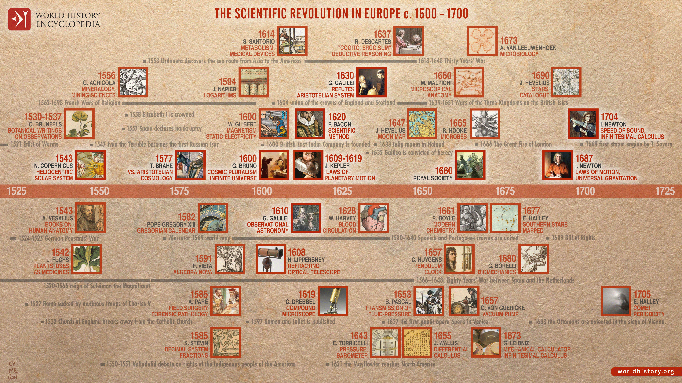

Slide 5
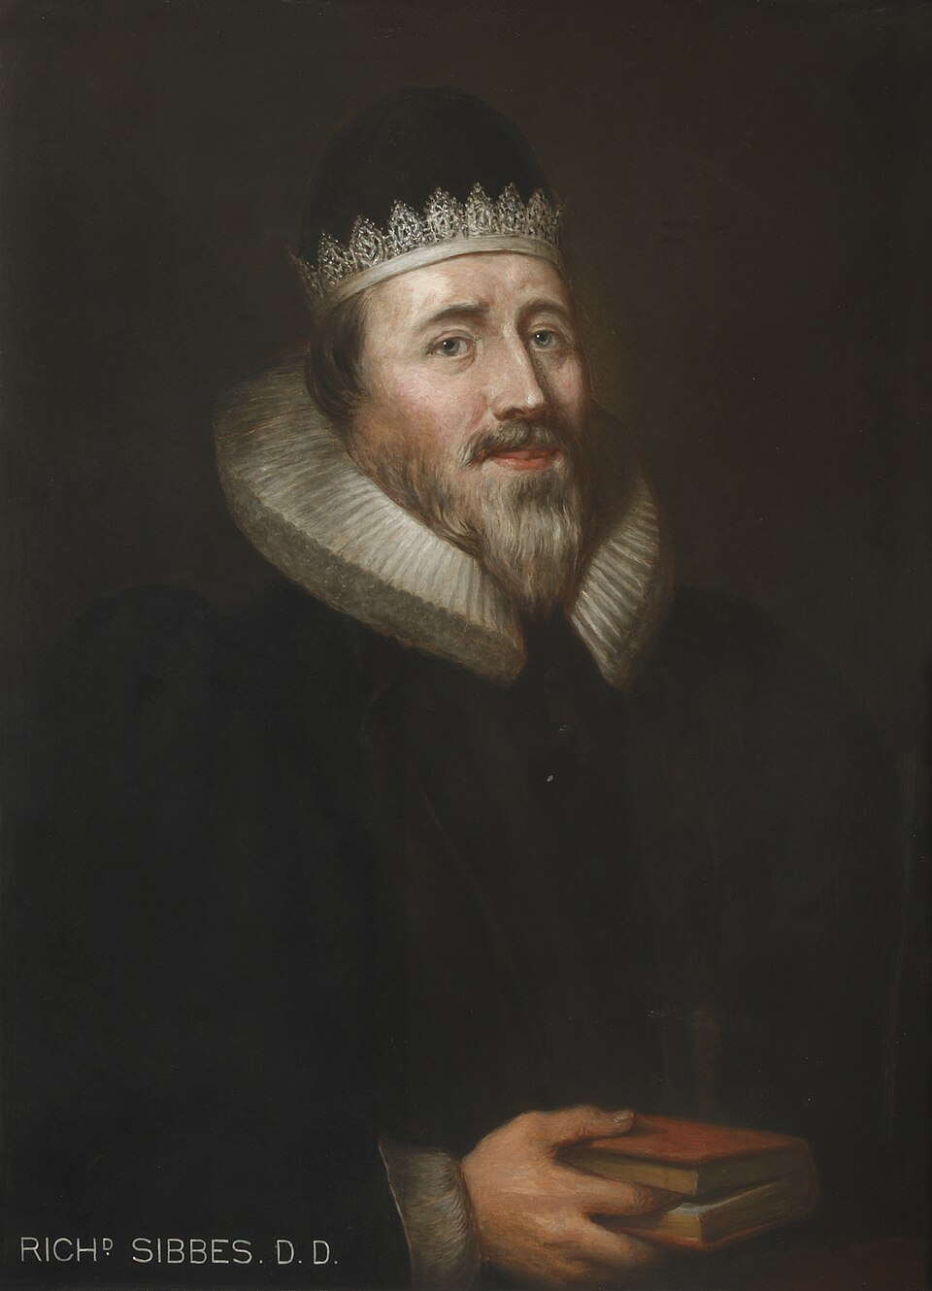
Richard Sibbes (1577-1635)
Born Suffolk; studied Cambridge
Called “honey tongued”
1629 The Saint’s Cordial
1631 Bruised reed and smoking flax
1635 The Soules Conflict
“There is more mercy in Christ than sin in us.”

Slide 6
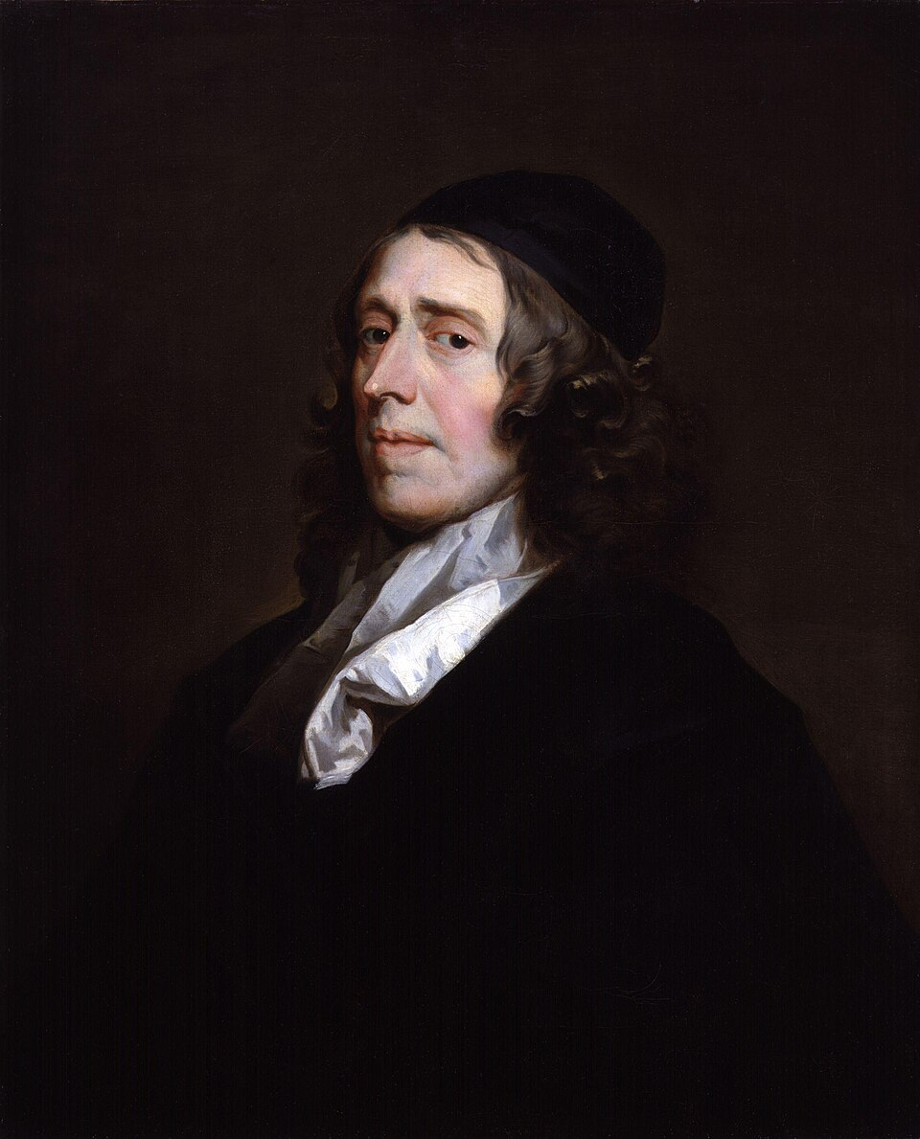
John Owen (1616-1683)
Welsh; Oxford trained
Christ Centered; 9 vols on Holy Spirit
1637 driven from Oxford by Laud’s statutes
Sided with Parliament
1642 The Display of Arminianism
1647 The Death of Death in the Death of Christ
Cromwell’s chaplain
1663 invited to pastor in Boston

Slide 7
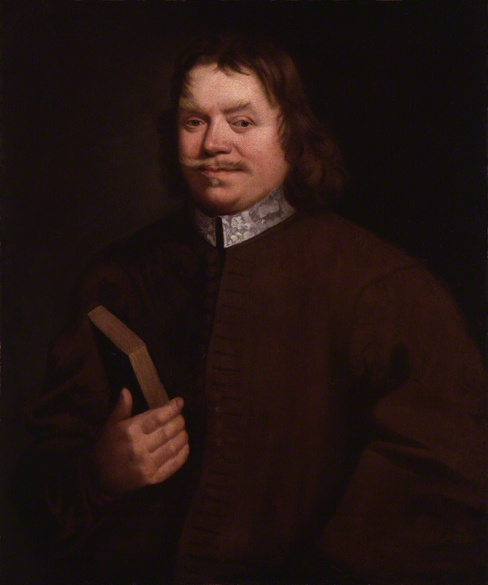
John Bunyan (1628-1688)
Fought on Parilmentary side
Worked as Tinker
1656 Gospel truths opened
1658 wife died (four young kids, 1 blind)
  Remarries
1560 12 years of imprisonment
  Occassionally released
  5th child
  Wrote grace abounding & Pilgrim’s progress

