Slide 1
Church History
The second millennium

Slide 2
18th Century
Events
  1687-1789 Age of Enlightenment
  1701 Yale University
  1707 Union of England and Scotland
  1730-1755 1st Great Awakening
  1733 Georgia
  1746 Princeton University
  1754–1763 French and Indian War
  1775-1781 Revolutionary War
  1783 Treaty of Paris
  1789 Constitution
  1791 Bill of Rights
  1789-1799 Frech Revolution
  1790-1840 2nd Great Awakening
People
  John Locke (1632-1704)
  Johann Sebastian Bach (1685-1750)
  George Frideric Handel ( 1685-1759)
  Voltaire (1694-1778)
  Jonathan Edwards (1703-1758)
  Gilbert Tennent (1703-1764)
  John Wesley(1703-1791)
  Benjamin Franklin (1706-1790)
  Charles Wesley (1707-1788)
  Samuel Johnson (1709-1784)
  David Hume (1711-1776)
  Jean-Jacques Rousseau (1712-1778)
  Frederick II (1712-1786)
  George Whitefield (1714-1770)
  Adam Smith (1723-1790)
  Immanuel Kant (1724-1804)
  George Washington (1732-1799)
  Johann Wolfgang von Goethe 749-1832)
  Wolfgang Amadeus Mozart (1756-1791)
  Ludwig van Beethoven (1770-1827)

Slide 3
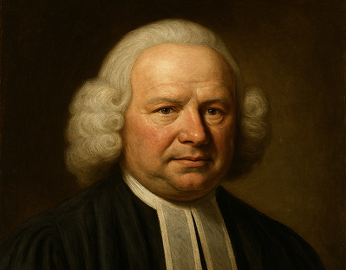
George Whitefield (1714-1770)
Poor (scholarship student) at Oxford
Met John Wesley
Mining communities growing up in England
1736 Open air preaching
1738 Savana Georgia, asked John Wesley to take over
1740 goes to New England (impacts Edwards)
1742 return England
1745 3rd American Tour

Slide 4
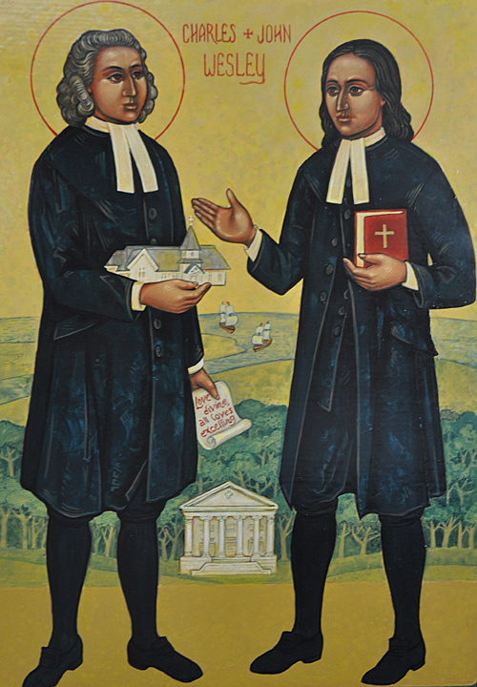
John Wesley(1703-1791)
Charles Wesley (1707-1788)
Father Anglican minister
both went to Oxford and part of “Holy Club”
1735 Oglethorpe requested them to come to Georgia
  Storm on way over
  Moravian Christians
C renewal then 3 days later J did in Aldersgate Church
J invited by Whitefield to open air preach
Embraced Arminian doctrine
  Perfectionism
  methodism
Charles Wesley
  Hymn Writer (6500+)
    "And Can It Be",
    "O for a Thousand Tongues to Sing",
    "Christ the Lord Is Risen Today",
    "Love Divine, All Loves Excelling",
    "Hark! The Herald Angels Sing"

Slide 5
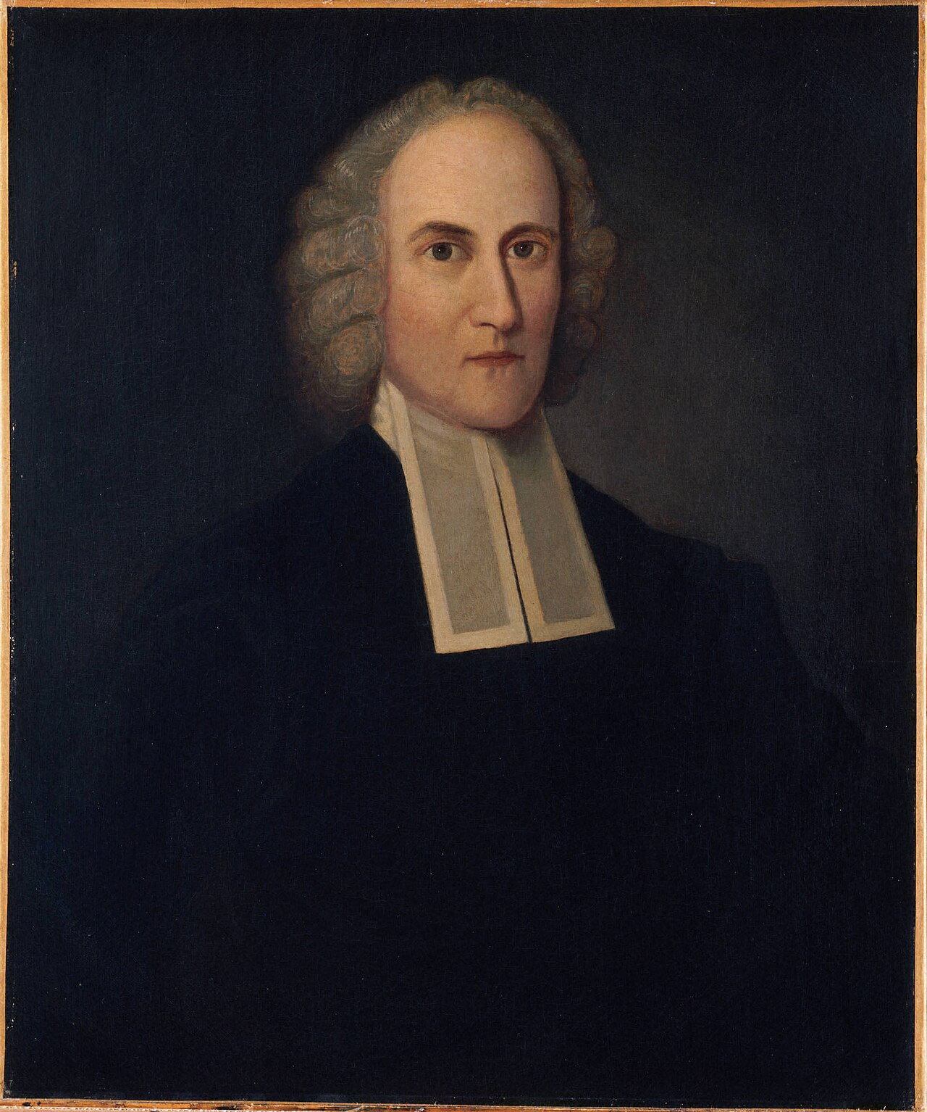
Jonathan Edwards (1703-1758)
Charity and its Fruits
Freedom of Will
Religious Affections
1731 preaching in Boston
1739 Whitefield
1741 Sinners in the hands of an Angry God
1751 removed from church
1758 smallpox vax

