Slide 1
Church History
The second millennium

Slide 2
19th Century
Events
1742 Philadelphia Confession of Faith (Particular Baptist)
1833 New Hampshire Confession of Faith (Particular Baptist)
1834 A Treatise on the Faith of the Freewill Baptists (General Baptist)
1925 Baptist Faith and Message - revised in 1963, 1998 and 2000 (Although originating from a Particular Baptist heritage, the Baptist Faith and Message, as variously revised, is theologically broad enough to include both General Baptists and Particular Baptists)
People
  William Carey (1761-1834)
  JC Ryle (1816–1900)
  Charles Haddon Spurgeon (1834-1892)
Other points of interest
1846 Free Will Baptists license Ruby Knapp Bixby as preacher
1873 Lottie Moon goes to China.
1888 Annie Armstrong creates Woman’s Missionary Union

Slide 3
Baptist Denoms
Particular
Philadelphia Association
General
1st Great
Awakening
Regular
Separate
Free will
United
2nd Great
Awakening
Triennial
Primitive
Slavery
Civil War
Northern
Southern
American
7th Day
Progressive
Reformed
Landmark
Progressive Primitive

Slide 4
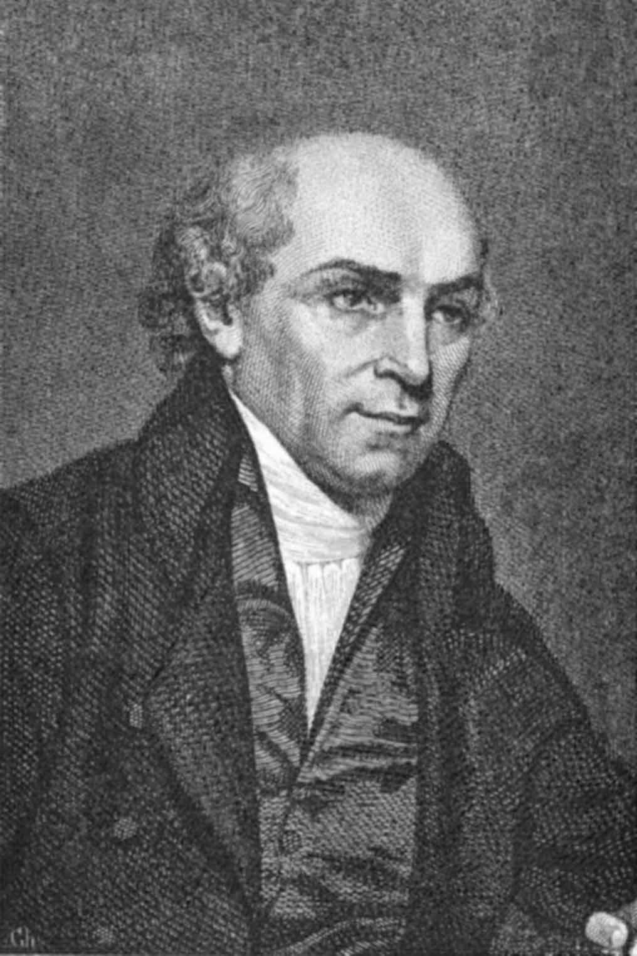
William Carey (1761-1834)
Father of modern Missions
Heros
  John Eliot (1604-1690)
  David Brainerd (1718-1747)
An Enquiry into the Obligations of Christians to use Means for the Conversion of the Heathens
  5 parts theological justification, history, 26 pages of tables, answers to objections, missionary society
Deathless Sermon (Isaiah 54:2-3)
  Expect great things from God
  Attempt great things for God
India – Dr. John Thomas
  Wife did not want to go
    Sister coming changed her mind
  British ships wouldn’t take him
    Abandoned on Isle of Wight
    finally Dutch ship took
  British East India Company opposed
  Indigo company and Bengali translation

Slide 5
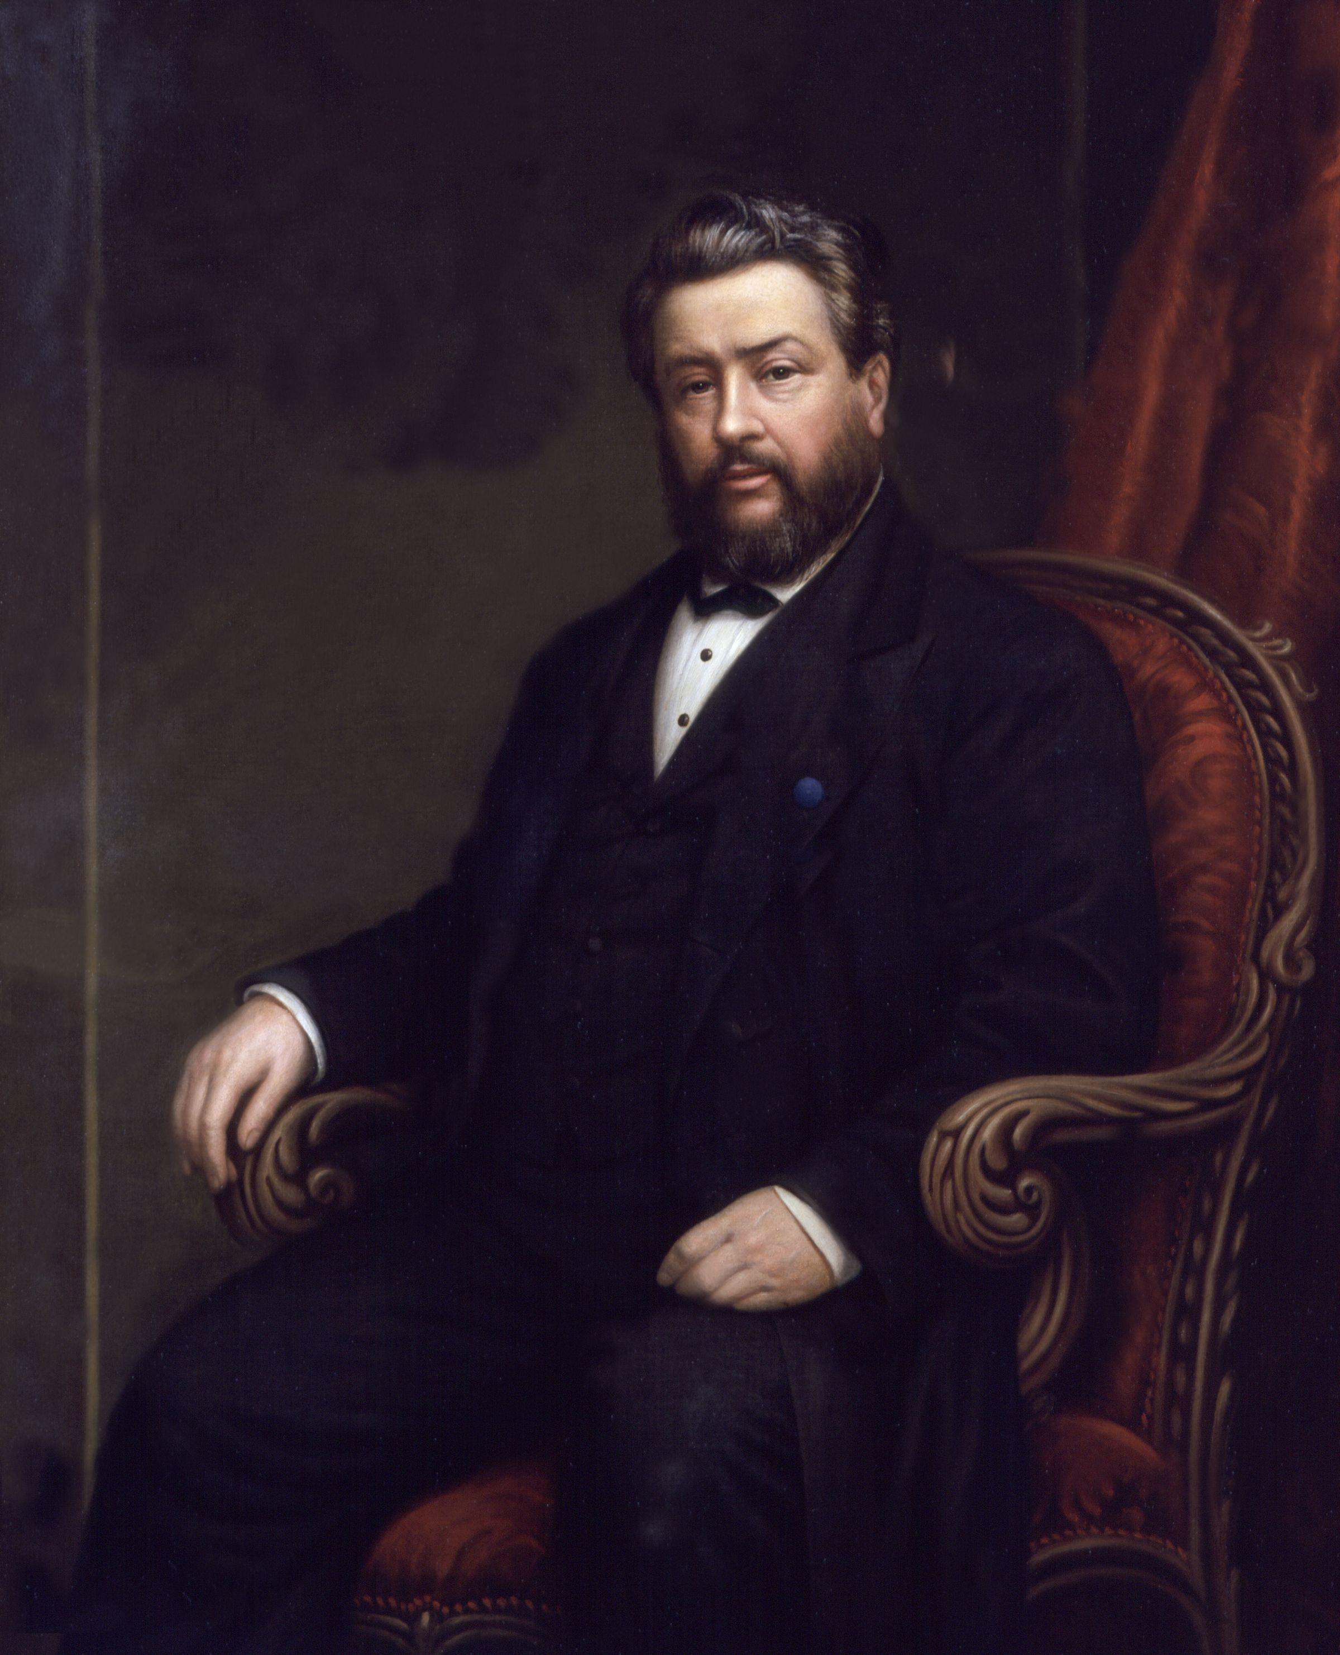
Charles Haddon Spurgeon
(1834-1892)
Prince of preachers
Pastor of New Park Street Chapel
  Metropolitan Tabernacle
  Founded 1650
  John Gill (1697-1771)
Opposition to slavery
More on primitive Baptist side
Downgrade Controversy
  1887 article in Sword & the Trowel
  Four issues
    Deny inerrancy
    Deny substitutionary atonement
    Deny eternality of hell
    Affirm Universalism
  Documentary hypothesis
  Evolution

Slide 6
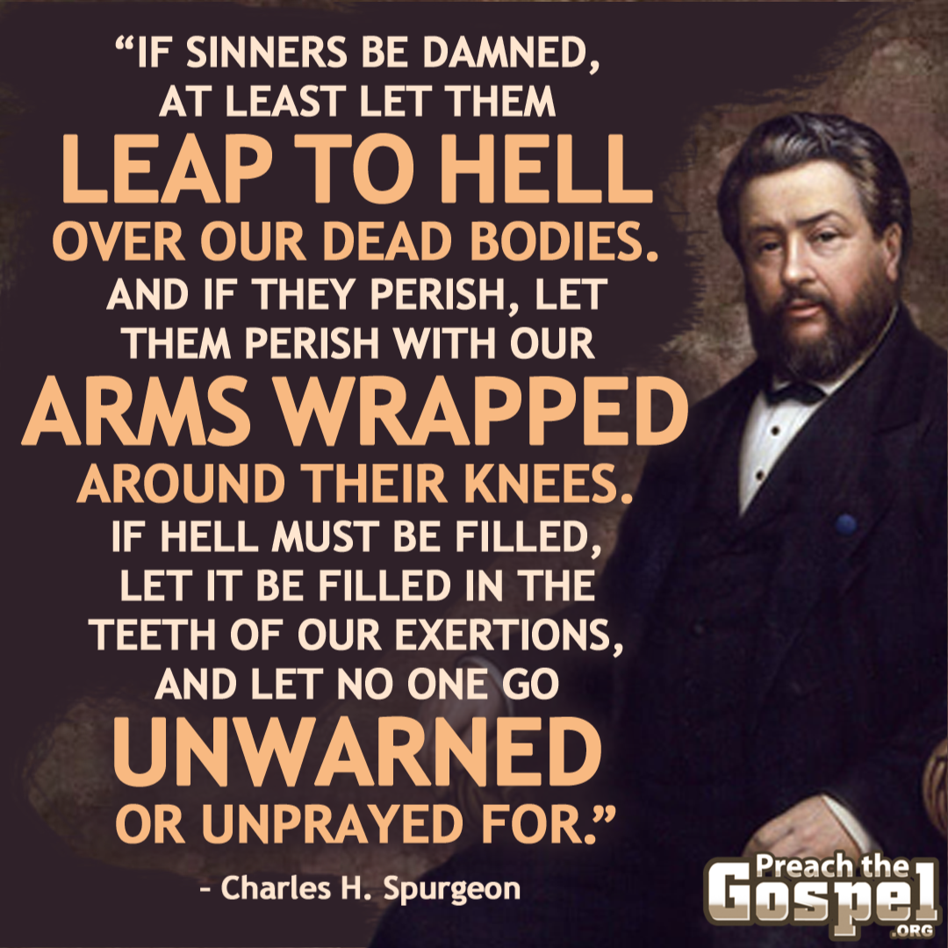
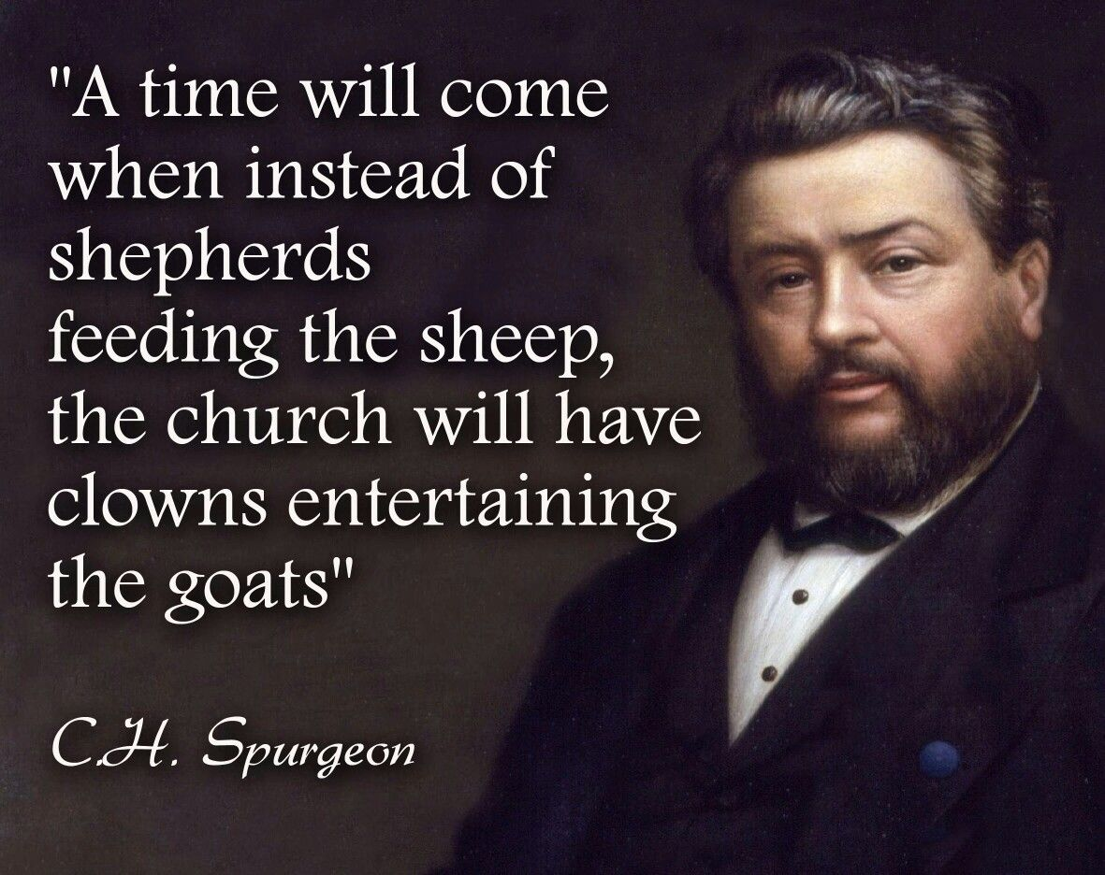
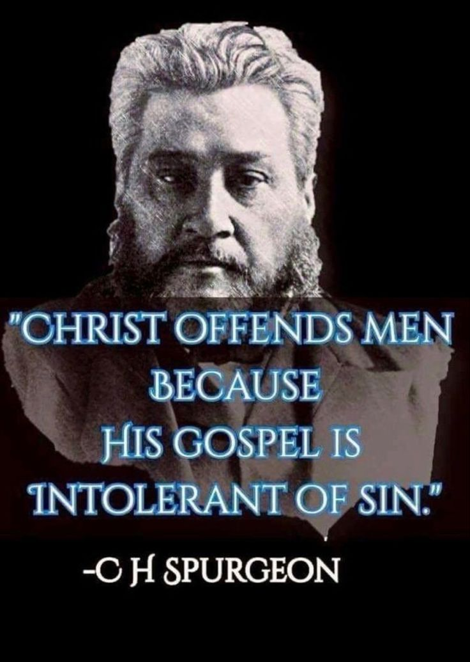
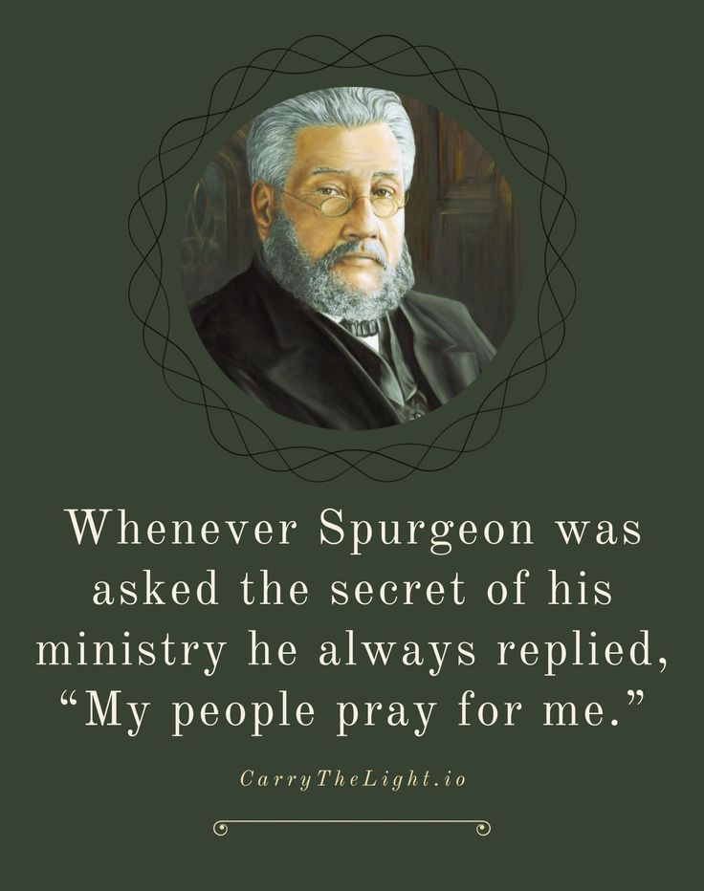
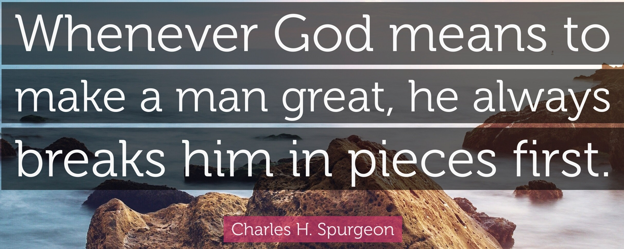
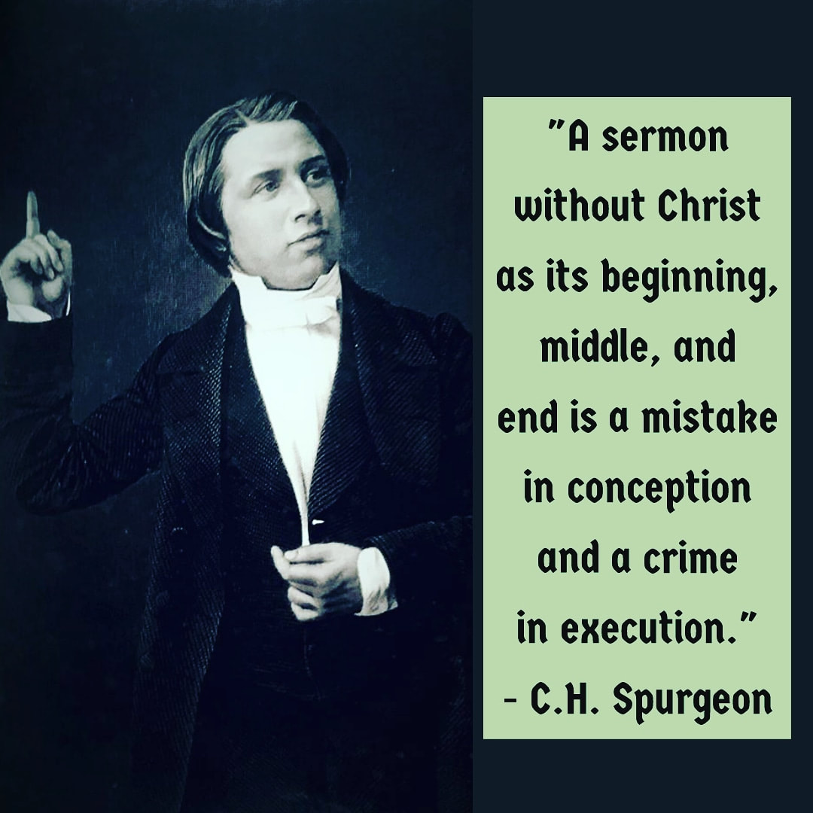
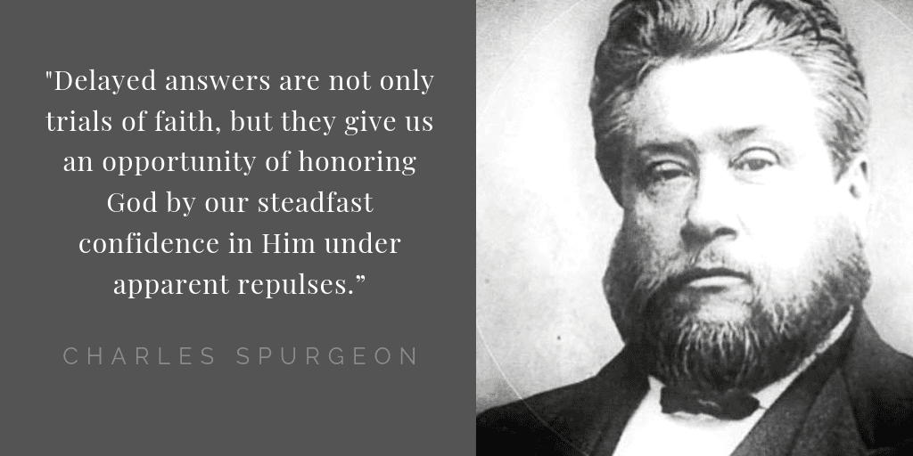


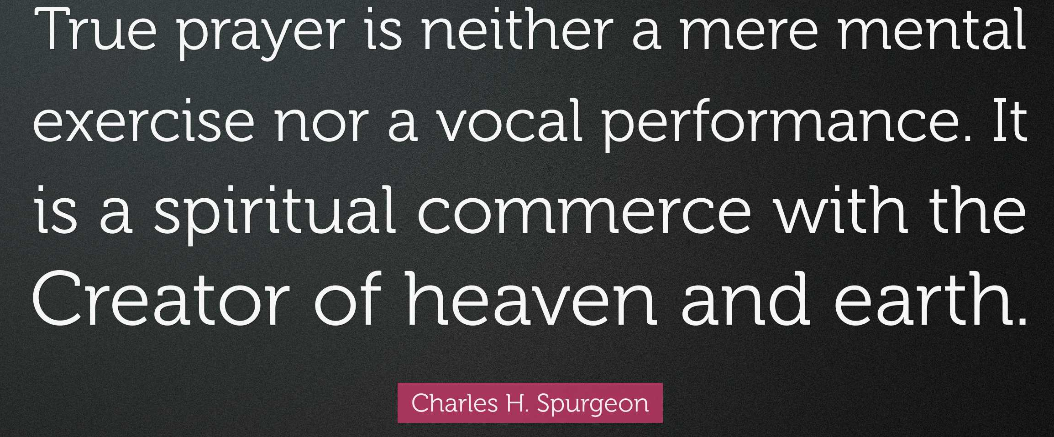
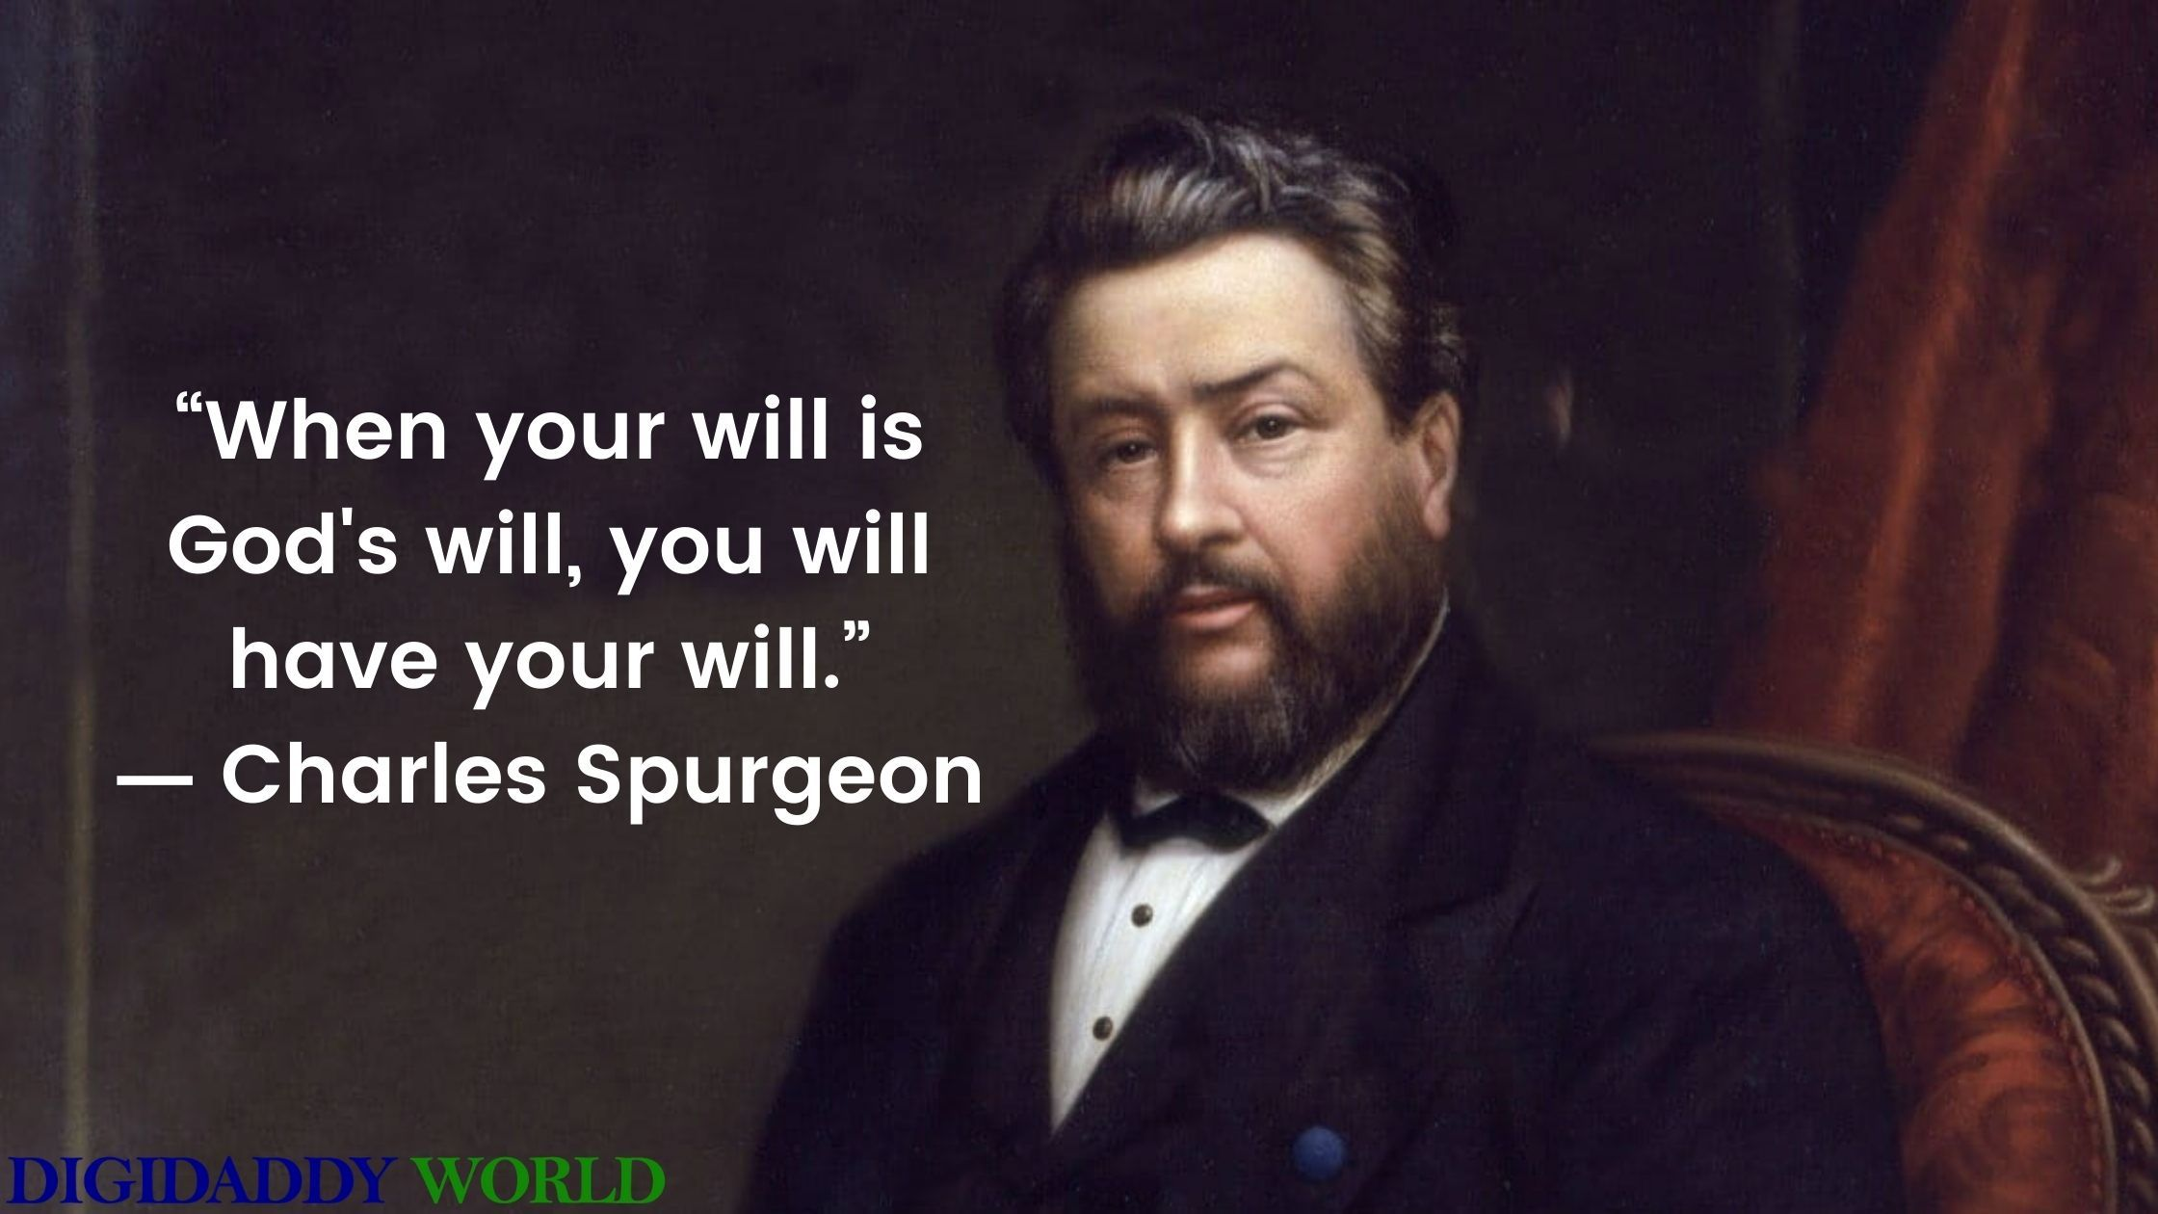
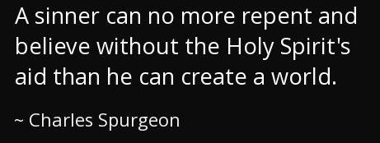

Slide 7
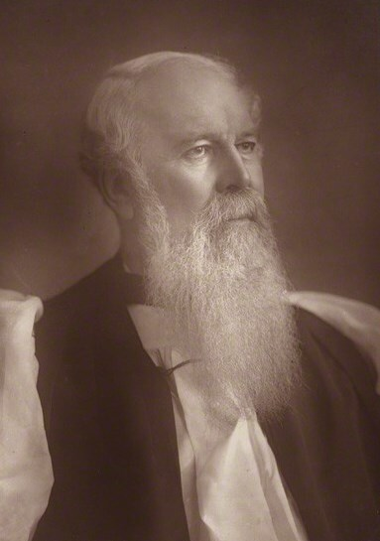
JC Ryle
Bishop of Liverpool
Expository series on Gospels, Holiness, Practical Religion, thoughts for young men
“Men fall in private long before they fall in public.”
“Doctrine is useless if it is not accompanied by a holy life. It is worse than useless; it does positive harm. Something of ‘the image of Christ’ must be seen and observed by others in our private life, and habits, and character, and doings.”
“The saddest road to hell is the one that runs under the pulpit, past the Bible, and through the middle of warnings and invitations.”
“Unity without the gospel is a worthless unity; it is the very unity of hell.”
“Abide in Me says Jesus. Cling to Me. Stick fast to Me. Live the life of close and intimate communion with Me. Get nearer to Me. Roll every burden on Me. Cast your whole weight on Me. Never let go your hold on Me for a moment. Be, as it were, rooted and planted in Me. Do this and I will never fail you. I will ever abide in you.”
“How can we love sin, when we remember that because of our sins Jesus died?”
“Whenever a man takes upon him to make additions to the Scriptures, he is likely to end with valuing his own additions above Scripture itself.”

