Slide 1
Church History
The second millennium

Slide 2
20th Century
So many wars…
  1910-1920 Mexican Revolution
  1914-1918 WWI1917 Russian Revolution (Feb, Oct)
  1918-1919 German Revolution (Nov)
  1918 Austro-Hungarian dissolution
  1918-1919 Greater Poland Uprising
  1918 Flu pandemic (20 M+ deaths)
  1920-1933 Prohibition
  1925 Scopes Trial
  1936-1939 Spanish Civil war
  1939-1945 WWII
  1945-1991 Cold War
  1950-1953 Korean War
  1955-1975 Vietnam War
People
  George Müller (1805-1898)
  Dwight Lyman Moody (1837-1899)
  Archibald Alexander Hodge (1823-1886)
  Abraham Kuyper (1837-1920)
  Benjamin Breckinridge Warfield (1851-1921)
  Reuben Archer Torrey (1856-1928)
  John Gresham Machen (1881-1937)
  Karl Barth (1886-1968)
  Cornelius Van Til (1895-1987)
  David Martyn Lloyd-Jones (1899-1981)
  J. Vernon McGee (1904–1988)
  Dietrich Bonhoeffer (1906-1945)
  F. F. Bruce (1910–1990)
  Francis Schaeffer (1912–1984)
  Billy Graham (1918-2018)
  John Stott (1921–2011)
  J. I. Packer (1926–2020)
  Jim Eliot (1927-1956)
  John Polkinghorne (1930–2021)
  Jerry Falwell (1933-2007)
  James Montgomery Boice (1938–2000)
  John Frame (1939-)
  John F. MacArthur (1939-2025)
  R. C. Sproul (1939–2017)
  John Lennox (born 1943)
  D. A. Carson (1946-)
  John Piper (1946-)
  Vern Poythress (1946-)

Slide 3
Higher Criticism and Presbyterians
1876-1893 Princeton Theological Seminary vs. Union Theological Seminary
  AA Hodge, BB Warfield vs. Briggs, rise of higher criticism in PCUSA
  1891 Briggs “Authority of Holy Scripture” talk
    Deny Biblical Authors
    Scripture riddled with errors
    OT merely a historical record showing lower state of morality in man, which moderns have progressed past
  John Gresham Machen (1881-1937)
    1929 Westminster Seminary
    1936 OPC

Slide 4
Fundamentalist/Modernist
1875-1897 Niagara Bible Conference - Believers' Meeting for Bible Study
1910 The Fundamentals (12 vol set of essays)
1910 Five Fundamentals (General Assembly of Pres. Church)
  Biblical inspiration/infallibility
  Virgin Birth of Christ
  Atonement for sin through Christ’s death on cross
  Bodily resurrection of Jesus
  Historical reality of Jesus’s miracles
1920 “fundamentalist” Watchman Examiner (Baptist newspaper)
1925 Evolution becomes major issue with Scopes Trial
1960 Creation Science
1989 Intelligent Design (Pandas)

Slide 5
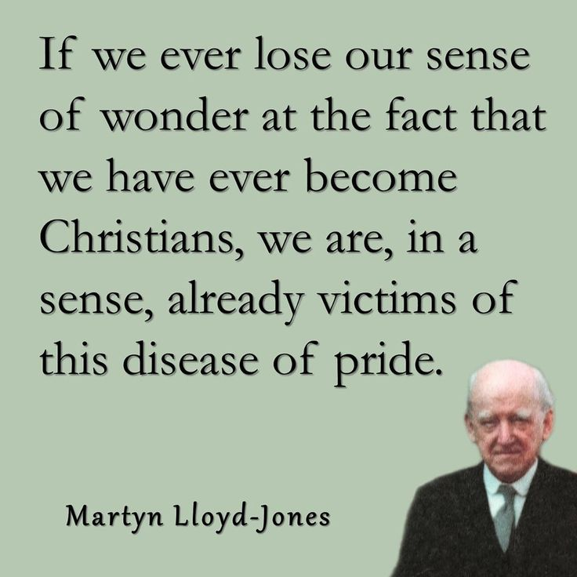
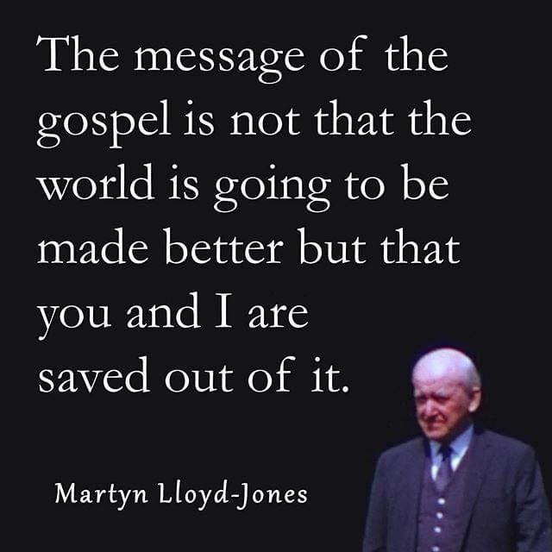
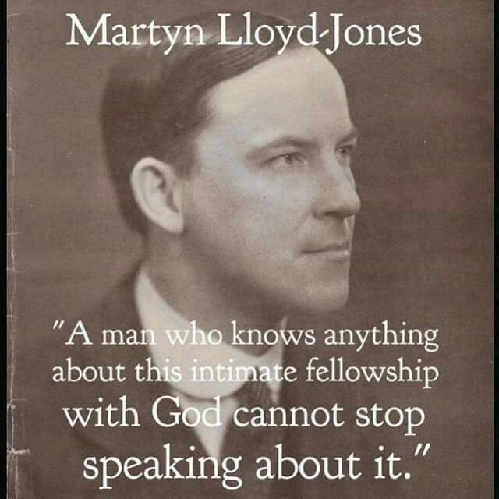
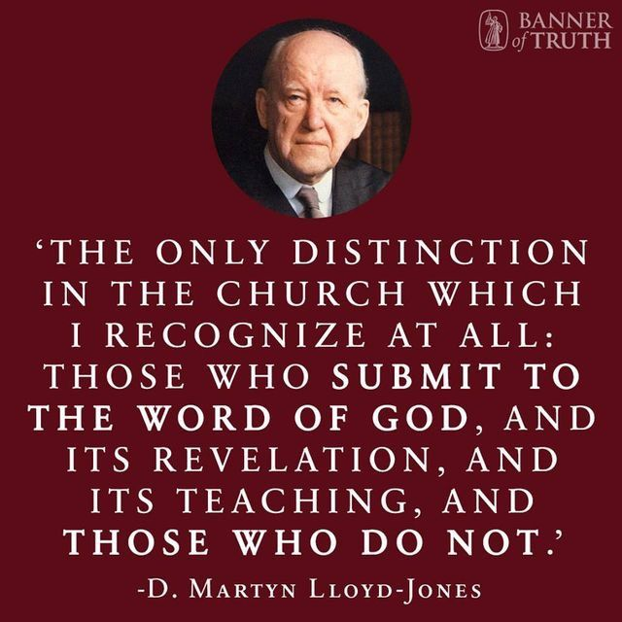
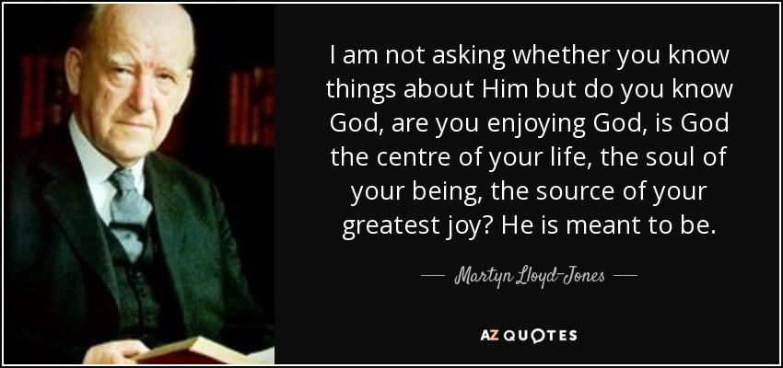
David Martyn Lloyd-Jones (1899-1981)
1917 medical student
1921 assistant to Royal Physician
1927 returned to Wales to pastor
1932 read BB Warfield
1939 Westminster Chapel, London
Expository preaching
  Logic on Fire

Slide 6

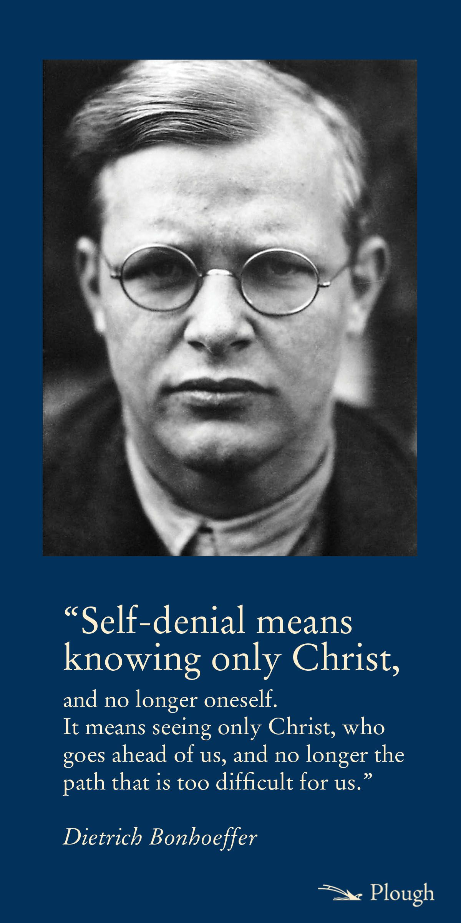
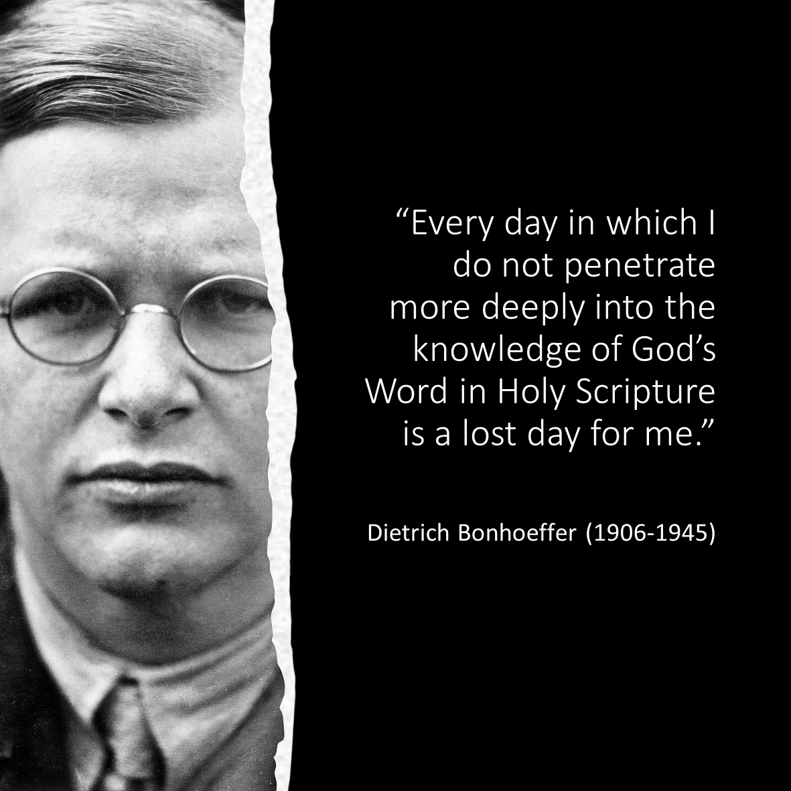

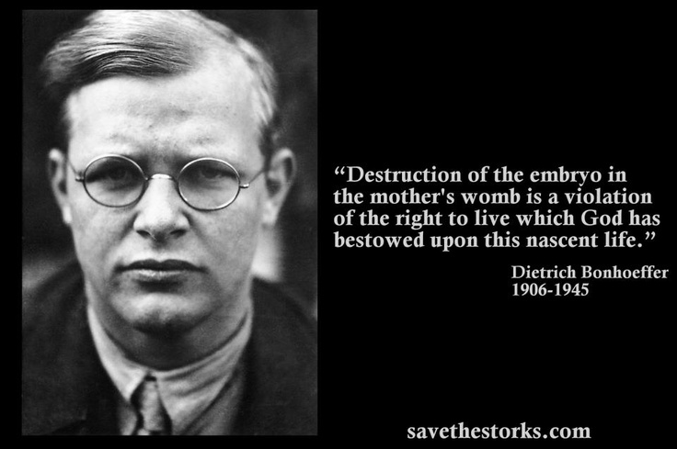
Dietrich Bonhoeffer (1906-1945)
Went to Union TS in 1930, unimpressed with US theology
Abyssinian BC
All Quiet on Western Front
The cost of discipleship, Life Together

Slide 7
Pentecostalism (1st wave)
700 denominations, 279M+ worldwide (644M+ with Charismatics)
Holiness/perfectionism, Baptism of Holy Spirit, Appostolic/Restoration, speaking in tongues, slain in spirit
1906-1915 Azusa Street Revival, William Seymore
1910 oneness/modalism in Finished Work Pentecostals
Aimee Semple Mcpherson (1890-1944)
EW Kenyon (1867-1948) Positive confession/word of faith
1950’s prosperity enters in healing revivals

Slide 8
Charismatic movement (2nd wave)
1960’s movement of Pentecostal-like beliefs into mainline
1960 Anglican/Episcopal
1962 Lutheran, Presbyterian
1967 Catholic
1970 Methodists
Third wave
  1965 Calvary Chapel (Chuck Smith)
  Jesus Movement (late 60’s-70’s)
  1982 Vineyard (John Wimber)

