Slide 1
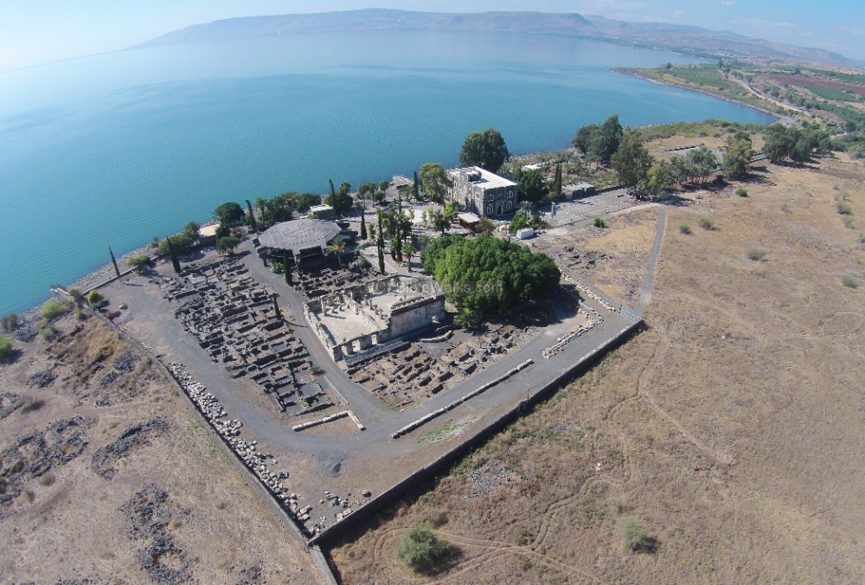
New Testament Survey I:
Gospels and Acts
Dr. Keith Schubert

Slide 2
New Testament Survey I: Gospels and Acts
8/14 Geography and History -
8/21 Synoptics Matthew, Mark, Luke
8/28 Mark Mark
9/4 Matthew Matthew
9/11 Luke Luke
9/18 John John
9/25 Narratives still picking
10/2 Parables still picking
10/9 Sermon on the Mount Matthew 5-7
10/16 Acts Early Church & Peter Acts 1-12
10/23 Travels of Paul Acts 13-28

Slide 3
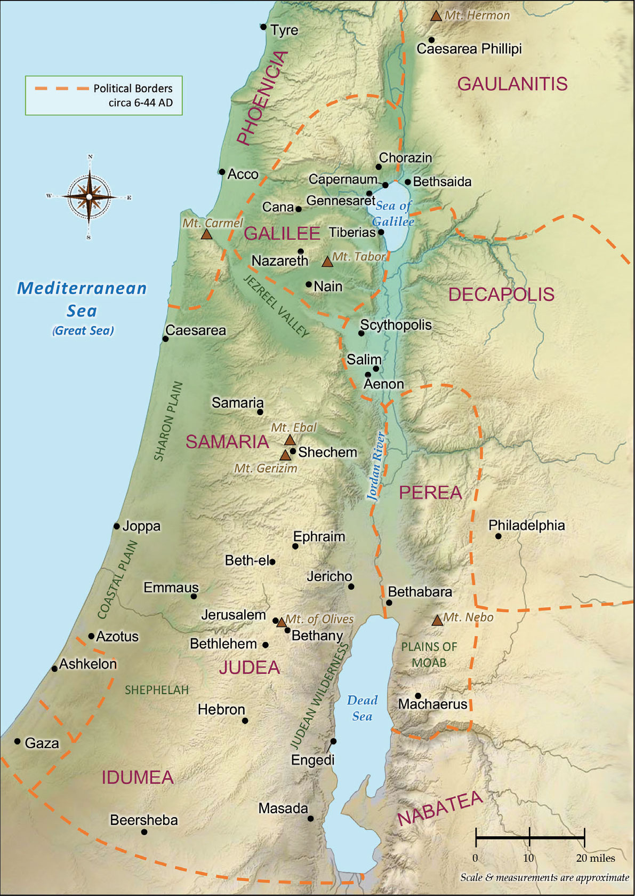
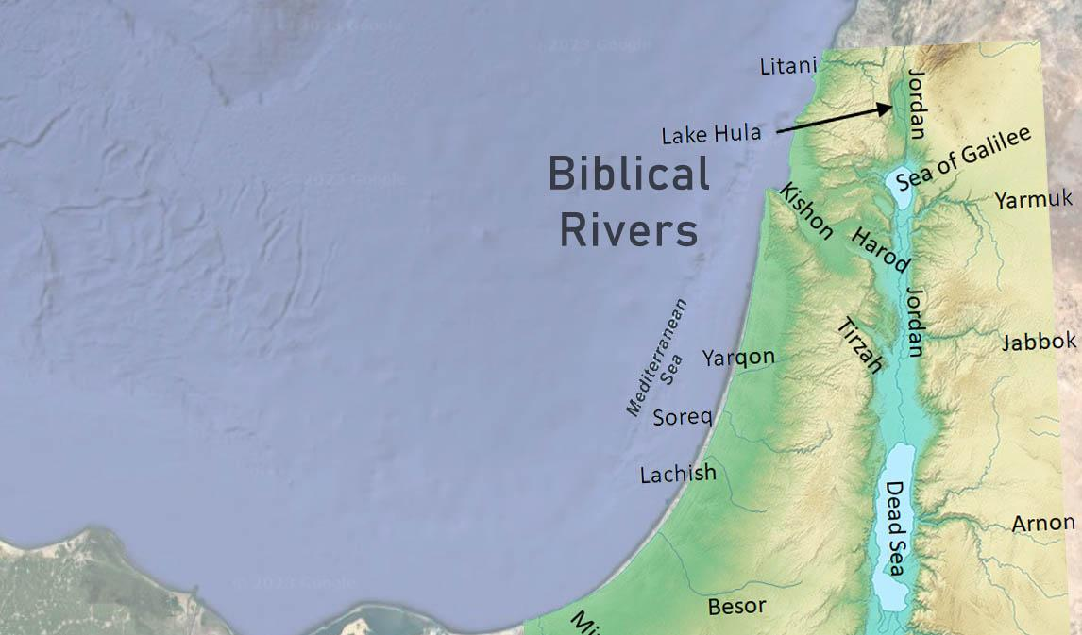
Bashan
Gilead
Ammon
Moab

Slide 4
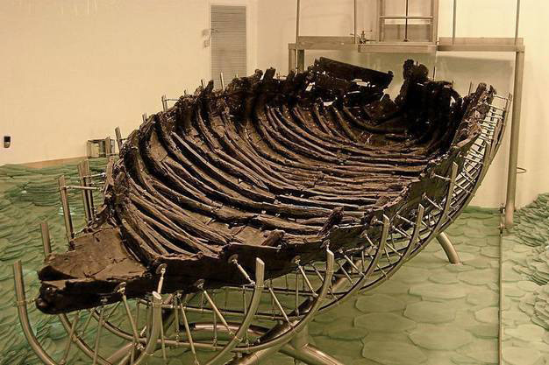
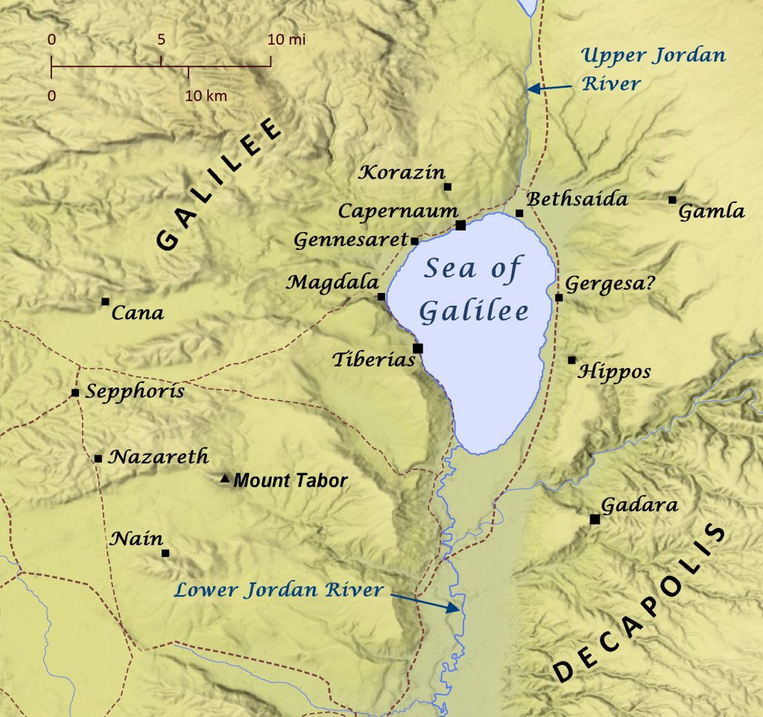
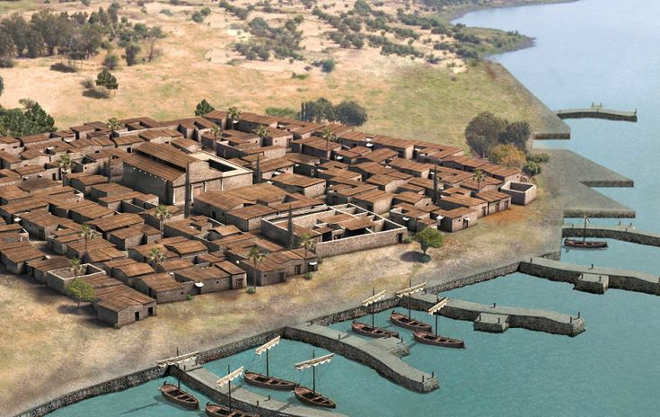

Slide 5
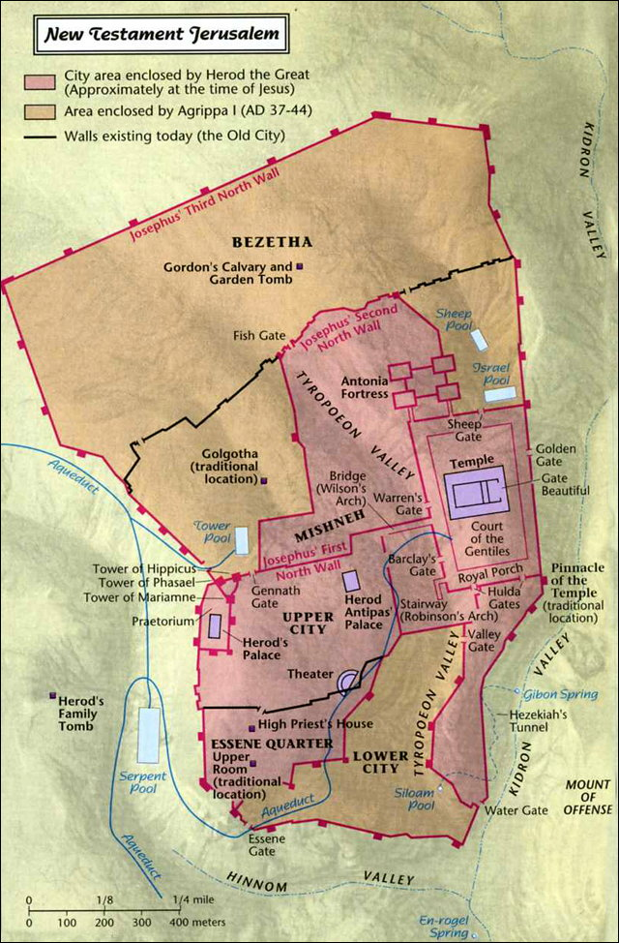
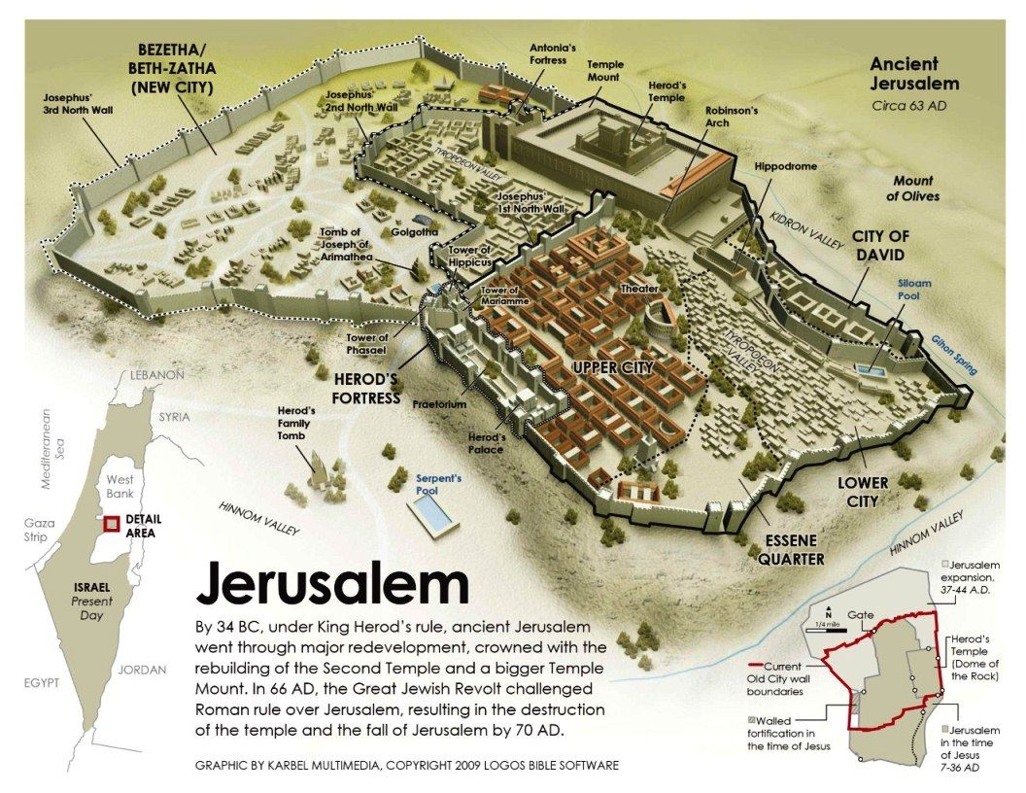

Slide 6
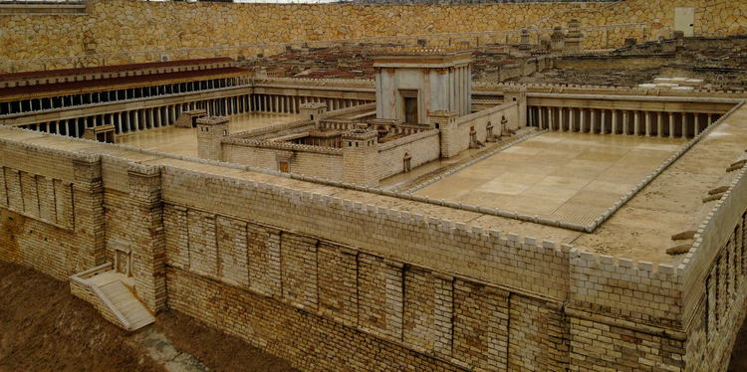

Slide 7
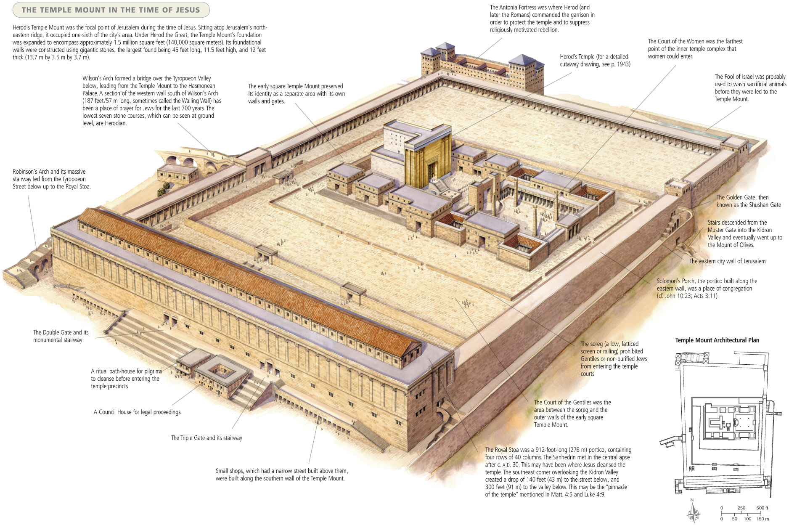

Slide 8
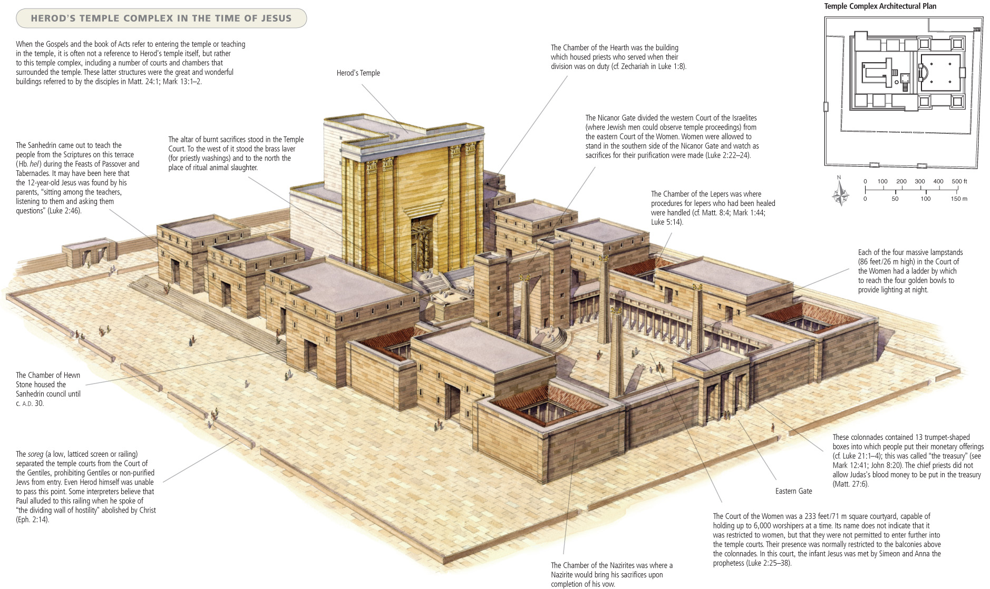

Slide 9
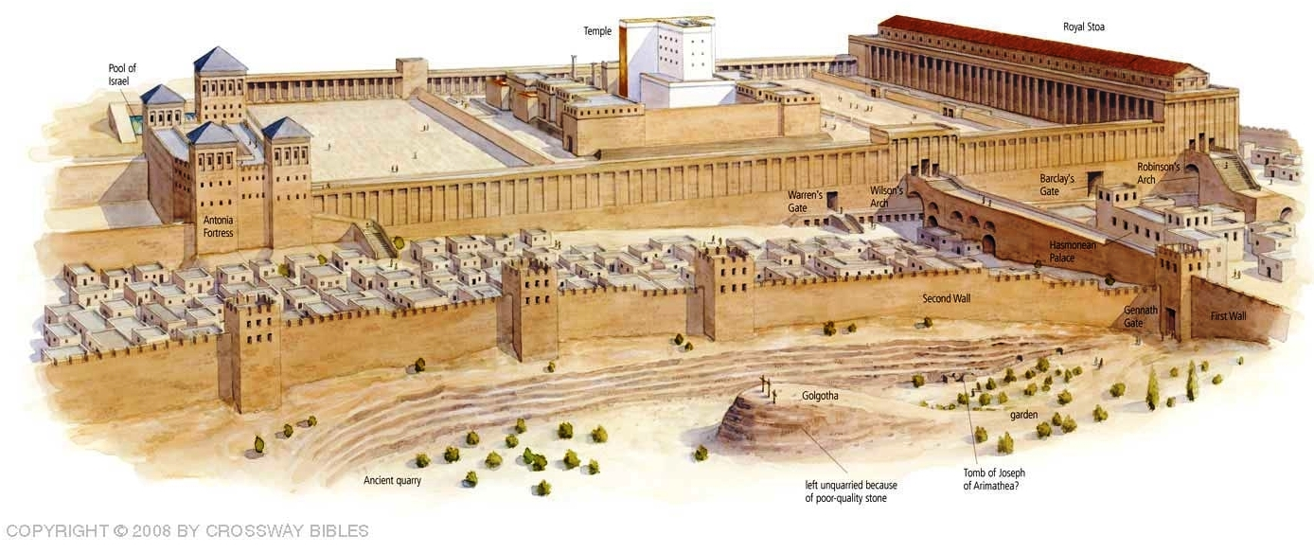

Slide 10
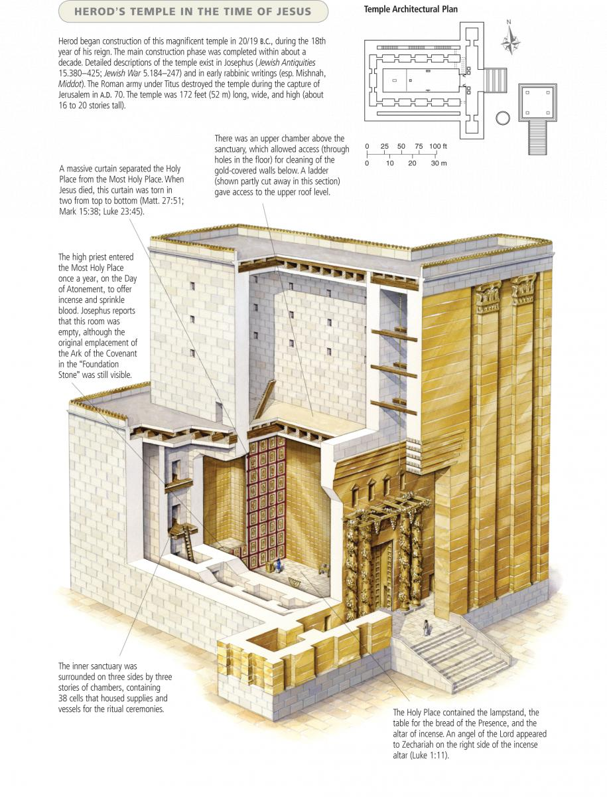

Slide 11
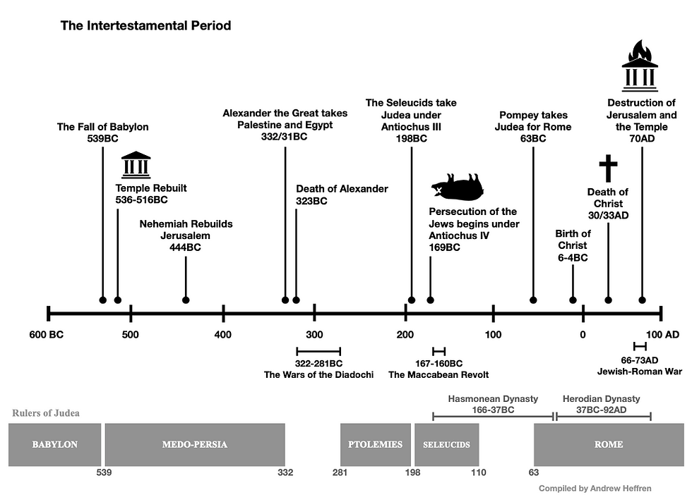

Slide 12
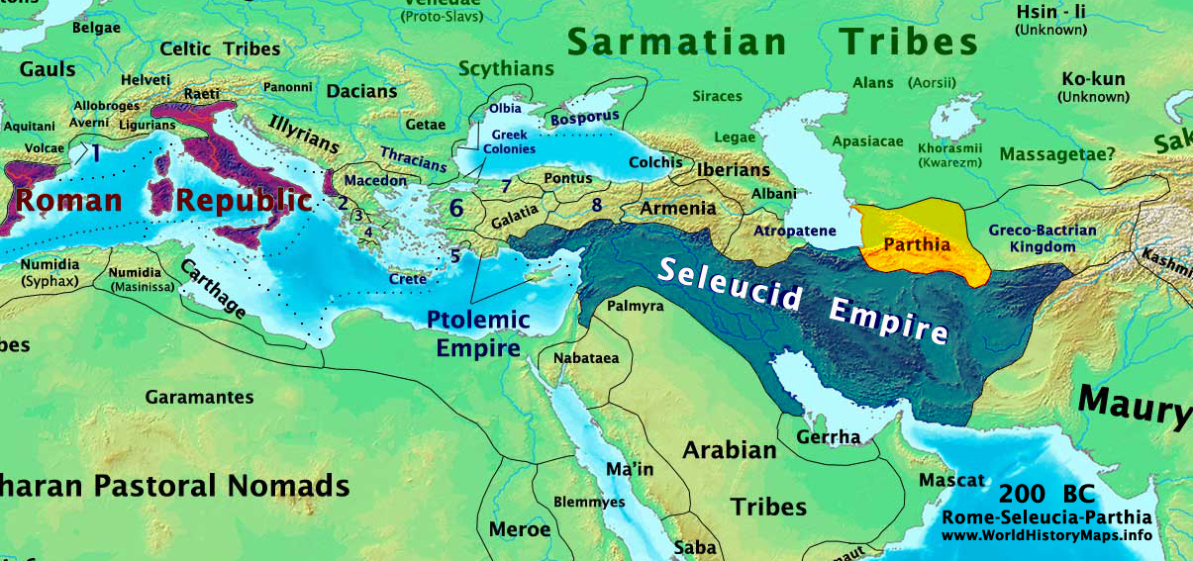

Slide 13
