Slide 1
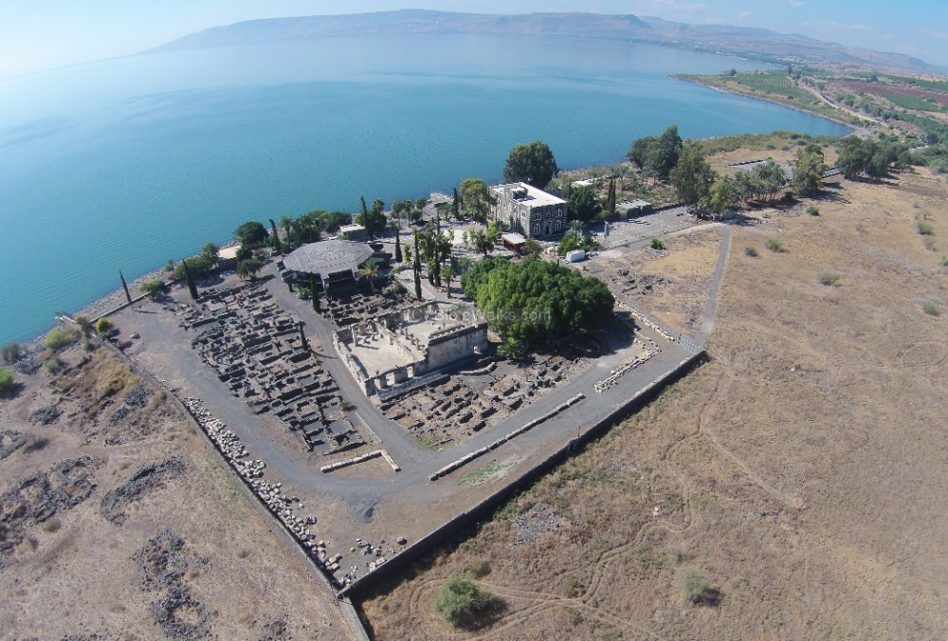
New Testament Survey I:
Gospels and Acts
Dr. Keith Schubert

Slide 2
New Testament Survey I: Gospels and Acts
8/14 Geography and History -
8/21 Synoptics Matthew, Mark, Luke
8/28 Mark Mark
9/4 Matthew Matthew
9/11 Luke Luke
9/18 John John
9/25 Narratives still picking
10/2 Parables still picking
10/9 Sermon on the Mount Matthew 5-7
10/16 Acts Early Church & Peter Acts 1-12
10/23 Travels of Paul Acts 13-28

Slide 3
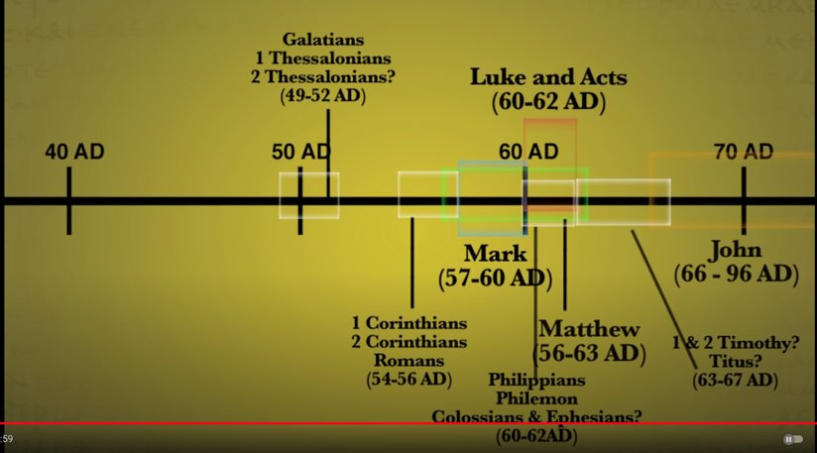

Slide 4
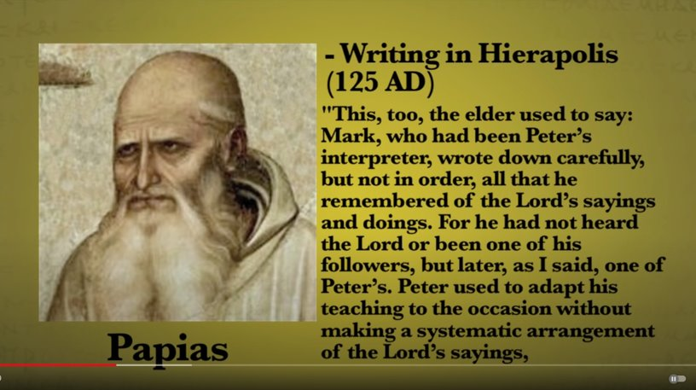

Slide 5
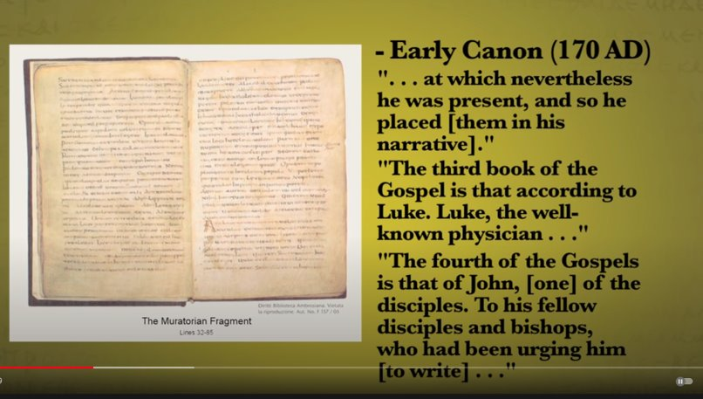

Slide 6
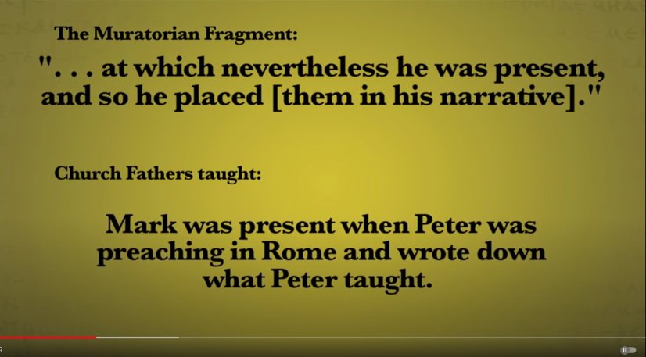

Slide 7
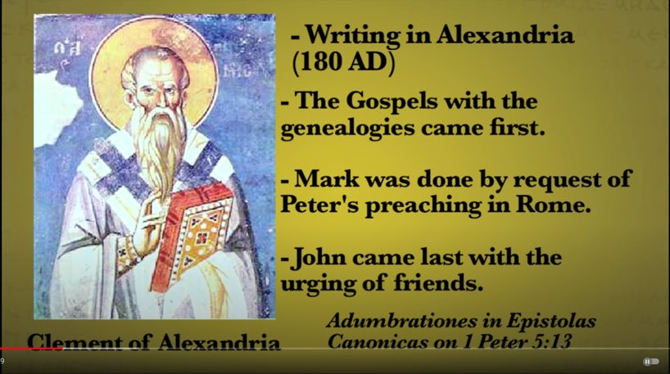

Slide 8
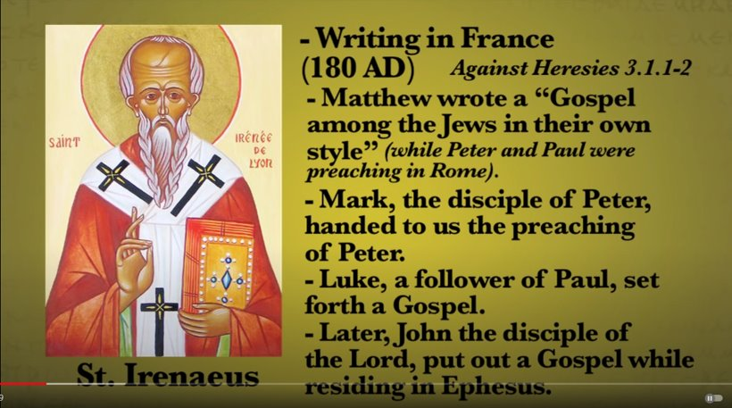

Slide 9
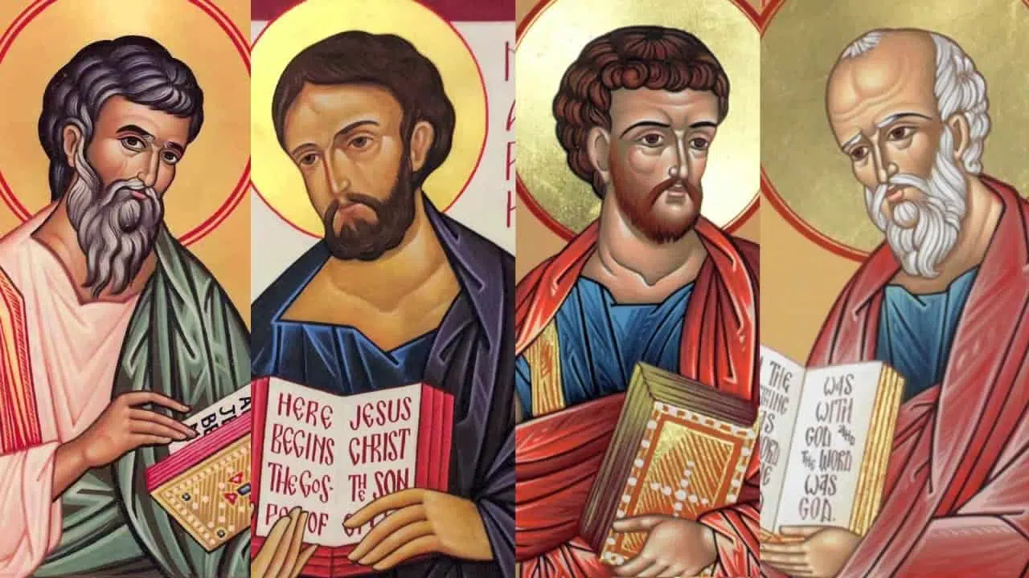
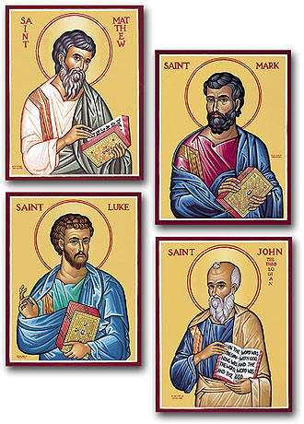

Slide 10
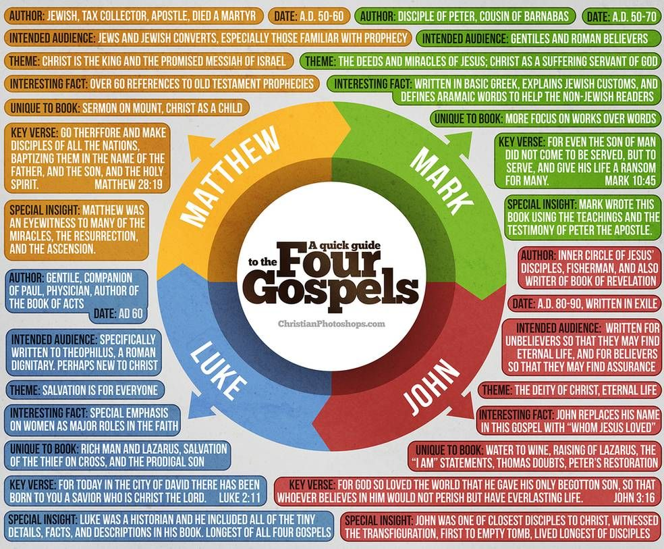

Slide 11
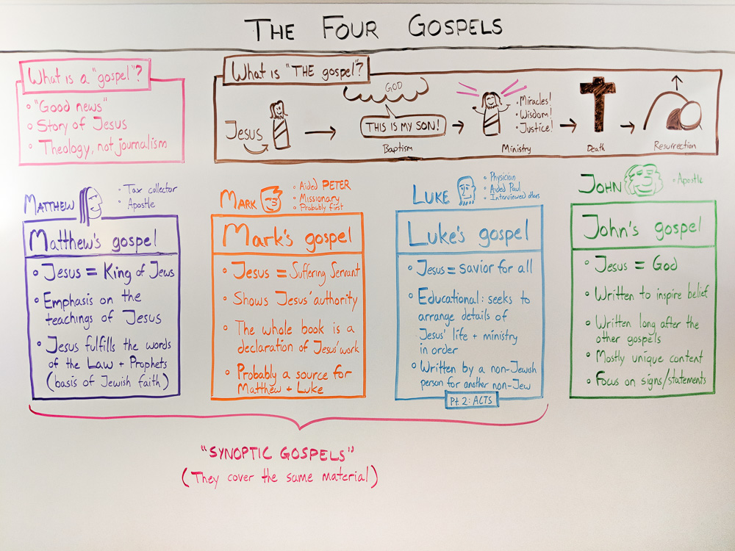

Slide 12
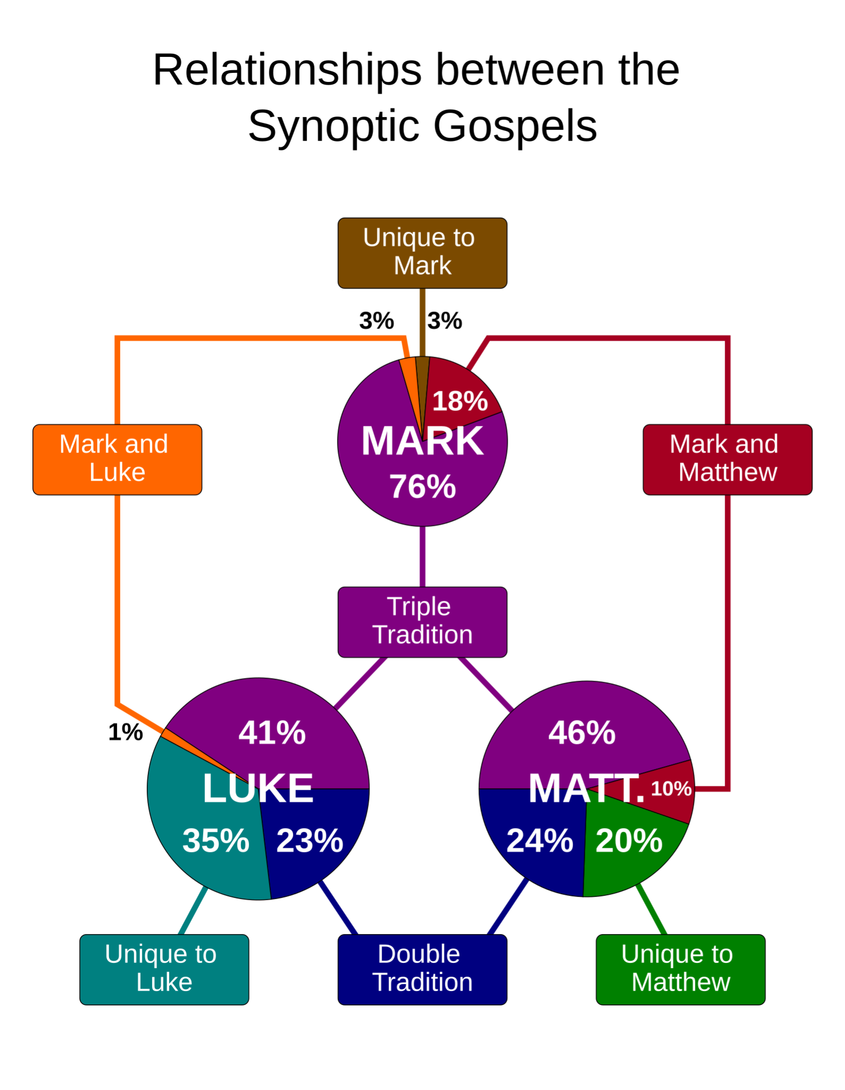
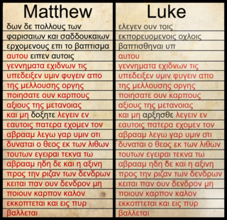
Mt 3:7–10 & Lk 3:7–9

Slide 13
Mark and the other Synoptics
Unique to Mark
Mark 7:33-36 (healing deaf & mute)
Mark 8:22-26 (healing blind in Bethsaida)
Mark 14:51-52 (naked runaway)
explanatory elaborations Mark 16:4 (for it was very large)
Aramaisms Mark 5:41
Mark & Luke
Capernaum exorcism Mk 1:23–28, Lk 4:33–37
departure from Capernaum Mk 1:35–38, Lk 4:42–43
the strange exorcist Mk 9:38–41, Lk 9:49–50
and the widow's mites Mk 12:41–44, Lk 21:1–4
Mark & Matthew
Mk 7:1-8:9, Mt 15:1-39

Slide 14
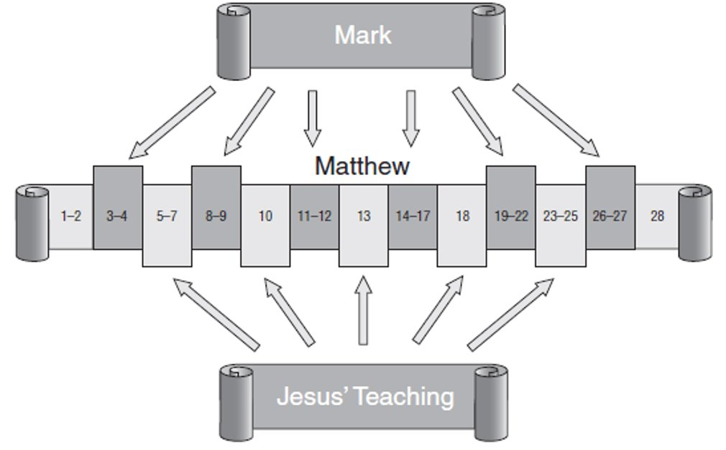

Slide 15
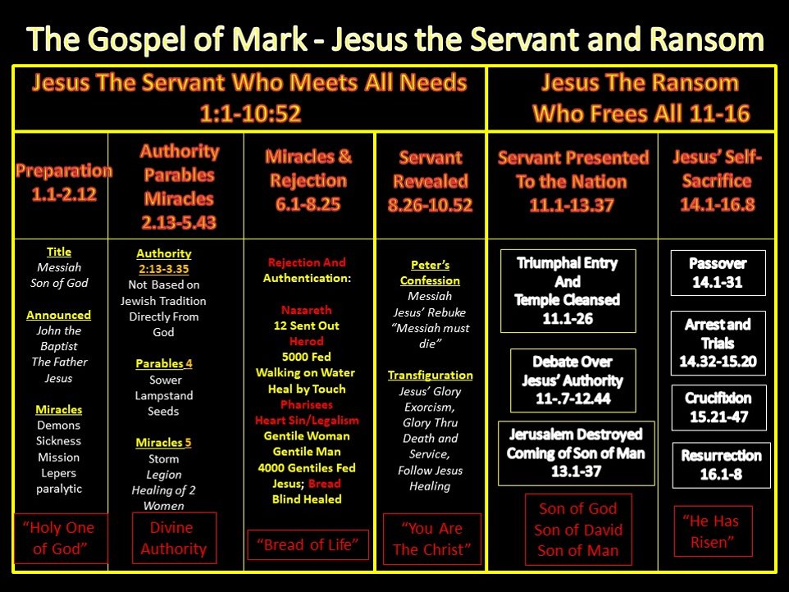
(1) Jesus predicts his death,
(2) the disciples misunderstand the nature of true discipleship,
(3) Jesus teaches that true discipleship is costly and involves suffering

Slide 16
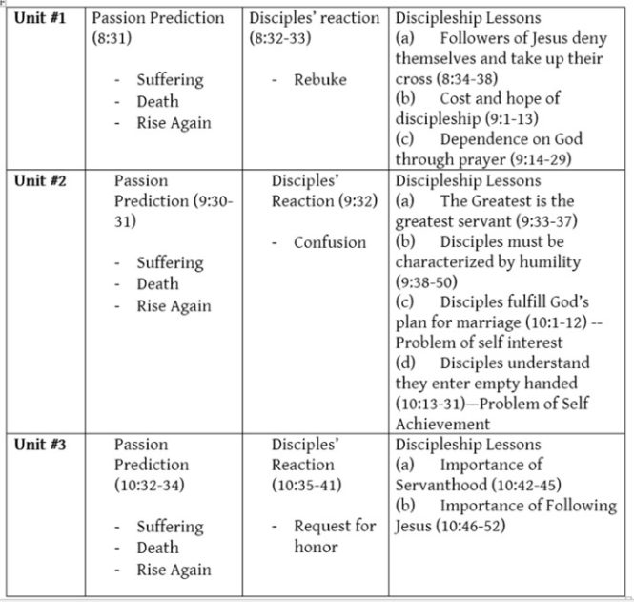

Slide 17


Slide 18
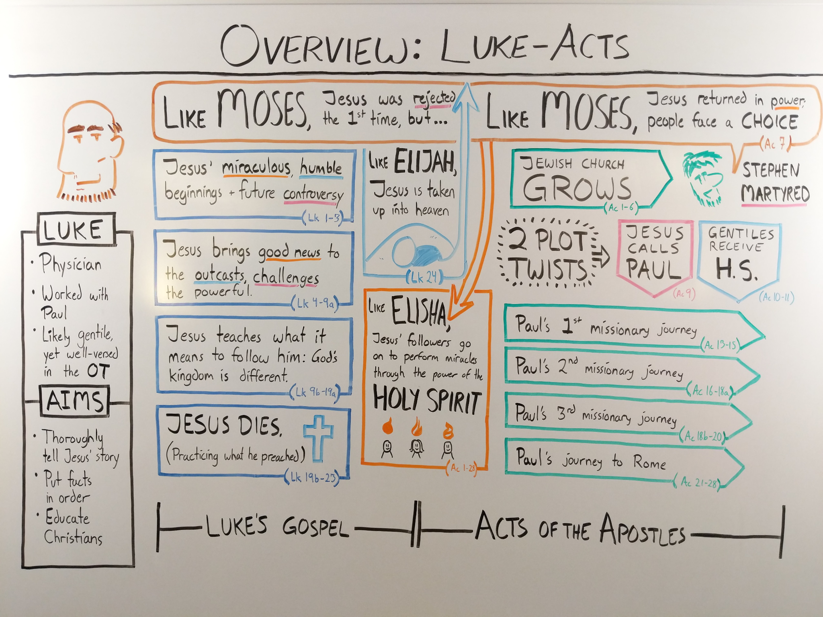

Slide 19
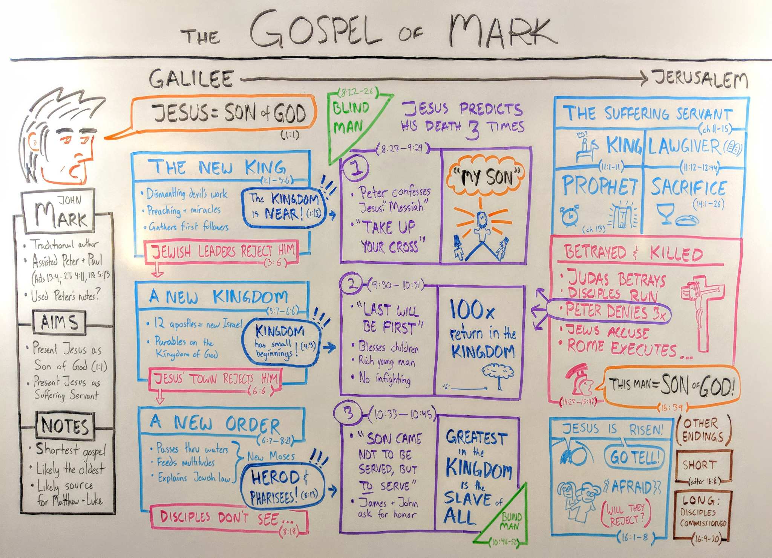

Slide 20


Slide 21
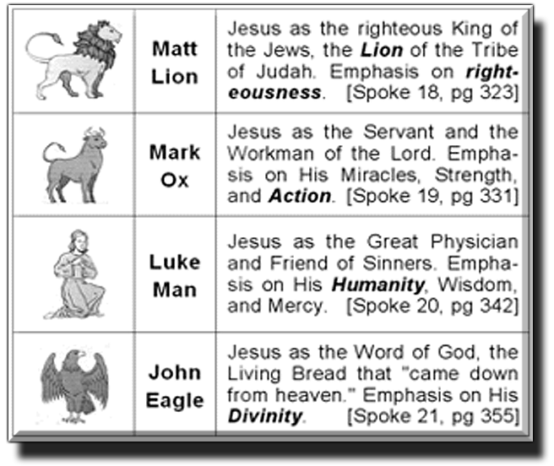
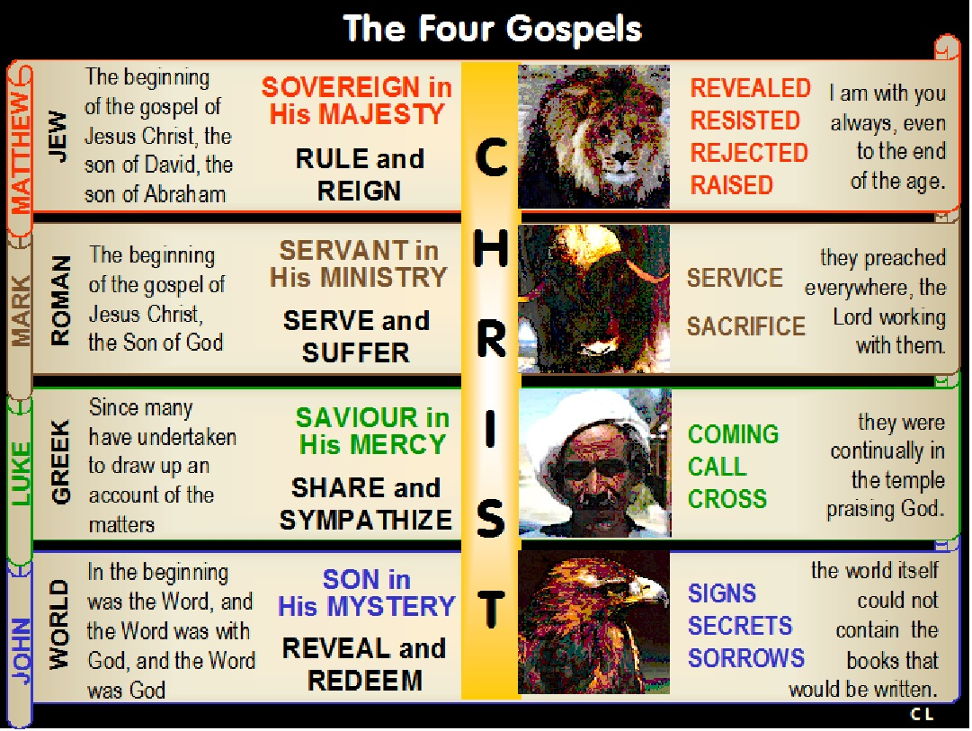

Slide 22
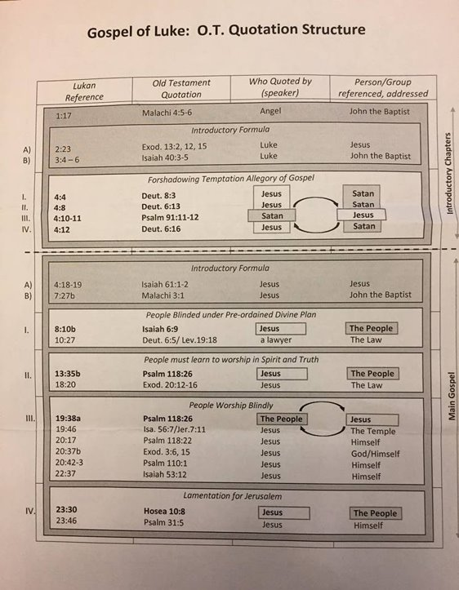

Slide 24
