Slide 1
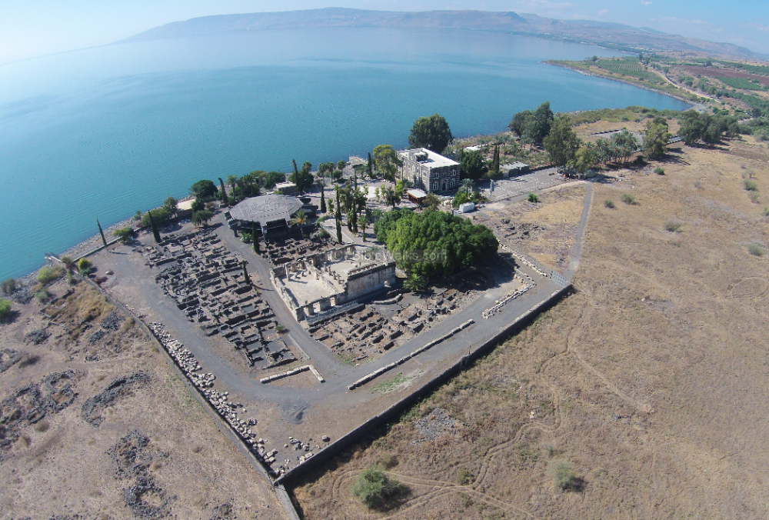
New Testament Survey I:
Gospels and Acts
Dr. Keith Schubert

Slide 2
New Testament Survey I: Gospels and Acts
8/14 Geography and History -
8/21 Synoptics Matthew, Mark, Luke
8/28 Mark Mark
9/4 Matthew Matthew
9/11 Luke Luke
9/18 John John
9/25 Narratives still picking
10/2 Parables still picking
10/9 Sermon on the Mount Matthew 5-7
10/16 Acts Early Church & Peter Acts 1-12
10/23 Travels of Paul Acts 13-28

Slide 3
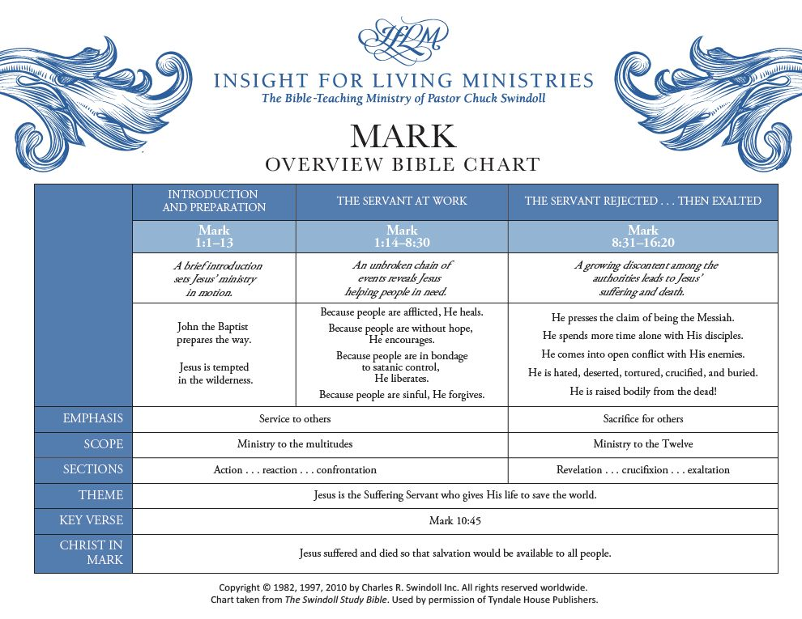

Slide 4
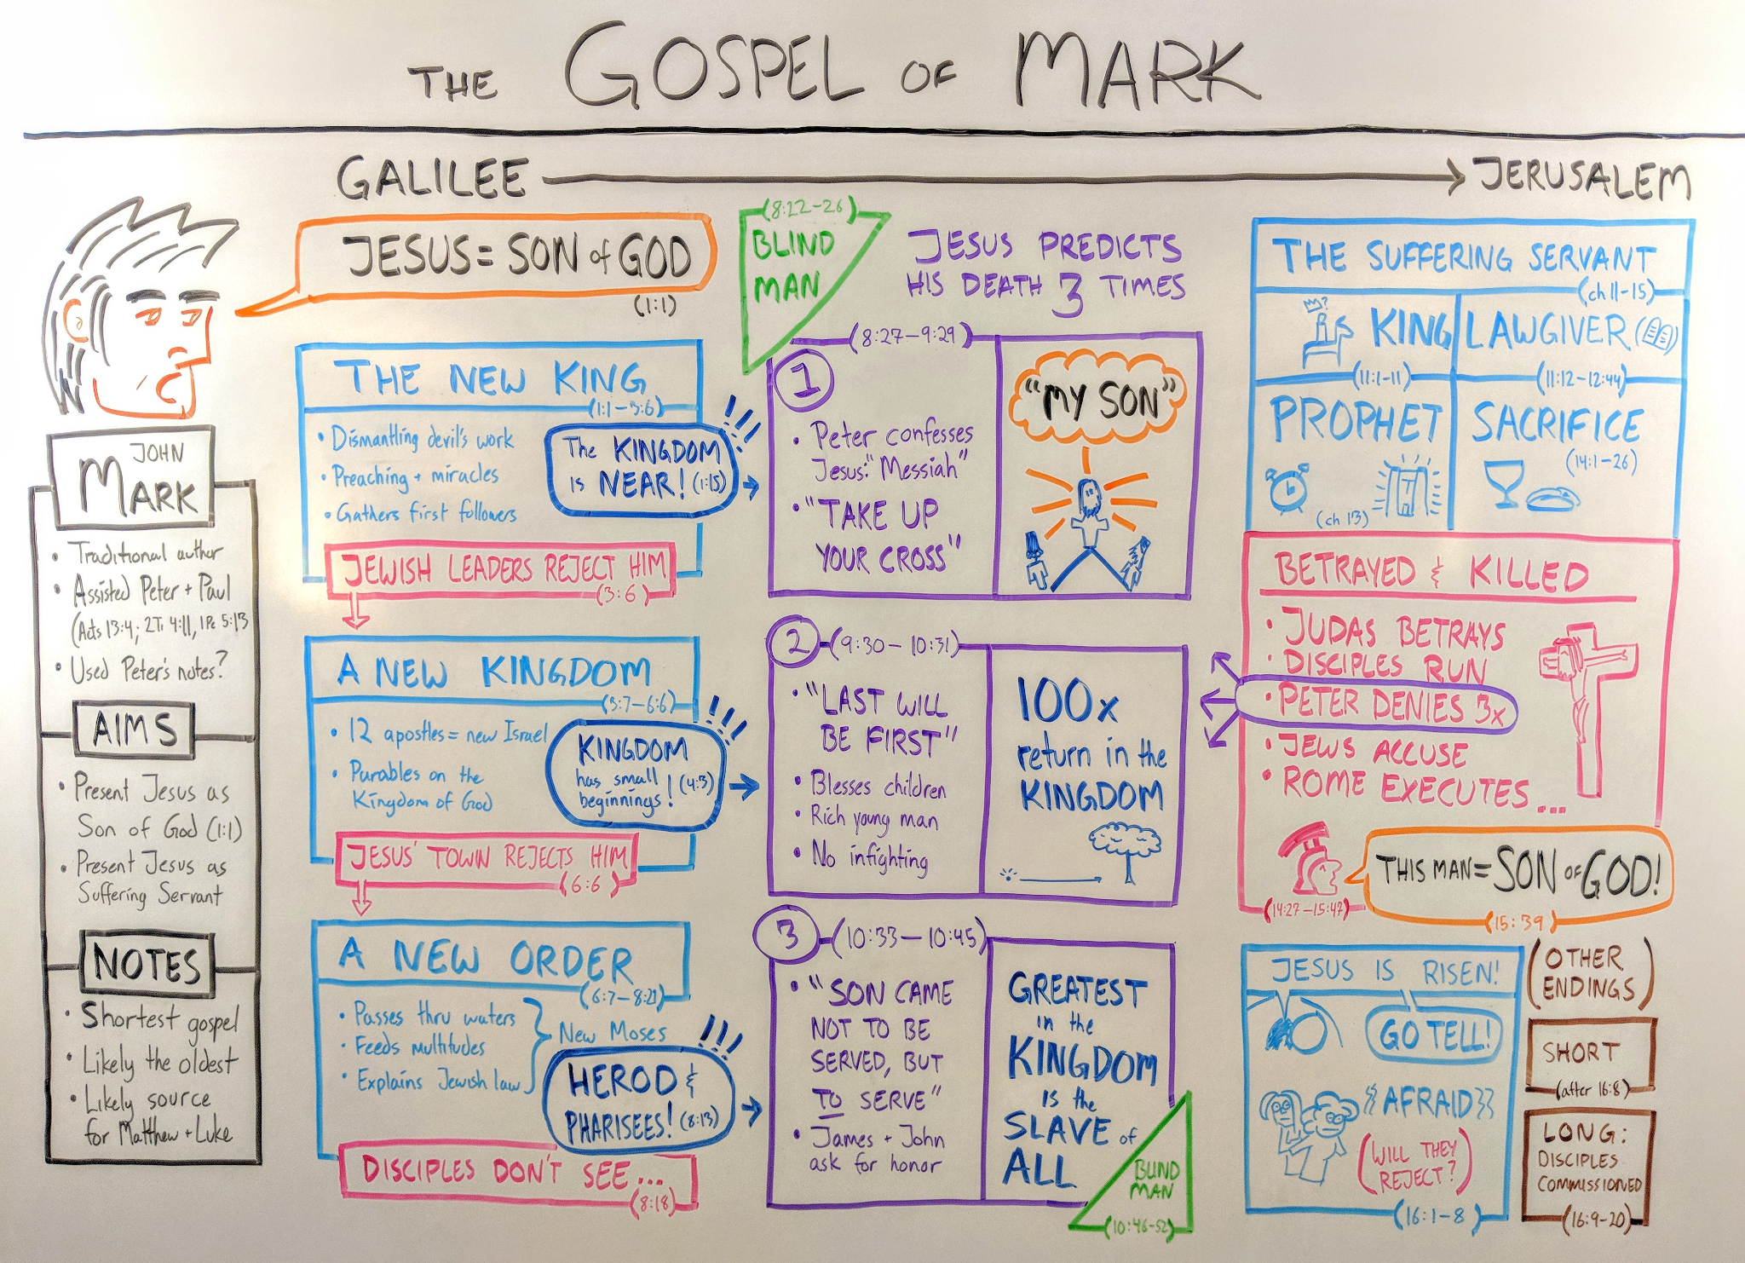
The First Disciples ( 1:16⁠–⁠20 )
Miracles at Capernaum ( 1:21⁠–⁠34 )
Jesus Expels an Unclean Spirit ( 1:21⁠–⁠28 )
Jesus Heals at Peter’s House ( 1:29⁠–⁠34 )
Jesus Prays and Preaches ( 1:35⁠–⁠39 )
The Leper’s Prayer ( 1:40⁠–⁠45 )
Ministry in Capernaum ( 2:1⁠–⁠22 )
Jesus Heals a Paralytic ( 2:1⁠–⁠12 )
Jesus Calls Levi ( 2:13⁠–⁠17 )
Questions about Fasting ( 2:18⁠–⁠20 )
Patches on Wineskins ( 2:21⁠–⁠22 )
The Lord of the Sabbath ( 2:23⁠–⁠3:6 )
Sabbath was Made for Man ( 2:23⁠–⁠27 )
Jesus Heals on the Sabbath ( 3:1⁠–⁠6 )

Slide 5
Multitudes Follow Jesus ( 3:7⁠–⁠12 )
The Twelve Apostles ( 3:13⁠–⁠19 )
A House Divided ( 3:20⁠–⁠27 )
The Unpardonable Sin ( 3:28⁠–⁠30 )
Jesus’ Mothers and Brothers ( 3:31⁠–⁠35 )
Parables
Sower ( 4:1⁠–⁠9 )
Purpose ( 4:10⁠–⁠12 )
Sower Explained ( 4:13⁠–⁠20 )
Lesson of the Lamp ( 4:21⁠–⁠25 )
Seed Growing Secretly ( 4:26⁠–⁠29 )
  Mustard Seed ( 4:30⁠–⁠34 )
The Authority of Jesus ( 4:35⁠–⁠5:20 )
Jesus Calms the Storm ( 4:35⁠–⁠41 )
The Demons and the Pigs ( 5:1⁠–⁠20 )
Jairus’ Daughter ( 5:21⁠–⁠23 )
Woman with Bleeding ( 5:24⁠–⁠34 )
Jairus’ Daughter Raised ( 5:35⁠–⁠43 )
The Rejection at Nazareth ( 6:1⁠–⁠6 )

Slide 6
Ministry of the Twelve ( 6:7⁠–⁠13 )
Beheading of John ( 6:14⁠–⁠29 )
Feeding of the Five Thousand ( 6:30⁠–⁠44 )
Jesus Walks on Water ( 6:45⁠–⁠52 )
Jesus Heals at Gennesaret ( 6:53⁠–⁠56 )
Tradition of the Elders ( 7:1⁠–⁠13 )
What Defiles a Man ( 7:14⁠–⁠23 )
Faith of the Gentile Woman ( 7:24⁠–⁠30 )
Deaf and Mute Man ( 7:31⁠–⁠37 )
Feeding of the Four Thousand ( 8:1⁠–⁠10 )
Demand for a Sign ( 8:11⁠–⁠13 )
Leaven of the Pharisees ( 8:14⁠–⁠21 )

Slide 7
Peter’s Confession of Christ ( 8:27⁠–⁠30 )
1st Prediction of the Passion ( 8:31⁠–⁠33 )
Take Up Your Cross ( 8:34⁠–⁠38 )
The Transfiguration ( 9:1⁠–⁠13 )
The Boy with an Evil Spirit ( 9:14⁠–⁠29 )
2nd Prediction of the Passion ( 9:30⁠–⁠32 )
Greatest in the Kingdom ( 9:33⁠–⁠41 )
Temptations and Trespasses ( 9:42⁠–⁠48 )
Good Salt ( 9:49⁠–⁠50 )
Teachings about Divorce ( 10:1⁠–⁠12 )
Jesus Blesses the Children ( 10:13⁠–⁠16 )
The Rich Young Man ( 10:17⁠–⁠31 )
3rd Prediction of the Passion ( 10:32⁠–⁠34 )
The Two and the Ten ( 10:35⁠–⁠45 )

Slide 8
The Triumphal Entry ( 11:1⁠–⁠11 )
Jesus Curses the Fig Tree ( 11:12⁠–⁠14 )
Jesus Cleanses the Temple ( 11:15⁠–⁠19 )
The Withering Fig Tree ( 11:20⁠–⁠25 )
Jesus’ Authority Challenged ( 11:27⁠–⁠33 )
Parable of the Wicked Tenants ( 12:1⁠–⁠12 )
P&H? Taxes to Caesar ( 12:13⁠–⁠17 )
Sad? Resurrection ( 12:18⁠–⁠27 )
Sc? Greatest Commandment ( 12:28⁠–⁠34 )
J? Whose Son Is the Christ? ( 12:35⁠–⁠37 )
Beware of the Scribes ( 12:38⁠–⁠40 )
The Widow’s Offering ( 12:41⁠–⁠44 )
Olivet Discourse ( 13 )
The Plot to Kill Jesus ( 14:1⁠–⁠2 )
Jesus Anointed at Bethany ( 14:3⁠–⁠9 )
Judas Agrees to Betray ( 14:10⁠–⁠11 )
Preparing the Passover ( 14:12⁠–⁠16 )
Judas the Betrayer ( 14:17⁠–⁠21 )
Bread and Cup After Supper ( 14:22⁠–⁠26 )

Slide 9
Jesus Predicts Peter’s Denial ( 14:27⁠–⁠31 )
Jesus Prays at Gethsemane ( 14:32⁠–⁠42 )
Betrayal of Jesus ( 14:43⁠–⁠52 )
Jesus before the Sanhedrin ( 14:53⁠–⁠65 )
Peter Denies Jesus ( 14:66⁠–⁠72 )
Jesus before Pilate ( 15:1⁠–⁠15 )
Soldiers Mock Jesus ( 15:16⁠–⁠20 )
Crucifixion ( 15:21⁠–⁠41 )
Burial of Jesus ( 15:42⁠–⁠47 )
The Women at the Tomb ( 16:1⁠–⁠8 )

Slide 10
