Slide 1
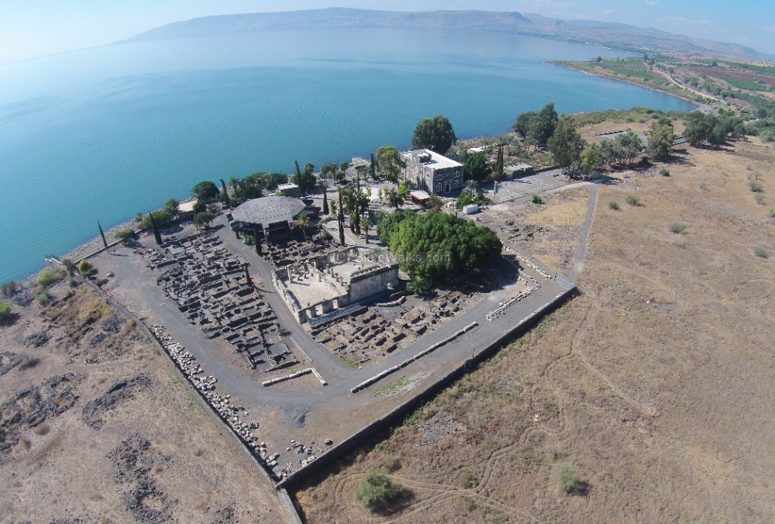
New Testament Survey I:
Gospels and Acts
Dr. Keith Schubert

Slide 2
New Testament Survey I: Gospels and Acts
8/14 Geography and History -
8/21 Synoptics Matthew, Mark, Luke
8/28 Mark Mark
9/4 Matthew Matthew
9/11 Luke Luke
9/18 John John
9/25 Narratives still picking
10/2 Parables still picking
10/9 Sermon on the Mount Matthew 5-7
10/16 Acts Early Church & Peter Acts 1-12
10/23 Travels of Paul Acts 13-28

Slide 3
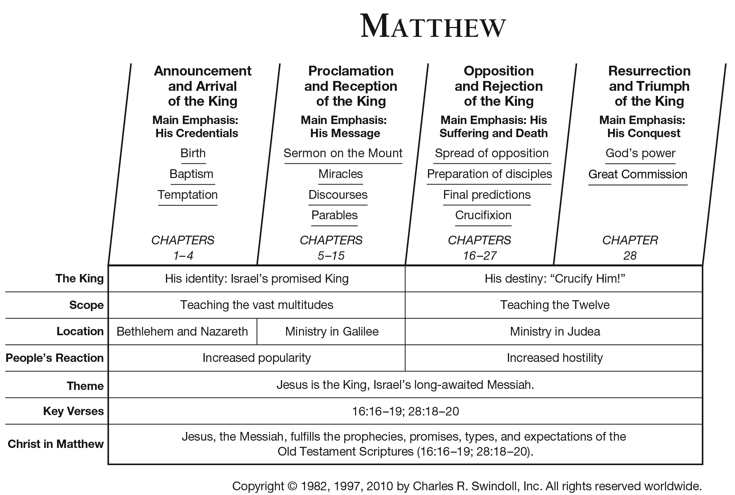

Slide 4
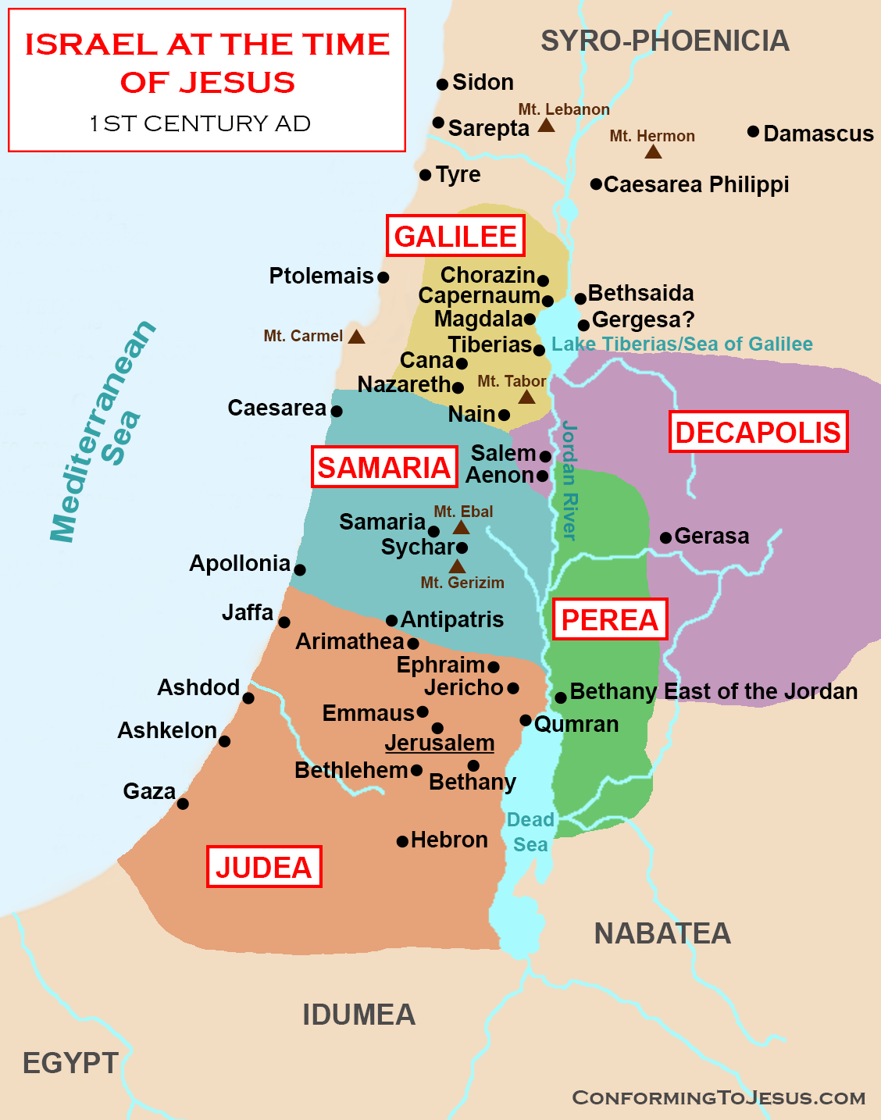
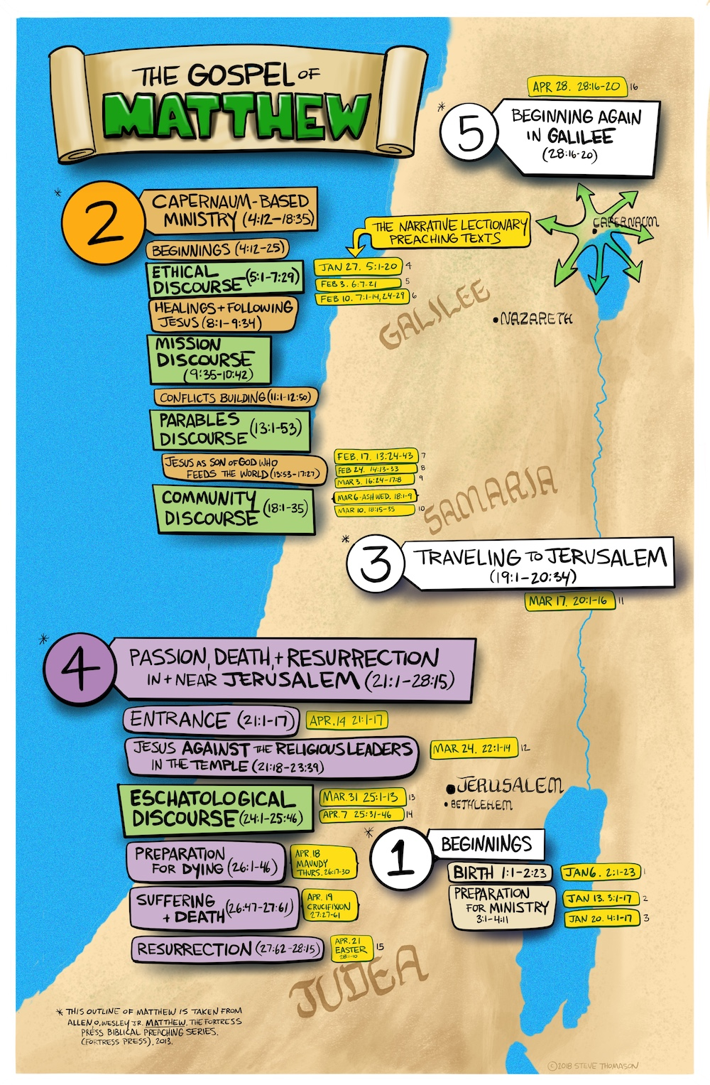

Slide 5
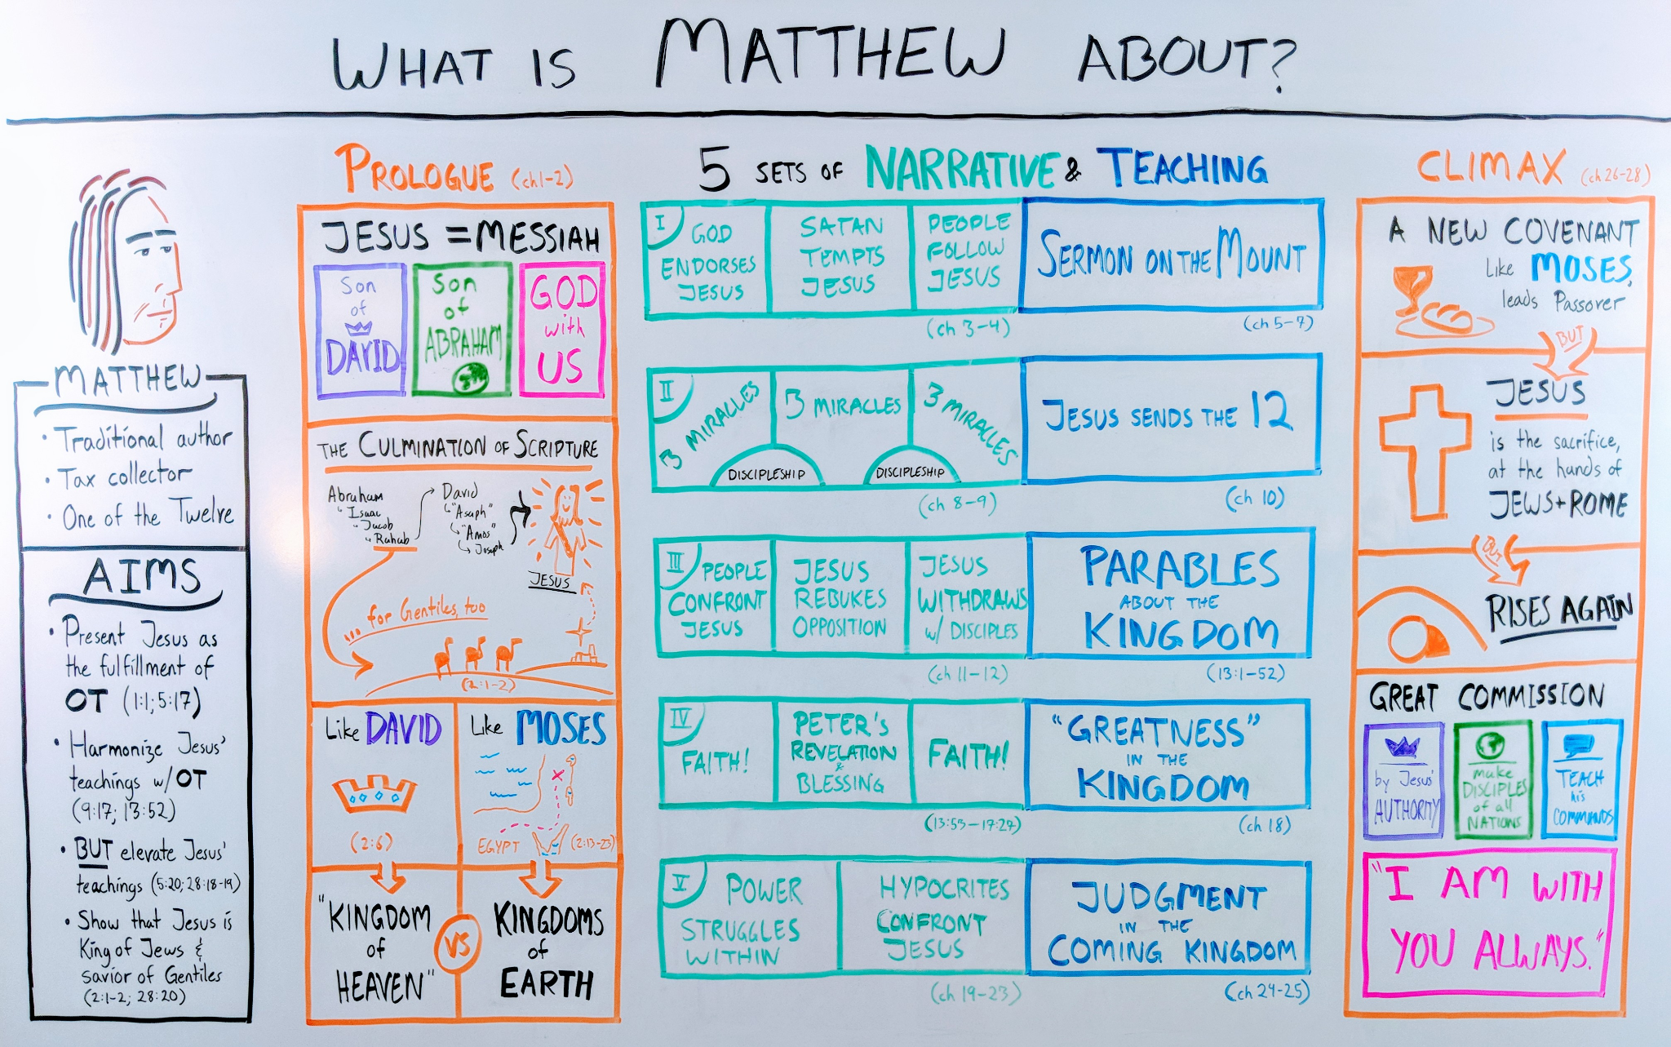

Slide 6
Matthew
Intro/Birth (1-2)
  Geneaology, Announcement to Joseph
  Visit of Magi, Flight to Egypt, Murder of Children
Preparation (3-4)
  John the Baptist, Baptism
  Temptation, Capernaum, Disciples, Preach
Sermon on Mount (5-7)
  Beatitudes, Salt & light, but I say
  Towards God, Treasure, Worry
  Judgement, ASK, Gates/fruits/rocks
Miracles and discipleship (8-9)
  Leper, centurion, healing, cost, storm, demoniacs
  Paralytic, Matthew, fasting, healings
Commission (10)
  12, sending, persecution, discipleship

Slide 7
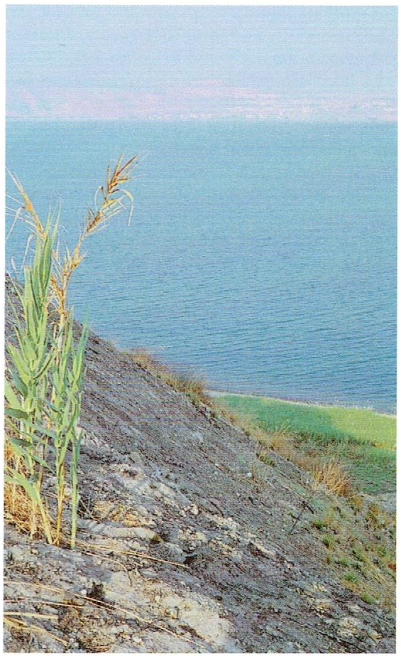
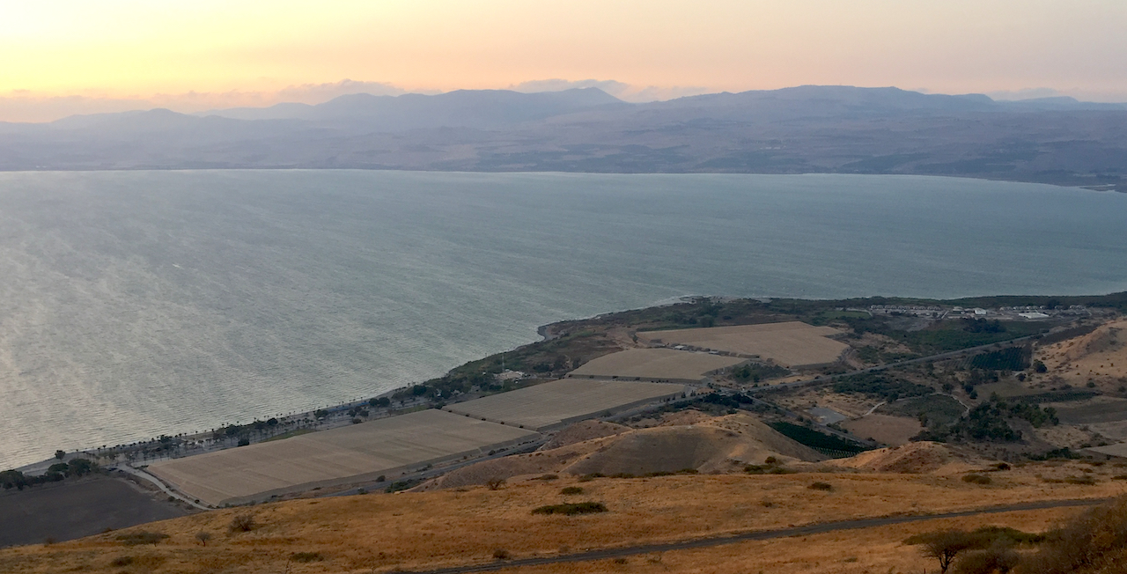
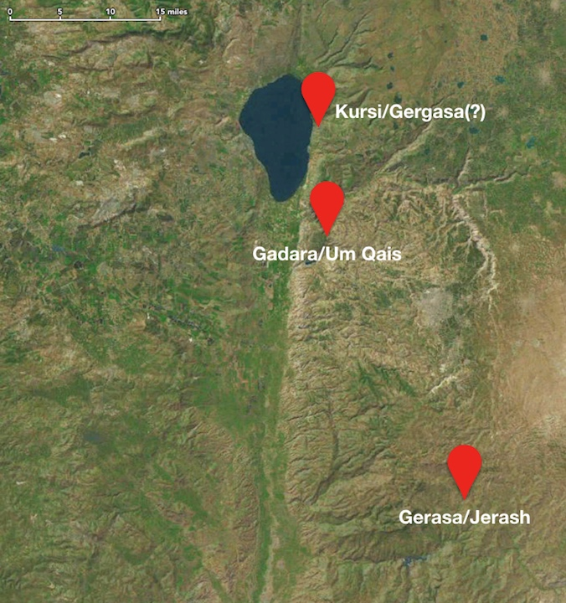
Matt. 8:28-34
Mark 5:1-20
Luke 8:26-39

Slide 8
Matthew
Questions (11-12)
  John the Baptist, woe, come to Me
  Sabbath, kingdom, heart, family
Parables (13:1-53)
  Sower, parables, explain, tares, mustard & leaven, explain, treasure, dragnet
Rejection path to cross (13:54-17)
  Nazareth
  John the Baptist, 5k, Walk on water
  God vs man, Canaanite, heal, 4k
  Test, Confession, C&R, take up cross
  Transfiguration, demon, temple tax
Humility & Forgiveness (18)
  Greatest, stumbling blocks, lost sheep, discipline, forgiveness

Slide 9
Matthew
Miracles and discipleship (19-23)
  Divorce, bless children, RYR, 1st last
  Laborers, C&R, left&right, sight
  Triumph entry, cleans, fig tree, authority, 2 sons, vine growers,
  Wedding feast, taxes, whose wife?, greatest command
  Denounce, woes, lament
Olivet Discourse (24-25)
  Signs, fig, ready
  10 virgins, talents, judgement
Passion, Resurrection, Commission (26-28)
  Plot, perfume, Judas, Passover/LS, Gethsemane, arrest, Caiaphas, denials
  Judas 2, Pilate, mocking, Crucifixion, burial
  Resurrection, Great Commission

