Slide 1
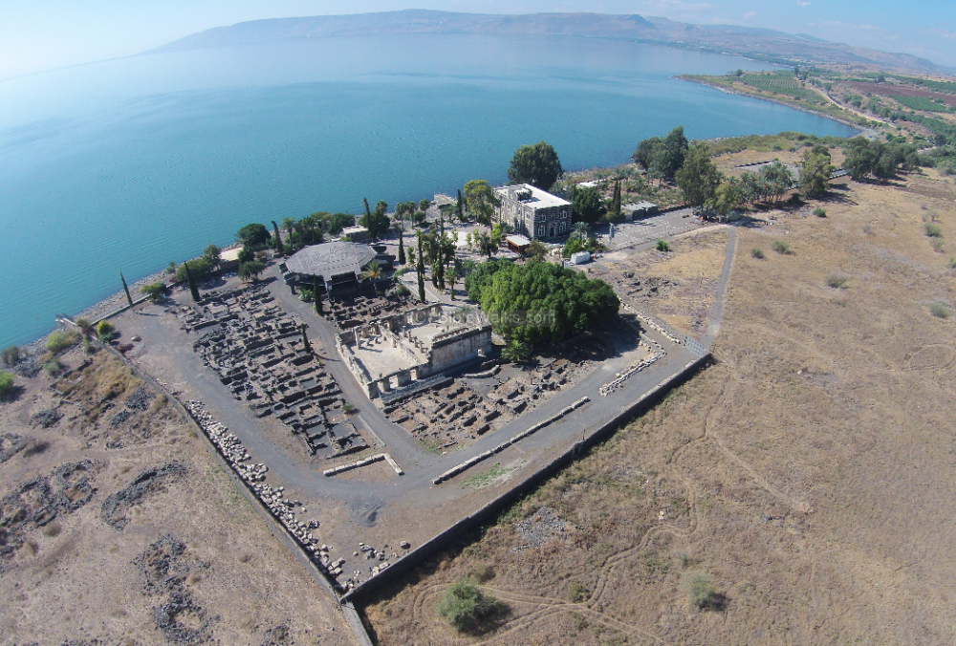
New Testament Survey I:
Gospels and Acts
Dr. Keith Schubert

Slide 2
New Testament Survey I: Gospels and Acts
8/14 Geography and History -
8/21 Synoptics Matthew, Mark, Luke
8/28 Mark Mark
9/4 Matthew Matthew
9/11 Luke Luke
9/18 John John
9/25 Narratives still picking
10/2 Parables still picking
10/9 Sermon on the Mount Matthew 5-7
10/16 Acts Early Church & Peter Acts 1-12
10/23 Travels of Paul Acts 13-28

Slide 3
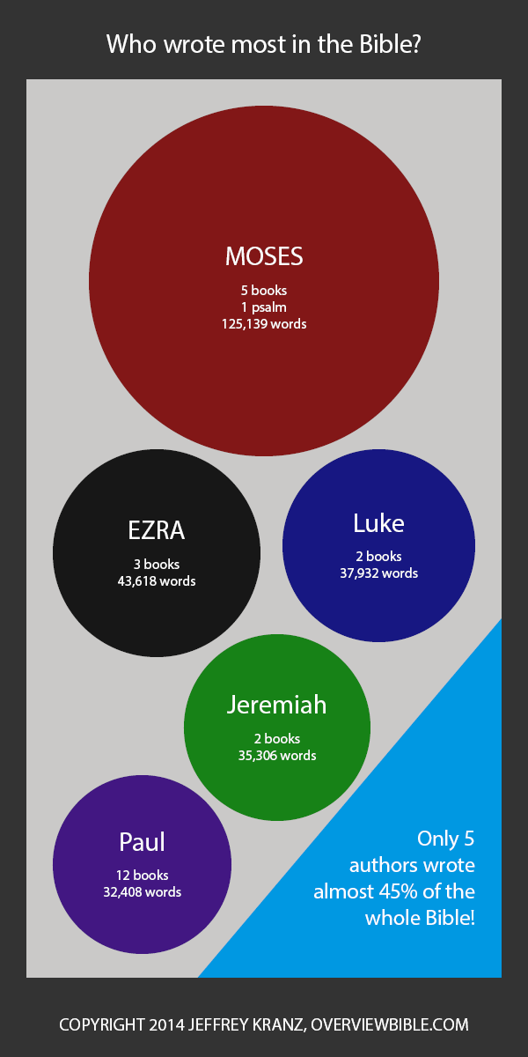
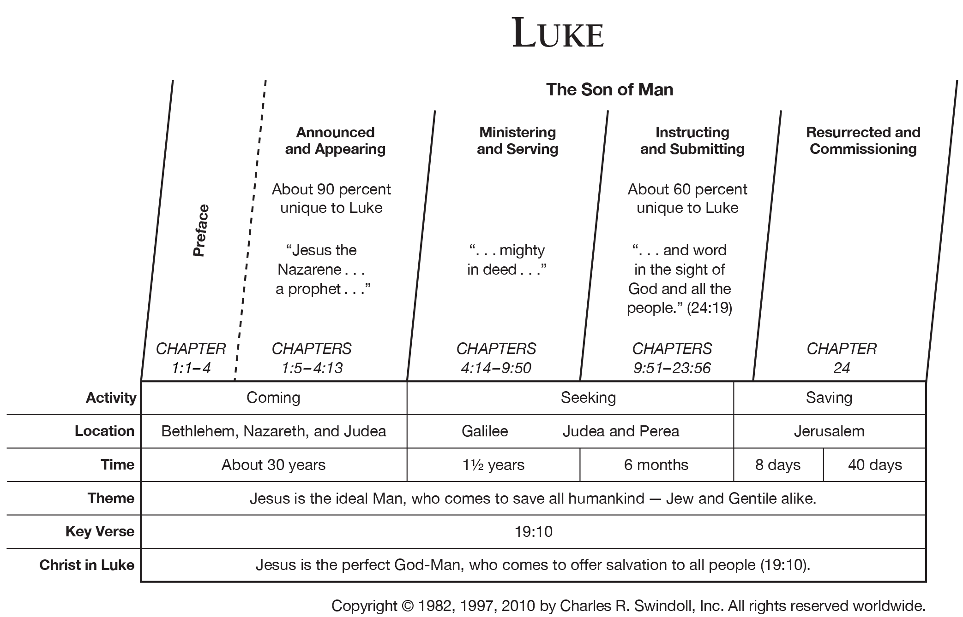

Slide 4
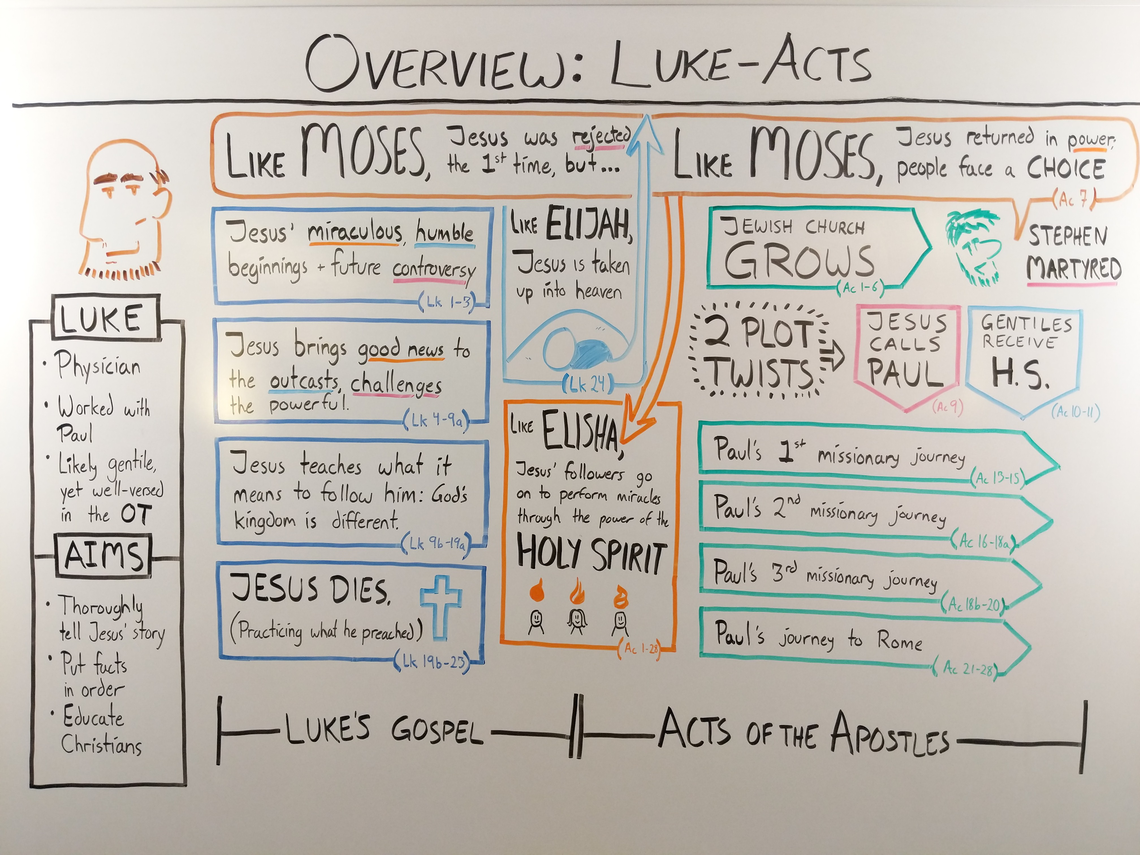

Slide 5
Luke: Introduction
Dedication to Theophilus ( 1:1⁠–⁠4 )
Births: John & Jesus
Announce John’s Birth ( 1:5⁠–⁠25 )
Announce Jesus’ Birth ( 1:26⁠–⁠38 )
Mary Visits Elizabeth ( 1:39⁠–⁠45 )
Mary’s Song ( 1:46⁠–⁠56 )
Birth of John ( 1:57⁠–⁠66 )
Zechariah’s Song ( 1:67⁠–⁠80 )
Birth in Bethlehem ( 2:1⁠–⁠7 )
Shepherds & Angels ( 2:8⁠–⁠20 )
Temple Presentation ( 2:21⁠–⁠24 )
Prophecy of Simeon ( 2:25⁠–⁠35 )
Prophecy of Anna ( 2:36⁠–⁠38 )
Return to Nazareth ( 2:39⁠–⁠40 )
Jesus at the Temple ( 2:41⁠–⁠52 )
John the Baptist ( 3:1⁠–⁠20 )
Baptism of Jesus ( 3:21⁠–⁠22 )
Genealogy of Jesus ( 3:23⁠–⁠38 )
Temptation (4:1-13)

Slide 6
Luke: Jesus in Galilee
Disciples
Rejection at Nazareth ( 4:14–⁠30 ) Cast Out Unclean Spirit ( 4:31⁠–⁠37 )
Heals at Peter’s House ( 4:38⁠–⁠44 )
First Disciples ( 5:1⁠–⁠11 )
Leper’s Prayer ( 5:12⁠–⁠16 )
Paralytic ( 5:17⁠–⁠26 )
Calling Levi ( 5:27⁠–⁠32 )
Fasting ( 5:33⁠–⁠35 )
Patches & Wineskins ( 5:36⁠–⁠39 )
Lord of the Sabbath ( 6:1⁠–⁠5 )
Heals on the Sabbath ( 6:6⁠–⁠11 )
Twelve Apostles ( 6:12⁠–⁠16 )
Sermon on the Plain
Healing Multitudes ( 6:17⁠–⁠19 )
Beatitudes ( 6:20⁠–⁠23 )
Woes to the Satisfied ( 6:24⁠–⁠26 )
Laws of the Kingdom ( 6:27⁠–⁠36 )
Judging ( 6:37⁠–⁠42 )
Tree and Its Fruit ( 6:43⁠–⁠45 )
House on the Rock ( 6:46⁠–⁠49 )
Miracles: Capernaum & Nain
Faith of the Centurion ( 7:1⁠–⁠10 )
Raises a Widow’s Son ( 7:11⁠–⁠17 )

Slide 7
Luke: Jesus in Galilee
John’s Inquiry ( 7:18⁠–⁠23 )
Testifies about John ( 7:24⁠–⁠35 )
Anointing Jesus ( 7:36⁠–⁠50 )
Women Minister to Jesus ( 8:1⁠–⁠3 )
Parables
Parable of the Sower ( 8:4⁠–⁠15 )
Lesson of the Lamp ( 8:16⁠–⁠18 )
Jesus’ Mom & Brothers ( 8:19⁠–⁠21 )
Authority
Jesus calms the Storm ( 8:22⁠–⁠25 )
Demons and the Pigs ( 8:26⁠–⁠39 )
Healing
Jairus’ Daughter Dying ( 8:40⁠–⁠42 )
Woman with Bleeding ( 8:43⁠–⁠48 )
Jairus’ Daughter Raised ( 8:49⁠–⁠56 )
Ministry of the Twelve ( 9:1⁠–⁠6 )
Herod Tries to See Jesus ( 9:7⁠–⁠9 )
Feeding of the Five Thousand ( 9:10⁠–⁠17 )
Peter’s Confession of Christ ( 9:18⁠–⁠20 )
1st Passion Prediction ( 9:21⁠–⁠22 )
Take Up Your Cross ( 9:23⁠–⁠27 )
Transfiguration ( 9:28⁠–⁠36 )
Boy with an Evil Spirit ( 9:37⁠–⁠42 )
2nd Passion Prediction ( 9:43⁠–⁠45 )
Greatest in the Kingdom ( 9:46⁠–⁠50 )

Slide 8
Luke: Way to Jerusalem 1
Samaritans
Samaritans Reject Jesus ( 9:51⁠–⁠56 )
Cost of Discipleship ( 9:57⁠–⁠62 )
Sending the Seventy-Two ( 10:1⁠–⁠12 )
Woe to the Unrepentant ( 10:13⁠–⁠16 )
Joyful Return ( 10:17⁠–⁠20 )
Prayer of Thanksgiving ( 10:21⁠–⁠24 )
Parable:Good Samaritan ( 10:25⁠–⁠37 )
Martha and Mary ( 10:38⁠–⁠42 )
Teaching & Opposition
The Lord’s Prayer ( 11:1⁠–⁠4 )
Ask, Seek, Knock ( 11:5⁠–⁠13 )
House Divided ( 11:14⁠–⁠23 )
Unclean Spirit Returns ( 11:24⁠–⁠26 )
True Blessedness ( 11:27⁠–⁠28 )
Sign of Jonah ( 11:29⁠–⁠32 )
Lamp of the Body ( 11:33⁠–⁠36 )
Woe to Pharisees & Lawyers ( 11:37⁠–⁠54 )

Slide 9
Luke: Way to Jerusalem 1
The Leaven of the Pharisees ( 12:1⁠–⁠3 )
Fear God Alone ( 12:4⁠–⁠7 )
Confessing Christ ( 12:8⁠–⁠12 )
Parable of the Rich Fool ( 12:13⁠–⁠21 )
Do Not Worry ( 12:22⁠–⁠34 )
Readiness Parables
Watchful Servant ( 12:35⁠–⁠38 )
Thief in the Night ( 12:39⁠–⁠40 )
Wise Managers ( 12:41⁠–⁠48 )
Not Peace but Division ( 12:49⁠–⁠53 )
Interpreting Time ( 12:54⁠–⁠56 )
Reconciling w/ Adversary ( 12:57⁠–⁠59 )
Call to Repentance ( 13:1⁠–⁠5 )
Parable: Barren Fig Tree ( 13:6⁠–⁠9 )
Woman healed on Sabbath ( 13:10⁠–⁠17 )
Kingdom of God Parables
Mustard Seed ( 13:18⁠–⁠19 )
Leaven ( 13:20⁠–⁠21 )

Slide 10
Luke: Way to Jerusalem 2
Living in the Kingdom of God
The Narrow Door ( 13:22⁠–⁠30 )
Lament over Jerusalem ( 13:31⁠–⁠35 )
Pharisee’s house
Heal on Sabbath ( 14:1⁠–⁠6 )
Parable: Guests seats ( 14:7⁠–⁠11 )
Parable: Inviting poor ( 14:12⁠–⁠14 )
Parable: Banquet ( 14:15⁠–⁠24 )
Cost of Discipleship ( 14:25⁠–⁠33 )
Good Salt ( 14:34⁠–⁠35 )
Parable’s of Lost
Lost Sheep ( 15:1⁠–⁠7 )
Lost Coin ( 15:8⁠–⁠10 )
Prodigal Son ( 15:11⁠–⁠32 )
Shrewd Manager ( 16:1⁠–⁠13 )
Lovers of Money
Law and the Prophets ( 16:14⁠–⁠18 )
Rich Man and Lazarus ( 16:19⁠–⁠31 )
Temptations and Trespasses ( 17:1⁠–⁠4 )
Power of Faith ( 17:5⁠–⁠10 )

Slide 11
Luke: Way to Jerusalem 3
Samaria/Galilee border
The Ten Lepers ( 17:11⁠–⁠19 )
Coming of the Kingdom ( 17:20⁠–⁠37 )
Persistent Widow ( 18:1⁠–⁠8 )
Entrance into the Kingdom
Pharisee and the Tax Collector ( 18:9⁠–⁠14 )
Little Children ( 18:15⁠–⁠17 )
Rich Young Ruler ( 18:18⁠–⁠30 )
3rd Passion Prediction ( 18:31⁠–⁠34 )
Blind Beggar ( 18:35⁠–⁠43 )
Zacchaeus ( 19:1⁠–⁠10 )
Parable of the Ten Minas ( 19:11⁠–⁠27 )

Slide 12
Luke: Ministry in Jerusalem
Arrive in Jerusalem
Triumphal Entry ( 19:28⁠–⁠40 )
Weep over Jerusalem ( 19:41⁠–⁠44 )
Cleans the Temple ( 19:45⁠–⁠48 )
Questioning
Authority Challenged ( 20:1⁠–⁠8 )
Parable: Wicked Tenants ( 20:9⁠–⁠18 )
Paying Taxes to Caesar ( 20:19⁠–⁠26 )
Question the Resurrection ( 20:27⁠–⁠40 )
Whose Son Is the Christ? ( 20:41⁠–⁠44 )
Beware the Scribes ( 20:45⁠–⁠47 )
Poor Widow’s Offering ( 21:1⁠–⁠4 )
Temple Destruction Foretold
Let No Man Deceive You ( 21:5⁠–⁠9 )
Witnessing to All Nations ( 21:10⁠–⁠19 )
Destruction of Jerusalem ( 21:20⁠–⁠24 )
Return of the Son of Man ( 21:25⁠–⁠28 )
Lesson of the Fig Tree ( 21:29⁠–⁠33 )
Be Watchful for the Day ( 21:34⁠–⁠38 )

Slide 13
Luke: Ministry in Jerusalem
Arrive in Jerusalem
Plot to Kill Jesus ( 22:1⁠–⁠6 )
Preparing the Passover ( 22:7⁠–⁠13 )
Last Supper
Bread and the Cup ( 22:14⁠–⁠23 )
Who Is the Greatest? ( 22:24⁠–⁠30 )
Predict Peter’s Denial ( 22:31⁠–⁠38 )
Mount of Olive
Jesus Prays ( 22:39⁠–⁠46 )
Betrayal of Jesus ( 22:47⁠–⁠53 )
Long Night
( 22:54⁠–⁠23:25 )
Peter Denies Jesus ( 22:54⁠–⁠62 )
Soldiers Mock Jesus ( 22:63⁠–⁠65 )
before the Sanhedrin ( 22:66⁠–⁠71 )
before Pilate ( 23:1⁠–⁠5 )
before Herod ( 23:6⁠–⁠12 )
Crowd Chooses Barabbas ( 23:13⁠–⁠25 )

Slide 14
Luke: Crucifixion
Crucifixion ( 23:26⁠–⁠49 )
Burial of Jesus ( 23:50⁠–⁠56 )
Empty Tomb ( 24:1⁠–⁠12 )
Road to Emmaus ( 24:13⁠–⁠35 )
Disciples ( 24:36⁠–⁠49 )
Ascension ( 24:50⁠–⁠53 )

