Slide 1
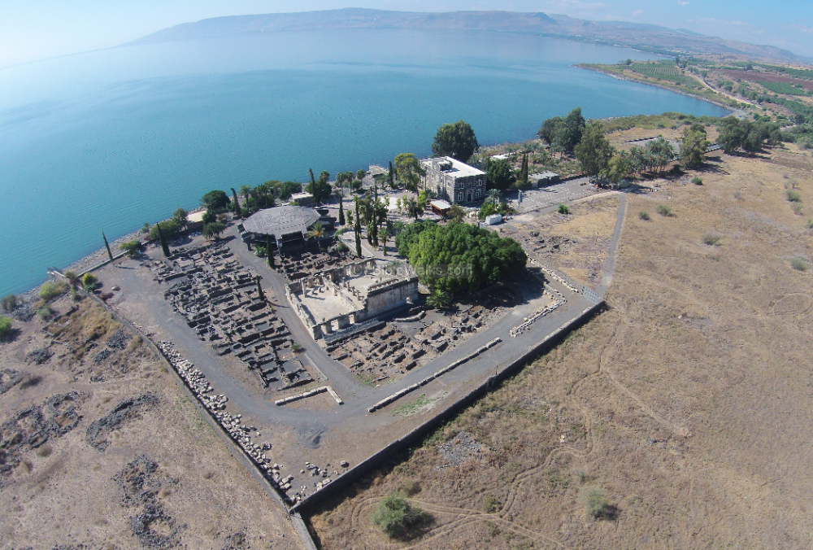
New Testament Survey I:
Gospels and Acts
Dr. Keith Schubert

Slide 2
New Testament Survey I: Gospels and Acts
8/14 Geography and History -
8/21 Synoptics Matthew, Mark, Luke
8/28 Mark Mark
9/4 Matthew Matthew
9/11 Luke Luke
9/18 John John
9/25 Narratives still picking
10/2 Parables still picking
10/9 Sermon on the Mount Matthew 5-7
10/16 Acts Early Church & Peter Acts 1-12
10/23 Travels of Paul Acts 13-28

Slide 3
Differences
Style
  Personal interaction vs Public teaching
  Lengthy discourses (Kaphalaia: Matthew has 68; Mark has 48, Luke has 83, and John has 18 or 19)
  Clear divinity statements
Not used:
  temptation,
  sermon on mount,
  Lord’s prayer,
  transfiguration,
  institution of Lord’s Supper,
  no casting out demons,
  narrative parables (John 15:1-8 not technically a parables)
Unique extras
  Starts at creation
  Early Galilean ministry (John 2-4)
  Earler ministry visits of Jesus to Jerusalem (prior to Passion Week)
    Three Passovers (2, 6, 11-19)
    Possible 4th (5)
  Bread of Life (ch 6)
  Resurrection of Lazarus (John 11)
  Teaching at Supper (John 13)
  Farewell Discourse (John 14-17)
  I am sayings
  Washing feet
  Emphasis on Holy Spirit

Slide 4
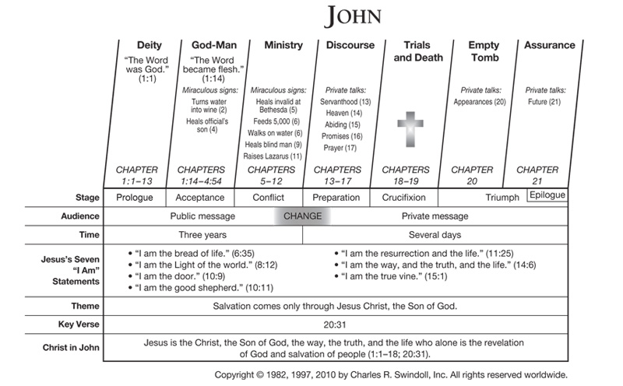

Slide 5
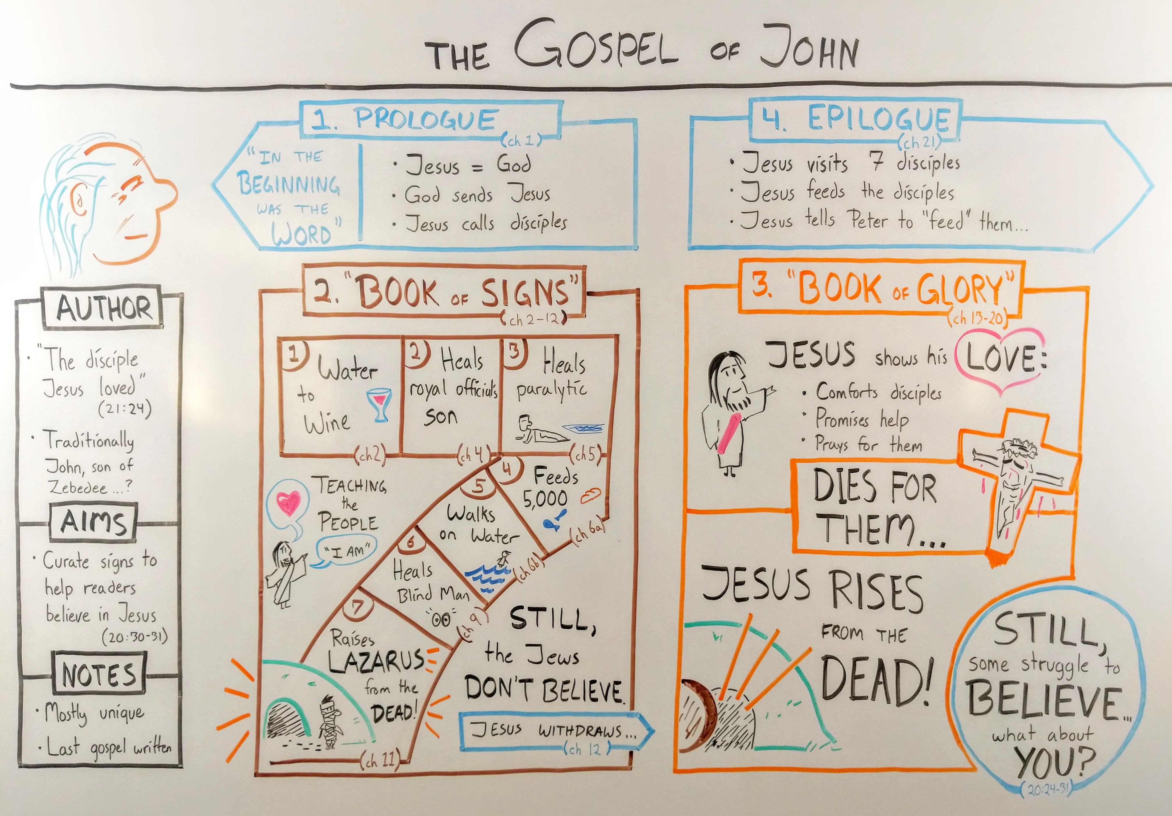

Slide 6
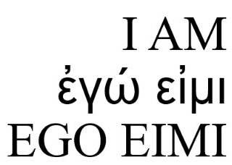
The Seven I AM Sayings
“I am the bread of life. He who comes to Me shall never hunger, and he who believes in Me shall never thirst” (John 6:35, 41, 48, 51). After feeding of 5k.
“I am the light of the world. He who follows Me shall not walk in darkness, but have the light of life” (John 8:12, 9:5). During Feast of Tabernacles, great menorah.
“I am the door of the sheep. All who ever came before Me are thieves and robbers, but the sheep did not hear them. I am the door. If anyone enters by me, he will be saved and will go in and out and find pasture” (John 10:7-9). During discourse with unfit leaders, excluded.
“I am the good shepherd. The good shepherd gives His life for the sheep…I am the good shepherd; and I know my sheep, and am known by My own.” (John 10:11, 14). Ibid, protect selves.
“I am the resurrection and the life. He who believes in Me, though he may die, he shall live” (John 11:25). Lazarus’s grave
“I am the way, the truth, and the life. No one comes to the Father except through Me” (John 14:6). Disciples do not know where Jesus is going.
“I am the true vine and My Father is the vinedresser… I am the vine, you are the branches. He who abides in Me, and I in him, bears much fruit; for without Me you can do nothing” (John 15:1-5). Final discourse, OT refs to Israel as God’s vine (Psalm 80:8; Isaiah 5:1-7; Ezekiel 15; Hosea 10:1).

Slide 7
Pericope Adulterae
John 7:53–8:11
  Interrupts narrative
  Different words
    “the scribes”
  Little manuscript support for it in John
    First surviving Greek or Latin appearance in this place in John is Codex Bezea (4th-5th)
      Next Greek Gospel inclusion is the 8th century
      Later annotators marked in margins not for liturgy
    Not in P66 or P75 from 100s-200s
    Not in Sinaiticus or Vaticanus from 300’s
    Appears in all but one Vulgate (latin text) of late 4th century and in Vetus Latina (late 4th)
    Some Byzantine manuscripts (4th-10th) have text as its own Kephalaion
    Earliest translations of the Greek New Testament (Syriac, Coptic, Armenian, Old Latin, and Georgian) omit it
  A few manuscripts include these verses, wholly or in part, after John 7:36 (ms. 225), John 7:44 ( several Georgian mss.), John 21:25 (1 565 1076 1570 1582 Armenian mss.), Luke 21:38 (Ferrar Group, 11th-15th) or Luke 24:53(a corrector of manuscript 1333).
  Early church fathers debated
    Origen (2nd-3rd) marked as an addition
    Tertullian (2nd-3rd), Cyprian (early 3rd), any eastern church father never quoted
    John Chrysostom (4th-5th), Cyril of Alexandria (4th-5th) didn’t have in commentaries on John
    Referenced in the Didascalia Apostolorum (3rd)
    Eusebius (3rd-4th) cited Papias (1st-2nd) as saying a similar story was in the Gospel of the Hebrews (lost)
    Didymus the Blind (4th) says the story was “in certain gospels”
    Jerome (4th) noted it was in many Latin manuscripts and chose to include it in Vulgate
    Augustine (4th to 5th) proposed it was removed by those who didn’t want a passage forgiving adultery
    Pacian of Barcelona (4th)Hilary of Poitiers (4th), Ambrose (4th), Ambrosiaster (4th), Leo the Great (5th), Gregory the Great (6th) quoted or mentioned
  Favorite true story of Jesus not in the Bible
  Adultery punishment: Leviticus 20:10, Deuteronomy 22:23-4

Slide 8
John 21
John 21:15
  Agapas more than these
  Philo
  feed (boske) my lambs (arnia)
John 21:16
  Agapas
  Philo
  shepherd (poimaine) my sheep (probata)
John 21:17
  Phileis
  grieved because the third time He said Phileis
  all things you oidas, you ginoskeis
  Philo
  feed (boske) my sheep (probata)

