Slide 1
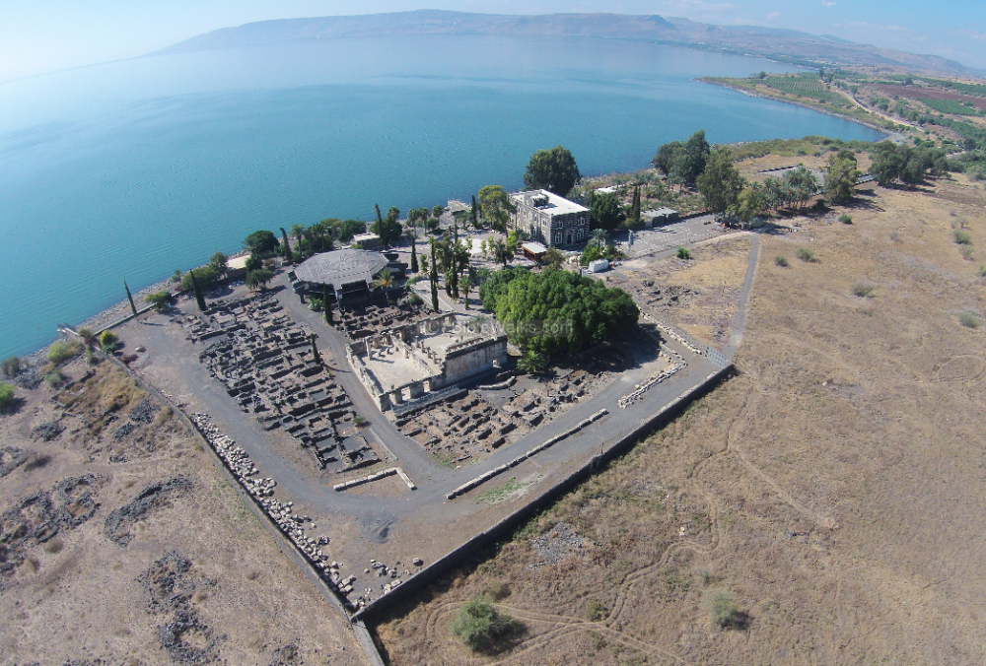
New Testament Survey I:
Gospels and Acts
Dr. Keith Schubert

Slide 2
New Testament Survey I: Gospels and Acts
8/14 Geography and History -
8/21 Synoptics Matthew, Mark, Luke
8/28 Mark Mark
9/4 Matthew Matthew
9/11 Luke Luke
9/18 John John
9/25 Narratives various
10/2 Parables Sower, Good Samaritan,
      Shrewd Manager
10/9 Sermon on the Mount Matthew 5-7
10/16 Acts Early Church & Peter Acts 1-12
10/23 Travels of Paul Acts 13-28

Slide 3
Poetry
Synonymous Parallelism
  Mark 3:24-25 kingdom divided, house divided
  Matthew 7:7-8 ASK
Antithetical Parallelism
  Matthew 7:17-18 good tree good fruit, bad tree bad fruit
  Luke 16:10 faithful in little is righteous with much, ...
Step Parallelism
  Mark 9:37 receive child... receives me... receives one who sent
  Matthew 5:17-20 not come to abolish but to fulfill
Chiasmic Parallelism
  Mark 8:35 lose-save-save-lose
  Matthew 7:6 dogs-swine-swine-dogs

Slide 4
Parabolic Actions: Fig Tree
Mark (Tree-Temple-Tree-Temple)
  Jesus Curses the Fig Tree ( Mark 11:12⁠–⁠14 )
  Jesus Cleanses the Temple ( Mark 11:15⁠–⁠19 )
  The Withering Fig Tree ( Mark 11:20⁠–⁠25 )
  Jesus Questioned in Temple (Mark 11:27-33)
Matthew (Temple-Tree-Temple)
  Jesus Cleanses Temple (Matthew 21:12-17)
  Jesus Curses the Fig Tree (Matthew 21:18-22)
  Jesus Questioned in Temple (Matthew 21:23-27)
Connected Parables
  Barren Fig Tree: Luke 13:6-9
  Budding Fig Tree: Matthew 24:32–35, Mark 13:28–31, and Luke 21:29–33

Slide 5
Puns
Play on words, multiple meanings, increases memory
similar sound
  Matthew 23:23-4 gnat=galma, camel=gamla
  Matthew 16:18 Peter Petros, Rock Petra
alternate meanings
  John 3:8 Wind blows , Spirt both pnuema (forces to think which is meant)
  Luke 9:59-60 let the dead bury their own dead (not spiritually committed to Christ vs actual dead)
  Mark 4:9 he who has ears to hear let him hear

Slide 6
Paradox
Opposing meaning
Mark 8:35 who would save loses and who loses will save
Mark 10:43-44 great-servant, first-slave
Mark 12:41-42 mite while smallest was biggest
Matthew 11:11 John greatest but least in kingdom is greater
Matthew 23:27-28 white washed tombs- pretty outside-unclean inside

Slide 7
Use of Questions
Rhetorical Questions
  Mark 7:18-19 are you so lacking in understanding?
  Mark 8:12 why does this generation seek sign?
Counterquestion
  Mark 2:6-9 Which is easier to say...
  Mark 11:27-33 I will answer if you answer…
Socratic Questioning
  Matthew 6:26-30
  Matthew 11:7-9, 16
  Matthew 16:13,15,26
  Matthew 22:15-22

Slide 8
Hyperbole
Exaggeration to convey emotion, correct wrong, emphasis
  Matthew 7:3-5 speck log
  Matthew 6:2-4 left not know right
  Matthew 23:23-4 gnat galma, camel gamla (aramaic)

Slide 9
A Fortiori
from the stronger - from less to greater
Matthew 6:28-30 grass clothed better than Solomon
Matthew 12:11-12 help sheep, people more valuable

