Slide 1
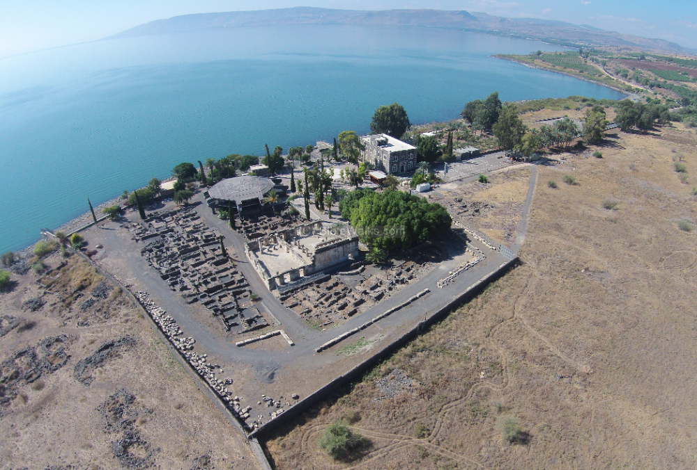
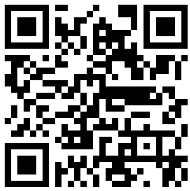
New Testament Survey I:
Gospels and Acts
cabcwaco.org/new-testament-class
Dr. Keith Schubert

Slide 2
New Testament Survey I: Gospels and Acts
8/14 Geography and History -
8/21 Synoptics Matthew, Mark, Luke
8/28 Mark Mark
9/4 Matthew Matthew
9/11 Luke Luke
9/18 John John
9/25 Narratives various
10/2 Parables Sower, Good Samaritan,
      Shrewd Manager
10/9 Sermon on the Mount Matthew 5-7
10/16 Acts Early Church & Peter Acts 1-12
10/23 Travels of Paul Acts 13-28

Slide 3
Parables
Short story “thrown alongside” a teaching to illustrate a moral lesson by an example that could happen in real life or nature
  Typically, only one point
  Typically, one main character
  Subtext explaining the right action (or to avoid the wrong action)
  Many applications
  Used throughout the Bible, e.g. Nathan’s parable to David in 2 Samuel 12:1-10
Not a metaphor or simile
  Comparison to illustrate/explain
  John 15:1-8
Not a proverb
  Short saying that expresses common wisdom/sense
Not an allegory
  In an allegory everything stands for something
  Symbolic representation of abstract ideas
  E.g.: Pilgrim’s Progress
Not an Apologue
  Brief fable or allegory to teach a moral truth through exaggeration
  E.g.: Jotham’s apologue in Judges 9:7-21

Slide 4
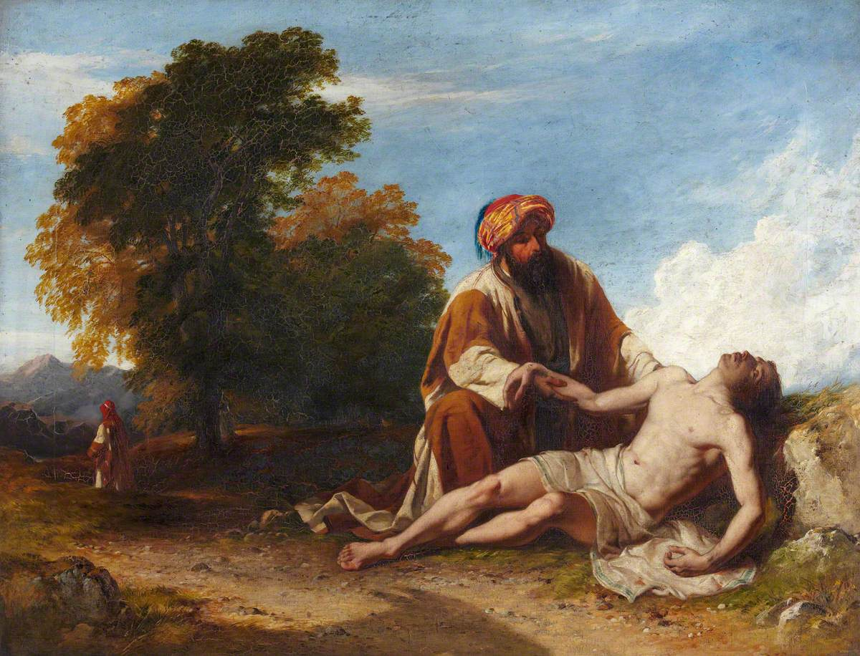
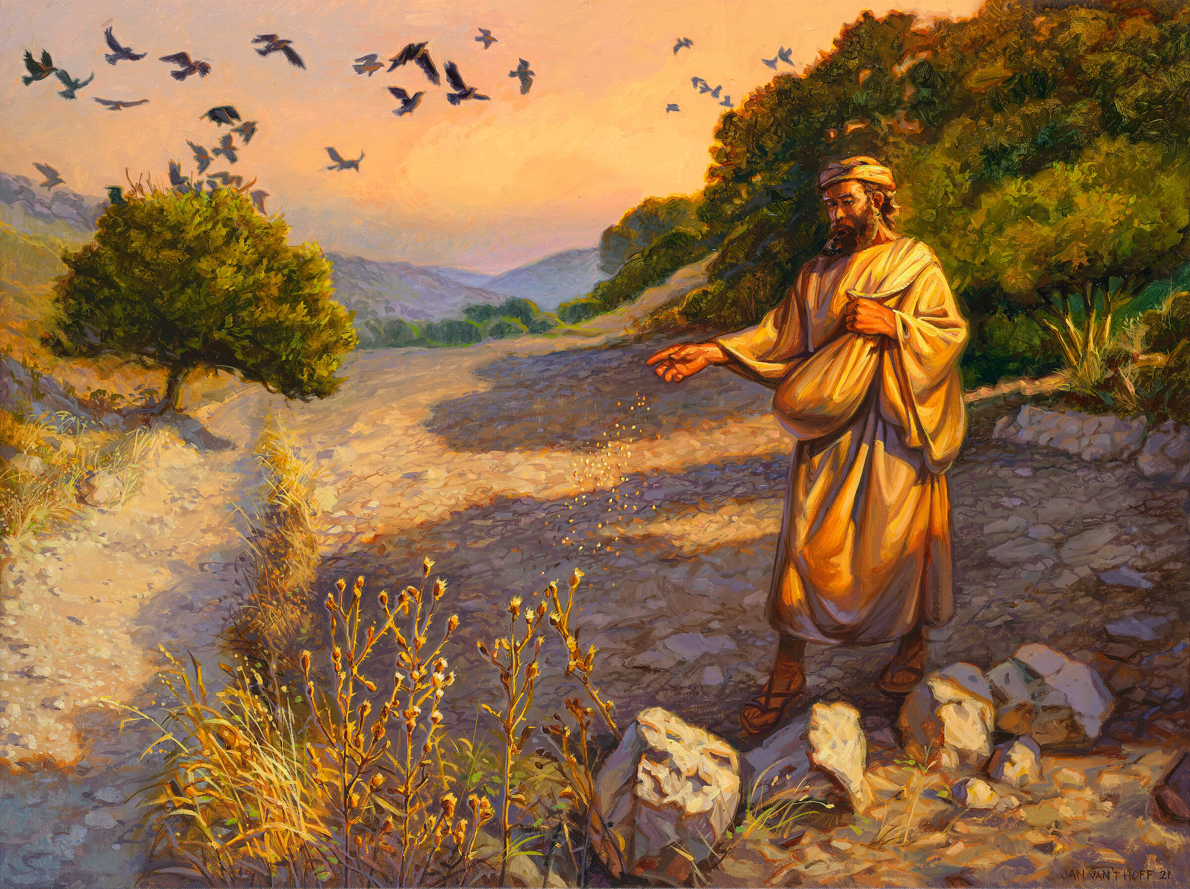
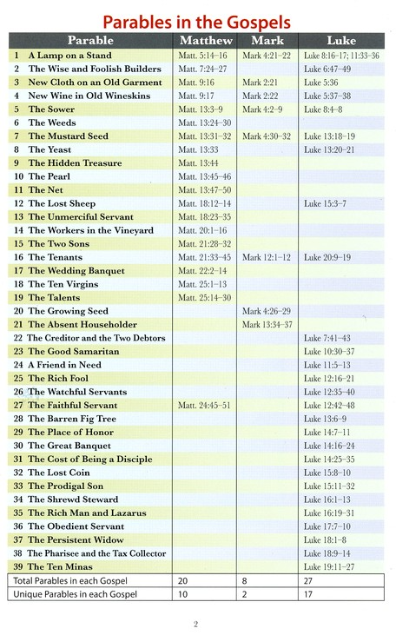
Parables in the Gospels

Slide 5
Parables
Sower (Matthew 13:1–23, Mark 4:1–20, Luke 8:4–15)
Good Samaritan (Luke 10:25-37)
Parable of Shrewd Manager (Luke 16:1-15)

Slide 6
Parables
Sower (Matthew 13:1–23, Mark 4:1–20, Luke 8:1–15)
Why parables? (Matthew 13:10-17, Mark 4:10-12, Luke 8:9-10)
  Ref Isaiah 6
Parable (Matthew 13:1–9, Mark 4:1–9, Luke 8:1–8)
  Context where teaching appears
  Characters?
  What do they do?
Explanation (Matthew 13:18–23, Mark 4:10–20, Luke 8:9–15)
  Who do we follow?

Slide 7
Parables
Good Samaritan (Luke 10:25-37)
  Context where teaching appears (Luke 10:25-29)
  Characters?
  What do they do?
  Who do we follow?
Incorrect allegorical view common in church history
  Caird, George Bradford (1980). The Language and Imagery of the Bible.
  Dodd quotes as a cautionary example Augustine’s allegorization of the Good Samaritan, in which the man is Adam, Jerusalem the heavenly city, Jericho the moon – the symbol of immortality; the thieves are the devil and his angels, who strip the man of immortality by persuading him to sin and so leave him (spiritually) half dead; the priest and Levite represent the Old Testament, the Samaritan Christ, the beast his flesh which he assumed at the Incarnation; the inn is the church and the innkeeper the apostle Paul. Most modern readers would agree with Dodd that this farrago bears no relationship to the real meaning of the parable.

Slide 8
Parables
Parable of Shrewd Manager
(Luke 16:1-15)
  Considered one of the harder parables
  Context where teaching appears
    Luke 16:1
    Luke 15:11-32
    Luke 15:1
  Characters?
  What do they do?
  Who do we follow?
  What does Jesus say about it?
    Luke 16:10-13
    Luke 16:14-15
    Luke 16:9
  Two options:
    Sarcasm -yeah, trusting in rich friends works
    Principle -they use master’s resources to win friends, we should use master’s resources to win friends = people to Christ
Interesting facts
  1 measure of oil ≈ 875 gallons
  1 measure of wheat ≈ 10 and 12 bushels
  ≈ 90-110 gallons

