Slide 1
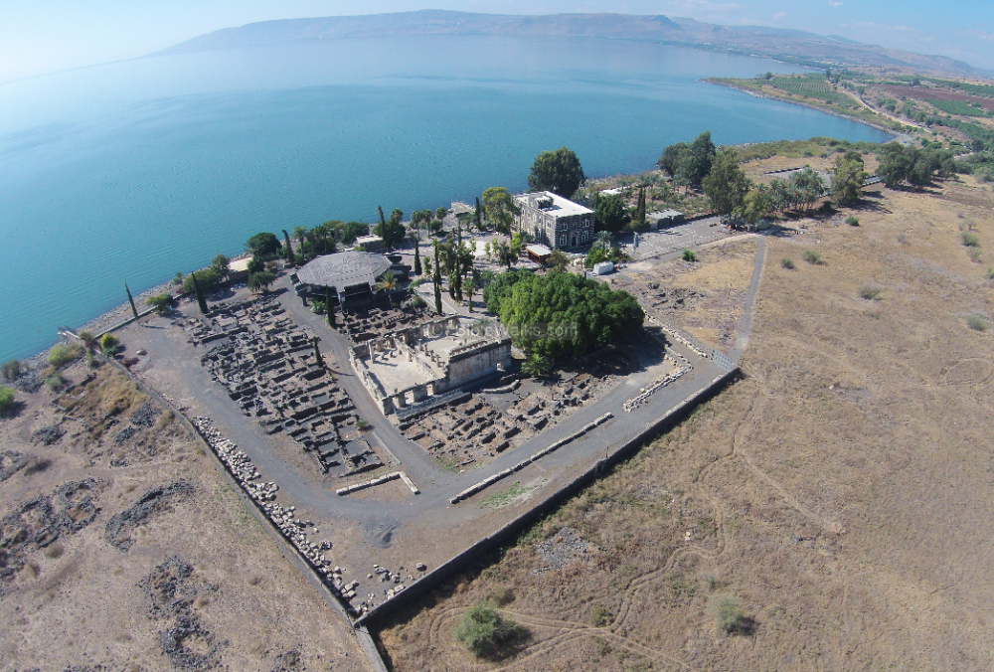
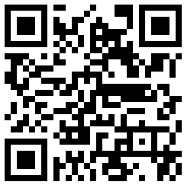
New Testament Survey I:
Gospels and Acts
Dr. Keith Schubert

Slide 2
New Testament Survey I: Gospels and Acts
8/14 Geography and History -
8/21 Synoptics Matthew, Mark, Luke
8/28 Mark Mark
9/4 Matthew Matthew
9/11 Luke Luke
9/18 John John
9/25 Narratives various
10/2 Parables Sower, Good Samaritan,
      Shrewd Manager
10/9 Sermon on the Mount Matthew 5-7
10/16 Acts Early Church & Peter Acts 1-12
10/23 Travels of Paul Acts 13-28

Slide 3
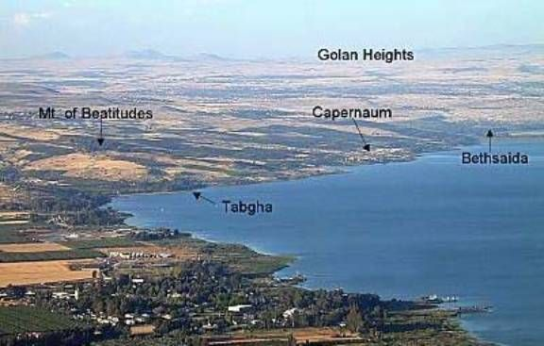

5 Discourses in Matthew
5-7 Sermon on the Mount
10 Discourse on Discipleship
13 Discourse on Parables
18 Discourse on Church
23-25 Discourse on Future

Slide 4
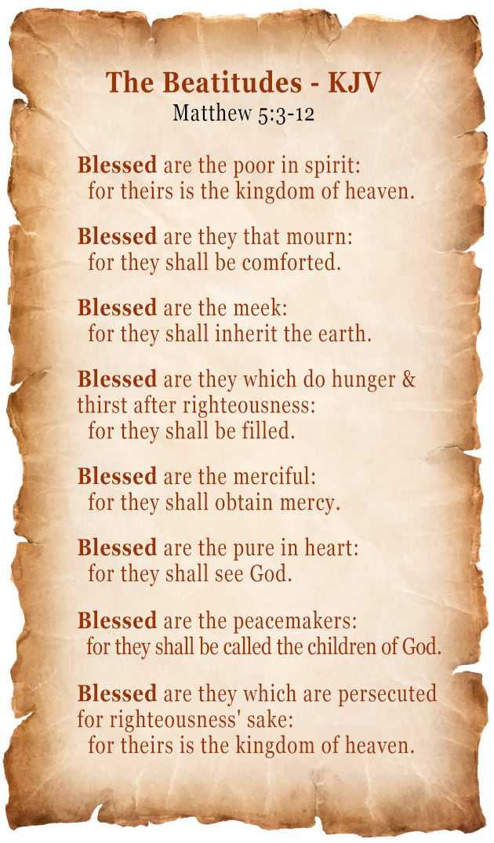
Blessing and the Believer
5:1-2 Introduction
5:3-12 Beatitudes
5:13-16 Salt and Light

Slide 5
God’s True Standard (2 Ways to Live)
5:17-20 Fulfillment of the Law
5:21-26 Murder
5:27-30 Adultery
5:31-32 Divorce
5:33-37 Oaths
5:38-42 Eye for Eye
5:43-48 Love Even Enemies
6:1-4 Alms
6:5-15 Prayer
6:16-18 Fasting
6:19-24 Treasure in Heaven
6:25-34 Worry
7:1-6 Judging
Do not give dogs what is holy
and do not throw your pearls before pigs
lest they trample them underfoot
and turn to attack you.

Slide 6
Two Types of People
7:7-12 ASK
7:13-14 Narrow & Wide Gates/Ways
7:15-20 True & False Prophets
7:21-23 True & False Disciples
7:24-27 Wise & Foolish Builders
7:28-29 Conclusion (even 8:1)

