Slide 1
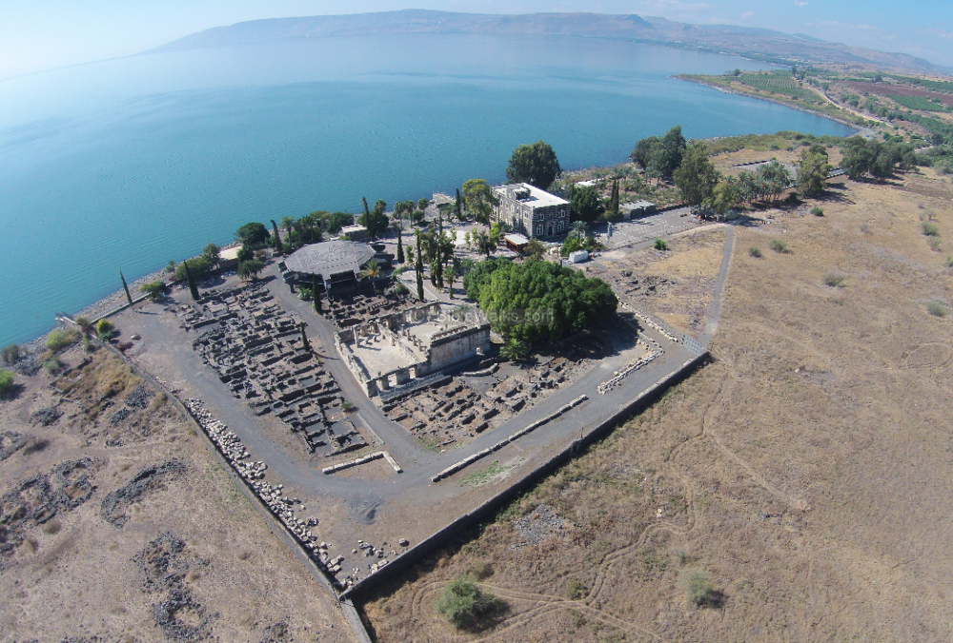
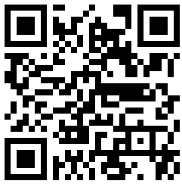
New Testament Survey I:
Gospels and Acts
Dr. Keith Schubert

Slide 2
New Testament Survey I: Gospels and Acts
8/14 Geography and History -
8/21 Synoptics Matthew, Mark, Luke
8/28 Mark Mark
9/4 Matthew Matthew
9/11 Luke Luke
9/18 John John
9/25 Narratives various
10/2 Parables Sower, Good Samaritan,
      Shrewd Manager
10/9 Sermon on the Mount Matthew 5-7
10/16 Acts Early Church & Peter Acts 1-12
10/23 Travels of Paul Acts 13-28

Slide 3
Division by Summary Statements
Founding the Church (1:1-2:41)
Mission to the Jews (2:42-12:25)
  The Church in Jerusalem (2:42-6:7)
  The Church in Judea, Galilee and Samaria (6:8-9:31)
  Advances in Palestine and Syria (9:32-12:25)
Mission to the Gentiles (13:1-28:31)
  Paul's first journey and the Apostolic Council (13:1-16:5)
  Paul's second and third journeys (16:6-19:20)
  Paul's final travels to Jerusalem and Rome (19:21-28:31)

Slide 4
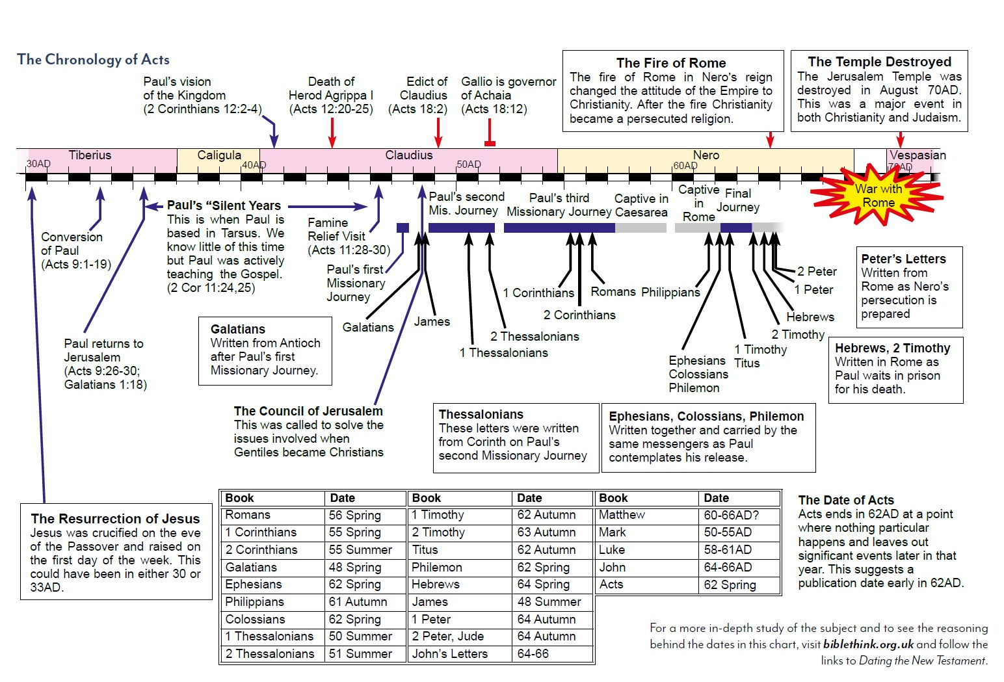

Slide 5
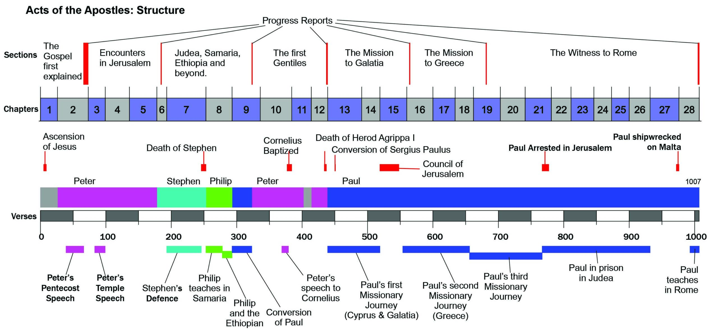

Slide 6
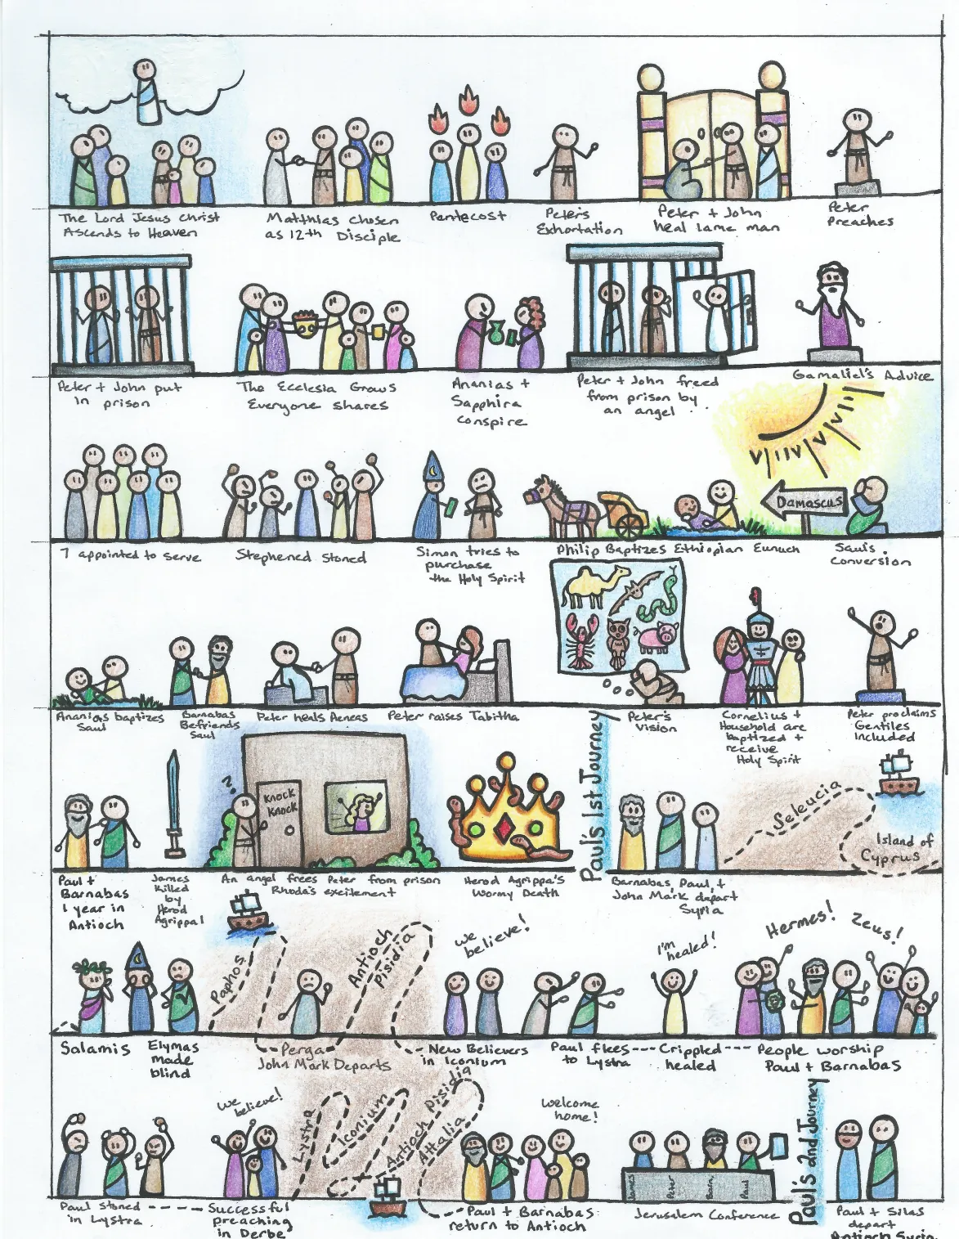
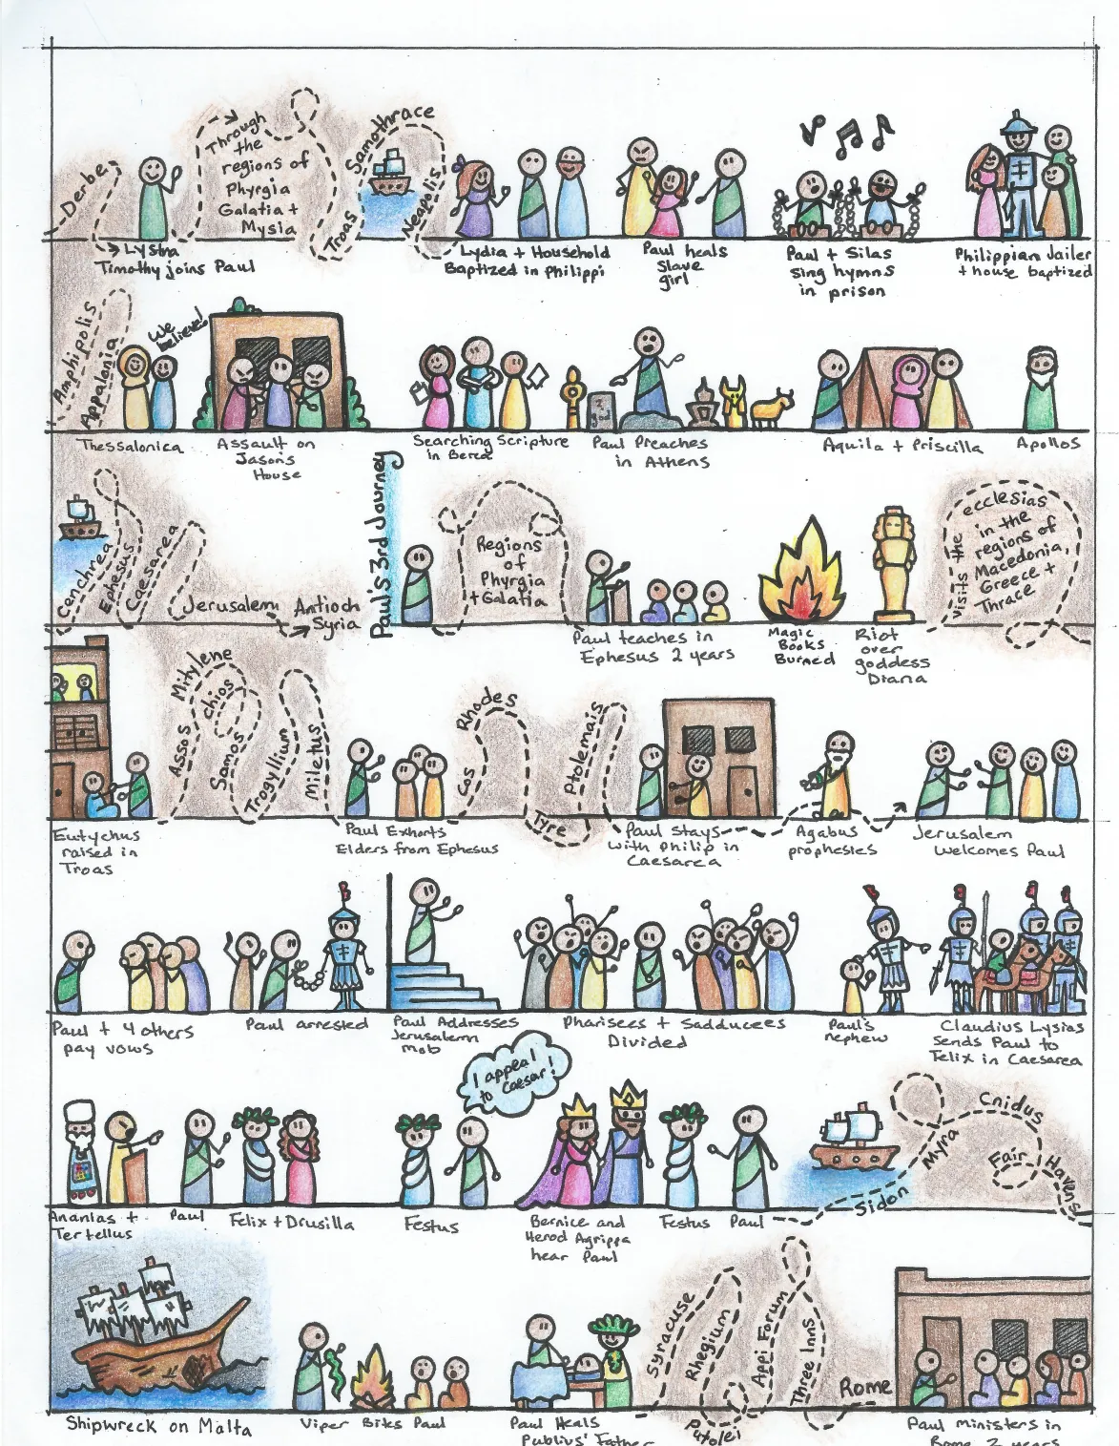

Slide 8
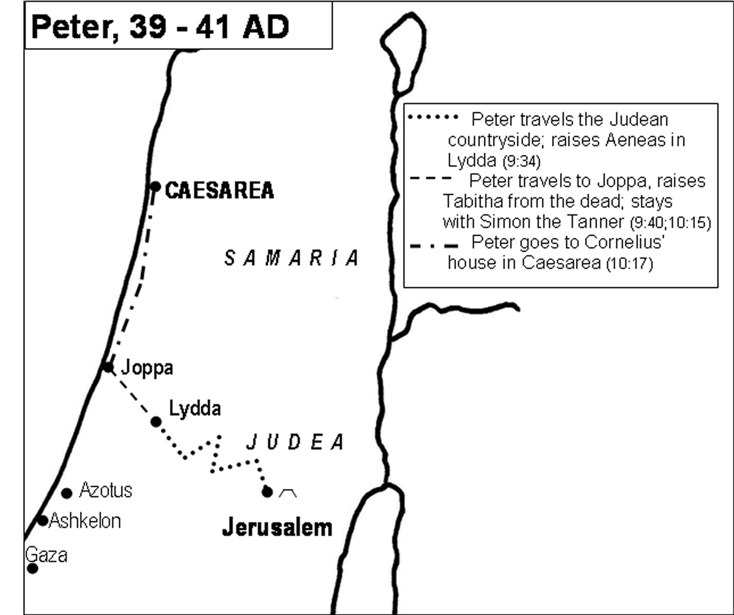

Slide 9
Interpreting Acts
Focus on key message
  Acts 1:8
Don’t confuse descriptive and proscriptive
  Acts 1:7 – date setting
  Acts 1:20 – not apostolic succession
  Acts 1:26 – casting lots
  Acts 2:6-11 – tongues

Slide 10
Belief & Baptism & Holy Spirit & Believers
Acts 2:1-4
Acts 2:38-47
Acts 4:23-35
Acts 5:1-11
Acts 8:4-25
Acts 10:44-48
Acts 11:1-18 (19-24)
Acts 19:1-7

