Slide 1
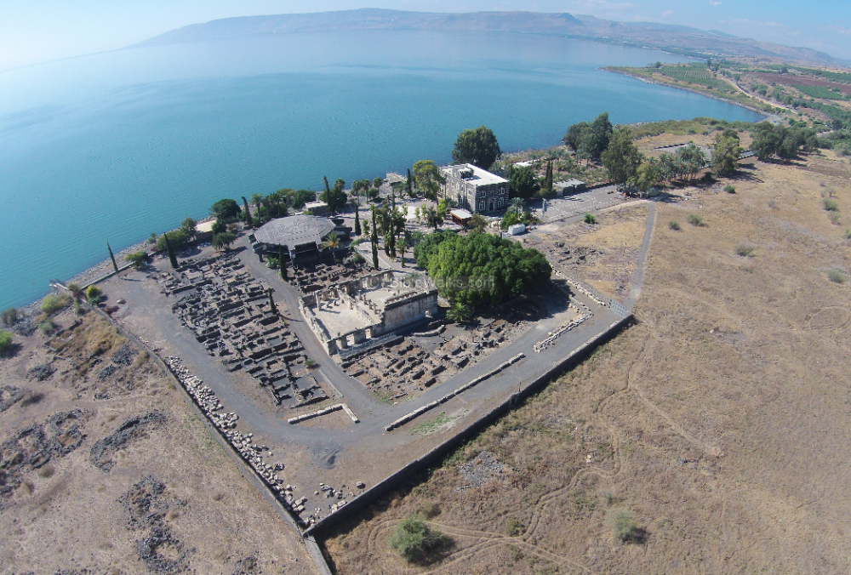
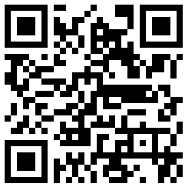
New Testament Survey I:
Gospels and Acts
Dr. Keith Schubert

Slide 2
New Testament Survey I: Gospels and Acts
8/14 Geography and History -
8/21 Synoptics Matthew, Mark, Luke
8/28 Mark Mark
9/4 Matthew Matthew
9/11 Luke Luke
9/18 John John
9/25 Narratives various
10/2 Parables Sower, Good Samaritan,
      Shrewd Manager
10/9 Sermon on the Mount Matthew 5-7
10/16 Acts Early Church & Peter Acts 1-12
10/23 Travels of Paul Acts 13-28

Slide 3
Repeated events in Acts
Saul’s Conversion
  Acts 9
  Acts 22
  Acts 26
Cornelius’s Conversion
  Acts 10
  Acts 11
  Acts 15

Slide 4
Sermons in Acts
Acts 2:14-36 Peter’s sermon at Pentecost
Acts 3-4 Peter’s preaching (as a result of the healing of the lame man)
Acts 7 Stephen’s sermon,
Acts 10 Peter’s gospel message at the home of Cornelius
Acts 13:13-41 Paul’s sermon at (Pisidian) Antioch
Acts 17:16-31 Paul’s preaching at Athens
Acts 20:17-34 Paul’s message to the Ephesian elders
Acts 26 Paul’s appeal to Agrippa

Slide 5
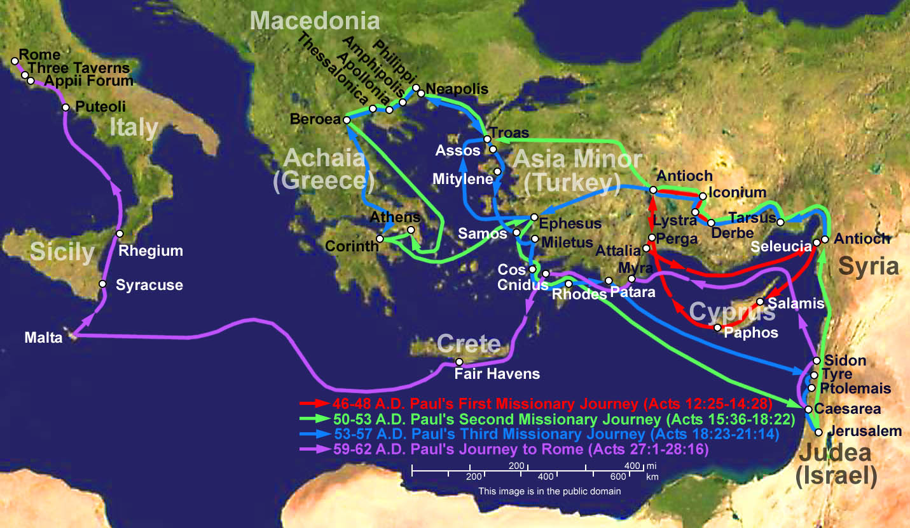
Notes:
We passages
Acts 16:10-17 Troas to Philippi
Acts 20:5-15 Philippi to Troas to Miletus
Acts 21:1-18 Miletus to Jerusalem
Acts 27:1–28:16
1 manuscript has “we” in Acts 11:28
Luke mentioned
Philemon 1:24
Colossians 4:14
II Timothy 4:11

Slide 6
Acts 16:10-17
Notes:
We passages
Acts 16:10-17 Troas to Philippi
Acts 20:5-15 Philippi to Troas to Miletus
Acts 21:1-18 Miletus to Jerusalem
Acts 27:1–28:16
1 manuscript has “we” in Acts 11:28
Luke mentioned
Philemon 1:24
Colossians 4:14
II Timothy 4:11

Slide 7
Acts 16:10-17
Acts 20:5-15
Notes:
We passages
Acts 16:10-17 Troas to Philippi
Acts 20:5-15 Philippi to Troas to Miletus
Acts 21:1-18 Miletus to Jerusalem
Acts 27:1–28:16
1 manuscript has “we” in Acts 11:28
Luke mentioned
Philemon 1:24
Colossians 4:14
II Timothy 4:11

Slide 8
Acts 16:10-17
Acts 20:5-15
Acts 21:1-18
Notes:
We passages
Acts 16:10-17 Troas to Philippi
Acts 20:5-15 Philippi to Troas to Miletus
Acts 21:1-18 Miletus to Jerusalem
Acts 27:1–28:16
1 manuscript has “we” in Acts 11:28
Luke mentioned
Philemon 1:24
Colossians 4:14
II Timothy 4:11

Slide 9
Acts 16:10-17
Acts 20:5-15
  Acts 27:1–28:16
Acts 21:1-18
Notes:
We passages
Acts 16:10-17 Troas to Philippi
Acts 20:5-15 Philippi to Troas to Miletus
Acts 21:1-18 Miletus to Jerusalem
Acts 27:1–28:16
1 manuscript has “we” in Acts 11:28
Luke mentioned
Philemon 1:24
Colossians 4:14
II Timothy 4:11

Slide 10
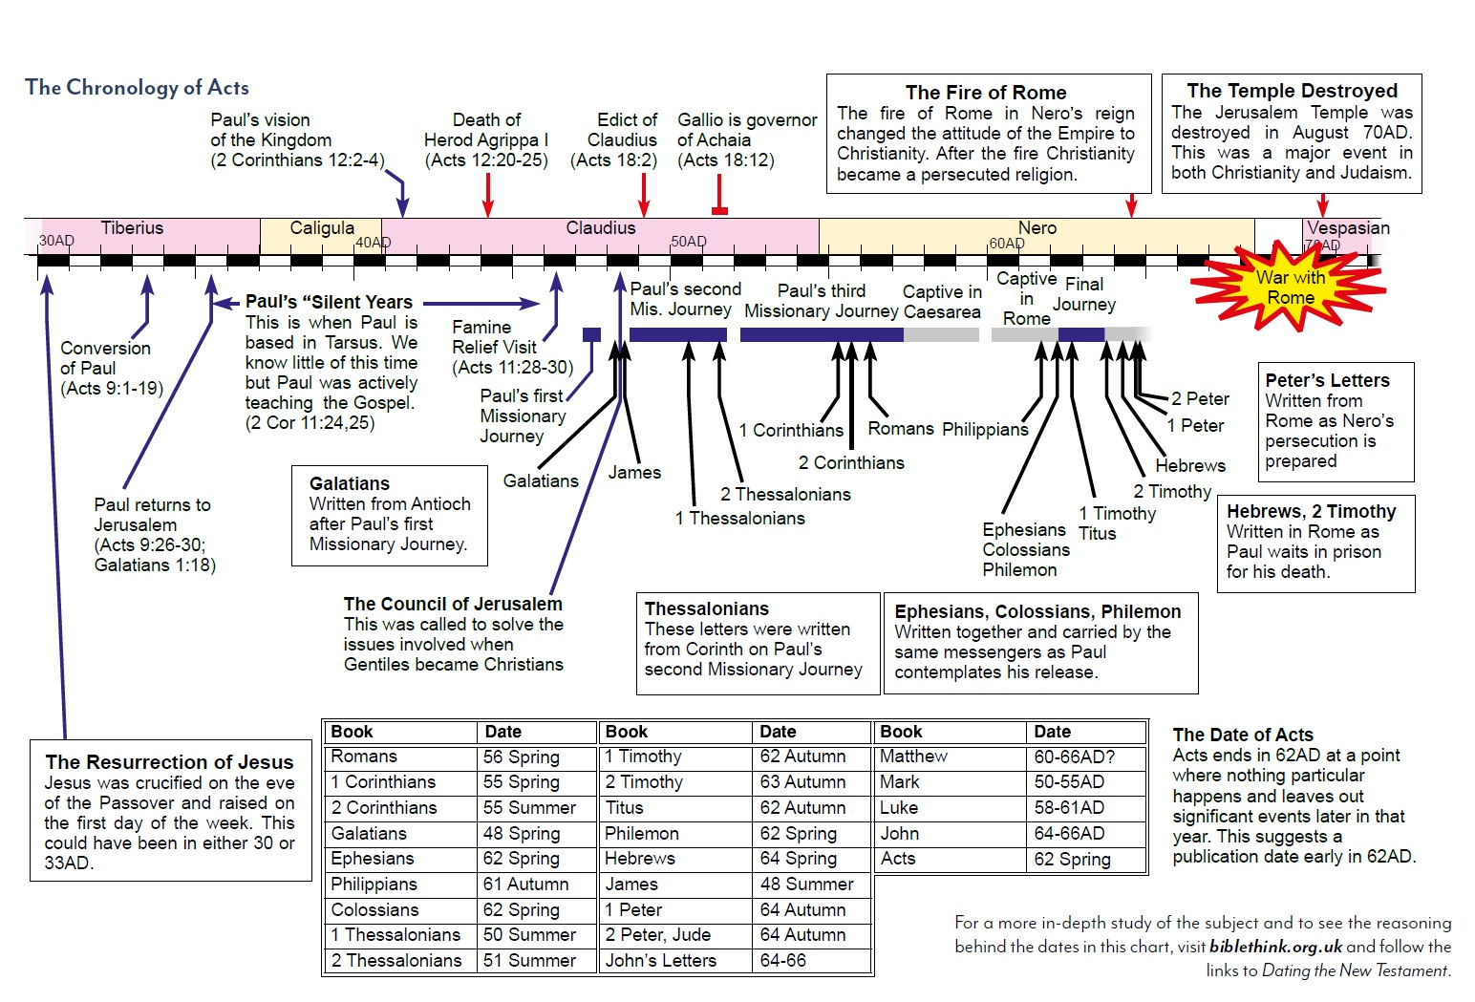

Slide 11
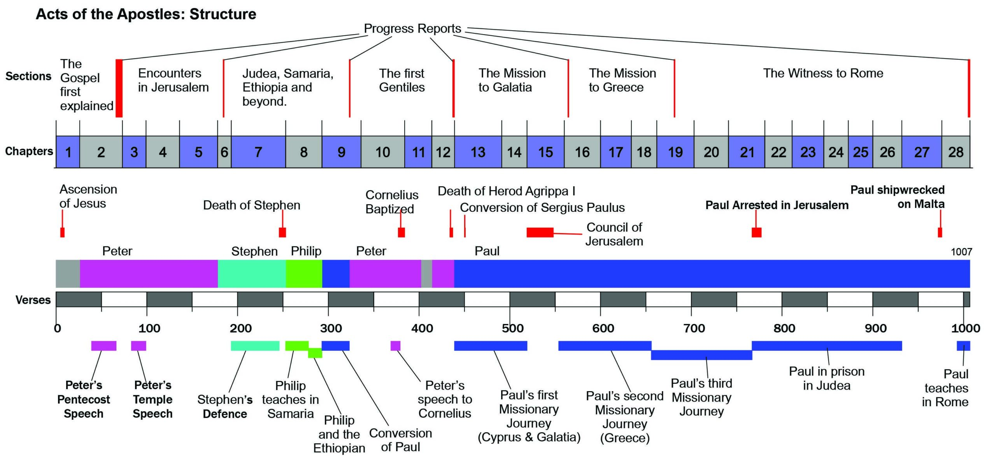

Slide 12
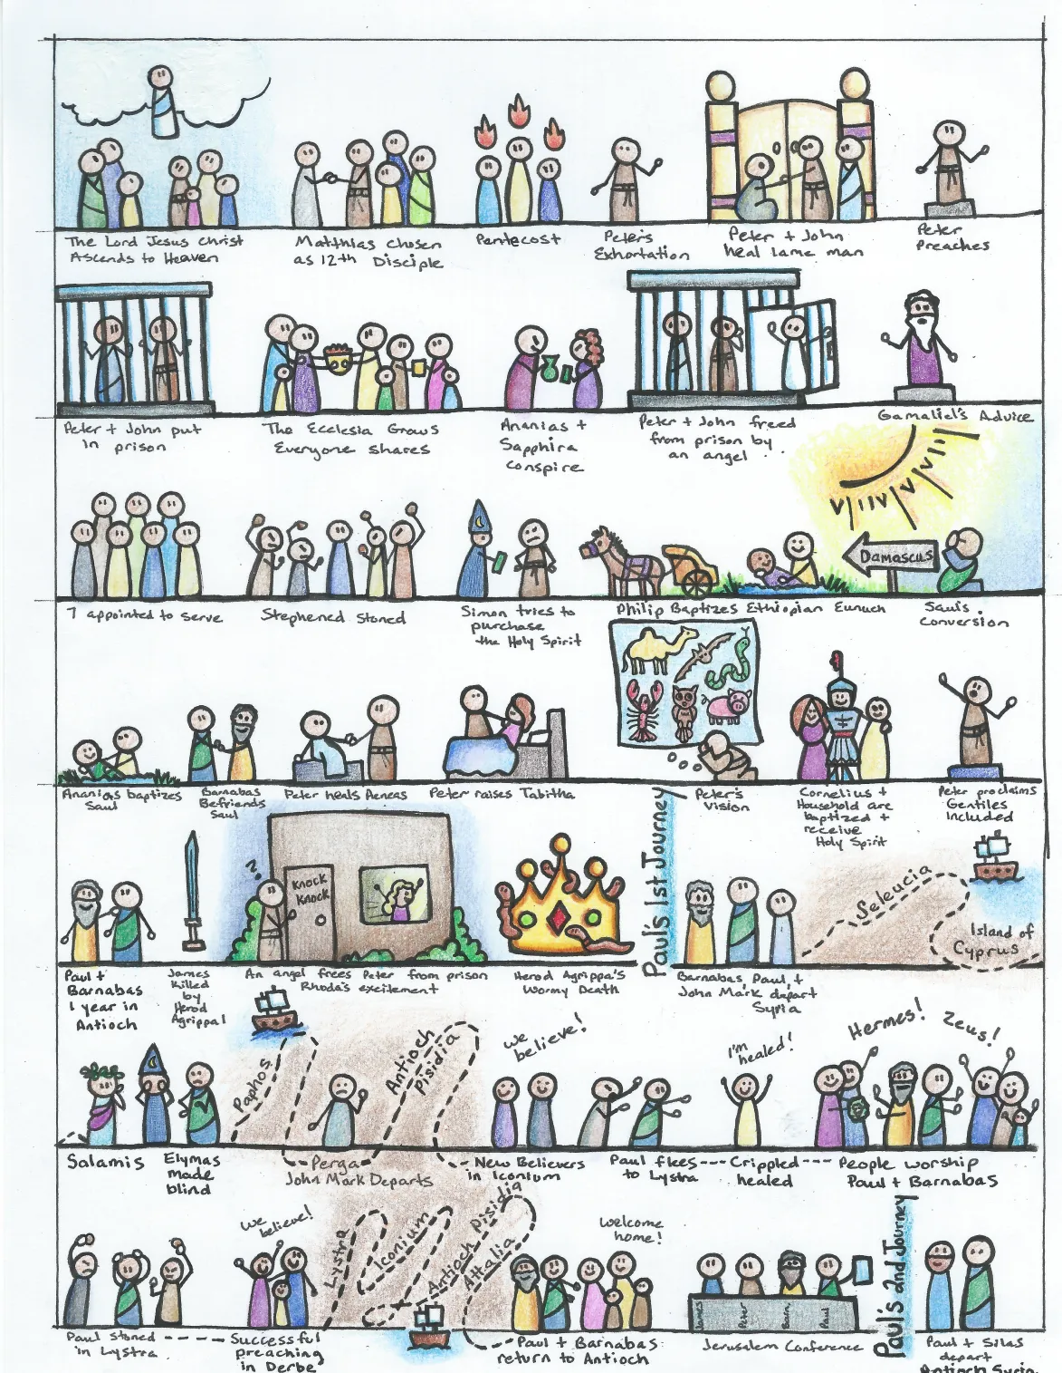
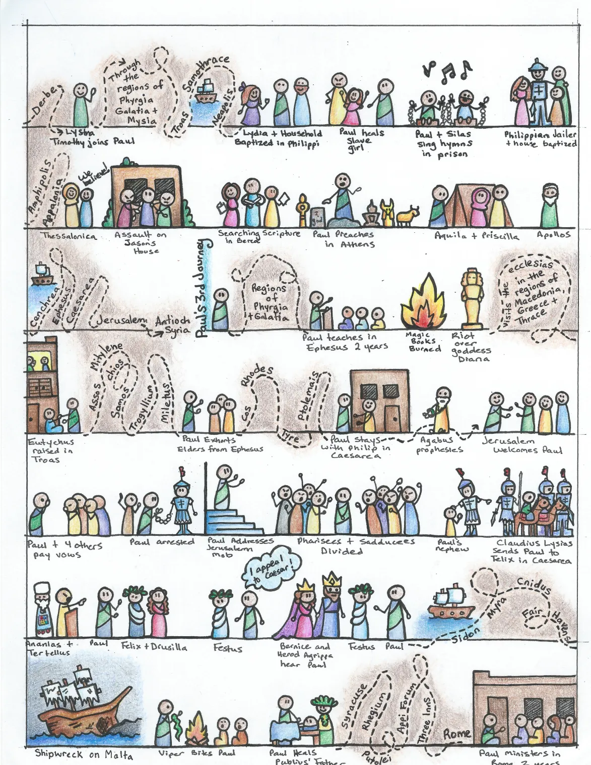

Slide 13
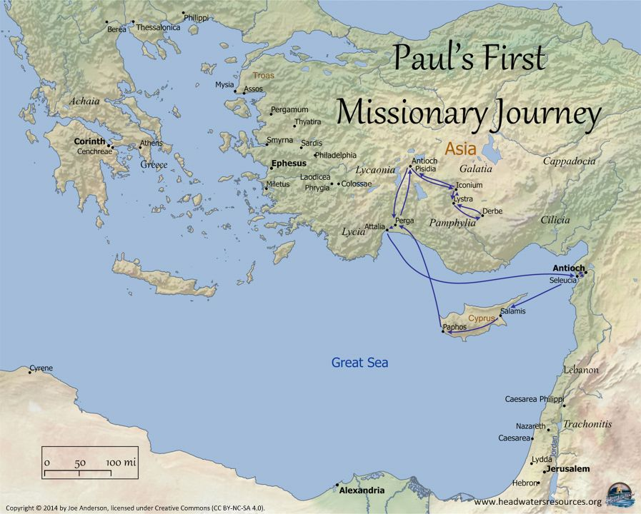
1st Mission
~46-49 AD
Acts 13-14
Antioch
Cyprus: Salamis & Paphos
Pamphylia: Perga
Pisidia: Antioch
Iconium: opposition
Lystra: Heal lame man, stoned
Derbe
Return: Revisit cities & appoint elders
Antioch

Slide 14
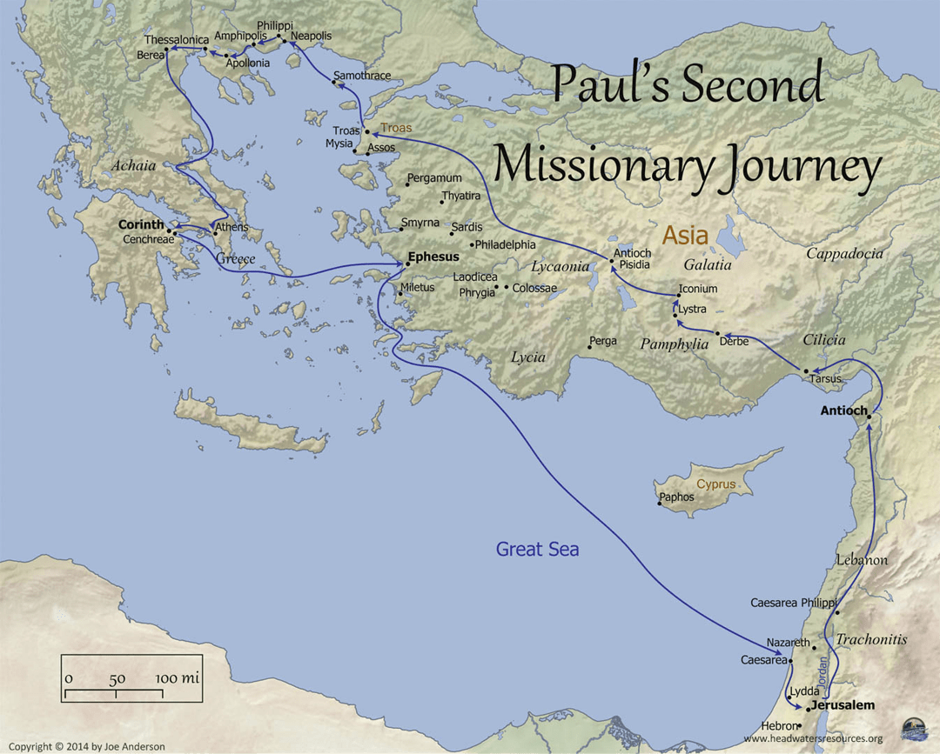
2nd Mission
~49-52 AD
15:36-18:22
Revisit Derbe and Lystra
Troas: vision of man from Macedonia
Philippi (in Macedonia): Preached and established a church
Berea: noble
Athens: Mars Hill/Areopagus
Corinth: I&II Thessalonians
Cenchreae: Departed for Syria
Return: Briefly visited Ephesus and returned to Antioch

Slide 15
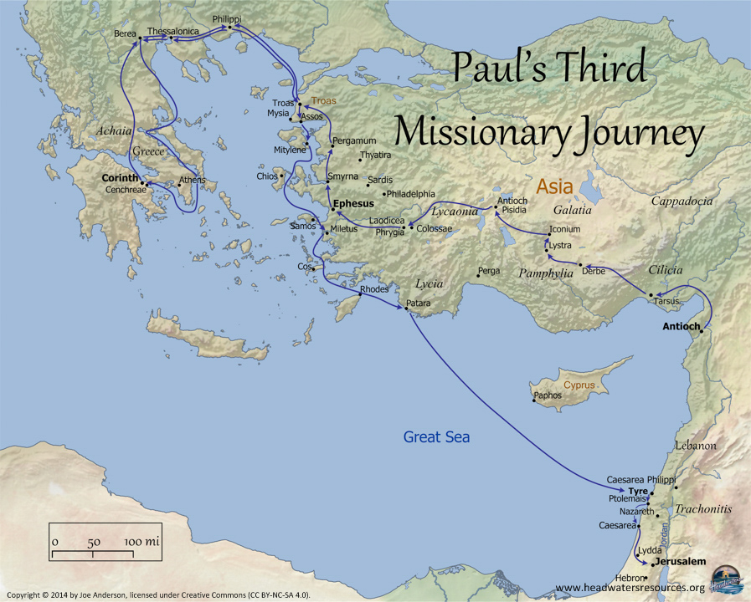
3rd Mission
~53-58 AD
Acts 18:23-21:16
2yrs Ephesus,
Macedonia and Greece: collect for Jerusalem church.
Troas: Raised Eutychus from the dead.
Miletus: Farewell address to Ephesian elders.
Caesarea: prophesies
Jerusalem

Slide 16
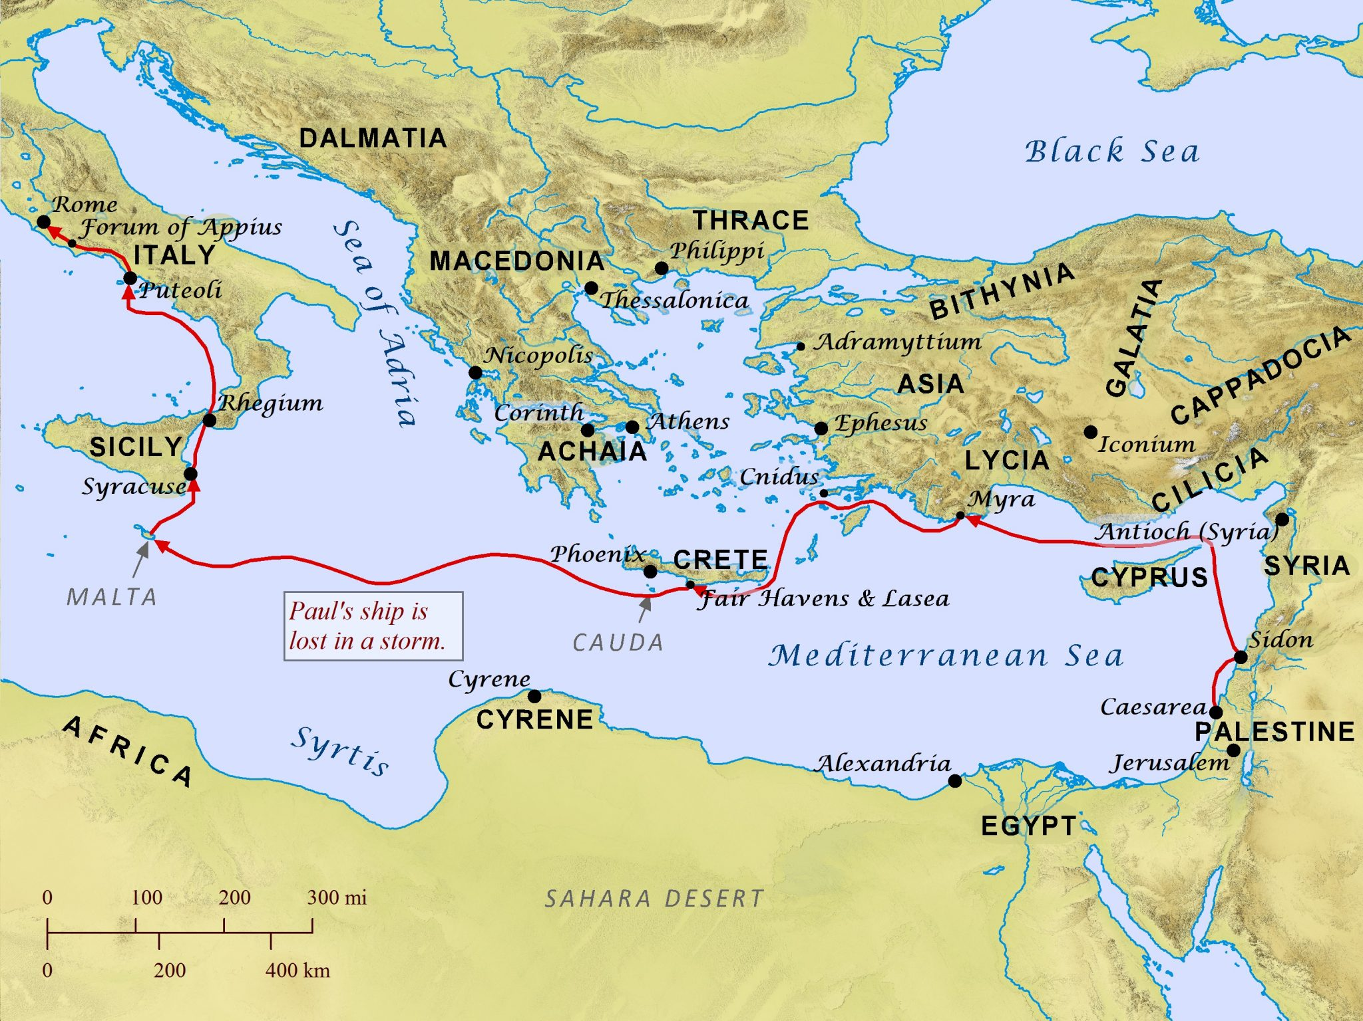
To Rome
~58-62 AD
Acts 21:17-28:31
Jerusalem: Arrested, attempted assassination.
Caesarea: imprisoned for ~two years.
Voyage to Rome: Appealed to Caesar, Shipwreck on Malta.
Rome: Preached while under house arrest.

Slide 17
Journey | Timeline | Stops and Significant Events
First | ~46-49 AD | Cyprus: Preached in Salamis and Paphos.
13-14 |  | Pamphylia: Visited Perga.
 |  | Pisidia: Preached in Antioch
 |  | Iconium: Preach, opposition arises.
 |  | Lystra: Healed a lame man, stoned.
 |  | Derbe: Preached.
 |  | Return: Revisited the cities and appointed elders, then returned to Antioch.
Second | ~49-52 AD | Revisited Derbe and Lystra.
15:36 |  | Troas: Received a vision of a man from Macedonia, prompting him to go to Europe.
 |  | Philippi (in Macedonia): Preached and established a church. Thessalonica: Preached but faced opposition.
 |  | Berea: Preached, and the Bereans were more receptive.
 |  | Athens: Preached on Mars Hill (Areopagus).
 |  | Corinth: Spent a significant amount of time and wrote letters to the Thessalonians.
 |  | Cenchreae: Departed for Syria.
 |  | Return: Briefly visited Ephesus and returned to Antioch.
Third | ~53-58 AD | 2yrs Ephesus, travel through Macedonia and Greece, collect for Jerusalem church. Returned to Troas.
 |  | Troas: Raised Eutychus from the dead.
 |  | Miletus: Farewell address to Ephesian elders. Caesarea: prophesies.
 |  | Jerusalem: Arrested, attempted assassination. Caesarea: imprisoned for ~two years.
 |  | Voyage to Rome: Appealed to Caesar, Shipwreck on Malta.
 |  | Arrival in Rome: Preached while under house arrest.

