Slide 1
NT Survey:
Pauline Epistles
Dr. Keith Schubert

Slide 2
Date | Topic
1/22 | Intro, Galatians (48 or 56)
1/29 | I & II Thessalonians (50-53)
2/5 | I & II Corinthians (54-56)
2/12 | Romans (57-58)
2/19 | Prison: Ephesians, Philippians, Colossians, Philemon (61-63)
2/26 | Prison: Ephesians, Philippians, Colossians, Philemon (61-63)
3/5 | Pastorals: I & II Timothy, Titus (67-68)

Slide 3
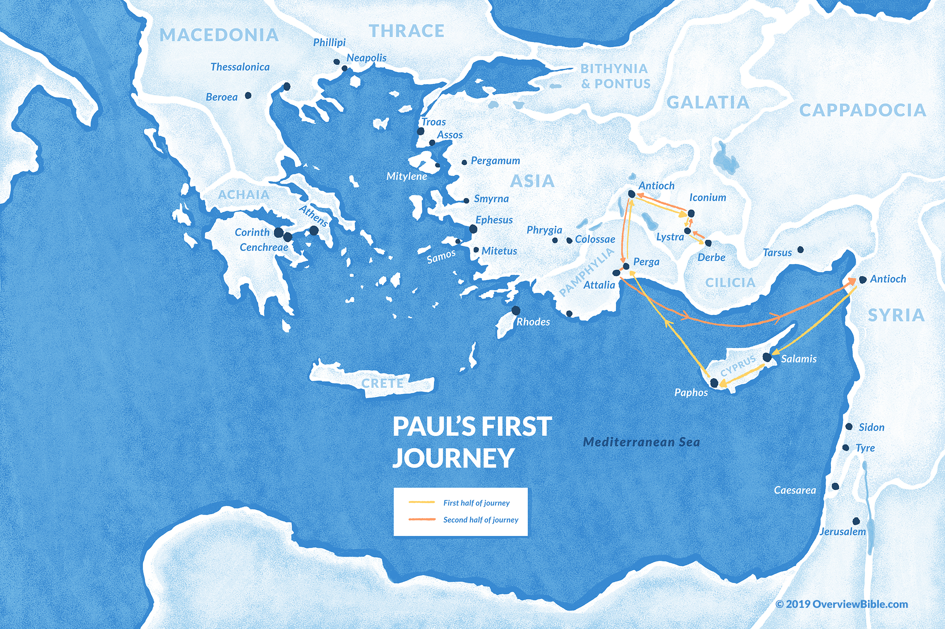
1
Acts 13–14
45-47 AD
  2 years
Acts 15
50 AD
  Jerusalem Council
G

Slide 4
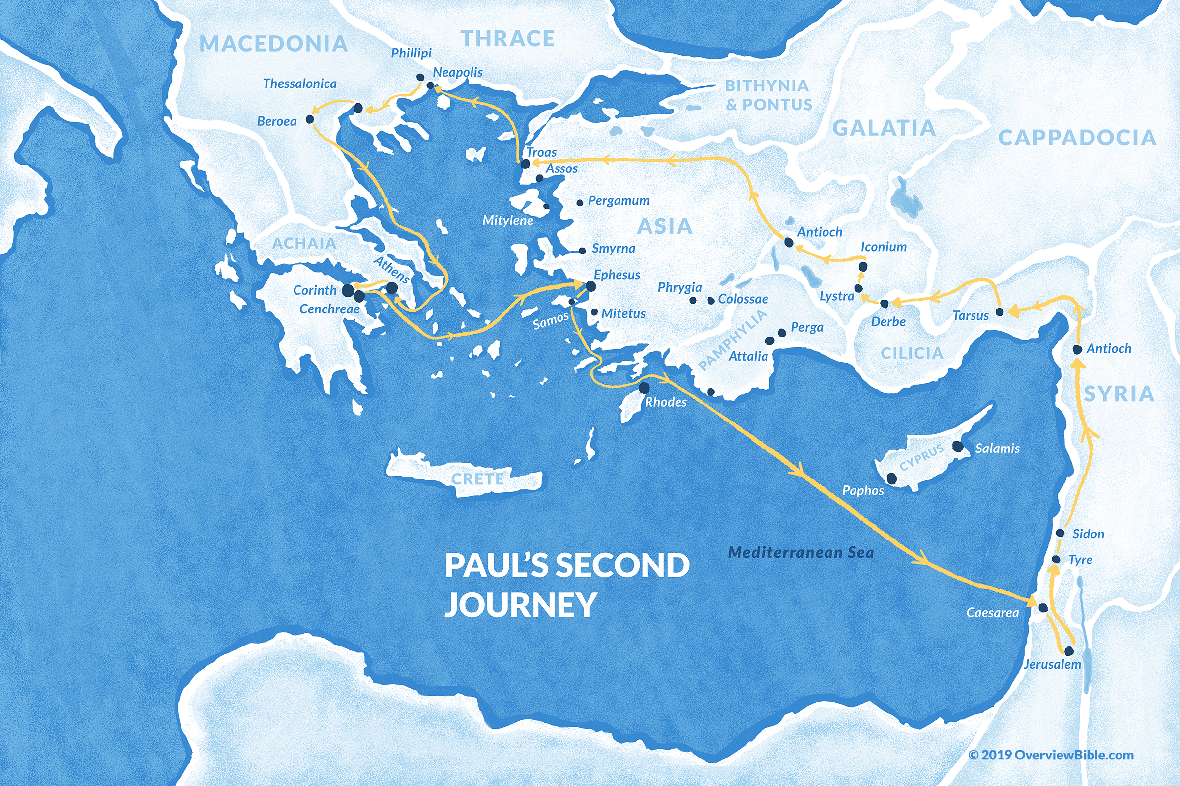
2
1,2 T
Acts 16:23–18:22
50-54
  3 years

Slide 5
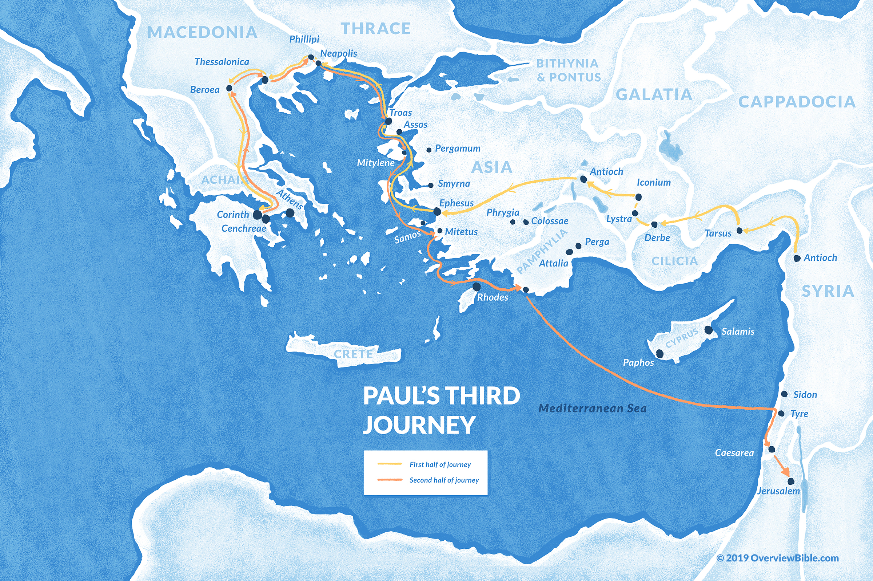
3
2 C
Acts 18:23–20:38
54-58
  4 years
1 C

Slide 6
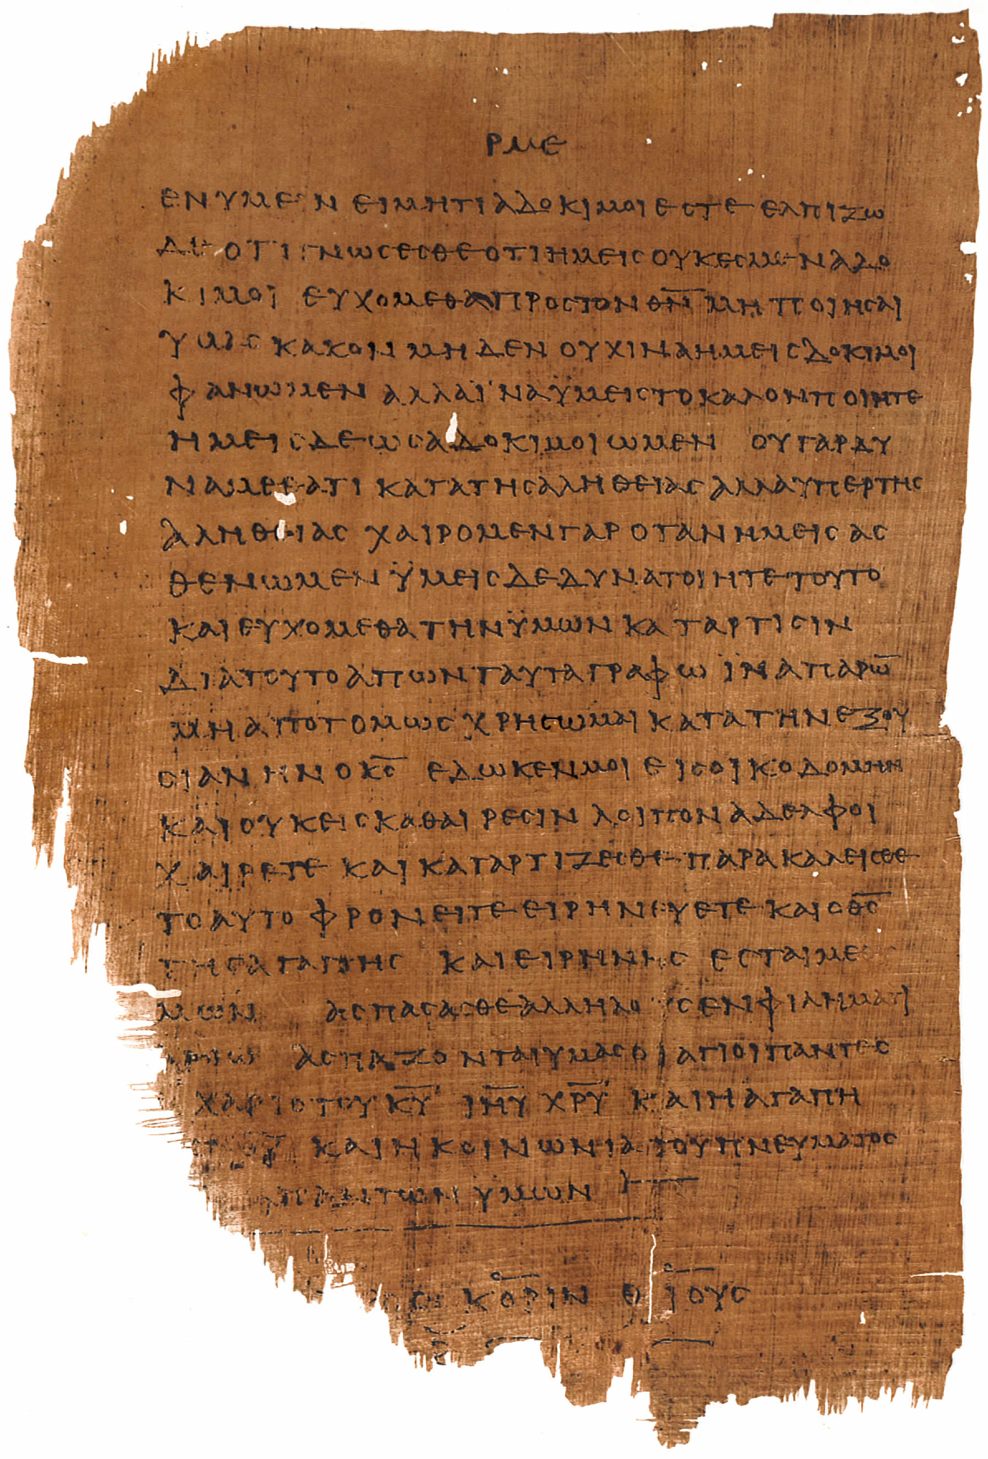
1+2 Corinthians
Letters to Corinth
  0.5 Ref.: 1 Corinthians 5:9
  1 1 Corinthians
  1.5 Ref 2 Corinthians 2:3-4, 7:8
  2 2 Corinthians
Oldest Papyrus 46 - 175AD (2 Cor to right)

Slide 7
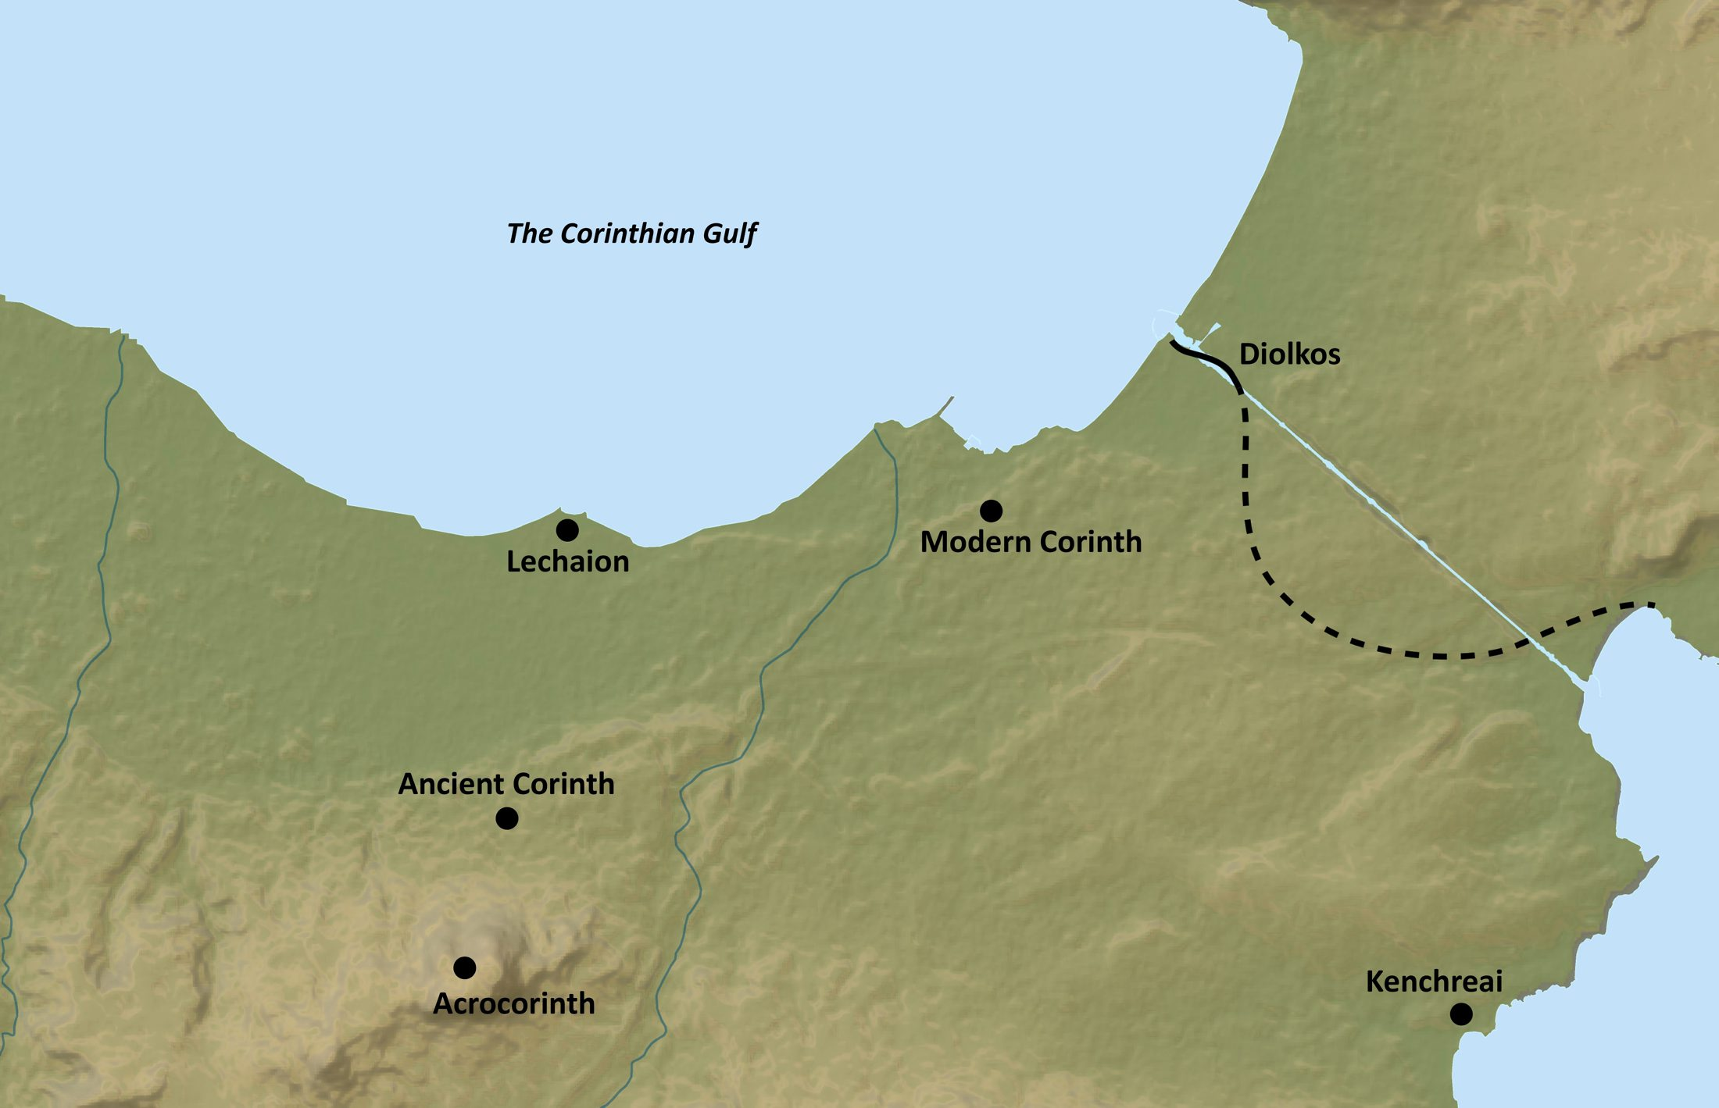

Slide 8
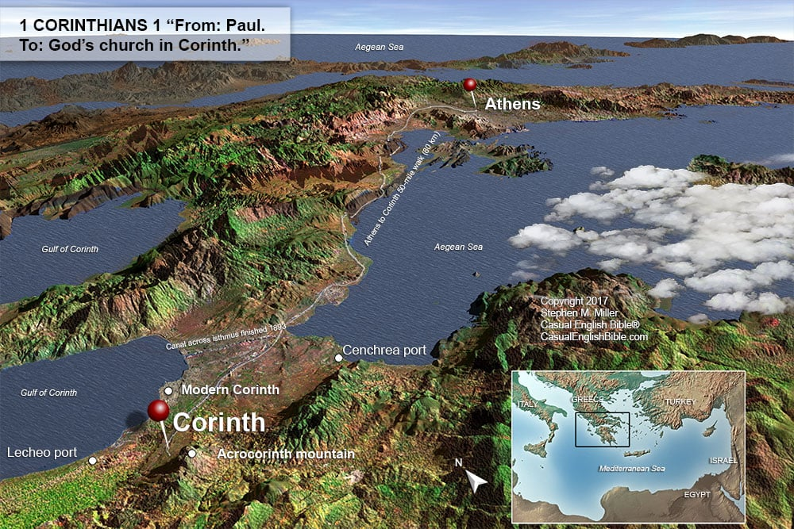

Slide 9
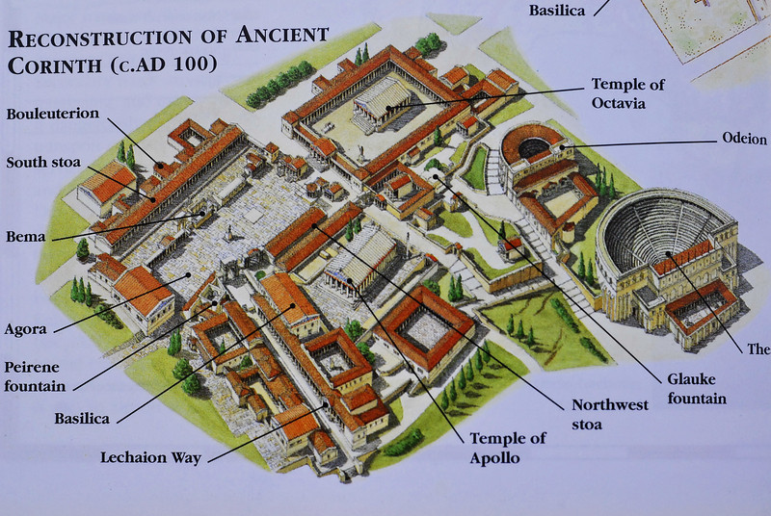

Slide 10
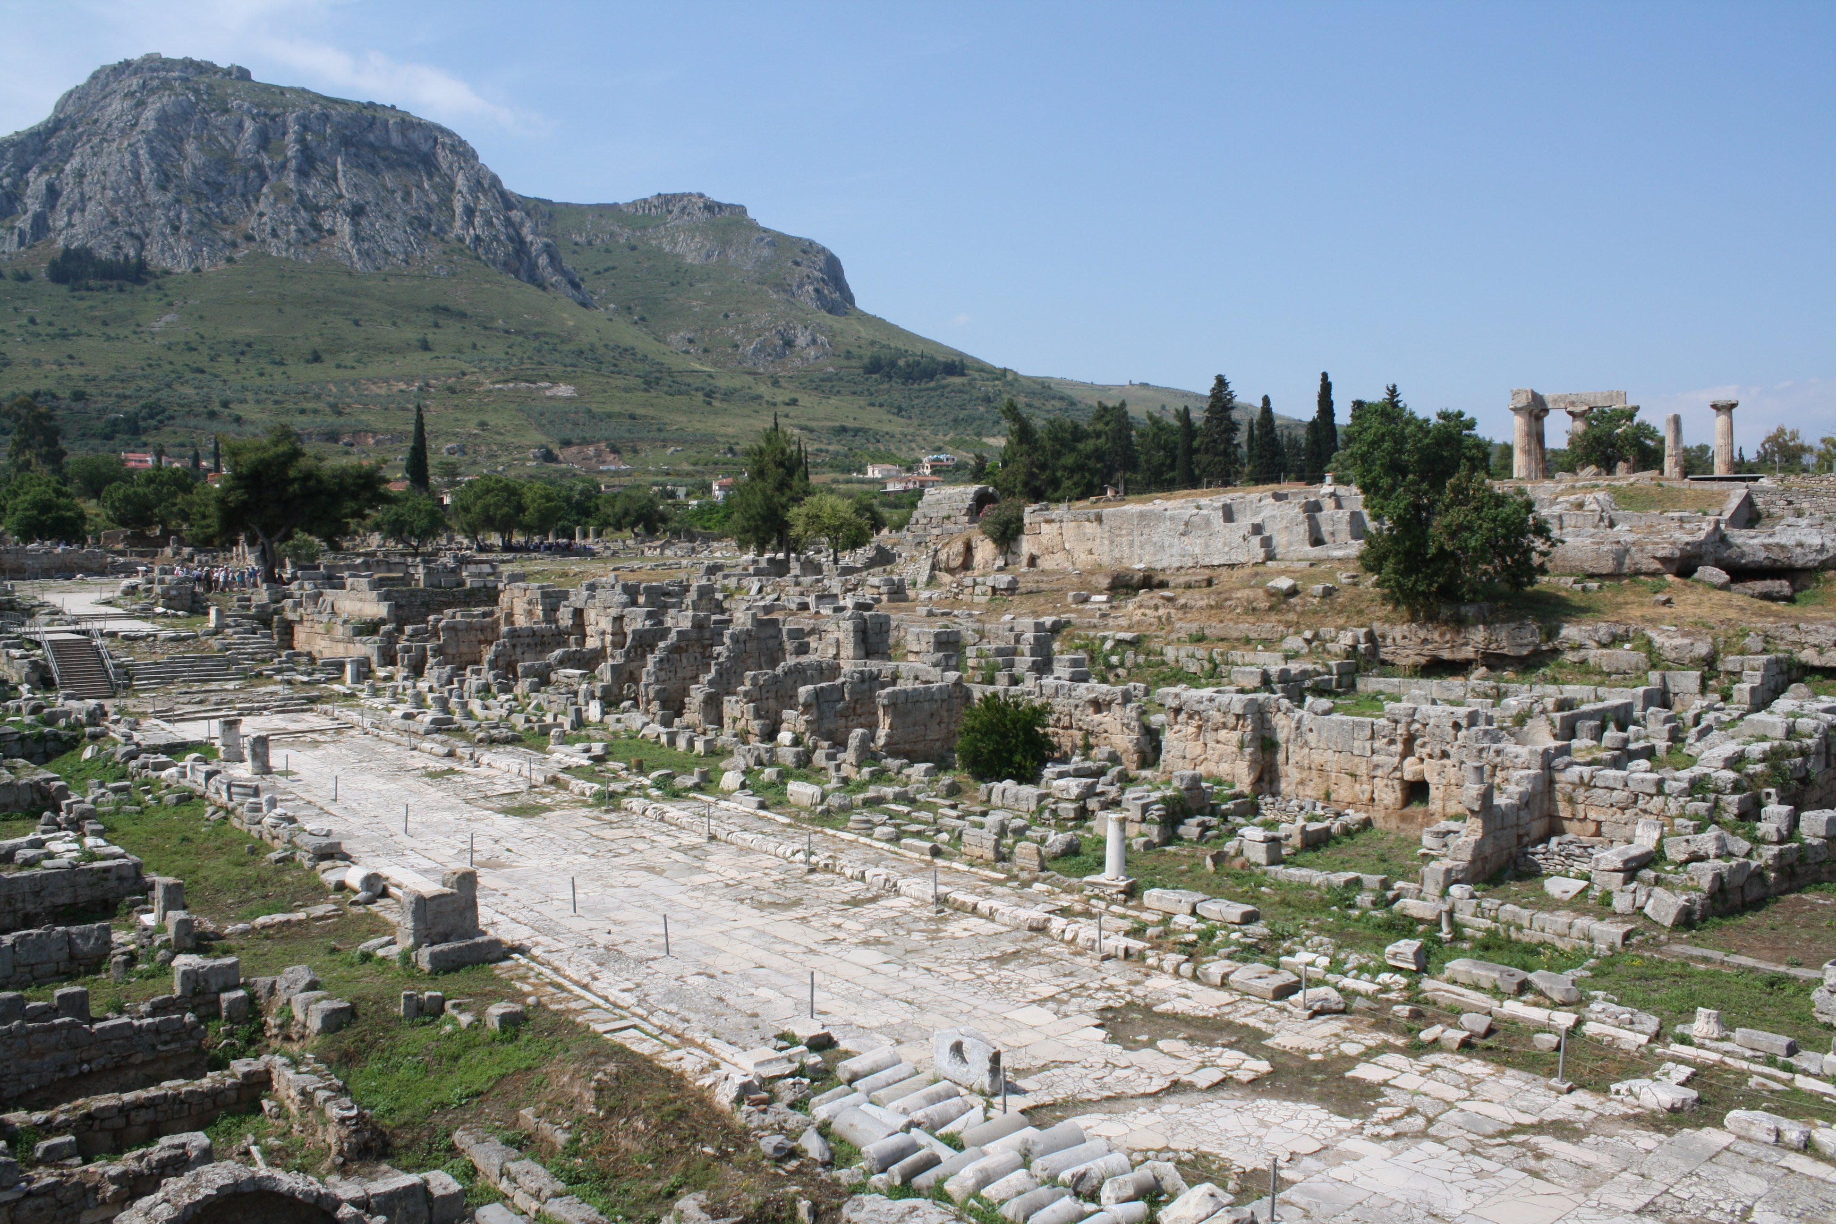

Slide 11
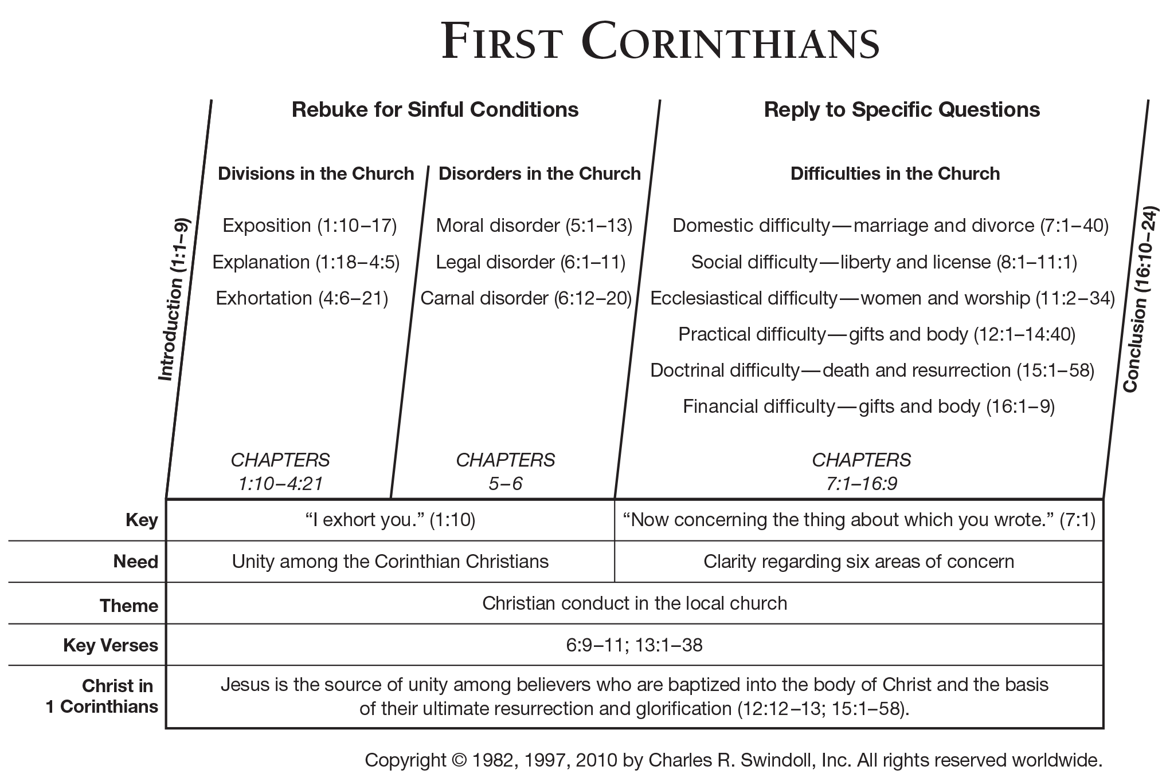

Slide 12
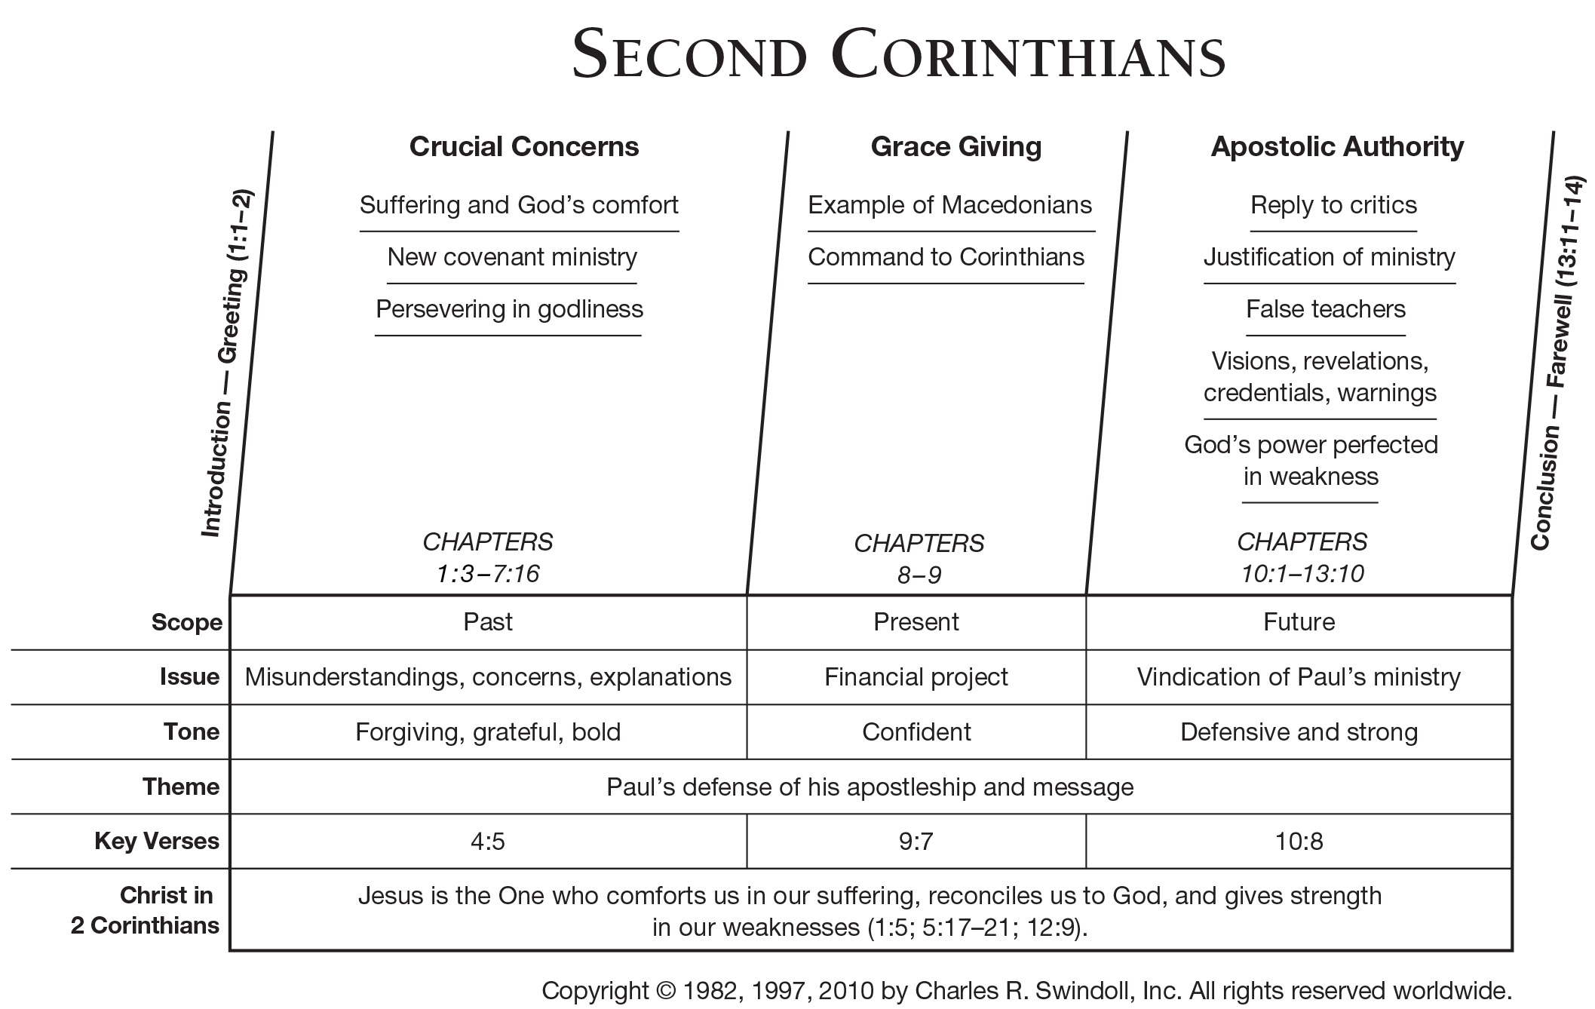

Slide 13
Possible Chiasm
Confidence in motive 1:12-22
  Sorrow for punished 1:23-2:11
    Travel 2:12-13
      Contrast spirit vs letter (new vs old) 2:14-4:6
        Present affliction vs coming glory 4:7-5:10
          Ministry of Reconciliation 5:11-21
        Present affliction vs. present glory 6:1-10
      Christ vs Belial (belief vs unbelief) 6:11-7:4
    Travel 7:5-7
  Sorrow among Corinthians 7:8-13a
Confidence in Corinthians 7:13b-16

