Slide 1
NT Survey:
Pauline Epistles
Dr. Keith Schubert

Slide 2
Date | Topic
1/22 | Intro, Galatians (48 or 56)
1/29 | I & II Thessalonians (50-53)
2/5 | I & II Corinthians (54-56)
2/12 | Romans (57-58)
2/19 | Prison 1: Ephesians, Philemon, Colossians (61-63)
2/26 | Prison 2: Philippians (61-63)
3/5 | Pastorals: I & II Timothy, Titus (67-68)

Slide 3
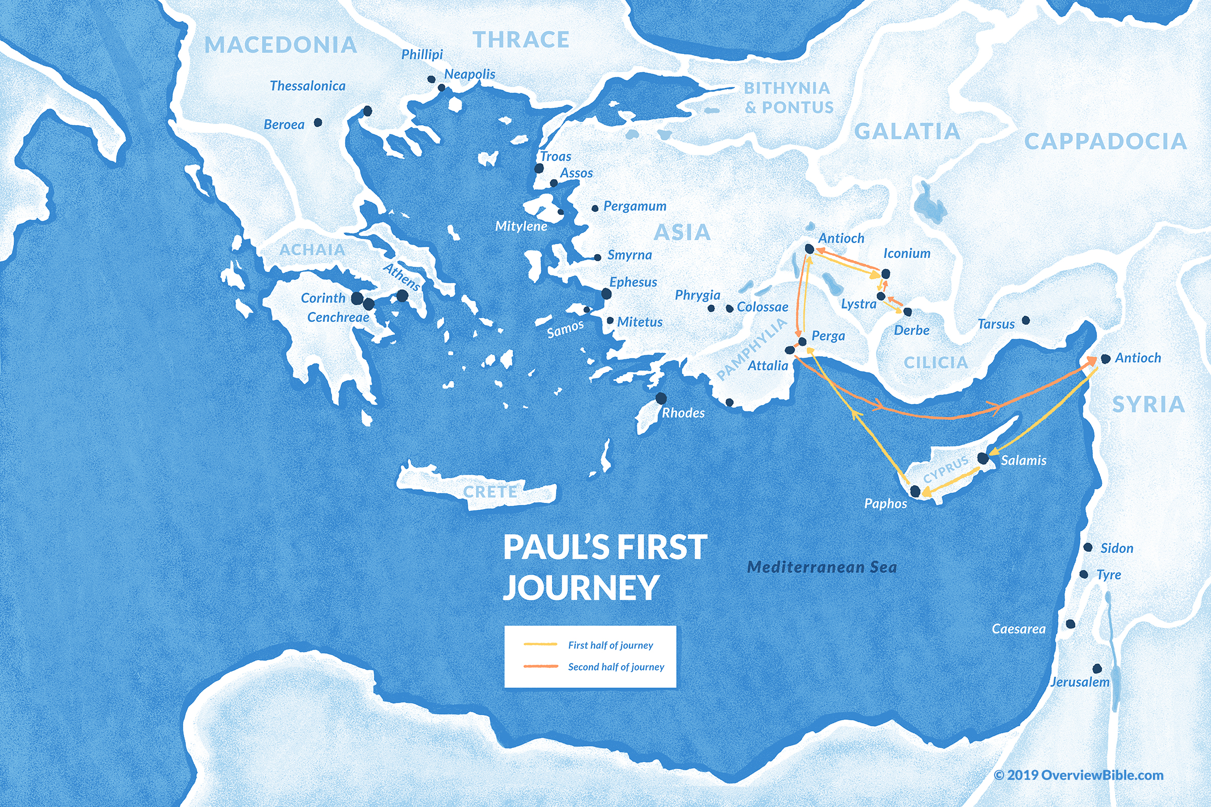
1
Acts 13–14
45-47 AD
  2 years
Acts 15
50 AD
  Jerusalem Council
G

Slide 4
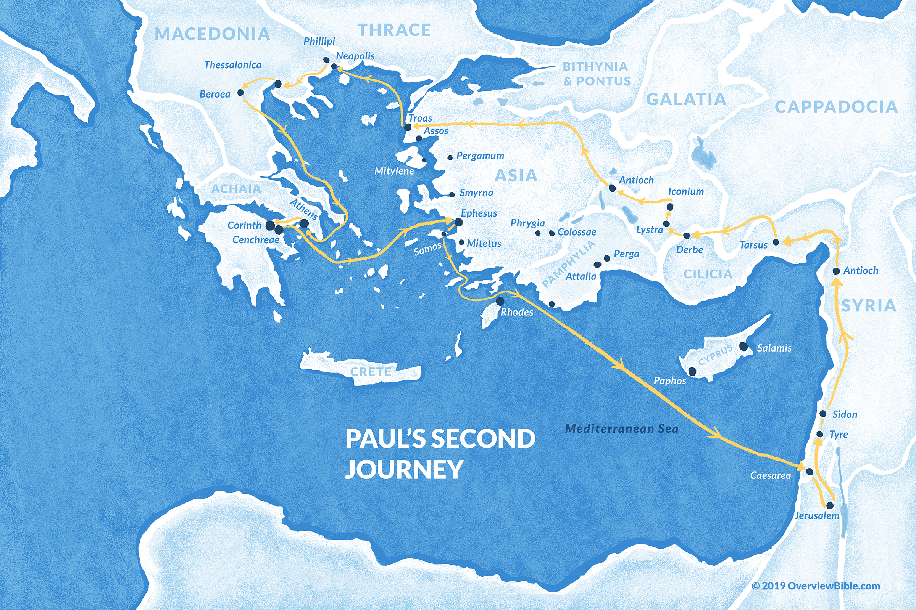
2
1,2 T
Acts 16:23–18:22
50-54
  3 years

Slide 5
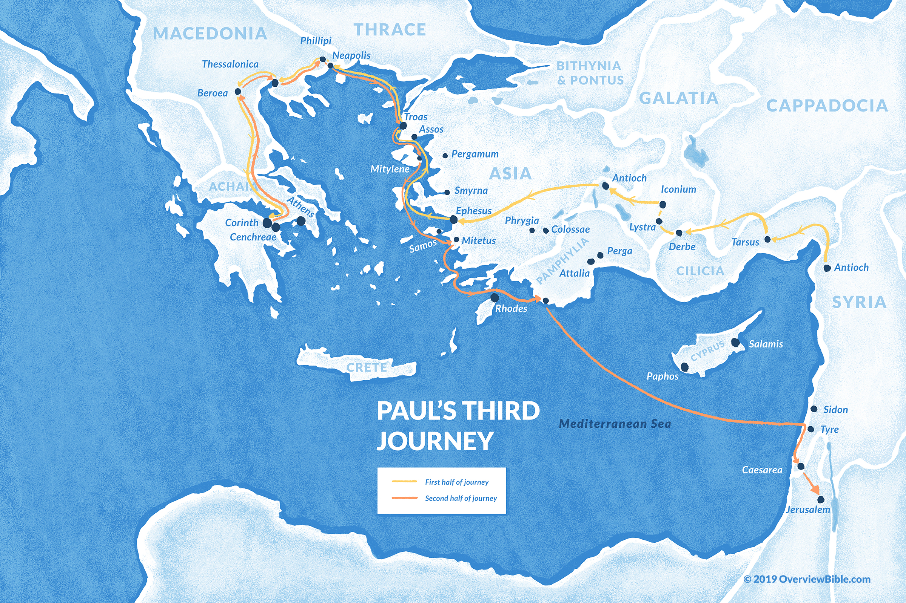
3
2 C
Acts 18:23–20:38
54-58
  4 years
R
1 C

Slide 6
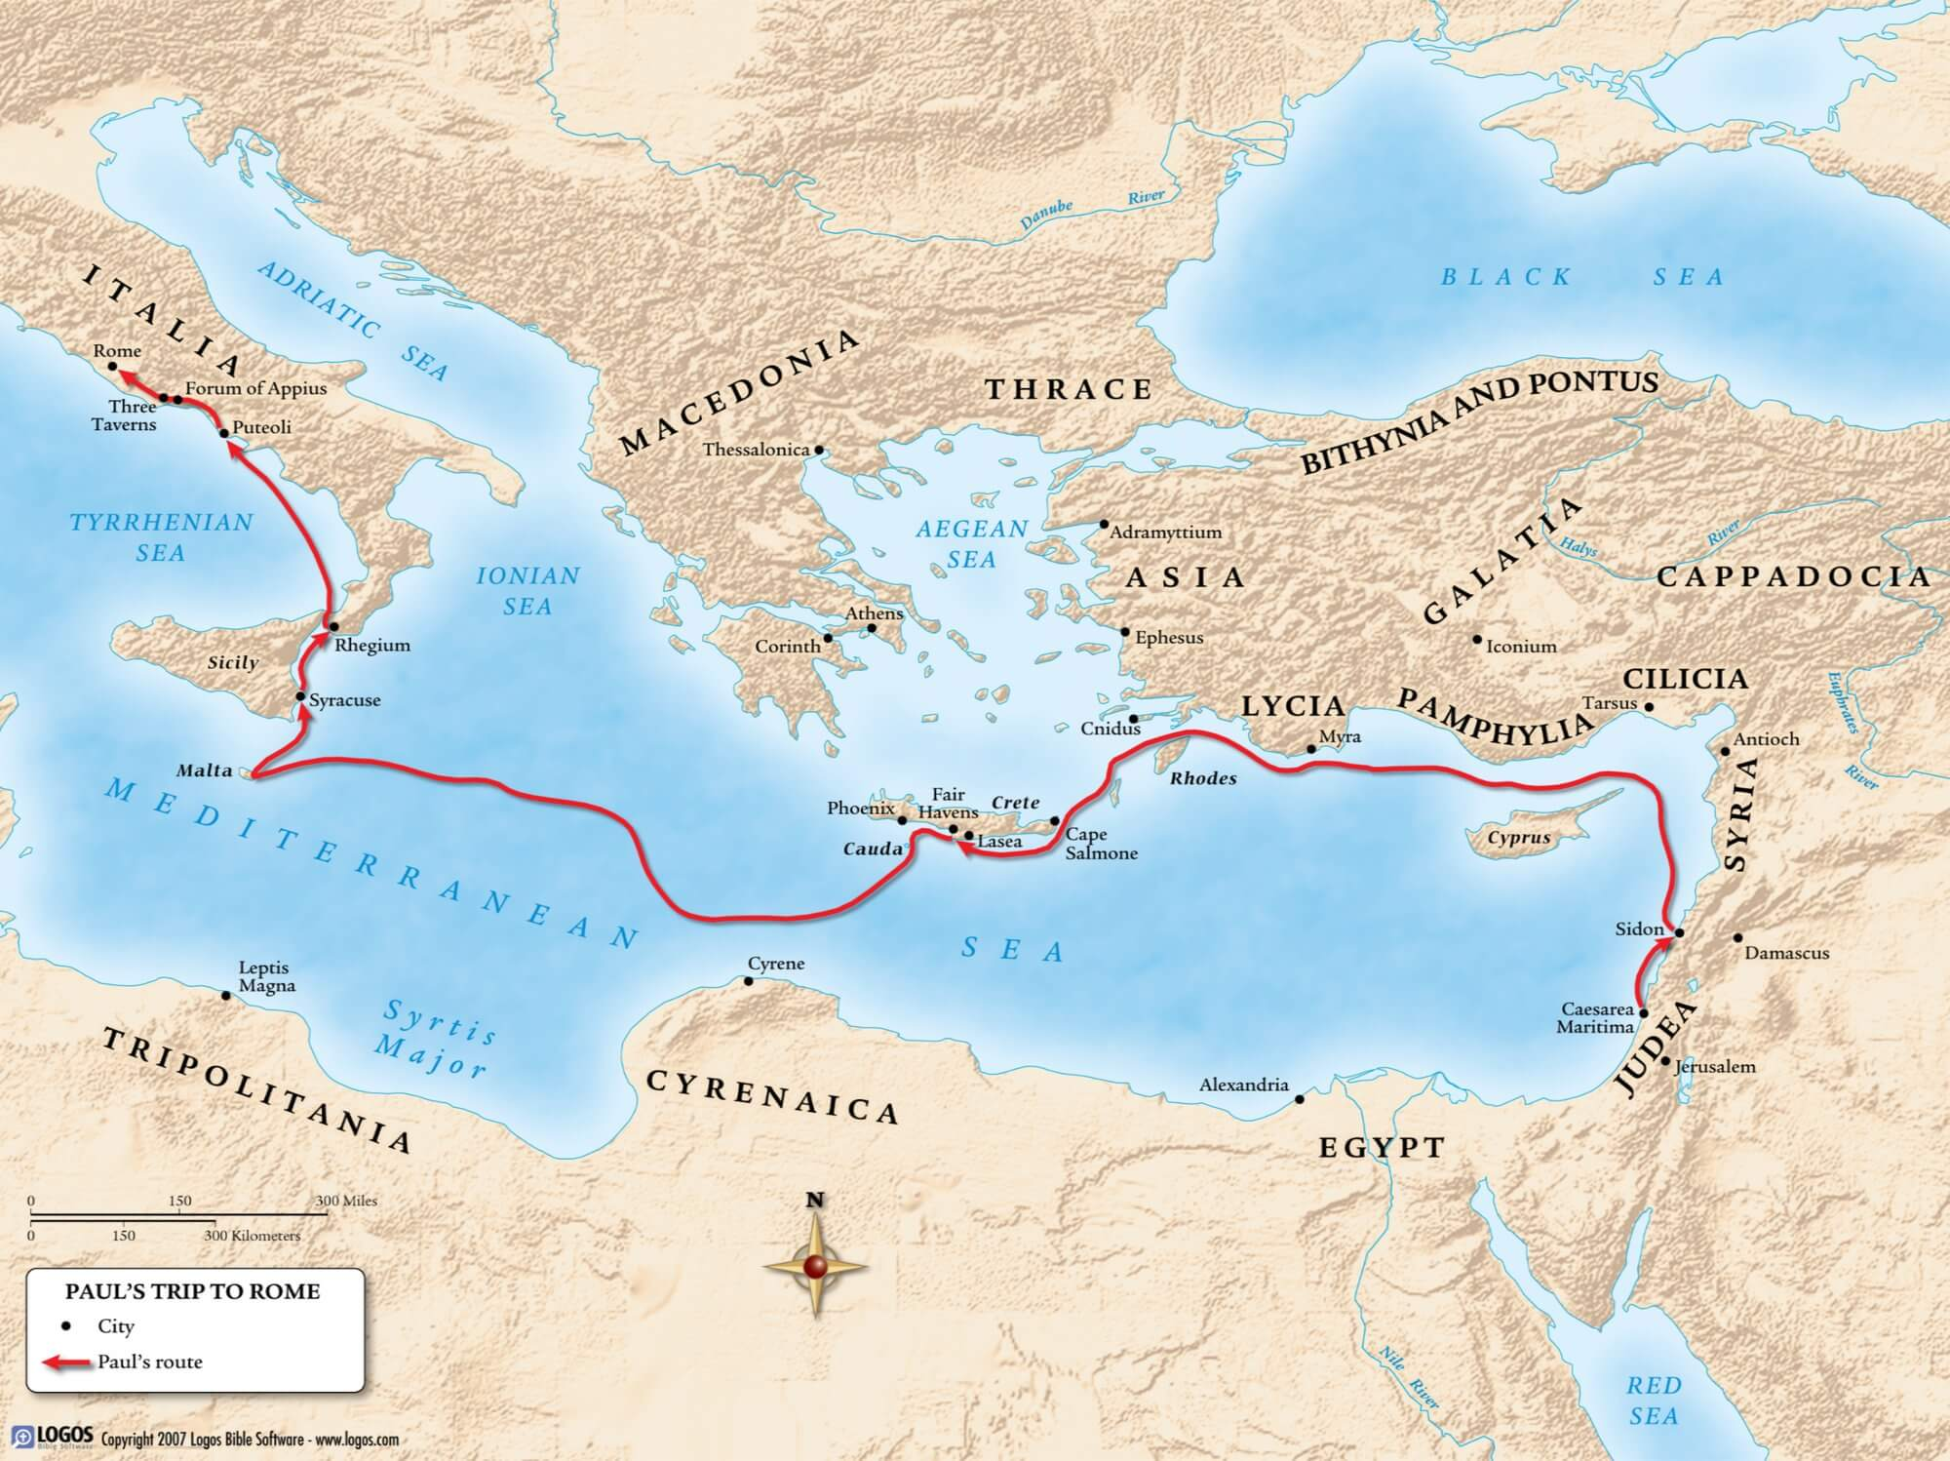
E,P,
C, P
I T,
IIT, T

Slide 7
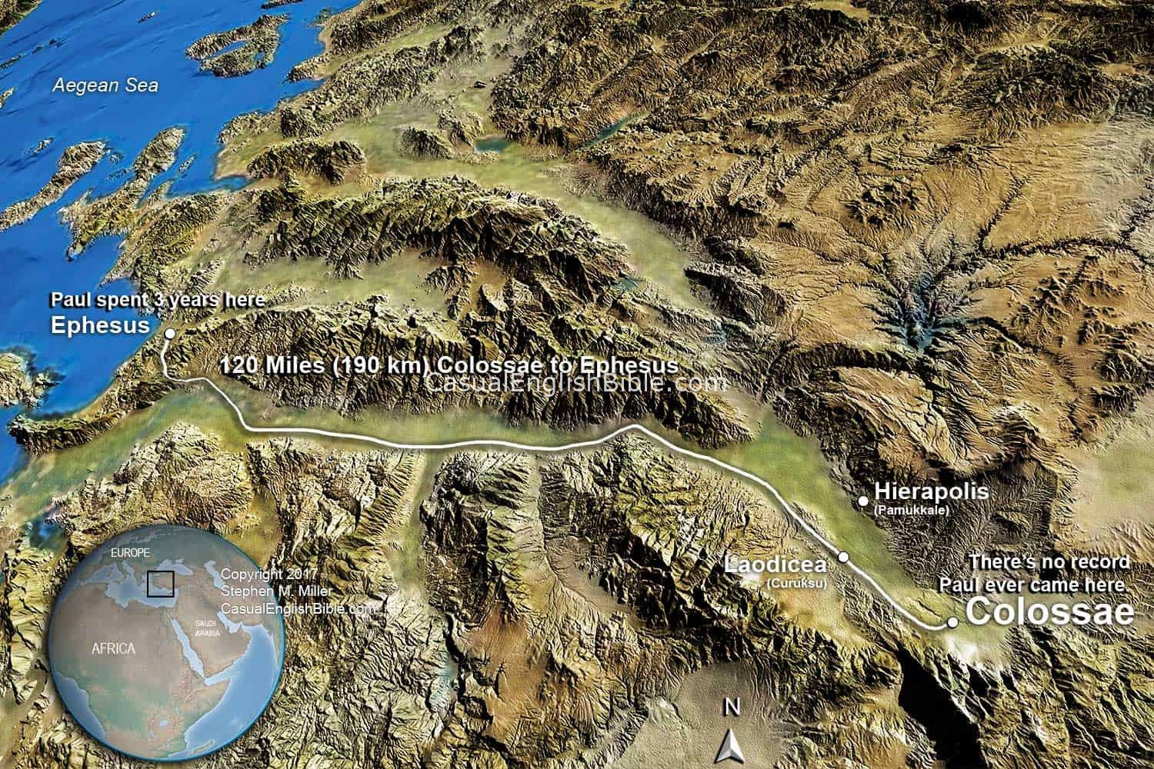

Slide 8
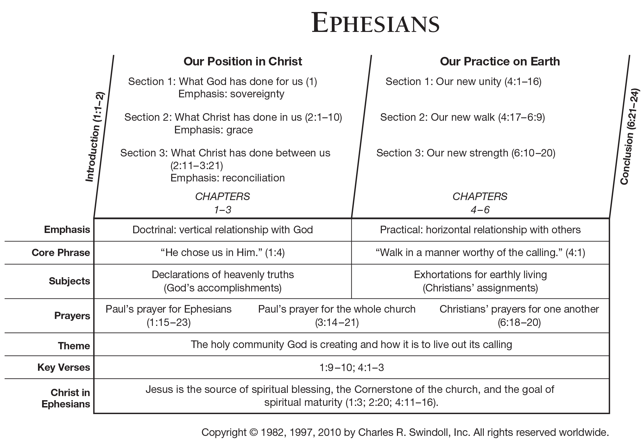

Slide 9
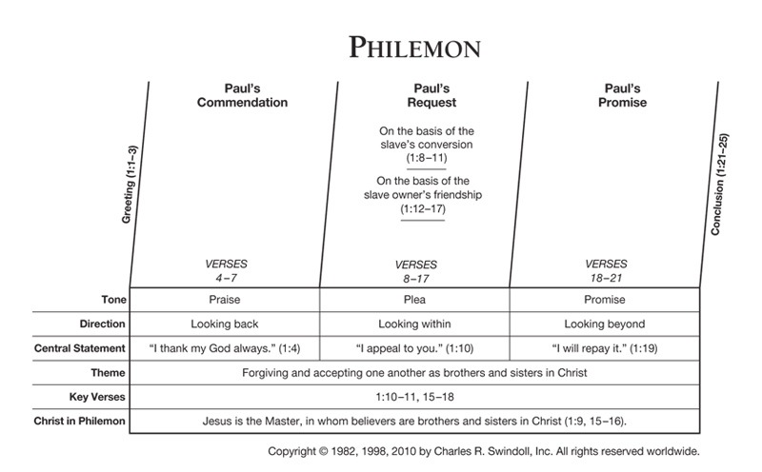

Slide 10
