Slide 1
NT Survey:
Pauline Epistles
Dr. Keith Schubert

Slide 2
Date | Topic
1/22 | Intro, Galatians (48 or 56)
1/29 | I & II Thessalonians (50-53)
2/5 | I & II Corinthians (54-56)
2/12 | Romans (57-58)
2/19 | Prison 1: Ephesians, Philemon (61-63)
2/26 | Prison 2: Philippians, Colossians (61-63)
3/5 | Pastorals: I & II Timothy, Titus (67-68)

Slide 3
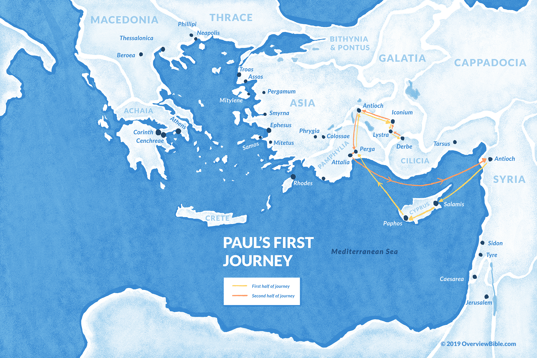
1
Acts 13–14
45-47 AD
  2 years
Acts 15
50 AD
  Jerusalem Council
G

Slide 4
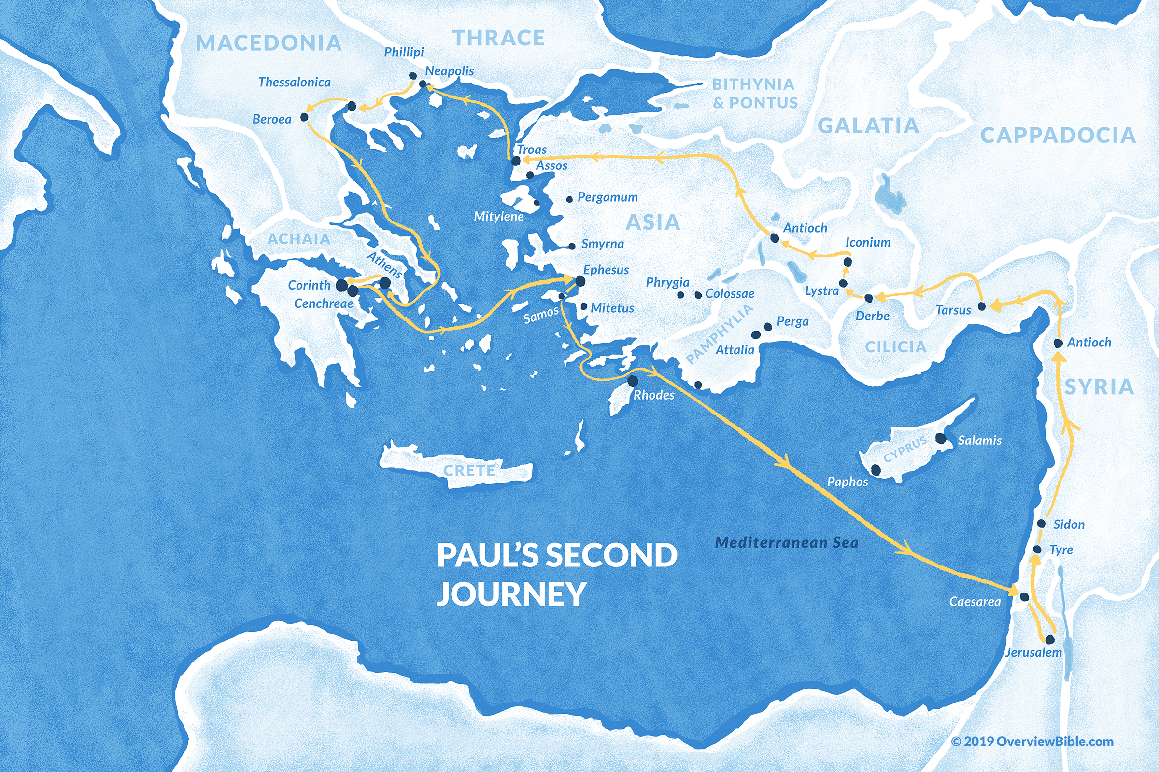
2
1,2 T
Acts 16:23–18:22
50-54
  3 years

Slide 5
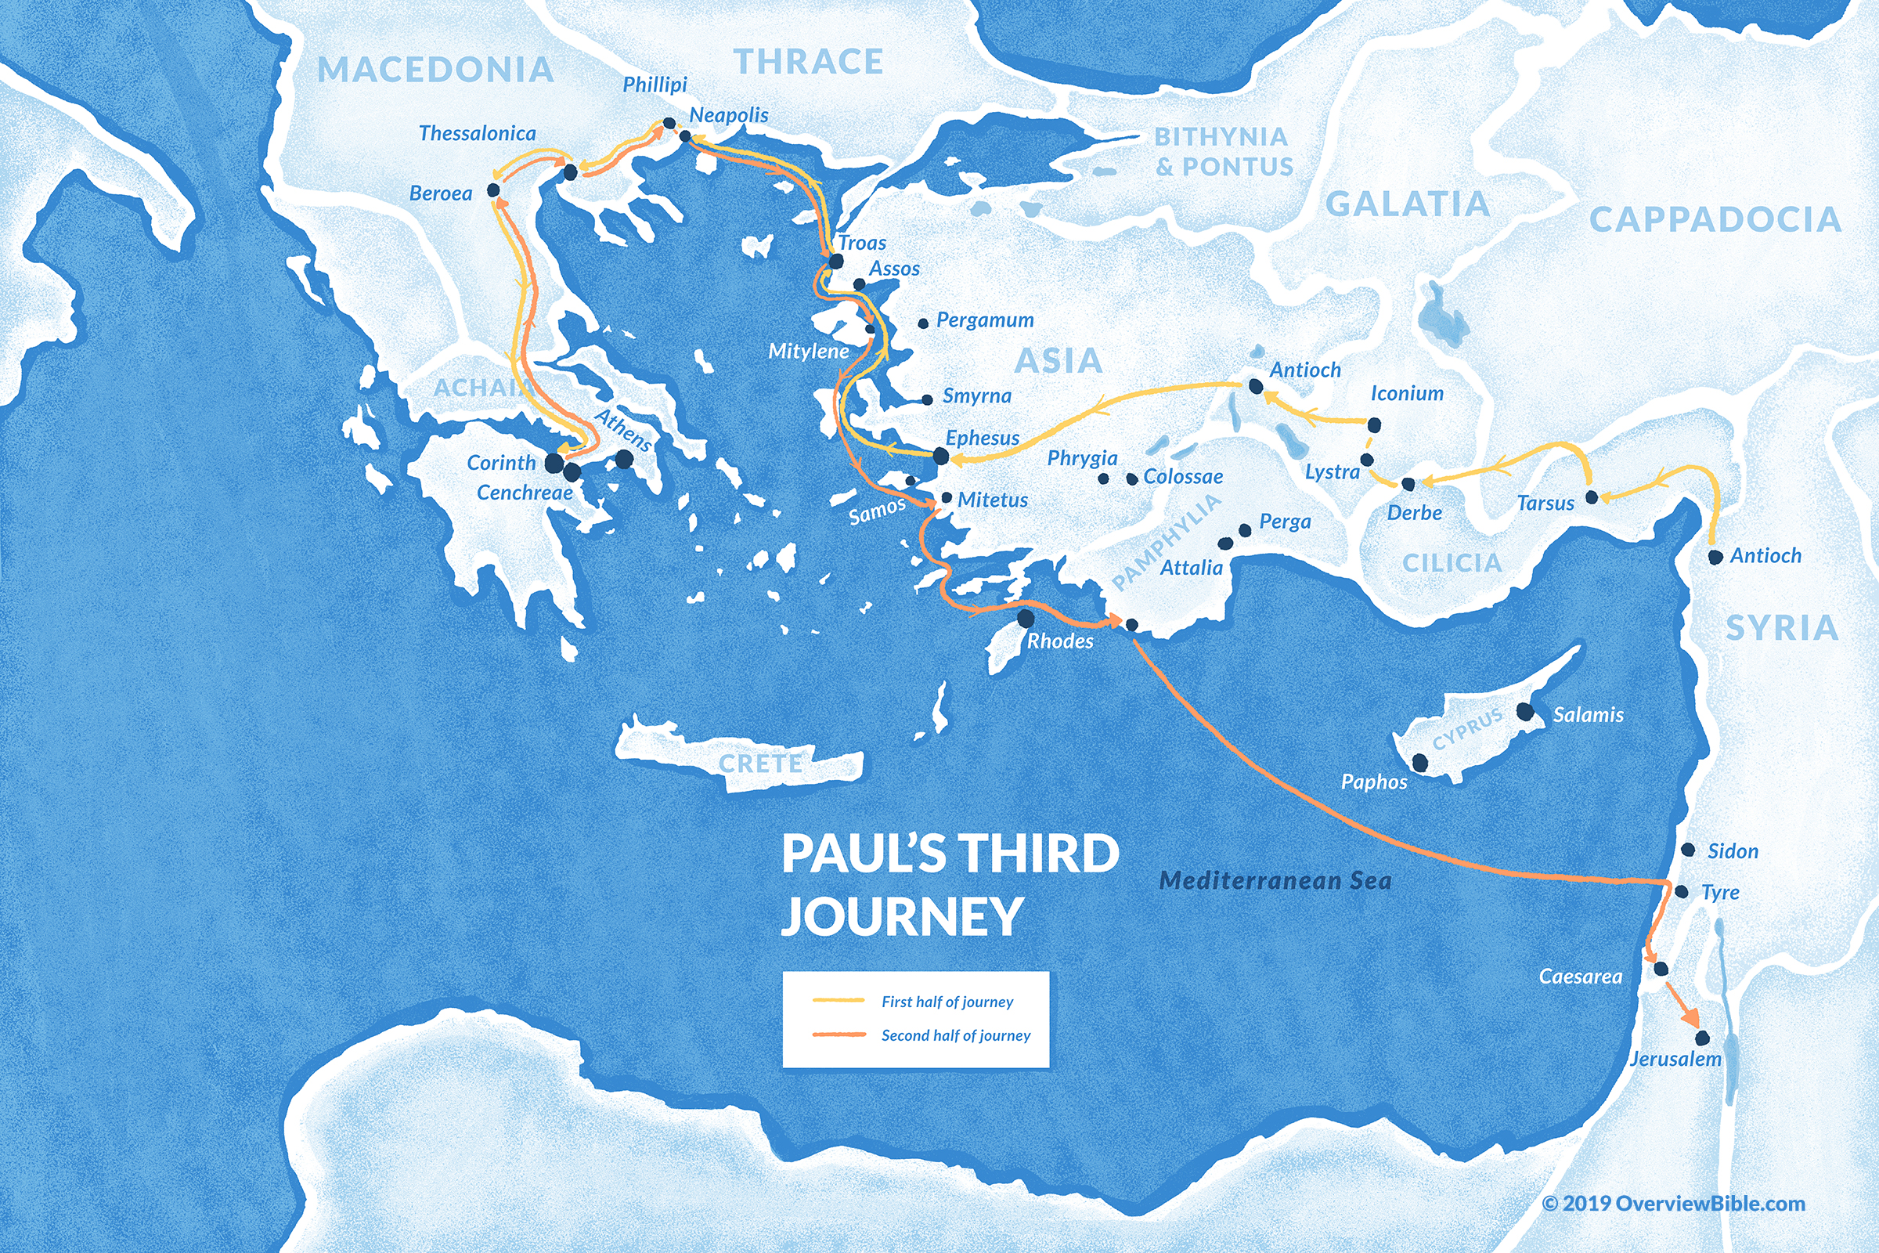
3
2 C
Acts 18:23–20:38
54-58
  4 years
R
1 C

Slide 6
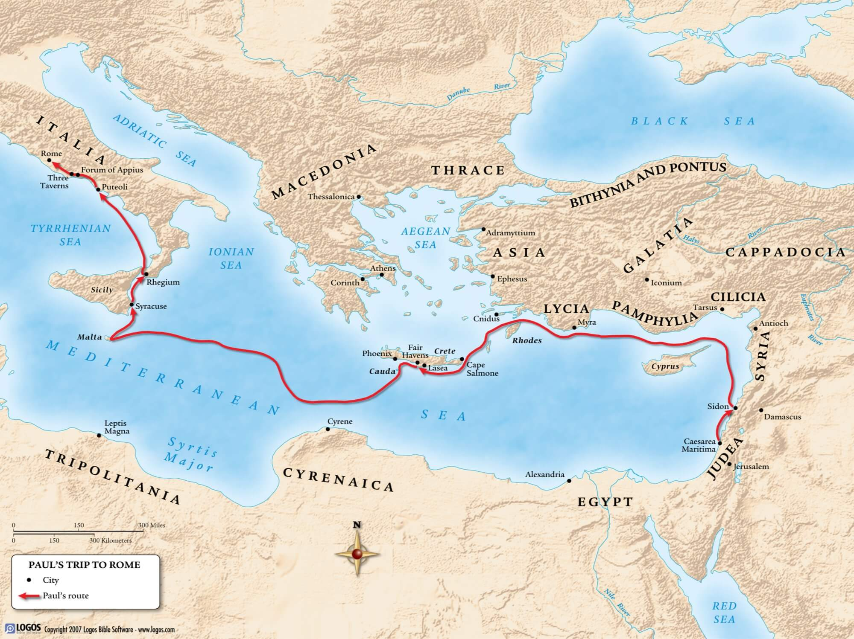
E,P,
C, P
I T,
IIT, T

Slide 7
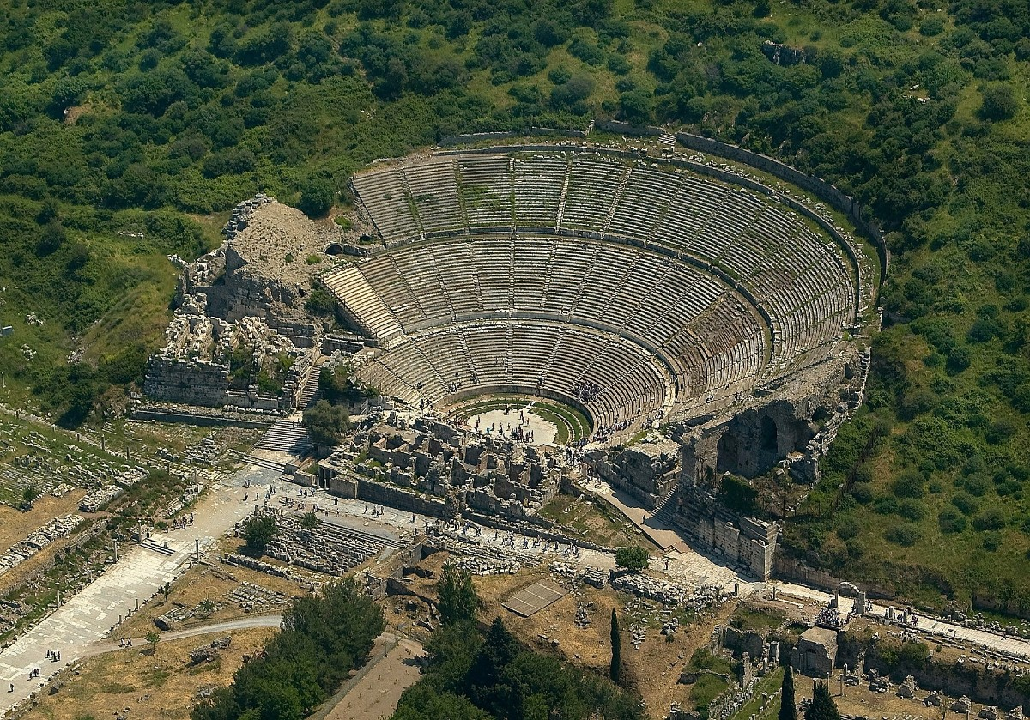
Timothy
1+2 Timothy
Born Lystra AD 17-30
With Paul from c. AD 50
At Ephesus by mid 60’s AD
Died Ephesus c. AD 97
Family (Acts 16, 2Tim 1):
  Father: unknown (gentile)
  Mother: Eunice (Jewish)
  Grandmother: Lois (Jewish)
Timid (1 Cor 16, 1+2 Tim)
Written after events of Acts.
  2 Timothy from prison
  1 Timothy possibly from 4th missionary journey
Notes:
Birthdate is uncertain, some questionable sour
Hebrews 13:23 indicates he was in prison
Died as a martyr

Slide 8
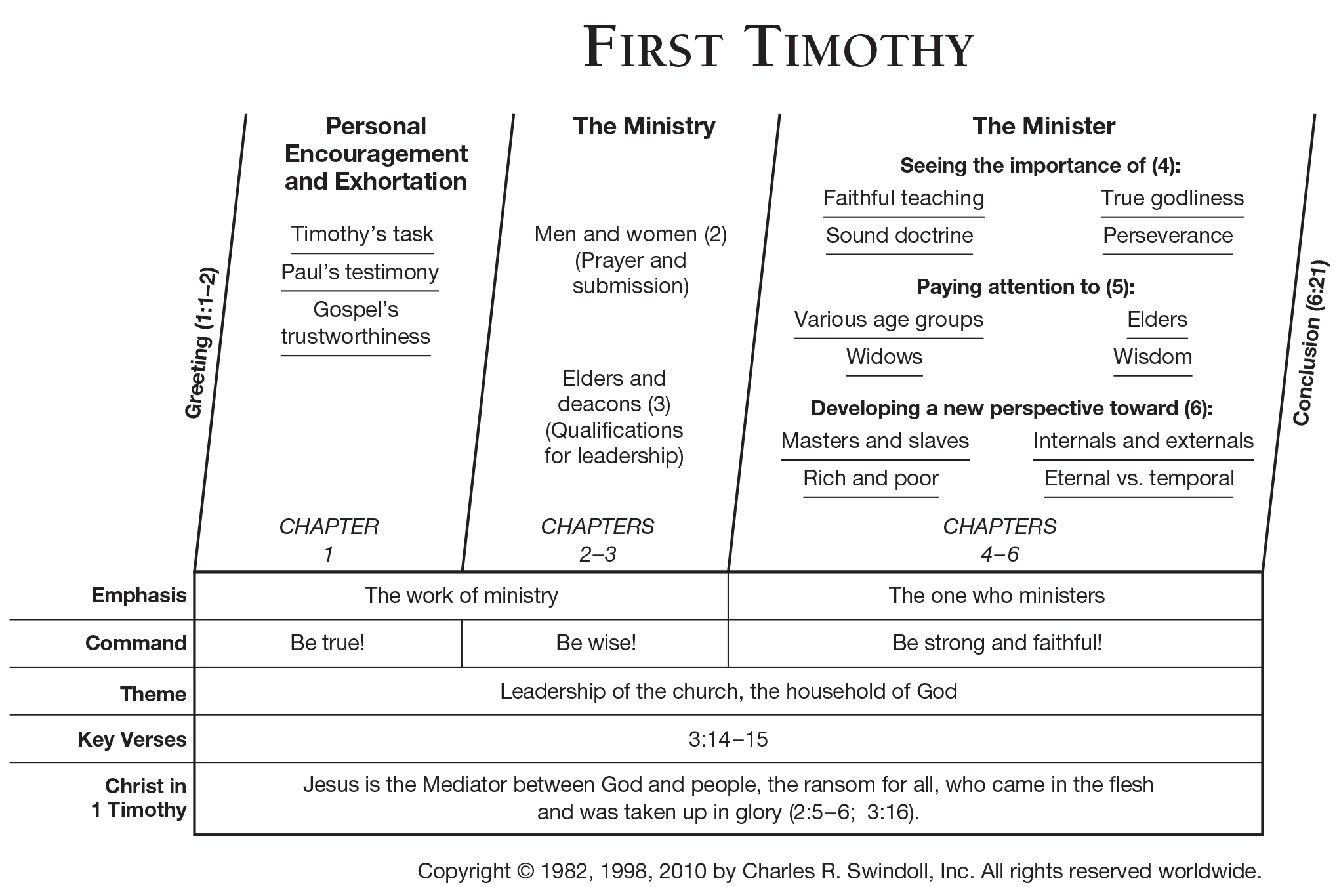

Slide 9
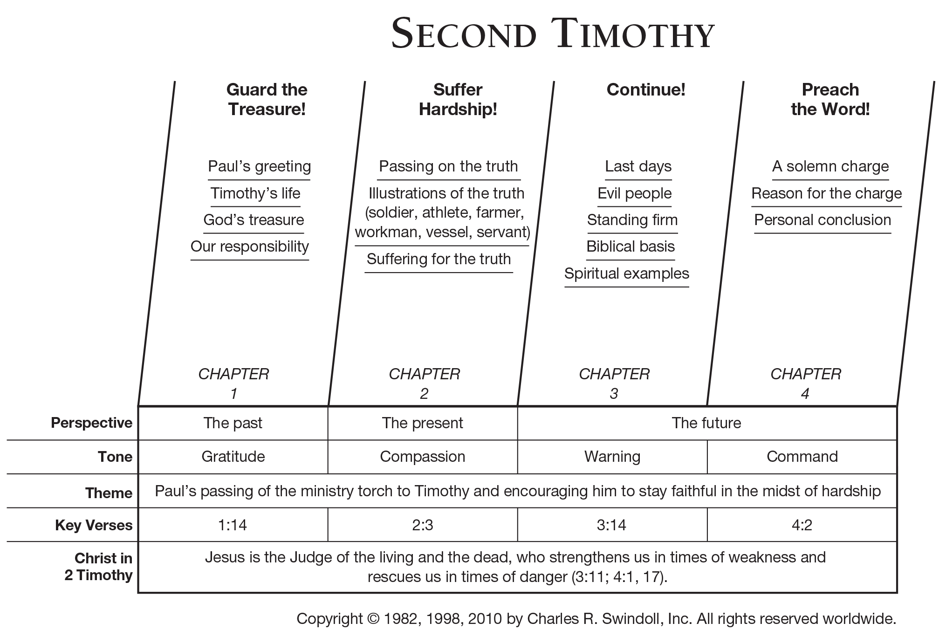

Slide 10
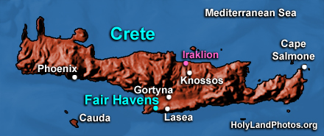
Titus
Epistle to Titus
Died Gortyn, Crete c. AD 96-107
Greek, accompanied Paul to the Jerusalem Council
Carried the “severe” letter to Corinth
Jerome identified him as the scribe of 2 Corinthians which he carried
Paul put him in charge of setting up churches in Crete between imprisonments
Paul summoned him to Nicapolis in Titus
Sent to Dalmation (per 2 Timothy)
Not sure of timing:
  Between 1st and 2nd Timothy?
  Before 1st Timothy?
  Between 1st and 2nd imprisonments?
  Probably after 1st imprisonment
    63-65
  After the possible Spain trip?
    66-67
Not sure of location
  Possibly Macedonia
Very similar to 1st Timothy
Notes:
Birthdate is uncertain, some questionable sour
Hebrews 13:23 indicates he was in prison
Died as a martyr

Slide 11
