Slide 1
NT Survey:
General Epistles & Revelation
Dr. Keith Schubert

Slide 2
Date | Topic
3/19 | Intro, Hebrews
3/26 | Hebrews
4/2 | I & II Peter
4/9 | I, II, III John
4/16 | James, Jude
4/23 | Revelation
4/30 | Revelation

Slide 3
Background to Hebrews
Date:
  Hebrews 5:1-4, 7:26-8:6
    Pre 70AD
  Hebrews 10:32-39, 13:3
    Church obligation
    Finish a project
    Personal obligation
    Imprisonment
    Post 63AD/68AD
Author:
  Hebrews 1:1-4, 2:1-4, 13:18-25
  Jewish ancestry
  Not first generation
  Knew Timothy
  Pauline similarities
  Written in Classical Greek
  Quotes from the Old Testament are from the Septuagint
  Detailed temple practice
  Greetings from Italians

Slide 4
Author
Paul:
  Pauline emphasis
  Paul is the most cited author.
  vocab & argument not Pauline
  earliest author cites not Paul
  Hebrews 2:3 v. Galatians 1:11-12.
Others with low likelihood
  Silas,
  Clement of Rome,
  Priscilla, and Aquila
Barnabas:
  friend of Paul (Acts 11:22-26) & Timothy
  a Levite (Acts 4:36-37),
  well known
  earliest recorded author by Tertulian
Luke:
  friend of Paul and Timothy,
  Style similarities but more differences
  several 2nd century writers cite as author
  very different to Luke’s writing
Apollos:
  friend of Paul (Titus 3:13) and Timothy
  well known (Acts 18:24-28)
  likely trained in Classical Greek
  considered the author by Martin Luther

Slide 5
Audience
Palestine
Italy
Why Palestine? Numerous references to the Temple/Tabernacle rather than Synagogue , the large number of Jewish believers present, and the temptation to fall back into Judaism (not pagan worship).
Why not Palestine? The references to the Temple/Tabernacle are equally relevant everywhere, Hebrews 2:3 indicates that the audience were all second generation Christians, which would be highly unlikely for Palestine.
Why Italy? Hebrews 13:24 includes the quote “Those from Italy greet you.” which from the original Greek leans heavily to the idea that these were Italians who were abroad. Who cares? Why single them out unless you are dealing with an Italian audience?
Why not Italy? Romans considered Christianity as a sect of Judaism, so going back to Judaism would not remove all the persecution.

Slide 6
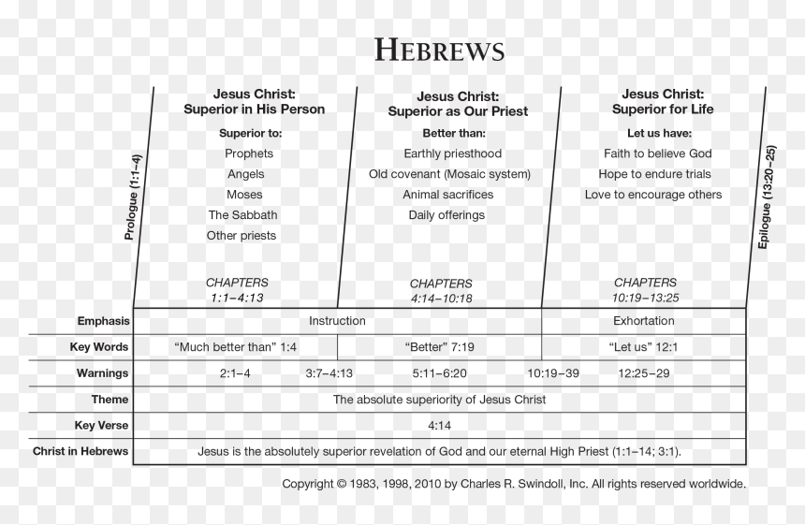

Slide 7
