Slide 1
NT Survey:
General Epistles & Revelation
Dr. Keith Schubert

Slide 2
Date | Topic
3/19 | Intro, Hebrews
3/26 | Hebrews
4/2 | I & II Peter
4/9 | I, II, III John
4/16 | James, Jude
4/23 | Revelation
4/30 | Revelation

Slide 3
Life: 6AD – 100AD
Parents: Zebedee and Salome
Brother: James the Great
1st cousin of Jesus
Quotes and allusions in writings of Polycarp and Justin Martyr
Traditionally, John is author of all 5
Papias is earliest to state this
Eusebius identifies John as widely agreed on author of gospel and 1st John but not 2nd and 3rd John or Revelation
Revelation has a similar style to the Gospel
Most believe now 1st, 2nd, and 3rd John have same author
Early tradition holds bishops in Asia asked John to write the gospel
Irenaeus mentions the first two epistles as John’s writing

Slide 4
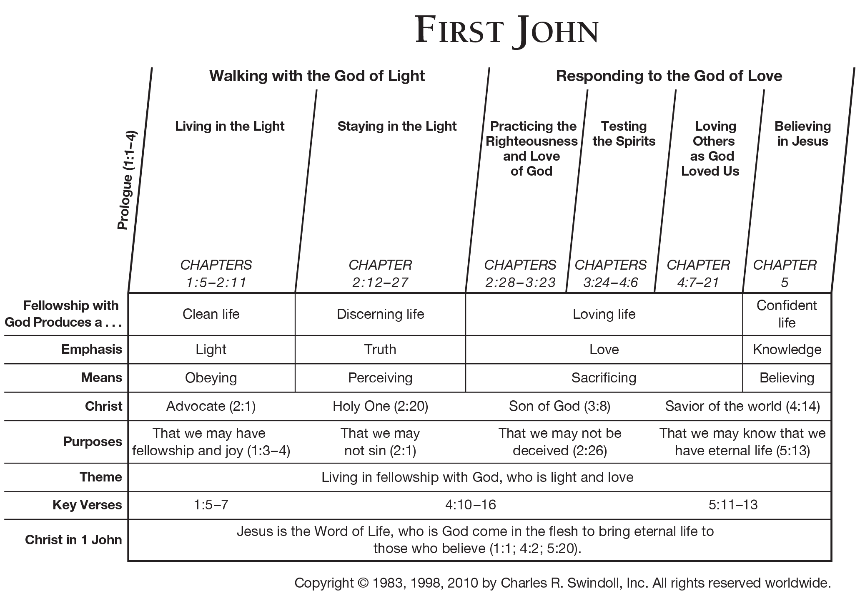

Slide 5
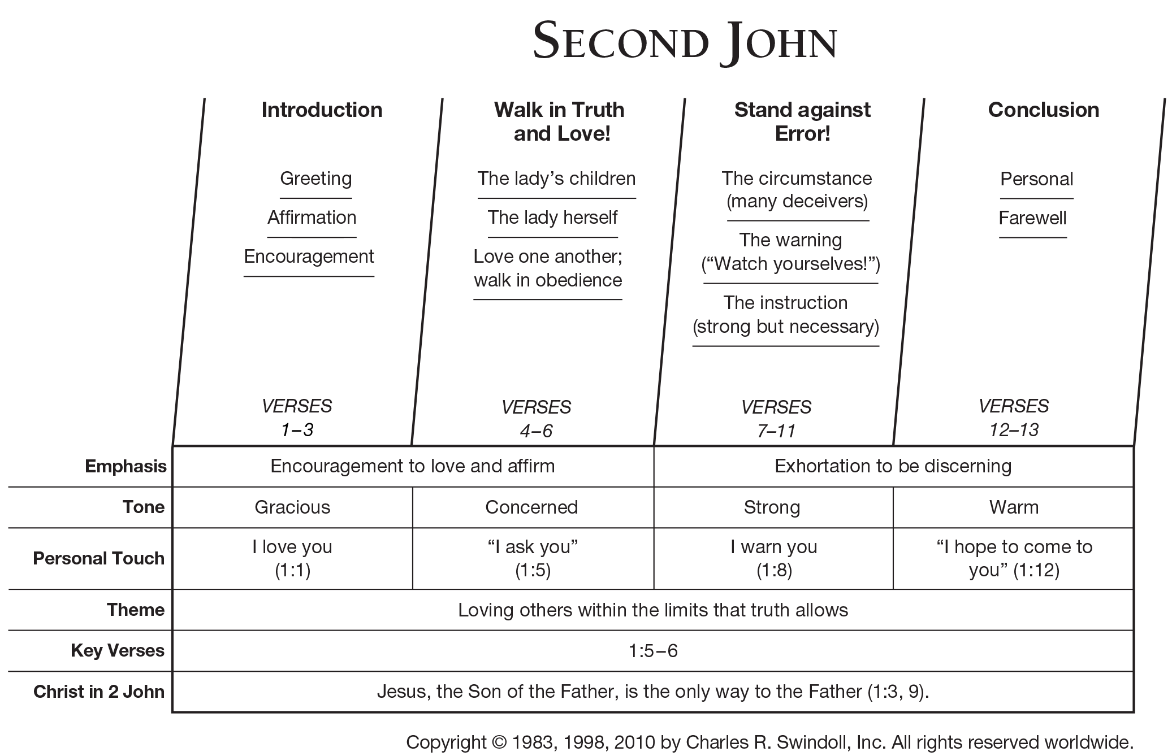

Slide 6
