Slide 1
NT Survey:
General Epistles & Revelation
Dr. Keith Schubert

Slide 2
Date | Topic
3/19 | Intro, Hebrews
3/26 | Hebrews
4/2 | I & II Peter
4/9 | I, II, III John
4/16 | James, Jude
4/23 | Revelation
4/30 | Revelation

Slide 3
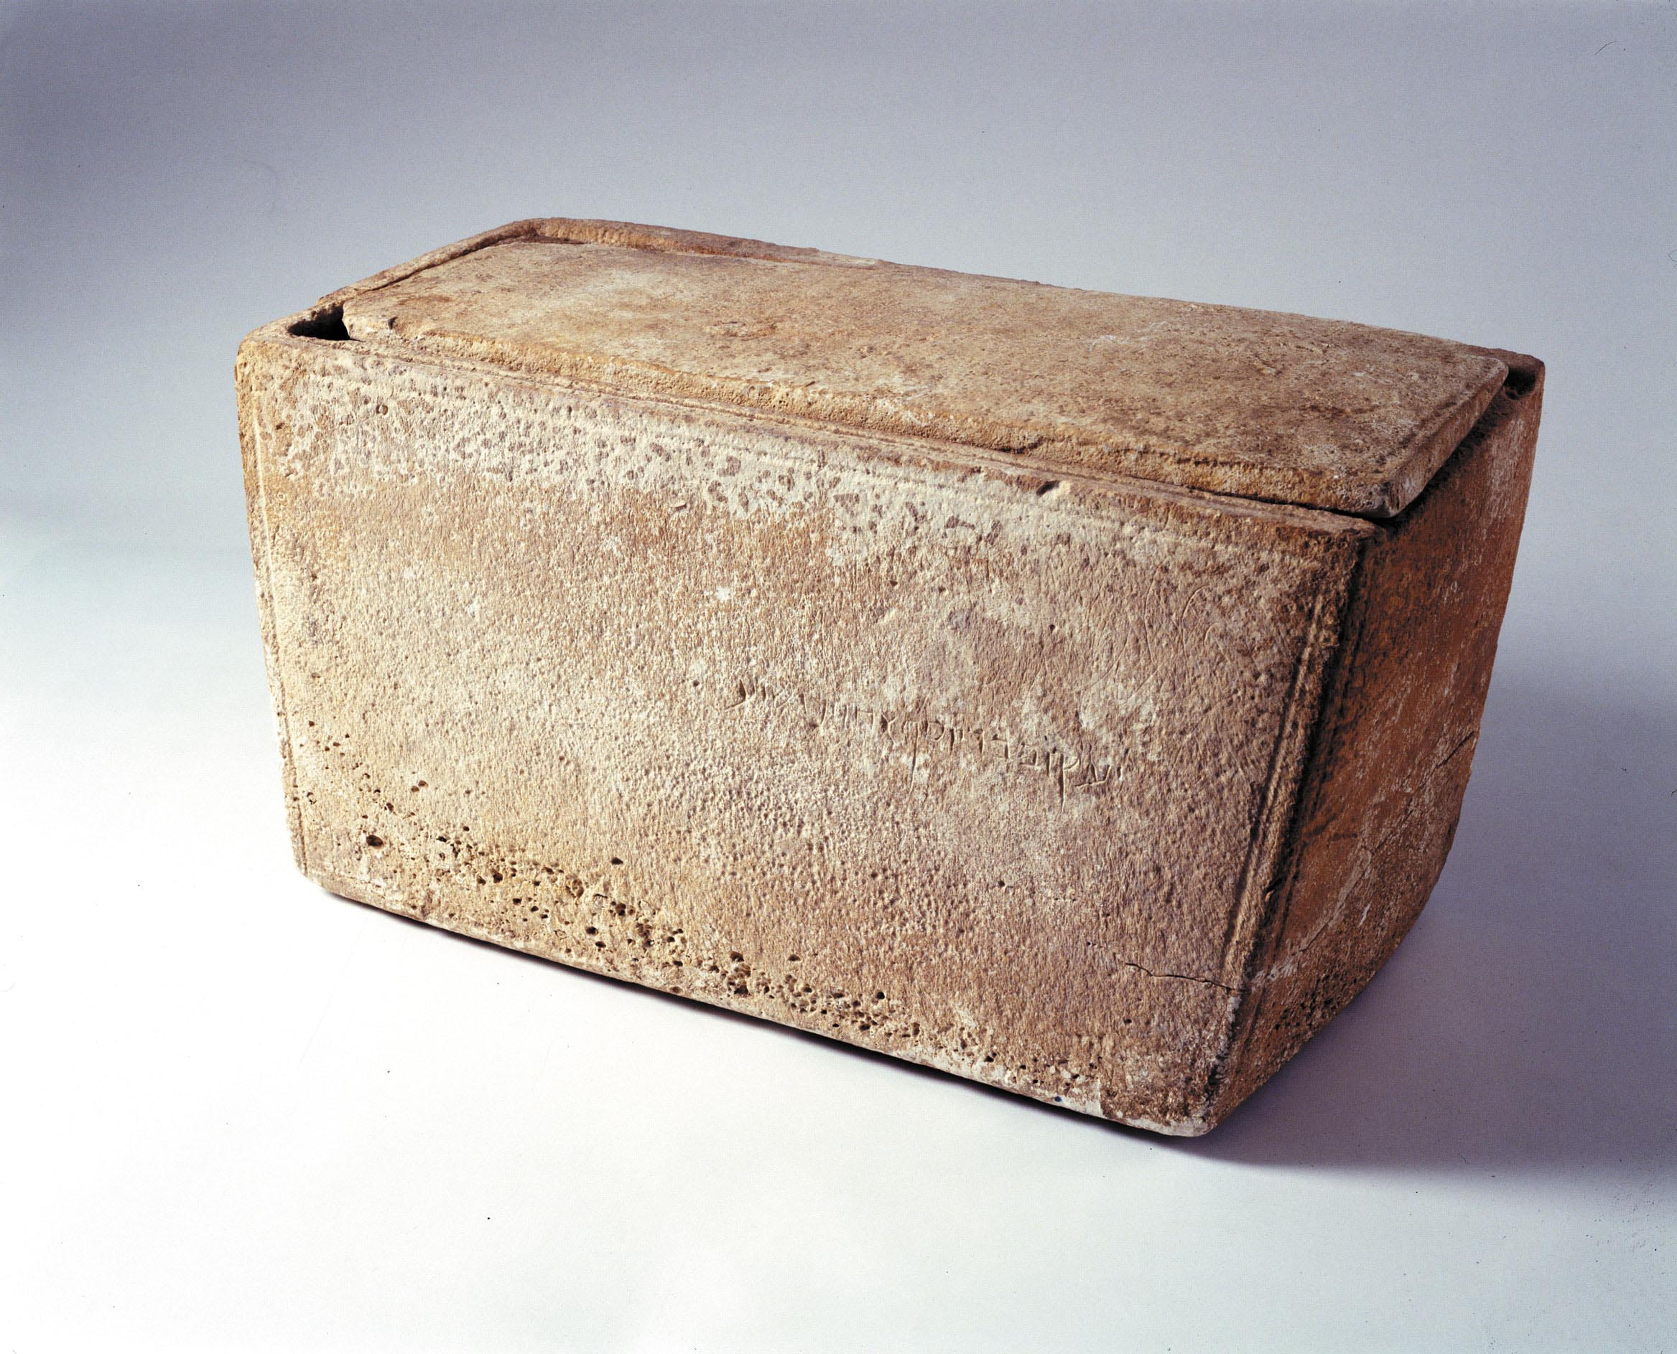
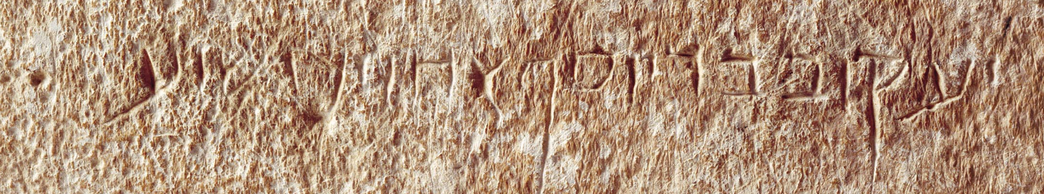
Brothers of Jesus
James, Joses/Joseph, Judas/Jude, Simon, & sisters
  Mark 6:3, Matthew 13:55-6
Rift in family, brothers not at burial
  Mark 3:31-5, Matthew 12:46-50,Luke 8:19-21
  Acts 1:14, 1 Corinthians 15:3–7
Hegesippus (c.110 – 180 AD) brother of Jesus -James the Just
Eusebius of Caesarea (260/5-339 AD) James spent so much of his life in prayer that his knees became "like the knees of a camel."
Clement of Alexandria (150-215 AD) reported by Eusebius, James was chosen as bishop of Jerusalem
Acts 15 - presiding over Council of Jerusalem
Galatians 1:19 “James, the brother of the Lord”
Galatians 2:9 “James, Cephas, and John”
Galatians 2:12 “certain men came from James”
James Ossuary
(19.9 in × 9.8 in × 12.0 in)
Ya'akov bar Yosef akhui di Yeshua
James, son of Joseph, brother of Jesus

Slide 4


Slide 5
