Slide 1
NT Survey:
General Epistles & Revelation
Dr. Keith Schubert

Slide 2
Date | Topic
3/19 | Intro, Hebrews
3/26 | Hebrews
4/2 | I & II Peter
4/9 | I, II, III John
4/16 | James, Jude
4/23 | Revelation
4/30 | Revelation

Slide 3
Late
Irenaeus
Irenaeus (A.D. 180), a student of Polycarp (who was a disciple of the apostle John), wrote that the apocalyptic vision “was seen not very long ago, almost in our own generation, at the close of the reign of Domitian” (Against Heresies 30). The testimony of Irenaeus, not far removed from the apostolic age, is first rate. He places the book near the end of Domitian’s reign, and that ruler died in A.D. 96. Irenaeus seems to be unaware of any other view for the date of the book of Revelation.
Clement of Alexandria
Clement of Alexandria (A.D. 155-215) says that John returned from the isle of Patmos “after the tyrant was dead” (Who Is the Rich Man? 42), and Eusebius, known as the “Father of Church History,” identifies the “tyrant” as Domitian (Ecclesiastical History III.23).
Even Moses Stuart, America’s most prominent preterist, admitted that the “tyrant here meant is probably Domitian.” Within this narrative, Clement further speaks of John as an “old man.” If Revelation was written prior to A.D. 70, it would scarcely seem appropriate to refer to John as an old man, since he would only have been in his early sixties at this time.
Victorinus
Victorinus (late third century), author of the earliest commentary on the book of Revelation, wrote:
When John said these things, he was in the island of Patmos, condemned to the mines by Caesar Domitian. There he saw the Apocalypse; and when at length grown old, he thought that he should receive his release by suffering; but Domitian being killed, he was liberated (Commentary on Revelation 10:11).
Jerome
Jerome (A.D. 340-420) said,
In the fourteenth then after Nero, Domitian having raised up a second persecution, he [John] was banished to the island of Patmos, and wrote the Apocalypse (Lives of Illustrious Men 9).

Slide 4
Early
A quote from Clement of Alexandria (150-220 AD) who plainly states that it was Nero who banished John to Patmos, not Emperor Domitian
A nd to give you confidence, when you have thus truly repented, that there remains for you a trustworthy hope of salvation, hear a story that is no mere story, but a true account of John the apostle that has been handed down and preserved in memory. When after the death of the tyrant (previously identified as Nero) he removed from the island of Patmos to Ephesus, he used to journey by request to the neighboring districts of the Gentiles, in some places to appoint bishops, in others to regulate whole churches, in others to set among the clergy some one man, it may be, of those indicated by the Spirit.
(“Who is the Rich Man that shall be Saved?”, Section 42)
Cerinthus was a first century A.D. author who wrote The Pseudo-Apocalypse. He died well before John, that is well before A.D. 95, but his Pseudo-Apocalypse contains many references to John’s Apocalypse (the Book of Revelation).
The internal evidence supports a pre-A.D. 64 authorship. This includes-
  Rev. 11- John is told to measure the Temple which was impossible in A.D. 95 because it had been destroyed in A.D. 70
  Rev. 17- There are “seven kings, five have fallen, one now is.” Nero was the 6th Roman King the “one [who] now is”. He reigned until A.D. 68.

Slide 5
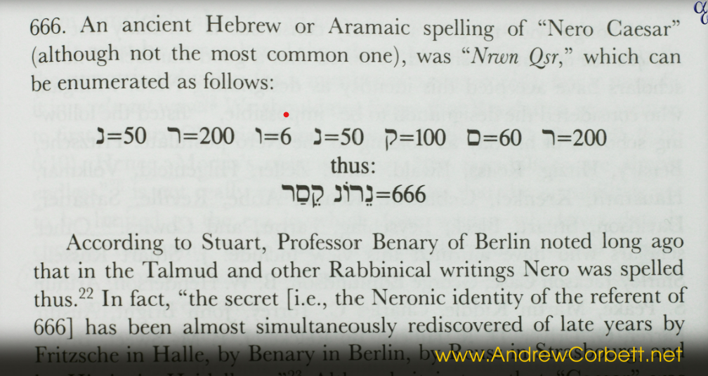
Early
The doctoral work by Kenneth L. Gentry on dating Revelation has concluded that it must have been written in the “mid to late 60s” rather than in A.D. 95-
There are suggestive evidences within the book to date it in the mid – to late 60s of the first century. In fact, the evidence is persuasive enough that it convinced such notable scholars Moses Stuart, F. J. A. Hort, B. F. Westcott, and F. W. Farrar in the 19th century, and J. A. T. Robinson, R. A. Torrey, Albert A. Bell, C. F. D. Moule, and R.C. Sproul, in the 20th century.
Two leading indicators of the early date are: (1) The “temple” in the “holy city” is still standing as John writes, though it is being threatened with devastation (Rev. 11: 1-2). We know as a matter of historical fact that the Jewish temple was destroyed in A.D. 70, and has never been rebuilt. (2) The sixth “king” is presently ruling from the “seven mountains” and will do so until a king comes who will reign a “short time” (Rev. 17:9-10). The Preterist takes this to be a clear enough allusion to Nero Caesar. According to the enumeration found in Josephus’ Antiquities (18:2:2,6, 10) and Suetonius’ Lives of the Twelve Caesars, Nero is Rome’s sixth King, following Julius Caesar, Augustus, Tiberius, Gaius, and Claudius. The next reigning emperor, Galba, reigned just six months, the shortest reigning emperor until that time.
Sourced from- http://www.kennethgentry.com/Merchant2/apocalypse.htm
by Dr. Kenneth Gentry Jr.
Full-Preterist, Don Preston, makes a similar point-
What is it Iranaeus [supposedly] said about the date of Revelation? Actually, Iranaeus did not discuss the dating of the book at all. The relevant quote is about the identity of the beast of Revelation and is found in the work of Eusebius, 4th century church historian, Book 5, chapter 8. Eusebius says Iranaeus speaks about John :“We, therefore, do not venture to affirm anything with certainty respecting the name of antichrist. For were it necessary that his name should be clearly announced to the present age, it would have been declared by him who saw the revelation. For it has not been long since it was seen, but almost in our own generation, about the end of Domitian’s reign.”
Don K. Preston

Slide 6
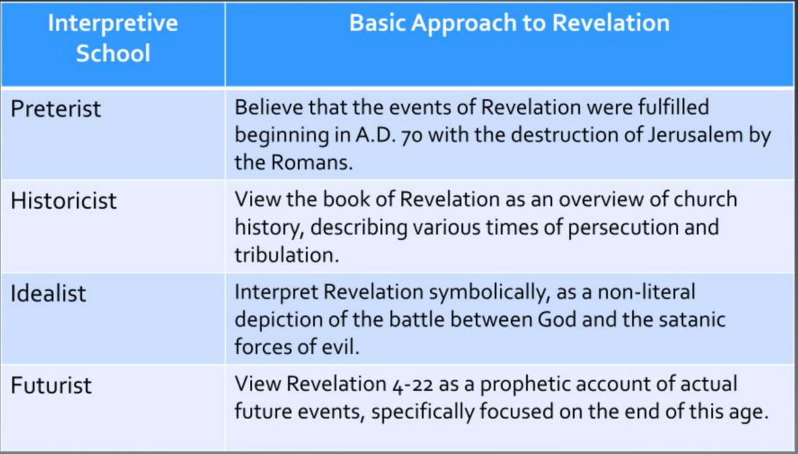

Slide 7
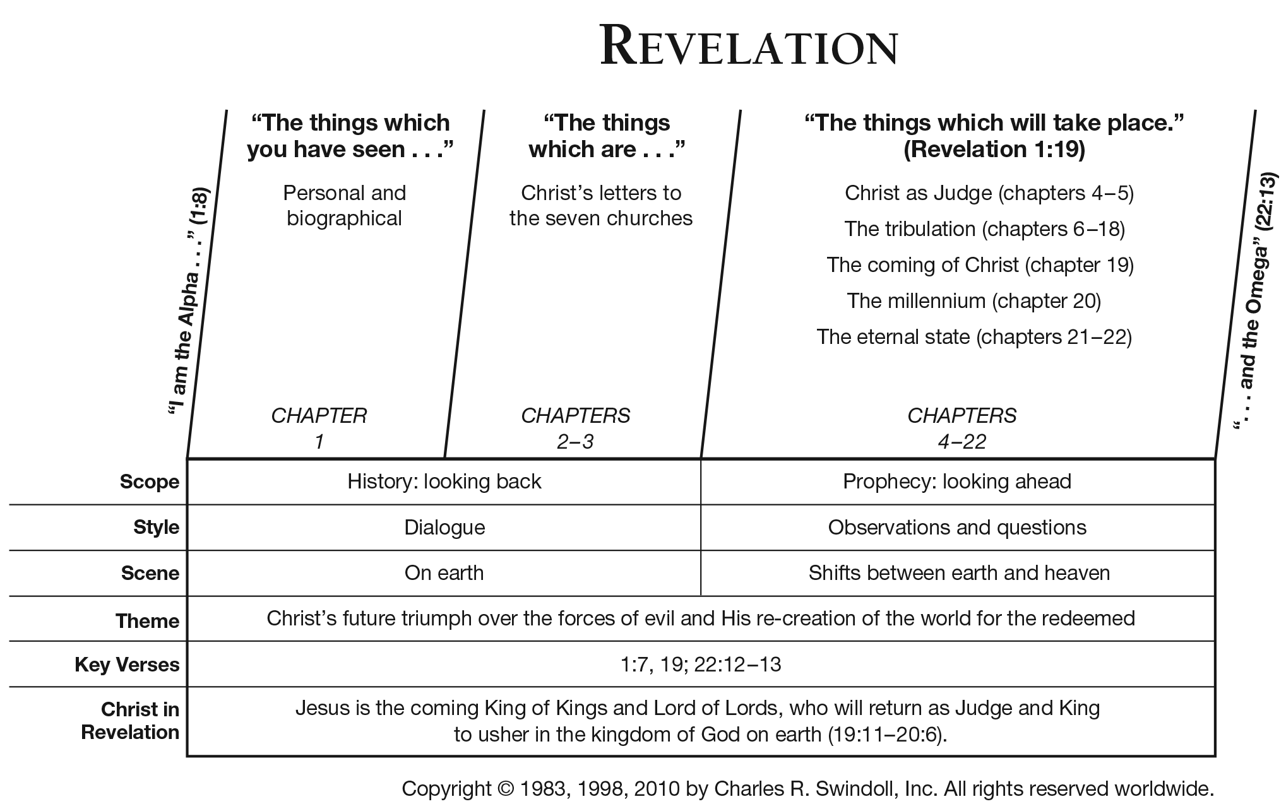

Slide 8
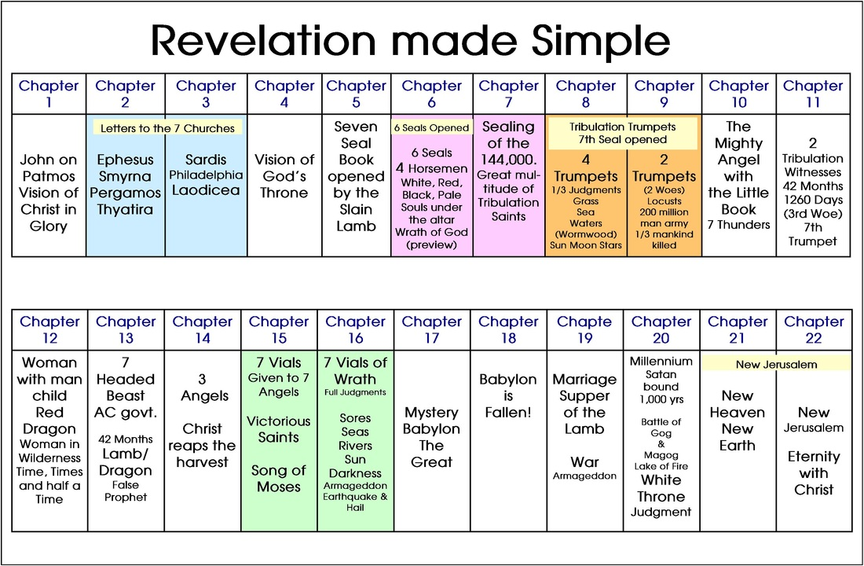

Slide 9
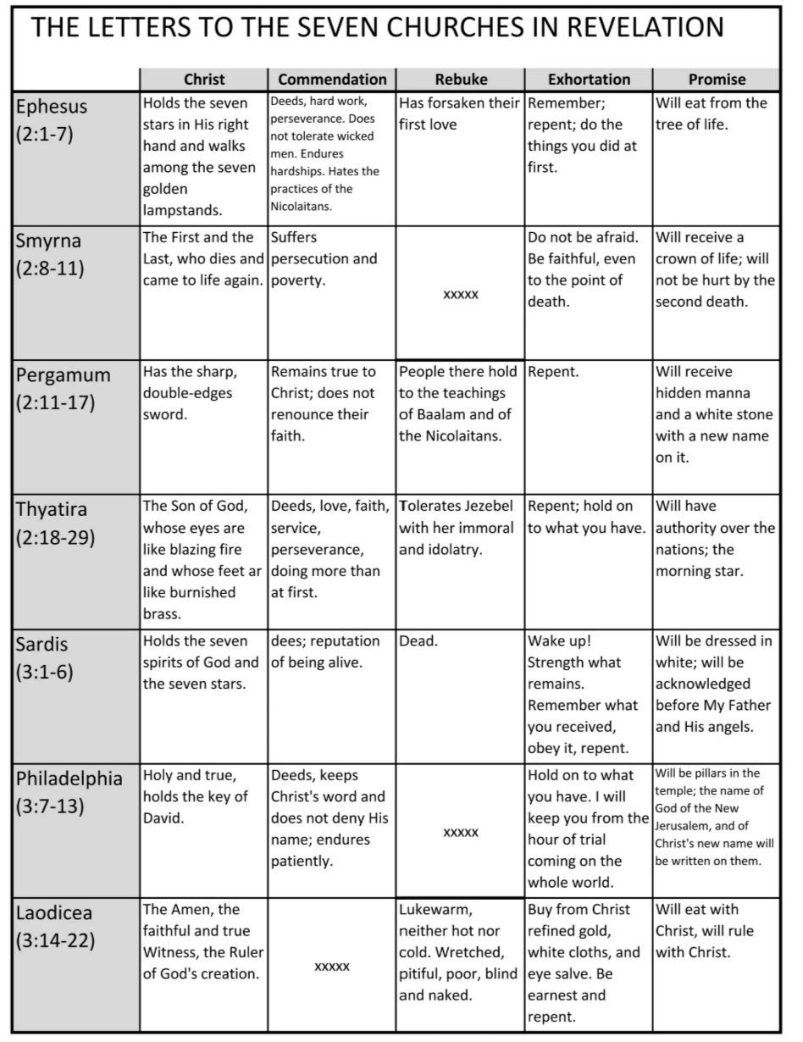
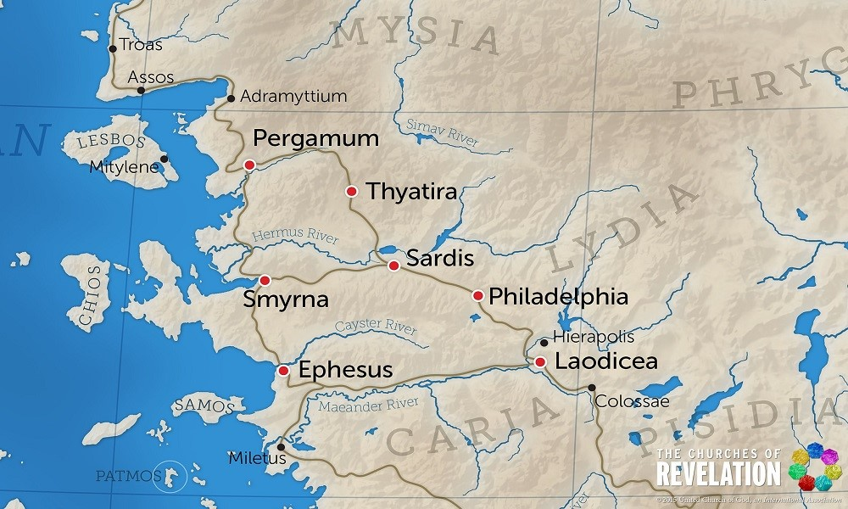
7 Churches
Ch 2-3

Slide 10
Worship to Father and Son
Revelation 4,5
Rev 4
  Worship Father for creation
  Heaven like the tabernacle
Rev 5
  Worship Son for salvation
  Scroll

Slide 11
7 seals
Rev 6-8:1
7 trumpets
Rev 8:2-11:19
6:1-2 1 White horse
6:3-4 2 Red horse
6:5-6 3 Black horse
6:7-8 4 Pale horse
6:9-11 5 Martyrs
6:12-17 6 Day of the Lord
7:1-8 sealing 144k
7:9-17 Multitude Worship God
8:1 7 Silence
8:2-6 Prelude & censer
8:7 1 1/3 earth burned
8:8-9 2 1/3 sea destroyed
8:10-11 3 1/3 rivers bitter
8:12 4 1/3 sun, moon, stars dark
8:13 woe, 3 more coming
9:1-12 5 locusts from abyss
9:13-21 6 4 angels kill 1/3 mankind
10:1-11 scroll, 7 thunders, no delay
11:1-14 2 witnesses
11:15-19 7 God’s reign, worship

Slide 12
Woman, son, and dragon
Rev 12
Woman
  Clothed with sun, moon under feet, crown of 12 stars
Son
  Rule nations
Dragon
  Takes 1/3 stars
War in heaven
Pursuit of the woman

Slide 13
Two Beasts
Rev 13
Sea
10 horns
7 heads
Leopard
Bear
Lion
Calls for patient endurance and faithfulness from God’s people
Earth
2 horns like lamb
Spoke like a dragon
Signs
Support first beast
Mark on right hand or forehead
666

Slide 14
Rev 14-15
14:1-5 144k part 2
14:6-7 First angel: gospel
14:8 Second angel: fall of Babylon
14:9-13 Third Angel: warning not to follow the beast
14:14-20 Harvest of earth, winepress
15:1-8 seven angels with seven last plagues, seven bowls given

Slide 15
Revelation 16
16:1 command
16:2 1 land, sores on those with the beast’s mark
16:3 2 sea, all sea creatures die
16:4-7 3 rivers, blood
16:8-9 4 sun, scorch
16:10-11 5 darkness
16:12-16 6 river Euphrates army, Armegeddon
16:17-21 7 it is done

Slide 16
Revelation 17-19
17 Prostitute on the Scarlet Beast with 7 heads and 10 horns
  7 heads are 7 hills and 7 kings (5 fallen, 1 is, 1 to come short)
  Beast is 8th king
  10 horns are kings will have authority with beast
  Hate prostitute
18:1-3 Lament over Babylon
18:4-8 Warning
18:9-20 threefold woe
18:21-24 finality of doom
19:1-10 threefold hallelujah
19:11-21 Jesus victory over beast

Slide 17
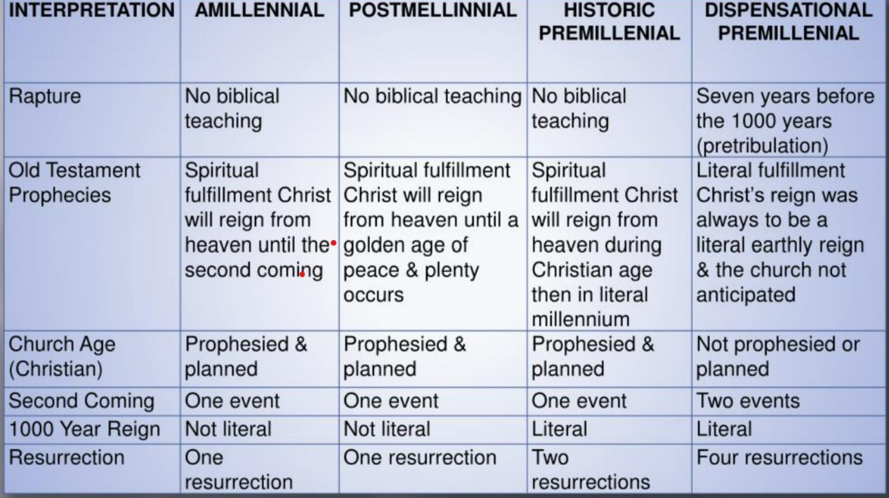
Revelation 20-22
20:1-6 Millenium
  Premil (historic, dispensational)
  Postmil
  Amil
20:7-10 Judgement of Satan
20:11-15 Judgement of Dead
21:1-8 New heaven and earth
21:9-27 New Jerusalem
22:1-5 New Eden
22:6-11 John and Angel
22:12-21 Epilogue

