Slide 1
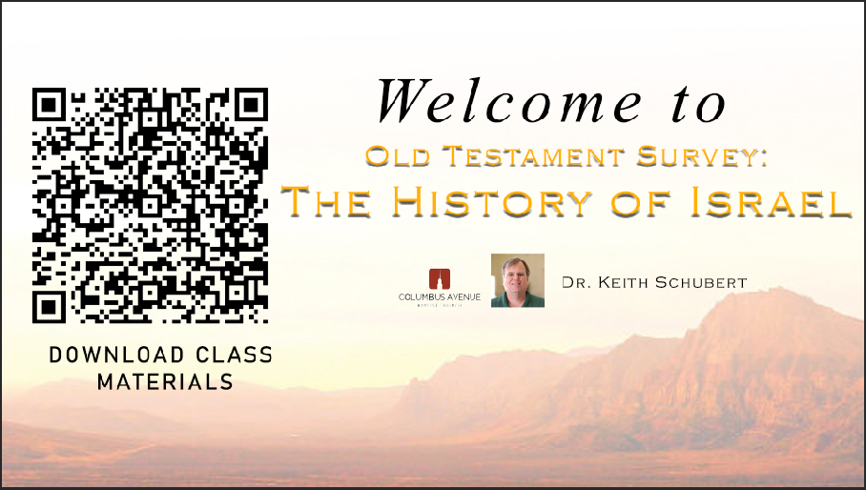

Slide 2

Old Testament Survey:
The History of Israel
Genesis
Dr. Keith Evan Schubert

Slide 3

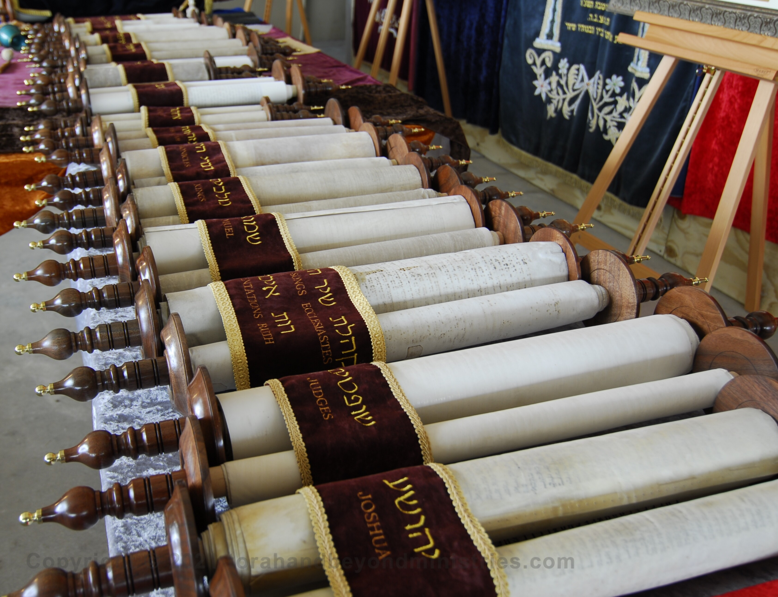
TNK
Nevi’im – Prophets
  Joshua
  Judges
  1&2 Samuel
  1&2 Kings
  Isaiah
  Jeremiah
  Ezekiel
  Hosea
  Joel
  Amos
  Obadiah
  Jonah
  Micah
  Nahum
  Habakkuk
  Zephaniah
  Haggai
  Zechariah
  Malachi
Ketuvim – Writings
  Psalms
  Proverbs
  Job
  Megilloth
    Song of Songs
    Ruth
    Lamentations
    Ecclesiastes
    Esther
  Daniel
  Ezra
  Nehemiah
  1&2 Chronicles
Torah – Law (Moses)
  Genesis
  Exodus
  Leviticus
  Numbers
  Deuteronomy

Slide 4
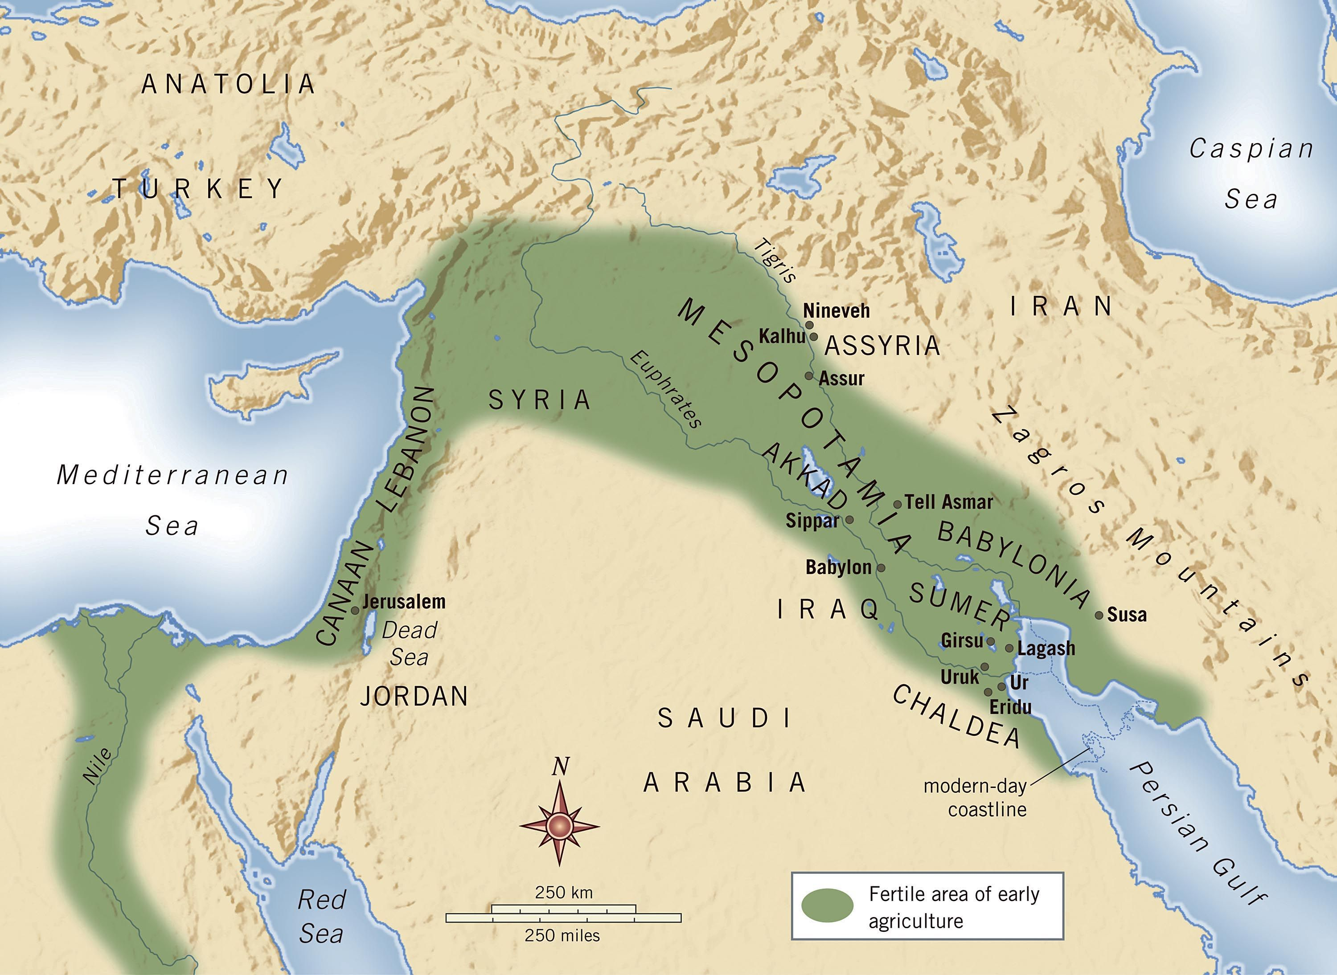
Fertile Crescent

Slide 5
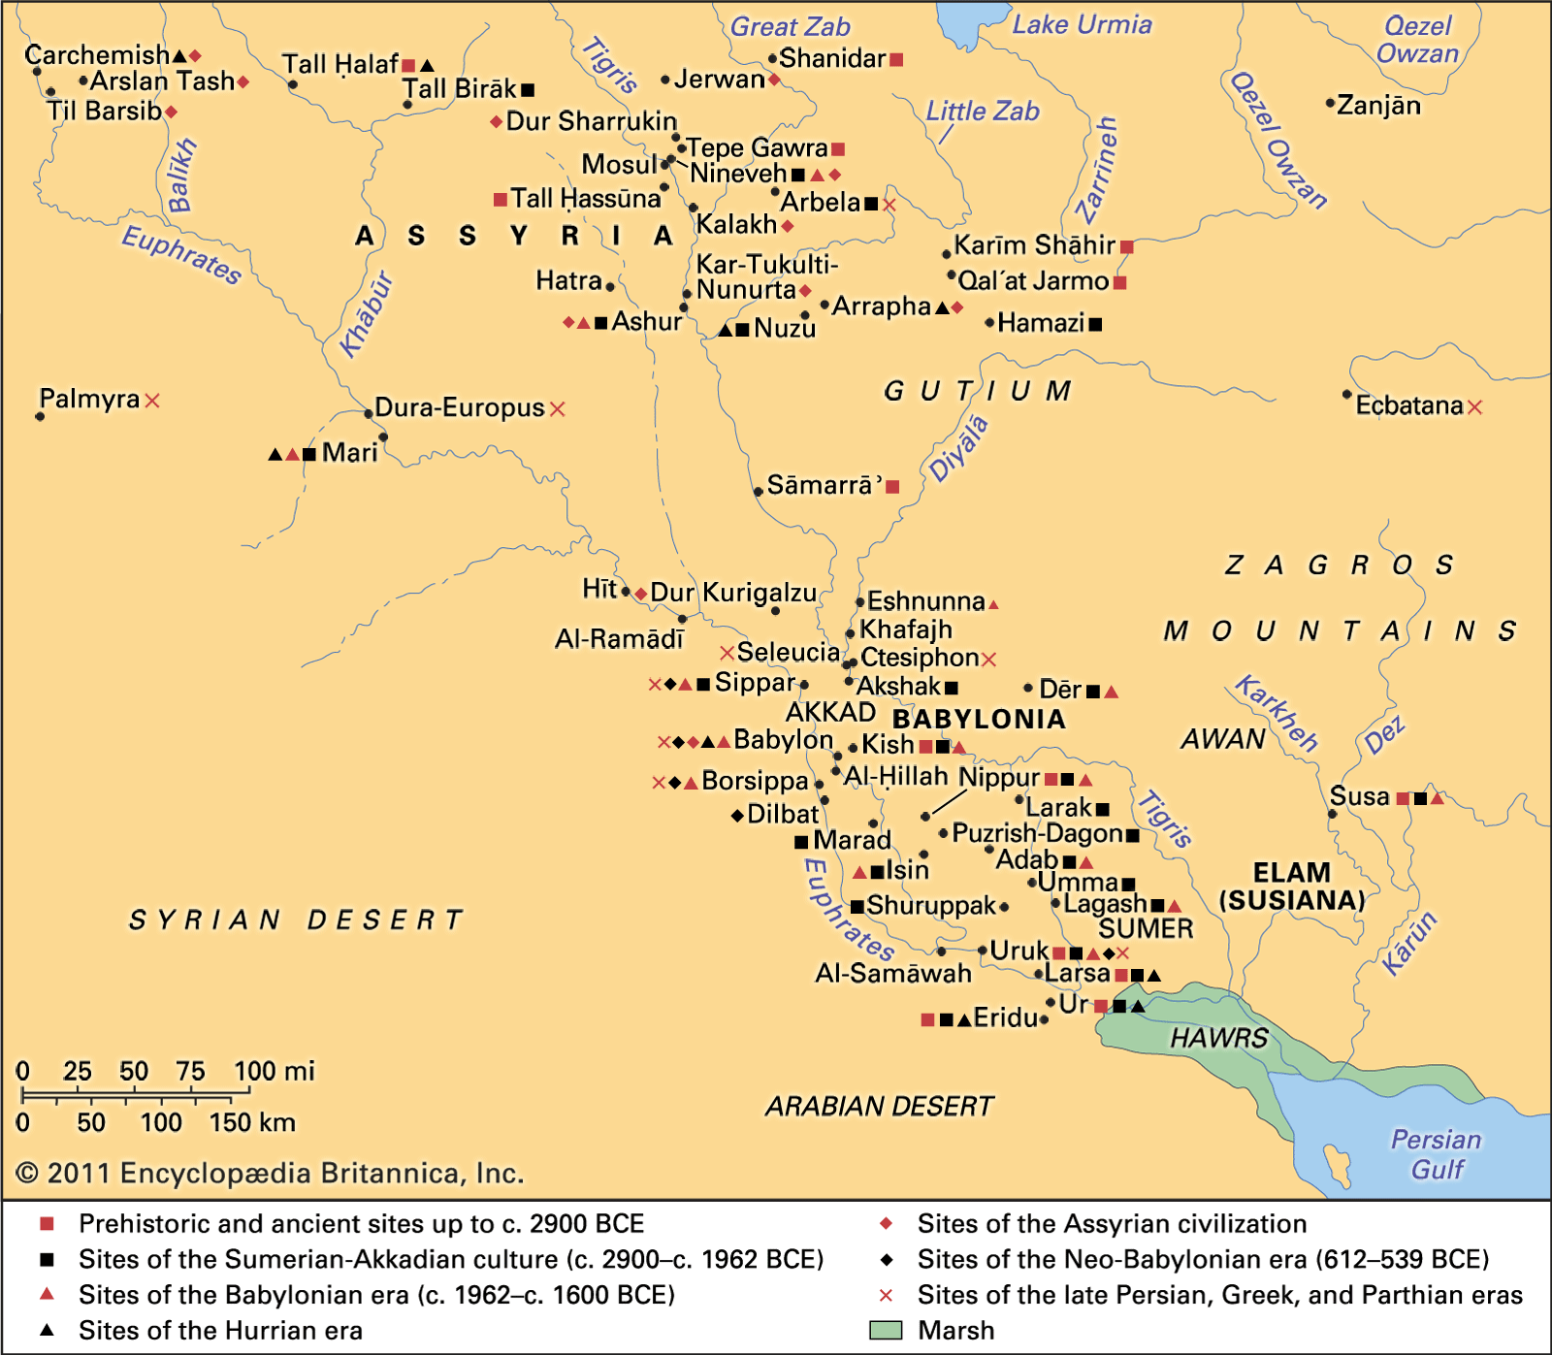
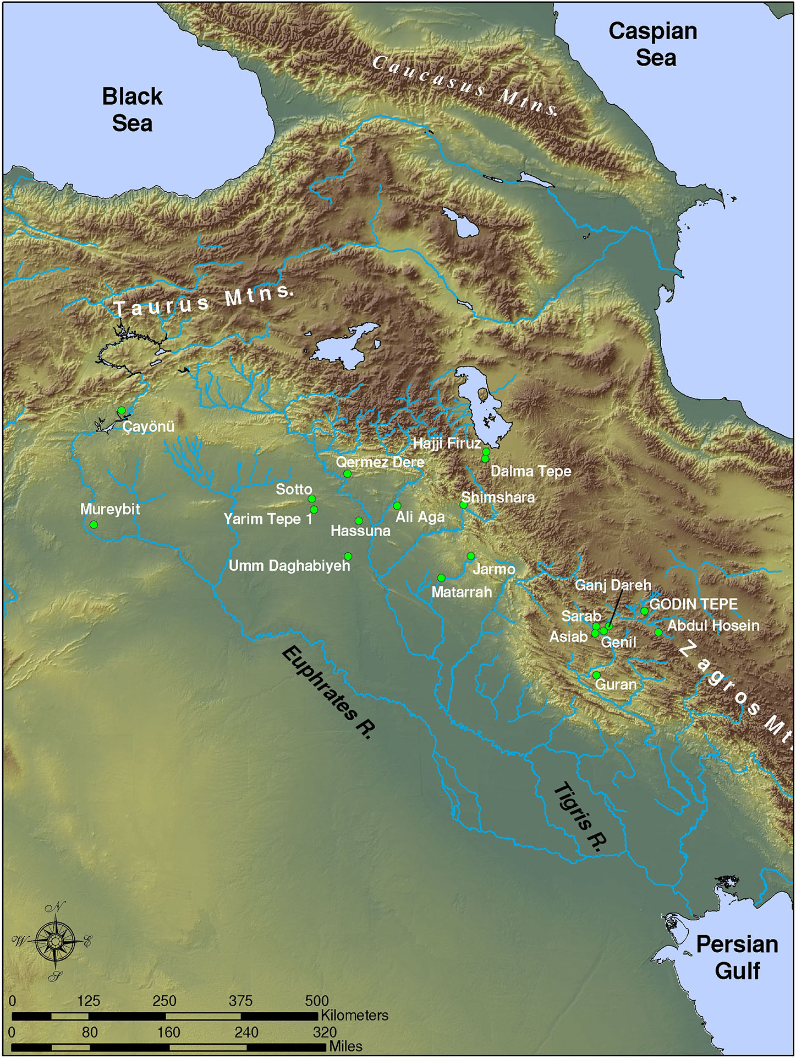

Slide 6
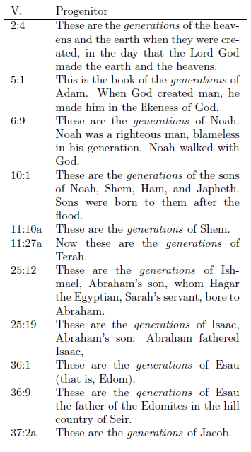
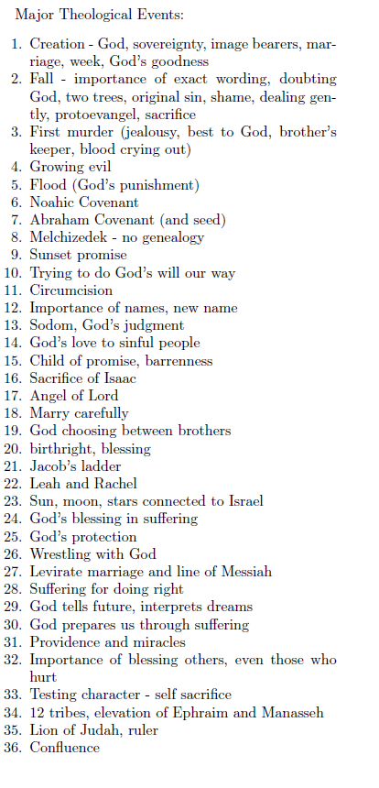
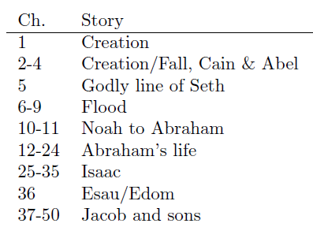
Structure of Genesis

Slide 7

Creation accounts
Initial State (v.2) | Preparation (days 1-3) | Population (days 4-6)
Darkness | Light, separate light/dark (day/night) | Sun Moon, stars
Watery Abyss | Firmament, separate water above/below | Birds Fish
Formlessness | Separate land/sea Create vegetation | Land animals Humans

Slide 8
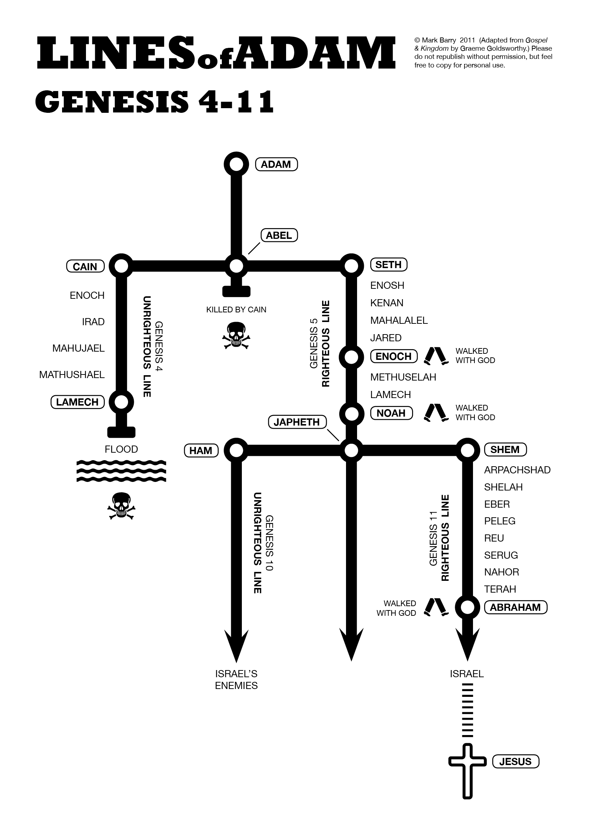
Fall to Flood
Read Genesis 3
  Who was there?
  What was God’s command
  What are the 3 curses
Read Genesis 4:1-7
  What does Eve say of Cain?
  What does God comment about the sacrifice?
Read Genesis 6:1-8

Slide 9
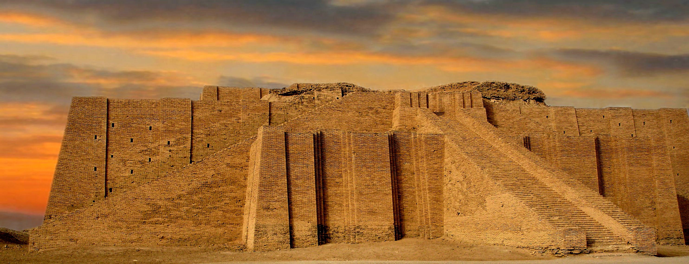
Tower of Babel

Slide 10
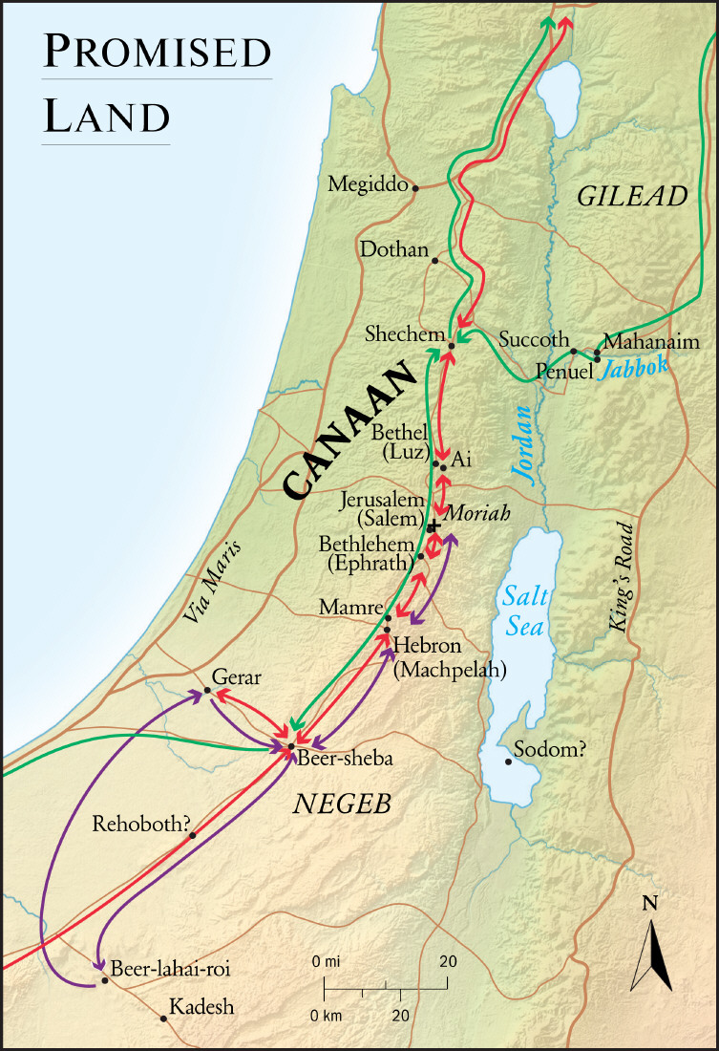
Abraham, Isaac, Jacob
Bethel
Salem/Moriah
Genesis 12:1-7
Genesis 28:10-22
Genesis 35:1-15
1 Samuel 7:16
1 Kings 12:25-33
Genesis 14
Genesis 22

Slide 11
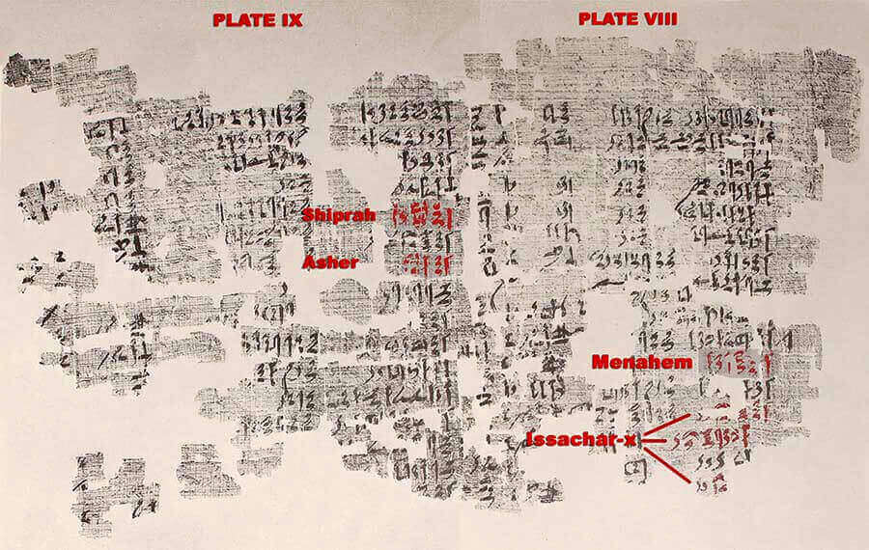
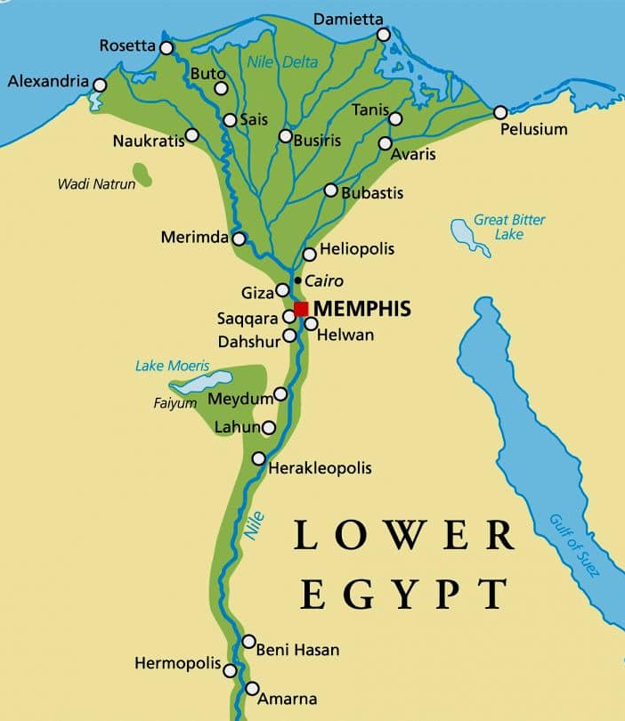
Joseph
Papyrus Brooklyn 35.1446 is an Egyptian seven foot long papyrus dating from 1809-1743 BC

Slide 12
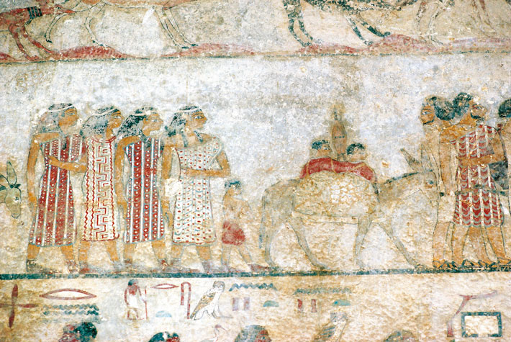
Canaanite Merchants and Hyksos
(De Agostini Picture Library/G. Sioen/ Bridgeman Images)A 12th Dynasty (1981–1802 B.C.) fresco from the tomb of Khnumhotep III in Beni Hassan shows a group of Semitic people, possibly Canaanite merchants, arriving in Egypt. They are thought to be related culturally to the dynasty that called itself the Hyksos.

Slide 13
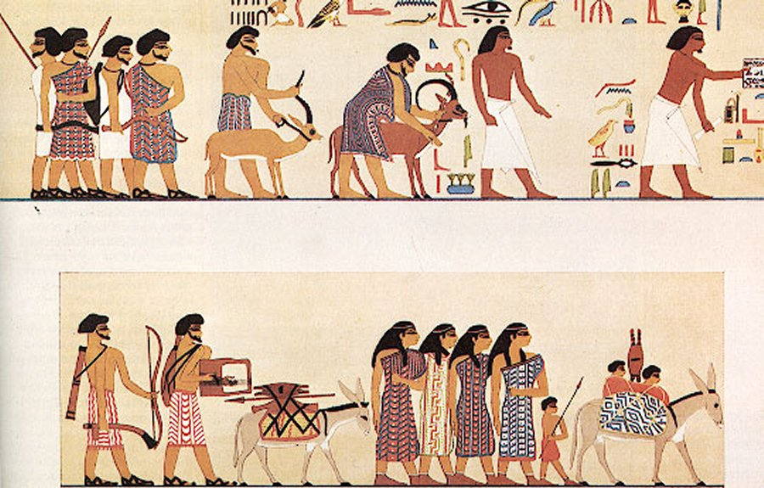
A group of people labelled Asiatics (the glyphs immediately above the head of the first animal) entering Egypt c.1900 BC. From the tomb of 12th-dynasty official Khnumhotep II, at Beni Hasan. Image via wikipedia

