Slide 1


Slide 2

Old Testament Survey:
The History of Israel
Exodus-Deuteronomy
Dr. Keith Evan Schubert

Slide 3
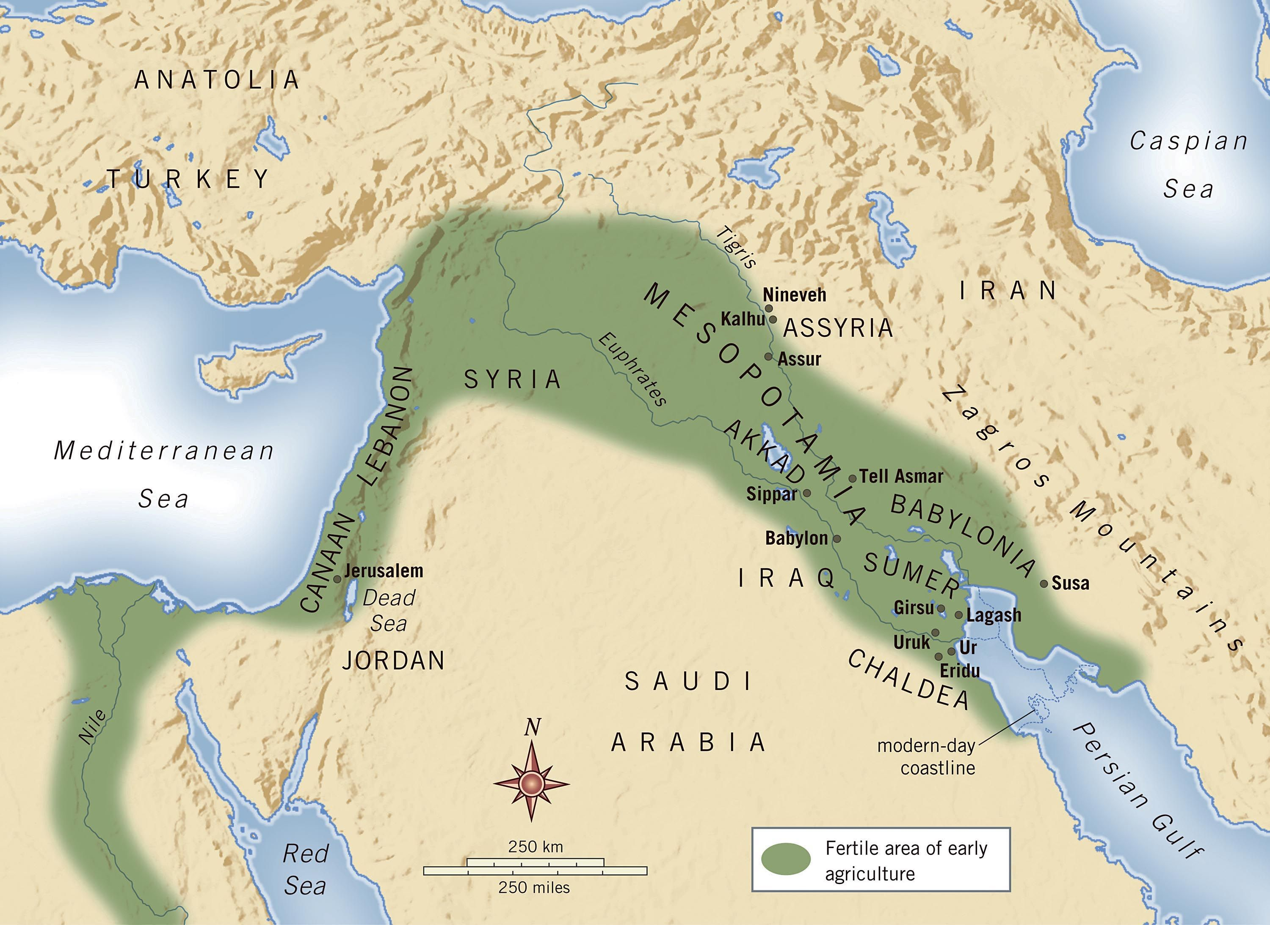
Fertile Crescent

Slide 4
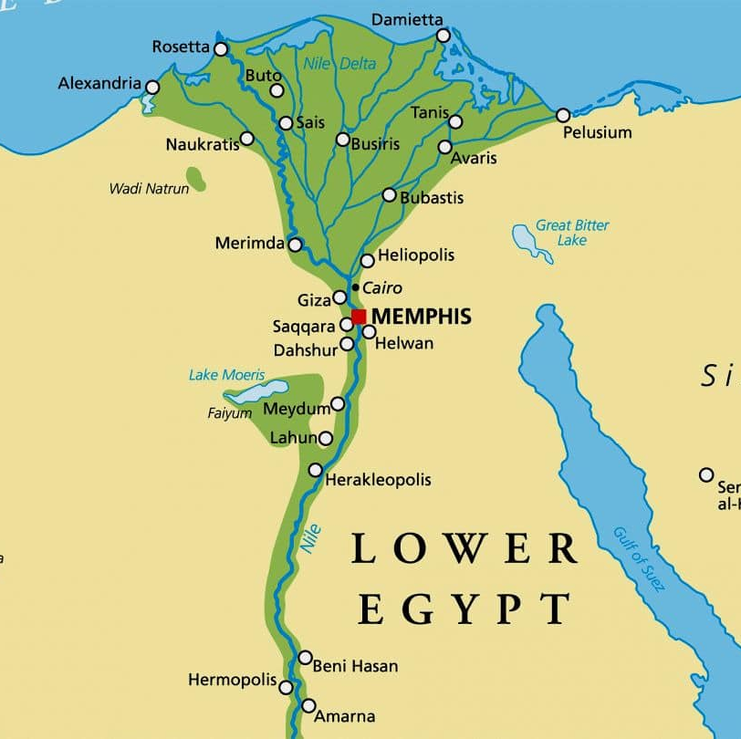
Egypt

Slide 5
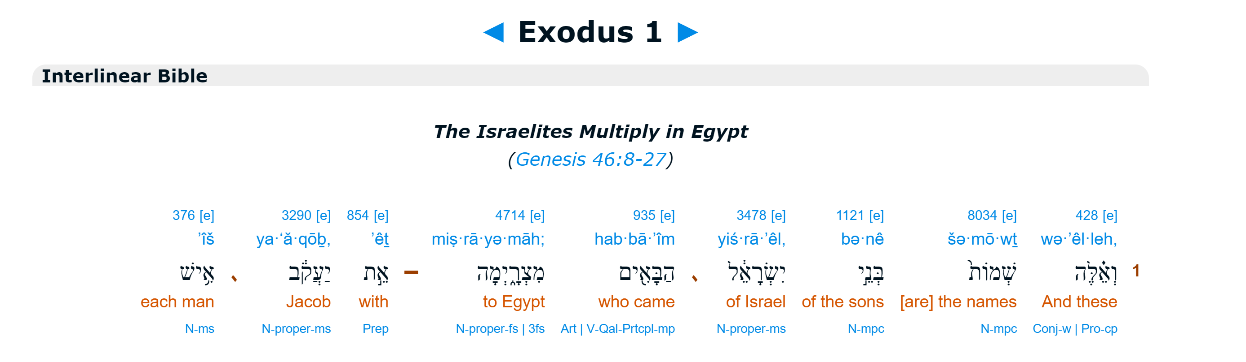
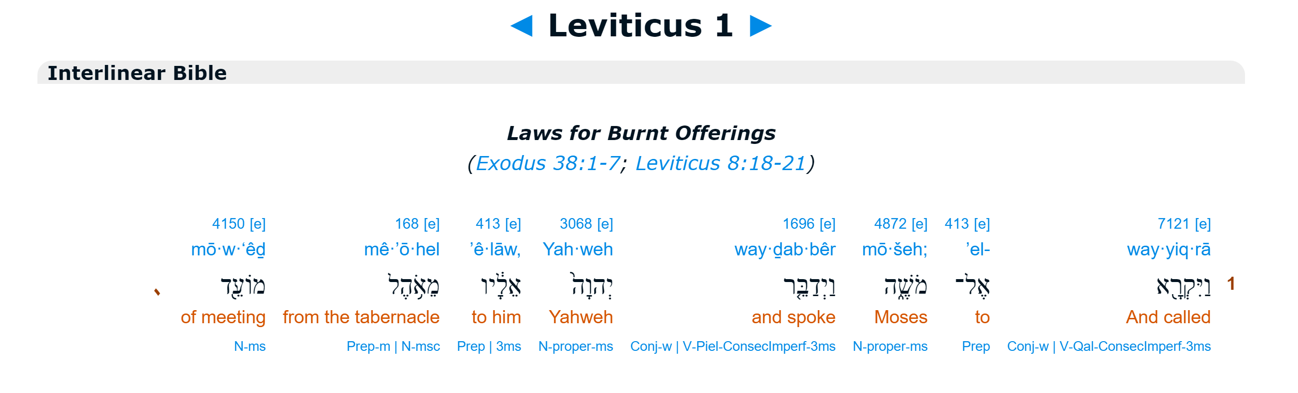
First Words

Slide 6
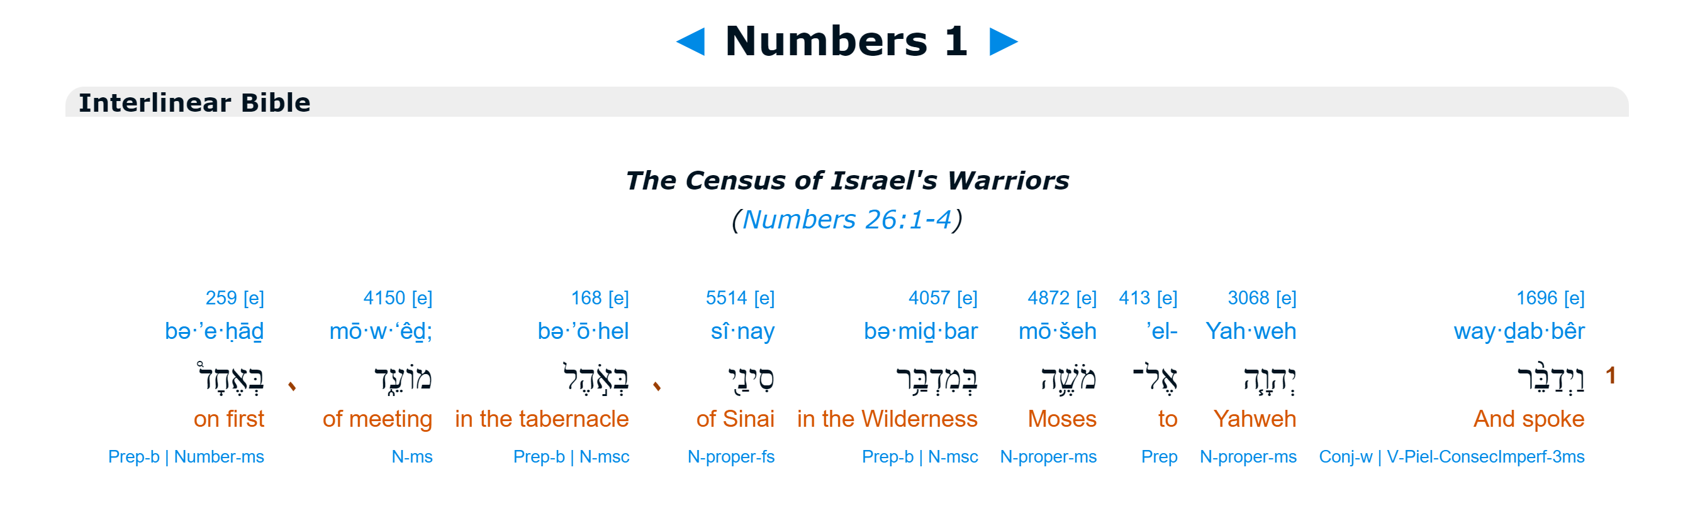
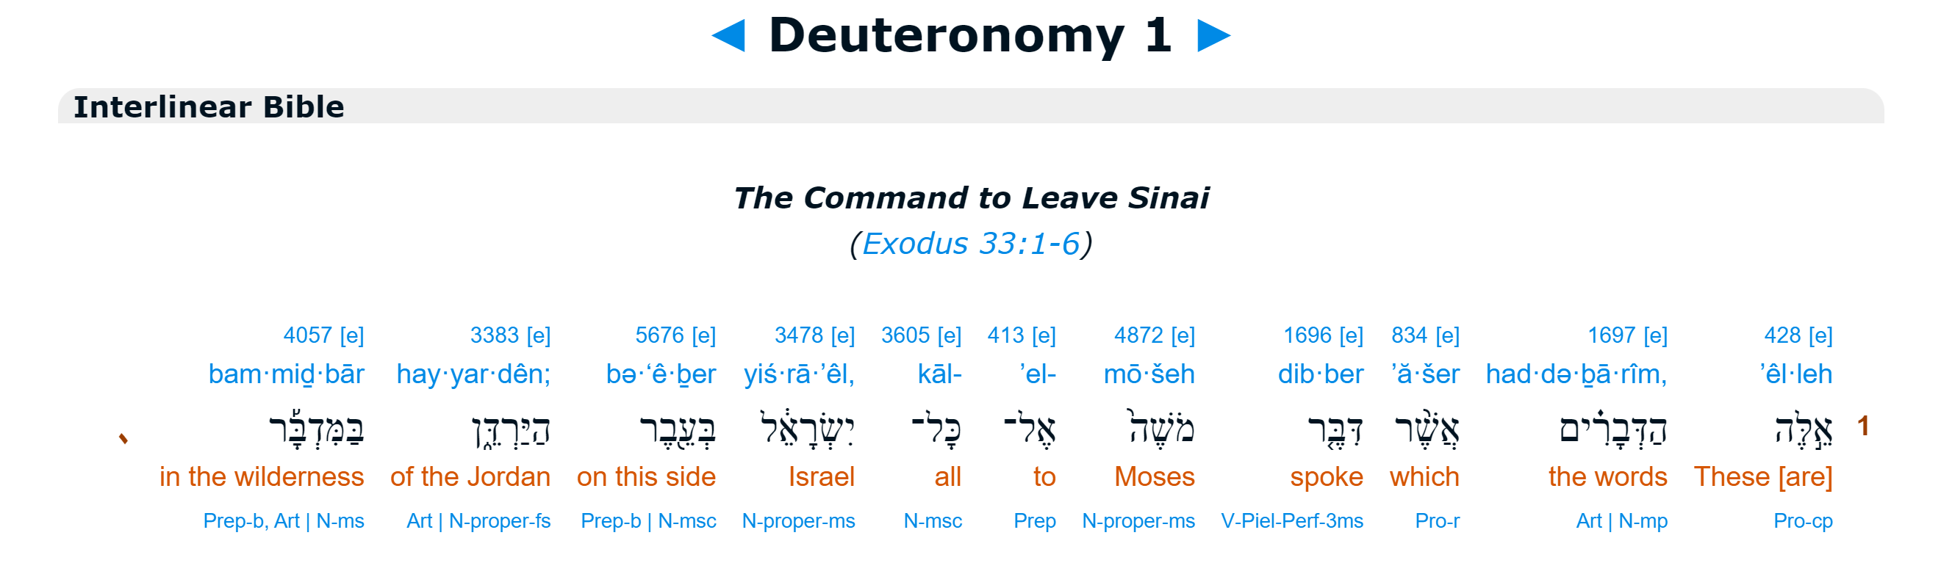
First Words

Slide 7
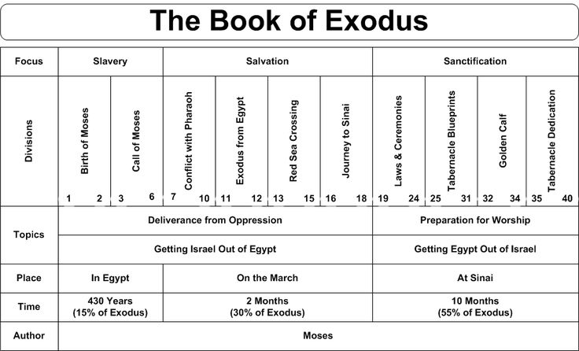

Slide 8
Plagues & God’s superiority
# | Plague | Egyptian “god” | Notes
1 | Water to Blood Exodus 7:14-25 | Hapi (flood & fertility), Sobek (river), Khnum (source) | Egyptians duplicated Killed fish
2 | Frogs Exodus 8:1-15 | Heqet (frogs) | Egyptians duplicated Pharoh pleaded and picked ending
3 | Lice/gnats Exodus 8:16-19 | Geb (earth god), Set (desert) | No duplication from now on “finger of God”
4 | Flies Exodus 8:20-32 | Fly Amulets (magic protection), Fly Pendants (military reward from Pharoh) Not Wadjet (cobra not fly) nor Khepri (beetle not fly) | Israelites no longer effected 1 day warning, Pharoh pleaded
5 | Death of Livestock Exodus 9:1-7 | Apis (bull), Bata (bull), Mnevis(bull), Buchis(bull), Hathor (cow form, Apis mother), Nut (cow form, main god’s mother) | 1 day warning, “all” means without distinction (except stated Israelites)
6 | Boils Exodus 9:8-12 | Isis(healing), Imhotep (medicine), Sekhmet (disease&heal) | Magicians couldn’t stand before Moses
7 | Hail Exodus 9:13-35 | Set (storms, disorder, desert, foreigners), Shu and Tefnut (calm and rain) | or this purpose I have raised you up 1 day warning, Pharoh pleads
8 | Locusts Exodus 10:1-20 | Neper (grain god), Geb (earth and plants), Osiris (agriculture, etc) | 1 day warning, Pharoh tries to only let men go
9 | Darkness Exodus 10:21-29 | Ra (sun god), Horus (sky), Amon-ra (sun), Aten (sun), Thoth (moon), Nut (sky) | 3 days of darkness, Moses not permitted to see Pharoh again
10 | Death of Firstborn Exodus 11:1-12:32 | Pharoh, Bes & Beset (protect home & kids), Wadjet and Nekhbet (protect Egypt and Pharoh), Isis(protection of kingdom, etc.), Nephthys (protection, etc) | Warning given to all people as Moses left Pharoh “in hot anger”
Notes: (1) Judgement shows Pharoh, magicians, and gods of Egypt can’t stand against the true God
(2) Calendar starts due to this salvation, Passover lamb selection on 10th day (10th plague), Passover 14th, unleavened bread till 21st

Slide 9
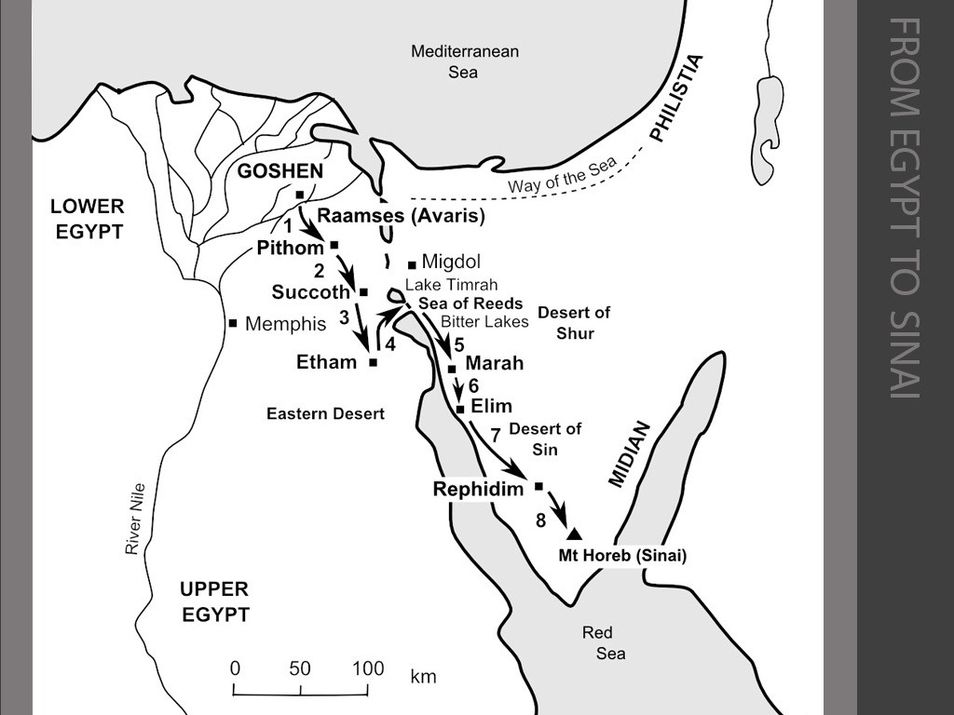
Desert
Journey 1
Several candidates for sea crossing
Complaints of water here repeated very similar in Numbers.

Slide 10
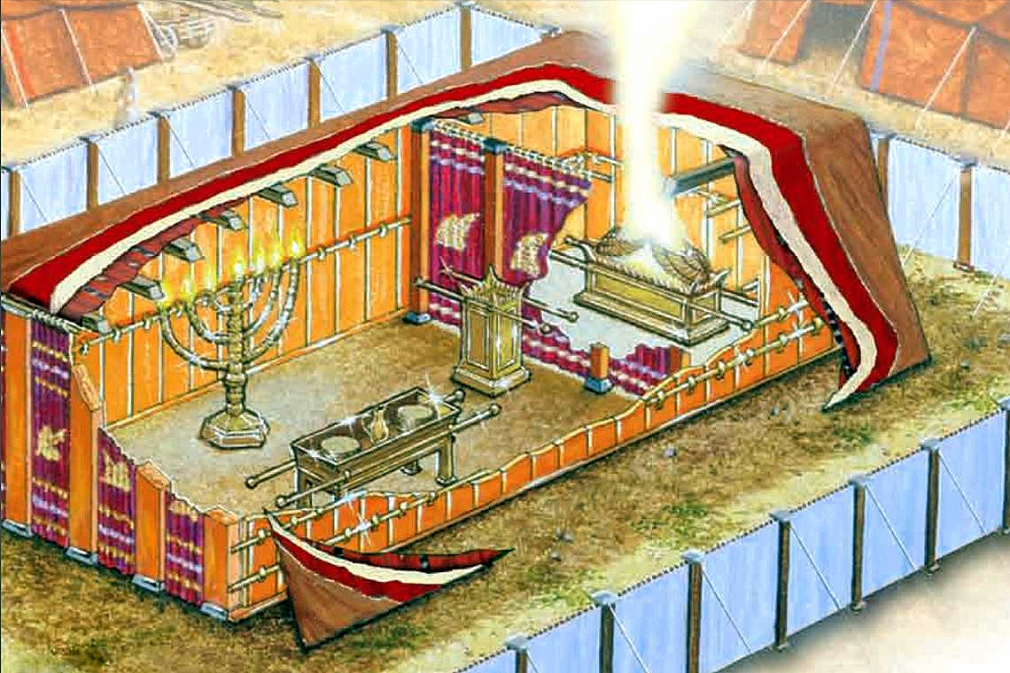
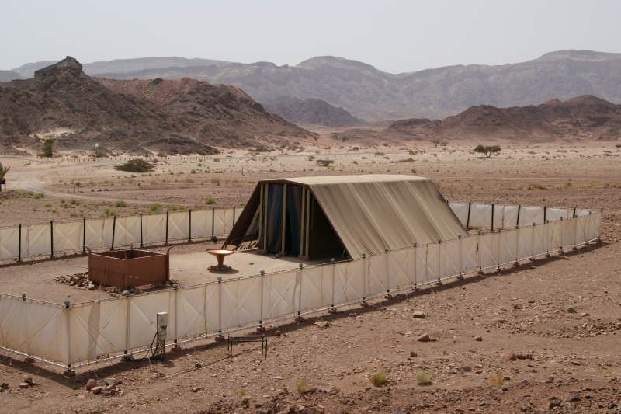
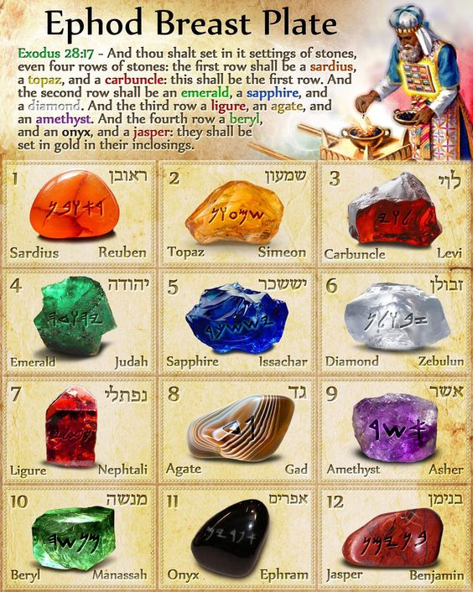
Tabernacle

Slide 11
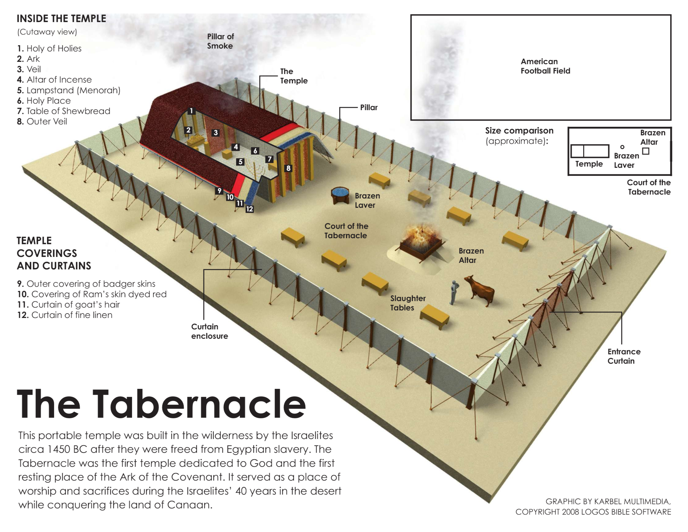
Tabernacle

Slide 12
Leviticus Chiastic Structure (Michael Morales)
Lev 1-7 Sacrifices (Burnt, Grain, Peace, Sin, Guilt offerings, Num 15:29-30)
  Lev 8-10 Institution of the Priesthood
    Lev 11-15 Laws of impurity
      Lev 16 Day of Atonement
    Lev 17-20 Holy/Profane
  Lev 21-22 Legislation for Priesthood
Lev 23-27 Festivals/Sacred Time

Slide 13
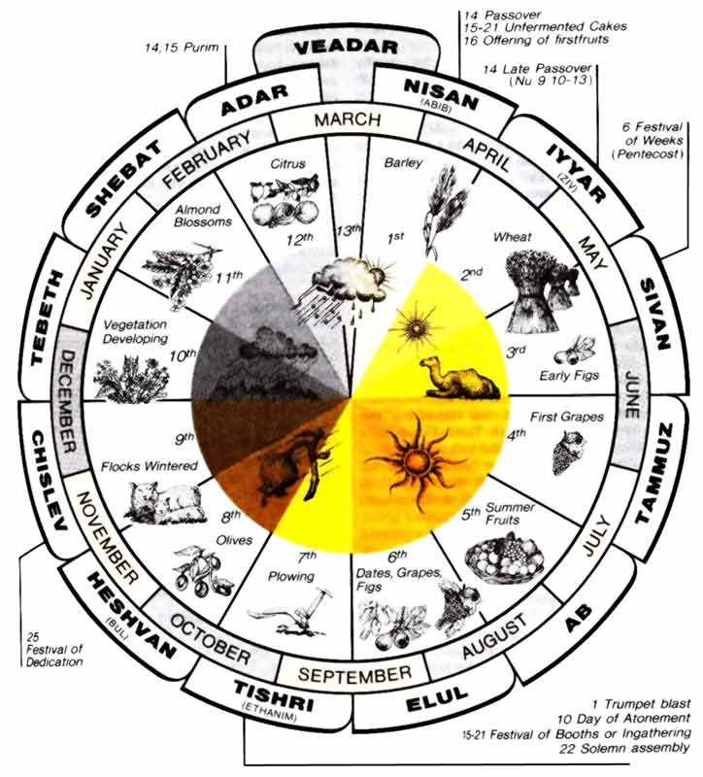

Slide 14
Numbers Structure
Exodus 19 – Numbers 10 Israel encamped at Sinai
Numbers 1-10:10 Prepare for the journey
Numbers 10:1-20:13 Sinai to Kedesh
Numbers 20:14 -25:18 Kedesh to Moab
Numbers 26-36 Prepare to enter the land
Numbers 1, 26 two censuses

Slide 15
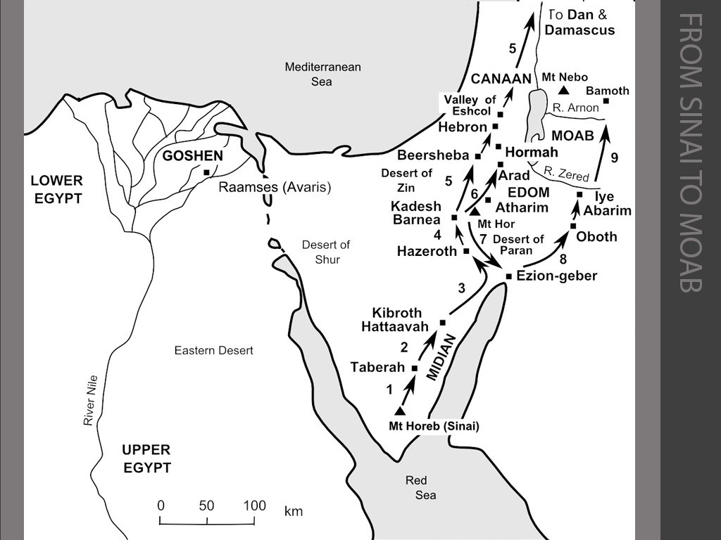
Desert wandering 2
Head to Kadesh Barnea and send scouts
2 good reports, 10 bad, people rebelled and walked in desert 1 year for each day of scouting, till all those who rebelled were dead.

Slide 16
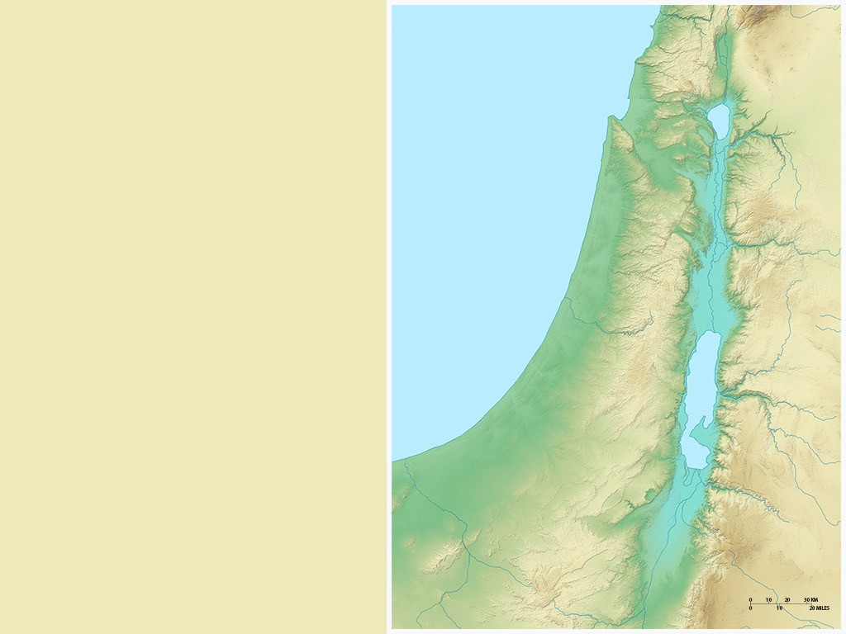
Spies Route
Lebo Hamath
Laish
Hazor
Rehob?
Beth Shan
Shechem
Bethel
Jerusalem
Hebron
Beersheba
Kadesh Barnea

Slide 17
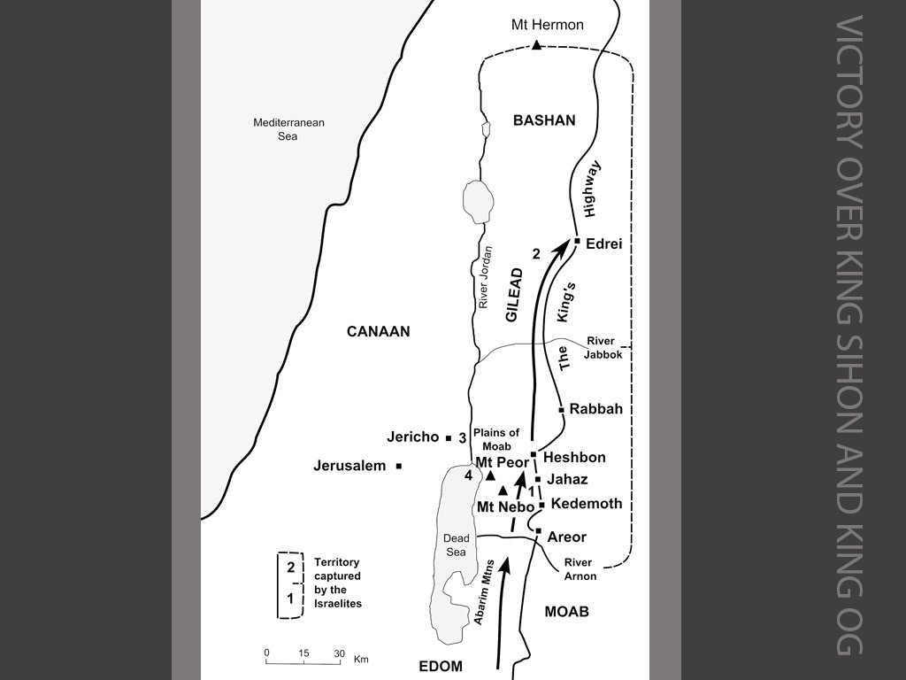
a

Slide 18
Transjordan
Four major rivers
  Yarmuk
  Jabbok
  Arnon
  Zered
Regions
  Bashan
  Lower Gilead
  Upper Gilead
    Ammon
  Mishor/Medebah
  Moab
  Edom

Slide 19
Transjordan
Yarmuk
Four major rivers
  Yarmuk
  Jabbok
  Arnon
  Zered
Regions
  Bashan
  Lower Gilead
  Upper Gilead
    Ammon
  Mishor/Medebah
  Moab
  Edom
Jabbok
Arnon
Zered

Slide 20
Transjordan
Bashan
Yarmuk
Dome of
Gilead
Four major rivers
  Yarmuk
  Jabbok
  Arnon
  Zered
Regions
  Bashan
  Lower Gilead
  Upper Gilead
    Ammon
  Mishor/Medebah
  Moab
  Edom
Jabbok
Ammon
Mishor
Arnon
Moab
Zered
EDOM

Slide 21
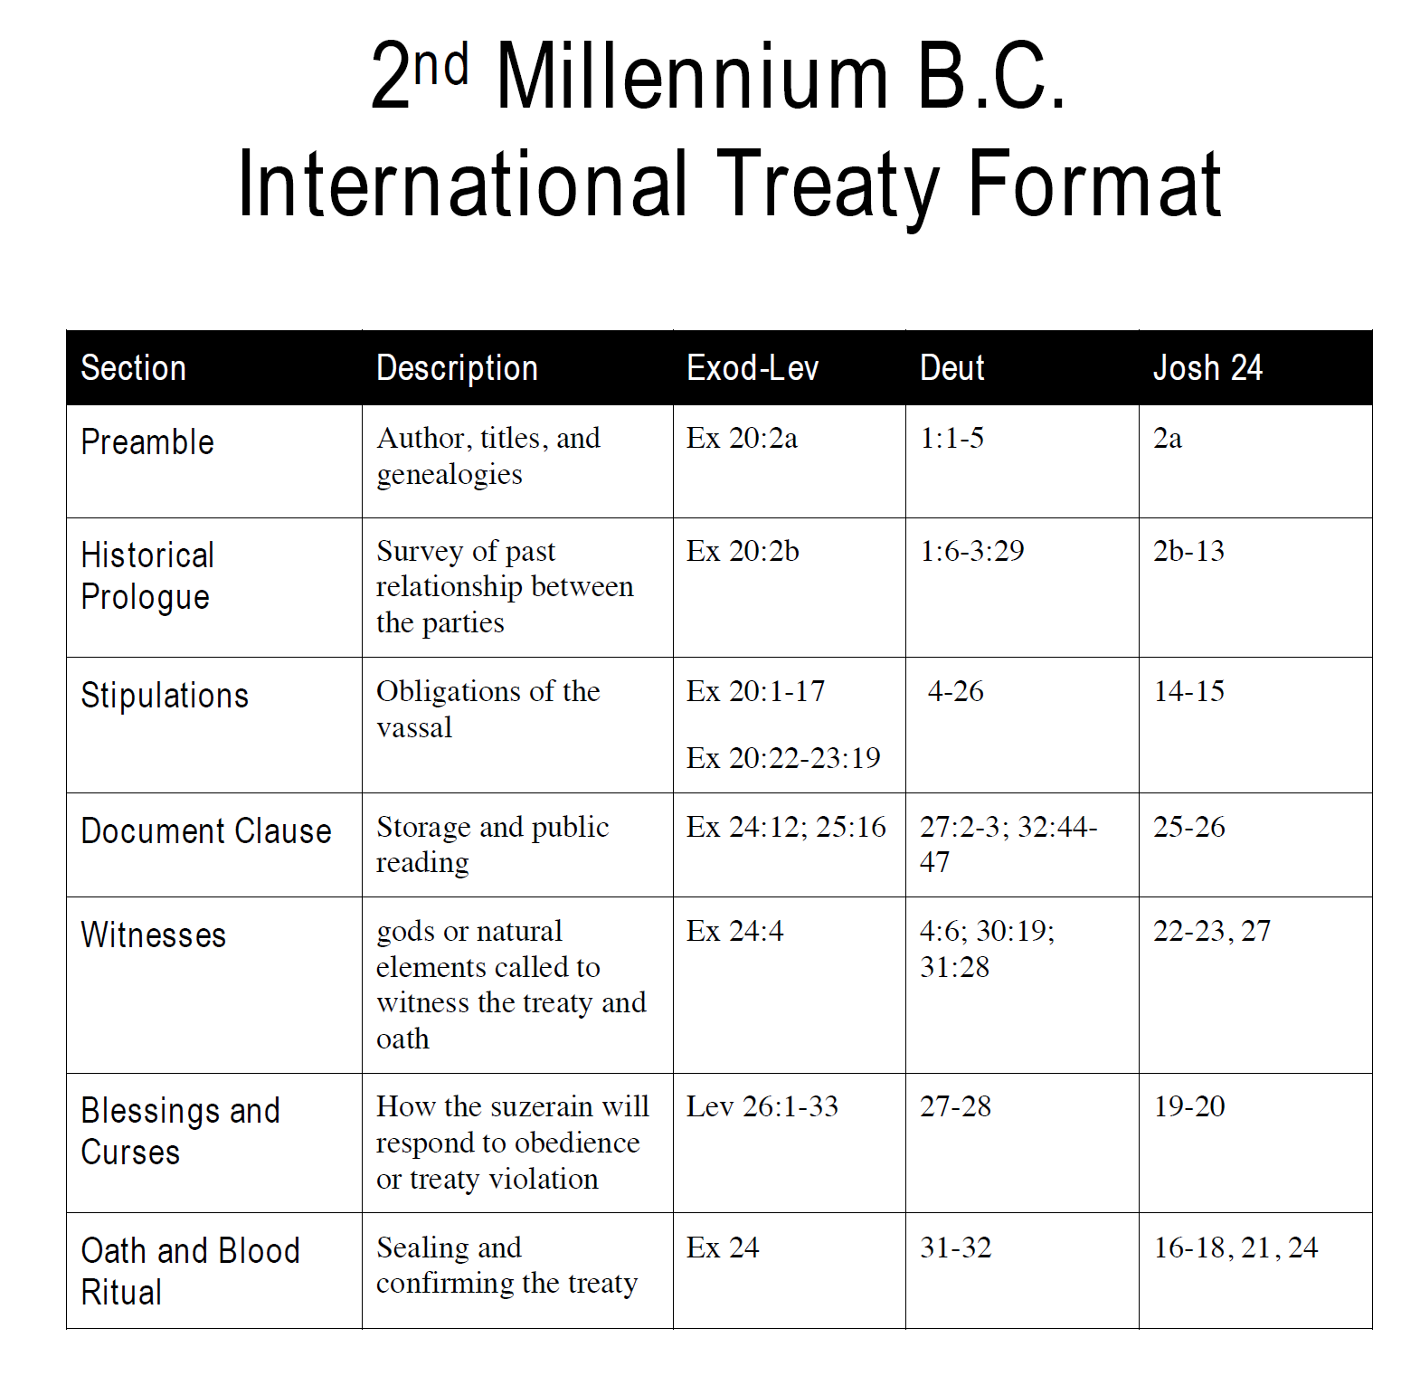
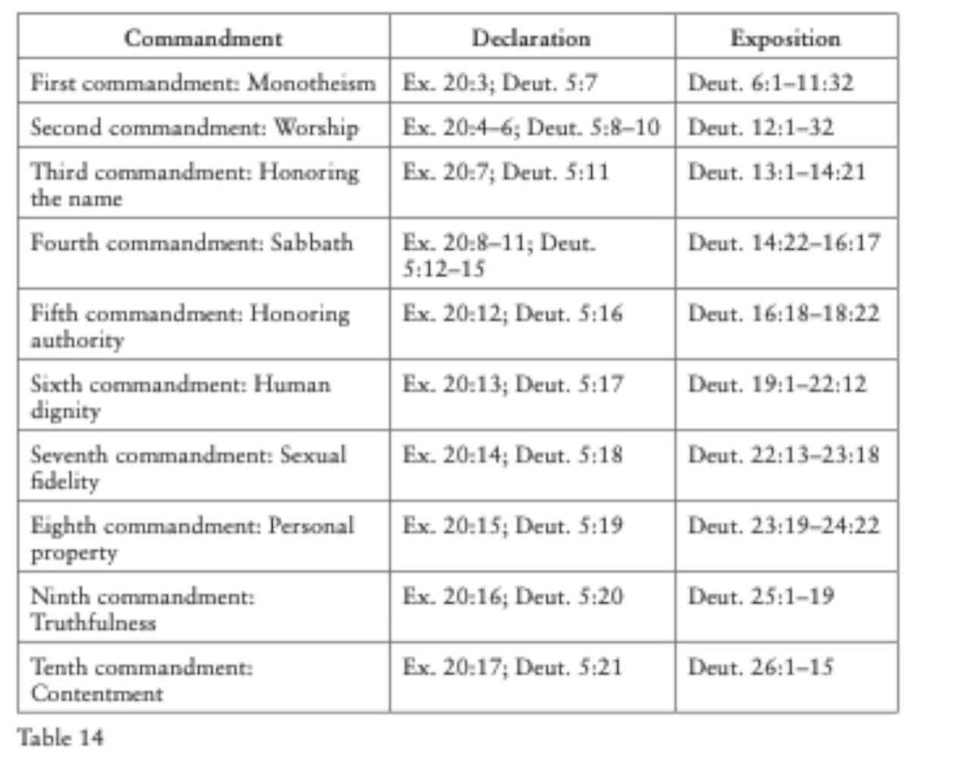
Deuteronomy

