Slide 1


Slide 2

Old Testament Survey:
The History of Israel
Joshua
Dr. Keith Evan Schubert

Slide 3
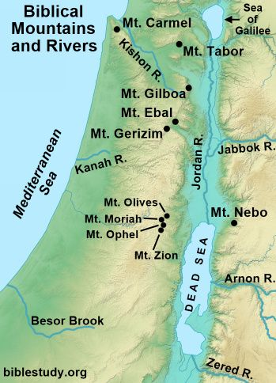
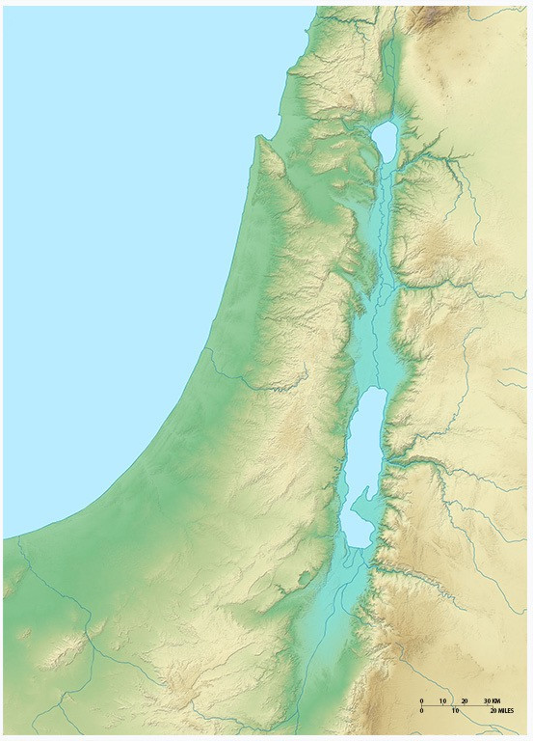
Litani
Jordan
Lake Hula
Sea of Galilee
Mediterranean Sea
Kishon
Yarmuk
Harod
Jordan
Yarqon
Tirzah
Jabbok
Soreq
Lachish
Dead Sea
Arnon
Besor
Mizraim (Egypt)
Zared

Slide 4
Mt Carmel
Plain of
Dor
Galilee
Bashan
Shephelah
of Carmel
Jezreel
Plain of
Sharon
Samaritan
Hill Country
Gilead
Ammon
Philistine
Plain
Jordan Valley
Shephelah
Judean
Hill Country
Wilderness
Negev
Moab
Edom

Slide 5
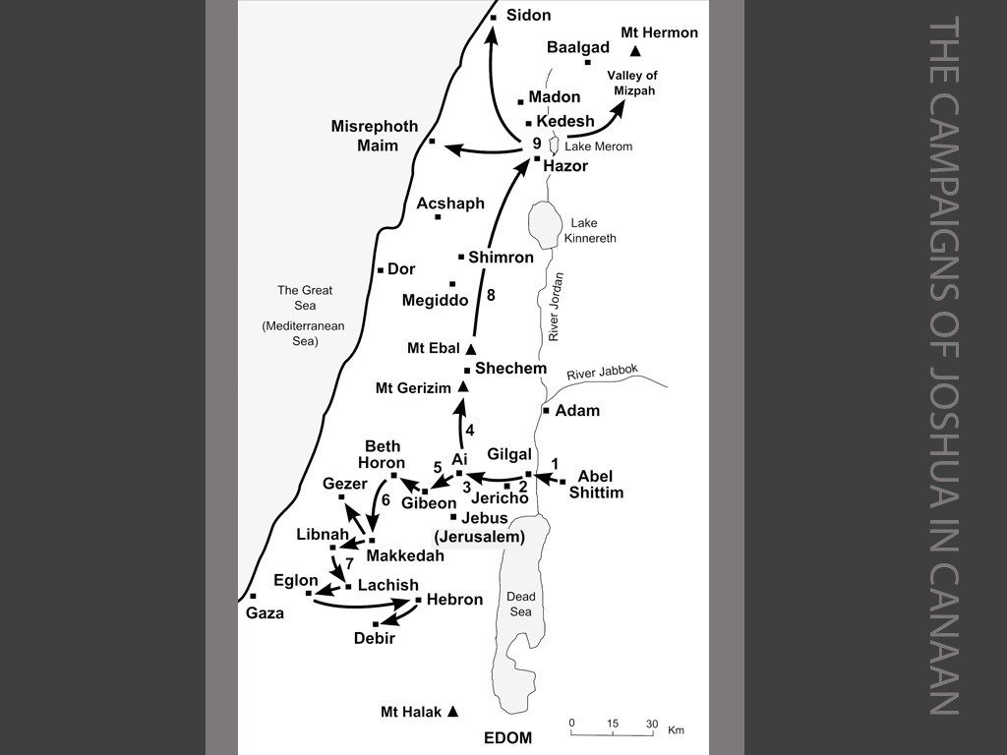
Mt Carmel
Plain of
Dor
Galilee
Bashan
Shephelah
of Carmel
Jezreel
Plain of
Sharon
Samaritan
Hill Country
Gilead
Ammon
Philistine
Plain
Jordan Valley
Shephelah
Judean
Hill Country
Wilderness
Negev
Moab
Edom

Slide 6
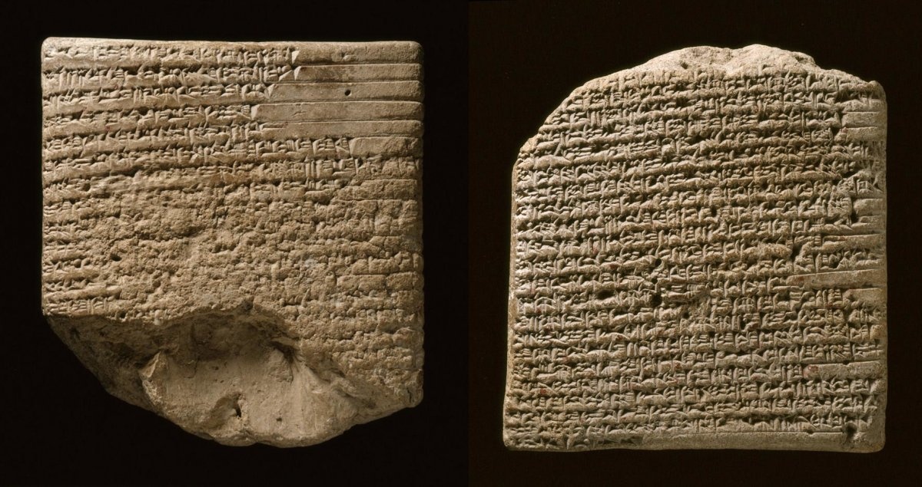
Amarna letters
c. 1360–1332 BC
Akhenaten, the pharaoh of Egypt
Requests for military aid against Habiru (`apiru), who are “licking all the land up”
Requests for aid from
  Lib'ayu of Shechem (son cooperated with Habiru)
  Abdi-Heba of Jerusalem (Lib’ayu’s son cooperate with Habiru and gave his land, EA287- Lost are the lands of the king & The Habiru are now attempting to take Jerusalem)
  Gezer also complains of Habiru invasions
  Rib-Hadda, of Byblos (Habiru mercinaries used by likely Damascus)
Notes:
The letters from Jerusalem (Urusalim) from ‘Abdi-Heba (EA 285-290) are full of dire news of invasions and desertions by local mayors to the Hapiru/’Apiru–“Lost are the lands of the king”–and imploring the king of Egypt for military rescue. “As the King (of Egypt) has placed his name in Jerusalem forever, he cannot abandon it!” (EA 287)

Slide 7
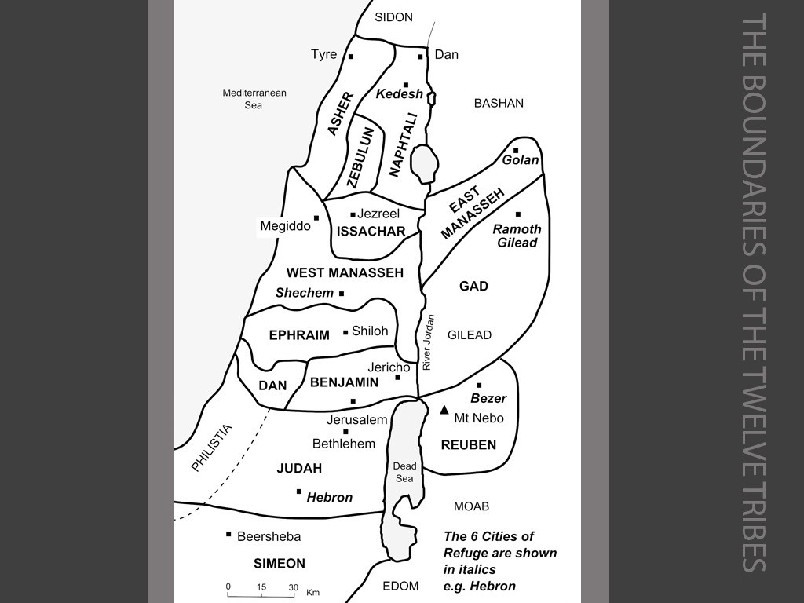
Mt Carmel
Plain of
Dor
Galilee
Bashan
Shephelah
of Carmel
Jezreel
Plain of
Sharon
Samaritan
Hill Country
Gilead
Ammon
Philistine
Plain
Jordan Valley
Shephelah
Judean
Hill Country
Wilderness
Negev
Moab
Edom

