Slide 1


Slide 2


Slide 3
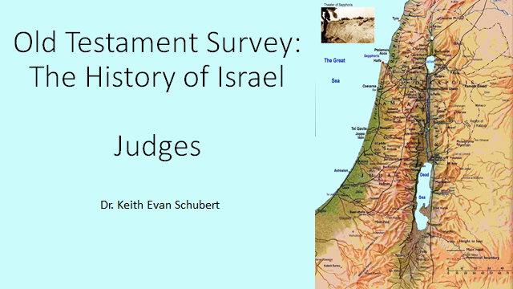

Slide 4
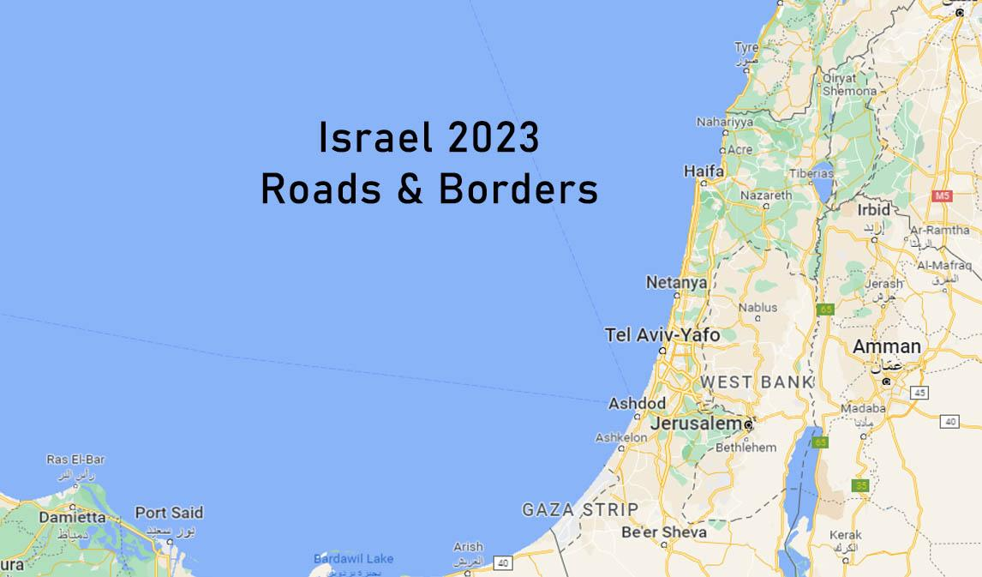

Slide 5
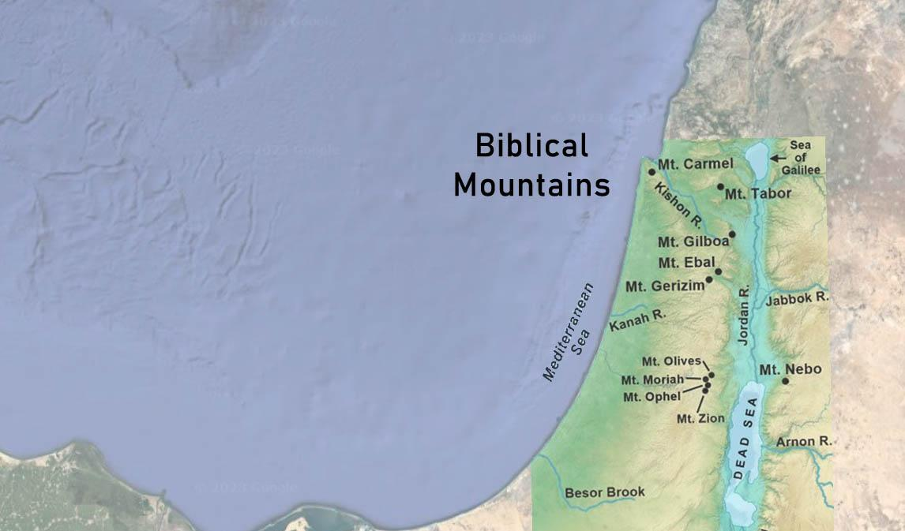

Slide 6
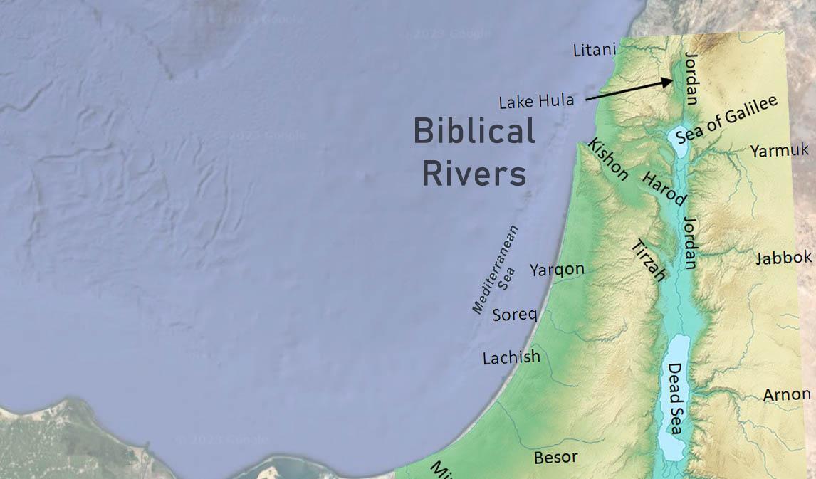

Slide 7
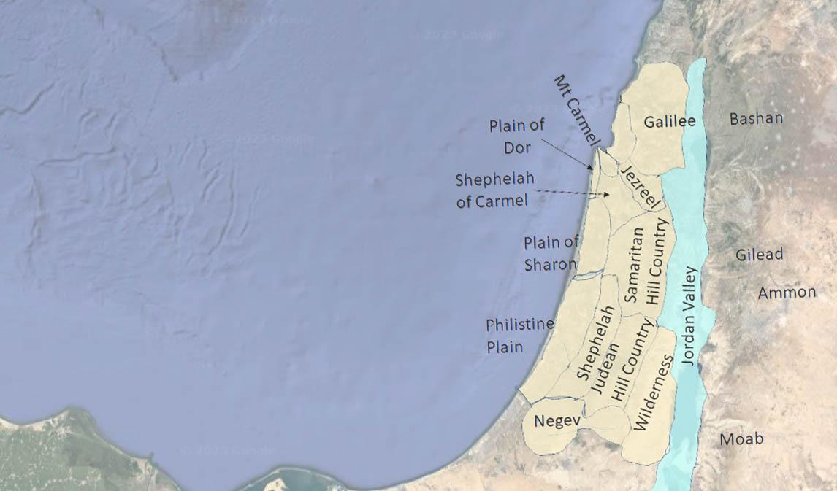

Slide 8
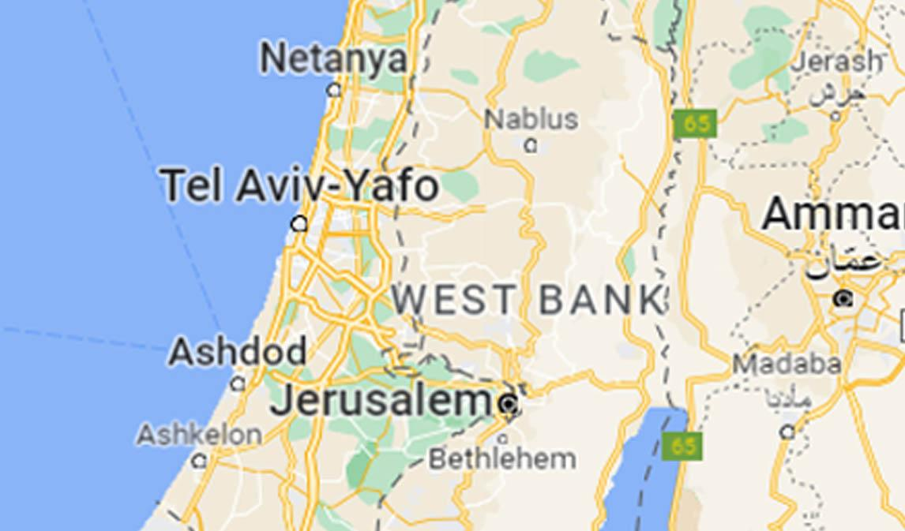

Slide 9
OUTLINE OF JUDGES
Military decline (1:1-2:9)
Spiritual decline (2:9-3:6)
Judges (3:7-16:31)
Religious disorder (17-18)
Moral disorder (19-21)
THE DEUTERONOMIC CYCLE (JUDGES 2:7-19)
Faithful, free (vv. 7-9)
Apostasy (vv. 10-12)
Anger of Yahweh (vv. 12-15)
Enemy oppression (vv. 14-15)
Cry for help (v. 18)
Rescue via judge (vv. 16, 18)
Faithful, free (vv. 16, 18)
Apostasy, etc. (vv. 17, 19)

Slide 10
Judge | Verses | Opponent | Notes
Othniel “lion of God” | 3:9-11 | Aram (Chushan-Rishathaim) | Judah, Caleb’s nephew (?+8+40yrs)
Ehud “united” | 3:11-29 | Moab (Eglon) | Benjamin, Lefty (18+?+80yrs)
Shamgar “sword” | 3:31 |  | Not Jewish, killed 600 Philistines (?+?+?yrs)
Deborah “bee” (Barak) | 4-5 | Hazor (Jabin & Sisera) | Ramah & Bethel (Kedesh in Naphtali) Battle by Mt Tabor ~1200bc (20+?+40yrs)
Gideon “hewer” | 6-8 | Midian, Amalek, “children of East” | (7+?+40yrs)
Tola “worm” and Jair “enlightener” | 10:1-5 |  | Issachar (?+23+?yrs) and Gilead (?+22+?yrs)
Jephthah “he opens” | 11-12:7 | Ammonites | Gilead (18+6+?yrs)
Ibzan “splendid”, Elon “oak tree”, Abdon “servant” | 12:8-15 |  | Bethlehem (?+7+?yrs), Zebulun (?+10+?yrs), Ephriam (?+8+?yrs)
Samson “sunlight” | 13-16 | Philistines | Dan, Zorah in Sorek (40+20+?yrs)
Micah's Idol (Judges 17–18), Dan moves north
Levite's concubine (Judges 19–21): Levite's concubine, war between the Benjamites and the other tribes
Notes:
(bondage+judge+peace yrs)
One archaeological stratum dating from around 1200 BCE shows signs of catastrophic fire, and cuneiform tablets found at the site refer to monarchs named Ibni Addi, where Ibni may be the etymological origin of Yavin (Jabin
The Judges
For the Judges, I have created both an article and a video. Both cover the same material, though with some different details/discussion.
Introduction
The book of Judges presents an interesting puzzle in the in the chronology of Israel. On the surface, it seems straightforward enough, recording the acts of each judge and the time between events from the time of Joshua until just before the events of I Samuel. However, there is a problem: the total of the years given in Judges is both too large and too small when considered against the whole of scripture.
I Kings 6:1 gives the time from the Exodus to the laying of the foundation of the temple in the fourth year of King Solomon as 480 years. The total of the years given in the book of Judges is 410. If you include the 40 years given for Eli in I Samuel, this increases to 450 years. Add 40 years for the time in the wilderness, 40 years for David, and 4 for Solomon and the total is 534 – 54 years greater than the total given in I Kings. At the same time, there are years missing from the total. First, no duration is given for the time from the beginning of the conquest of Canaan by Joshua until the first oppression recorded in Judges. Second, neither Judges or I Samuel provides a duration for the judgeship of Samuel or the reign of Saul. Thus, we have the unique problem of needing to add years to a total that is already too high.
Arriving at a correct chronology for the Judges period will require us to build a complete chronology from the Exodus to King Solomon in order to reconcile to I Kings 6:1. This in turn will require us to both fill in some gaps and identify ways to compress the timeline to fit. Scripture provides plenty of names and durations, but as we will see, reaching a conclusion as to who was active when is far from simple. Unlike the later period of the Kings, the information provided in Judges lacks both internal and external reference points to allow us to find dates. While Egypt was the primary foreign power for much of this period, no direct interaction with Egypt is recorded. Much of this is simply because, “In those days there was no king in Israel” (Judges 21:25), and consequently no central government to fight wars, build monuments, keep records, or (perhaps most important to the Egyptians) levy taxes and pay tribute. To get some idea of how the Judges fit into the period between the Exodus and the coronation of David we will need to look at the whole of scripture and what scant archaeological evidence we have and try to find a solution that makes sense in the larger context.
Before we begin, I should note that the lack of archaeological links and the level of interpretation necessary means that there is more than one possible chronology for this period, and indeed mine is far from the first attempt. I will lay out what I believe makes the most sense, and in some cases will provide multiple options. I will also present what I believe is the best solution based on the available information. However, the reader should understand that the best we can be expected to do with the available information is to get to an approximate solution, particularly for the early part of the book.
An Overview of Judges
I see the Book of Judges as consisting of four distinct segments: The Introduction, the Early Period, the Late Period, and the Appendix. The Introduction provides a summary of the situation at the end of the conquest of Canaan and then revisits the death of Joshua – a sort of “here is what you missed from last week’s episode”. It then provides the overall narrative pattern of the book: Israel forsakes the LORD and serves other gods, the LORD delivers them into the hands of an enemy, the people call on the LORD in their misery, and He sends a judge to deliver them. Things are good all the days of the judge, but once he or she is gone, the people quickly revert to following other gods and the cycle repeats. This cycle is particularly evident in the Early Period.
The Early Period begins with the first oppression and first judge (Othniel) and continues through to the brief reign of Gideon’s son Abimilech, covering Judges 3:7 through the end of Chapter 8. In this portion of the book we only hear about those judges that did something significant in delivering Israel from an oppressor: Othniel, Ehud, Shamgar, Deborah and Barak, and finally Gideon. These deliverances are separated by a period of peace, ostensibly the time required for the judge to pass on and the people to fall back into sin. What is interesting is that the length of the various oppressions is precise: 8, 18, 20, and 7 years. However, the length of the peace that follows is always 40 years or, in Ehud’s case, twice 40 = 80 years. To me this is schematic and indicates a generation. When we get into the detailed chronology of this period we will look at potential ways to handle this.
Beginning with Abimilech, we enter the Late Period (Judges 9-16). Here it seems we are being given the names of all of the judges in a sequence much like the lists of kings in Kings and Chronicles. Not all of these judges are significant, with many being given a number of years with no account of anything that took place while they were a judge. In fact in his Antiquities of the Jews, Flavius Josephus goes so far as to say that Ibzan, “did nothing in the seven years of his administration that was worth recording”, and makes similar comments about the next two judges (Ant 5.271-3). For whatever reason, it seems that beginning with Abimilech, there is a more complete history available to the writer of Judges and that is what is passed down to us. Also of note, and key to constructing a proper chronology, is that in the Late Period the time allotted to each judge changes from being a spacer between oppressions and likely overlaps those oppressions.
Finally, we enter what I call the Appendix (Judges 17-21): Two additional stories that fall in this period, but are not dated to any particular judge. In fact, the book of Ruth could be considered a third part of this Appendix, but we won’t address that here. The stories of Micah’s idol and the Levite’s concubine and subsequent war with Benjamin don’t impact the overall chronology, but we will try to place them once we have a chronological framework in place.
Bookends
In solving a problem like the chronology of the Judges period, it is best to start with what we can be certain about: the firm dates and time periods that we can rely on. While the specifics of the period of the judges are fuzzy, scripture does provide clear and easily datable boundaries for this period. I Kings 6:1 provides us with the overall span of time between the Exodus and the reign of Solomon:
And it came to pass in the four hundred and eightieth year after the children of Israel had come out of the land of Egypt, in the fourth year of Solomon’s reign over Israel, in the month of Ziv, which is the second month, that he began to build the house of the LORD. (NKJV)
This scripture is the primary basis for what is known as an early exodus, and the early date is the basis for the timeline proposed here. To those proponents of a later exodus in the reign of Ramses II I would suggest that the book of Judges cannot be reconciled with a later date as can be deduced from the discussion to follow. Consequently, the Judges account supports an early date for the Exodus.
The information given in I Kings 6:1 allows us to construct a set of bookends, if you will, for the period of the judges: A beginning and ending date inside of which to attempt to build a chronology. The current accepted date for the reign of Solomon is 970-930 BC following Thiele[1]. Thus, the fourth year of his reign would be 966 BC. Subtracting 480 years from this date gives us a date of 1446 BC for the Exodus. Adding back the 40-year period between the Exodus and the entry into Canaan (Deuteronomy 1:3, Joshua 4:19) gives us a starting date of 1406 BC and the bookend on the left. On the right side we can subtract from the fourth year of the reign of Solomon the four years of his reign, and forty years for the reign of David (II Samuel 5:4-5). This puts the right bookend at 1010 BC at the death of Saul.
Figure 1: Total Years vs. Available Time
As shown above in Figure 1, this math gives us 396 years in which to fit Joshua, 450 years of judges, Samuel, and Saul.
Jephthah
If making everything fit were not enough of a puzzle, we have one other requirement: In all of scripture, there is only one reference that allows us to fix a date for any of the events found in Judges relative to any other point in history. That reference is found in Judges 11:26 and quotes a letter sent by Jephthah to the king of Ammon:
While Israel dwelt in Heshbon and its villages, in Aroer and its villages, and in all the cities along the banks of the Arnon, for three hundred years, why did you not recover them within that time? (NKJV)
This tells us that in Jephthah’s time, Israel had occupied the area east of the Jordan river for 300 years. This area was conquered in the last year of the wilderness period, just months before the entry into the land. We thus date the conquest of this area to late 1407 BC and 300 years later would be 1107 BC. At this point, we have a choice of how to interpret this. We can choose to interpret the 300-year figure as a precise number and thereby date the beginning of Jephthah’s six-year judgeship to 1107 BC. But 300 is a round number, and as such may not be precise. If I, writing in 2021, were to say, “Columbus (re)discovered America 500 years ago”, you would not say that I was wrong, even though the actual number is 529 years, because you would recognize that I am giving a rounded number. Similarly, the 300 years given by Jephthah may not be exact. In fact, Josephus quotes him as saying, “for ABOVE three hundred years”. So, we should also consider the possibility that Jephthah is reasonably close to that 300-year mark but perhaps somewhat later.
Filling in the Blanks
Before we can begin to figure out how to compress everything into the available time, we first need to get a complete picture of what it is that we have to compress. So far, we have a total of 410 years from Judges, and 40 years for Eli, for a total of 450 years[2]. However, we still have some missing pieces.
Our first, or left-hand bookmark rests on the crossing of the Jordan river by Joshua and the armies of Israel to begin the conquest of Canaan. The first number given in Judges is the 8-year oppression by Cushan-Rishathaim recorded in Judges 3:8. But how much time had elapsed from the beginning of the conquest to the start of that oppression? Judges 2:7-10 tells us:
⁷So the people served the LORD all the days of Joshua, and all the days of the elders who outlived Joshua … ¹⁰When all that generation had been gathered to their fathers, another generation arose after them who did not know the LORD nor the work which He had done for Israel. (NKJV)
So we need to allow adequate time for conquest of Canaan to be completed, and for Joshua and the other elders of Israel to die out. Considering that, except for Joshua and Caleb, everyone above the age of 20 that came out of Egypt had perished in the wilderness, the maximum age for these elders would be 60 and most were more likely in their mid to late 50’s.
In the middle of the Early Period, we have one judge that does not have a number of years associated with him, namely Shamgar. We will need to find those missing years or otherwise understand why no years are assigned to him.
Finally, our right-hand bookend rests on the death of Saul. At this point we are beyond the scope of the book of Judges, but we need to assign a reign length to Saul and, before that, to Samuel for the period between the death of Eli and the coronation of Saul. Paul assigns Saul a 40-year reign in his speech at Pisidian Antioch in Acts 13:21. However, there is no Old Testament reference to the length of Saul’s reign. That number may have been given in I Samuel 13:1, but the text there is fragmentary. Some translations have inserted numbers there, but it’s important to understand that those numbers do not appear in any extant manuscripts. The best we can tell from the fragment is that the length of Saul’s reign likely ended in a “2”, but that’s it. With the absence of an Old Testament reference to tie it to, I am going to dismiss Paul’s 40-year number for now and see what else we can find. Perhaps we can verify this number or at least understand where it comes from. And we can’t forget that we still need a number for Samuel or to convince ourselves that his term as a judge completely overlaps that of Eli and the reign of Saul.
Fortunately, we have another witness to consult to try and fill in these gaps. I’ve already mentioned Flavius Josephus, but perhaps it’s time to give him a more formal introduction. Josephus was a first century AD Jew who wrote several works on Jewish history and religion for his Roman benefactor, most importantly his Antiquities of the Jews, a history of the people of Israel from creation to the time of the Jewish Revolt (69 AD). Most importantly, Josephus was in possession of the Hebrew scrolls recovered from Herod’s temple before its destruction, and so likely had access to information that is now lost to us. Of particular interest to us are Antiquities Book 5 covering the period from the death of Moses to the death of Eli and Book 6 covering the period from the death of Eli to the death of Saul.
Table 1 below shows the full set of references from both the Old Testament books of Joshua, Judges, and I Samuel as well as the corresponding information given by Josephus. The differences between the two are highlighted. In general, Josephus is in very close agreement with the Biblical sources, and he provides numbers to fill in the gaps that we have identified. On the downside, he leaves out one judge (Tola) entirely and fails to provide a number for another (Abdon). All together, Josephus gives us a total of 60 additional years: 28 between the conquest of Canaan and the first judge, and 32 for Samuel and Saul. That gives us more to compress, but at last we have a full set of numbers to work with.
Table 1: References in the Old Testament and Josephus
EventBiblical ReferenceBiblical YearsJosephus YearsJosephus ReferenceExodus StartStart Jordan CrossedJoshua 5:6, Deut 29:5, Many others4040 Conquest CompleteJoshua 14:10. 45 years from initial spying77Ant 5.117: Joshua for 25 years after Moses. Ant 5.84-85 18 years from death of Joshua to first judge. 43 years total conquest to first judge, including 8 year oppression. Eusebius (Chron 31-33) gives 27 years for JoshuaDeath of Joshua and EldersJoshua 24:31, Judges 2:7Not Given28Oppression by Cushan-Rishathaim, King of MesopotamiaJudges 3:888Othniel – JudahJudges 3:114040Ant 5.184Oppression by Eglon, King of MoabJudges 3:141818Ant 5.187EhudJudges 3:308080Ant 5.197. Note 5.198 curiously indicates “a short breathing time” after the Moabites before the oppression by JabinShamgar / PhilistinesJudges 3:31, Judges 5:6 – Shamagar was alive at the time of DeborahNot Given< 1 yearOppression by Jabin King of HazorJudges 4:32020Ant 5.200Deborah & BarakJudges 5:314040Ant 5.209Oppression by MidianJudges 6:177Ant 5.210 Chapter HeadingGideon / JerubbaalJudges 8:284040Ant 5.232AbimelechJudges 9:2233Ant 5.239 referring to Jotham’s time in hidingTola – EphraimJudges 10:223MissingNoneJair – GileadJudges 10:32222Ant 5.254Oppression by Philistines + AmmonJudges 10:81818Ant 5.263Jephthah – GileadJudges 12:7, 300 years Judges 11:2666Ant 5.270. 300 years Ant 5.262Ibzan – JudahJudges 12:877Ant 5.271Elon – ZebulonJudges 12:111010Ant 5.272Abdon – EphraimJudges 12:18Not GivenAnt 5.273Oppression by PhilistinesJudges 13:14040Ant 5.275Samson – DanJudges 15:20 – “In the days of the Philistines”; Judges 16:312020Ant 5.316Eli – LeviI Samuel 4:184040Ant 5.357Samuel – LeviNoneNot Given12Ant 6.292SaulNoneNot Given20Ant 6.378, 10.143DavidII Samuel 5:54040 SolomonTo Foundation of Temple, I Kings 6:144 Total 541570Composite total of 601 years (570 + 23 + 8)Archaeology
The political situation in the Levant during this period is largely one of Egyptian control. In the generally accepted, orthodox chronology, the area of Canaan is ruled by Egypt throughout the Judges period, specifically the 18th through 21st dynasties of the Egyptian New Kingdom and Third Intermediate Period. There is a period where Egyptian control loosens in the late 18th dynasty, particularly from Akenaten until early in the 19th dynasty. In the New Chronology of David Rohl, Canaan is outside the Egyptian sphere of influence until roughly the time of Gideon when it is conquered by Thutmose I, and Akenaten aligns with Saul and David. Regardless of the timeline used, after the conquest by Thutmose I the other major political powers in the Near East (the Hittites, Mittani, Assyrians and Babylonians) do not make incursions into the area of Israel until much later.
In the Judges narrative and into the time of Saul and David, the Philistines are the primary oppressor of Israel. The Philistines were, however, vassals of the Egyptian Pharoah. Thus, when we read about the actions of the Philistines we should see an Egyptian hand pulling the strings. As vassals, the cities of the Philistine pentapolis would have been required to send tribute to Pharoah and their oppression of Israel may be seen simply as a way to acquire resources to meet their Pharaonic obligations. At other times, we may see the Philistines as Pharoah’s policemen, assigned to keep order over the various city states, rural villages, and herdsmen in the area.
During this period, the archaeological evidence for Israel is scant. This might be expected given that the people of Israel at this time were largely farmers and herdsmen. In particular, they were not carving monuments in stone, and it seems that their material culture (pottery, jewelry, idols, and the like) was little different from their Canaanite neighbors. Thus, there is little for the archaeologist to find that denotes the presence of Israel or confirms any of these events. That does not mean, however, that this period is completely devoid of archaeological evidence. We do have a number of inscriptions from Egypt and Israel’s neighbors that confirms their presence in this time period.
The Amarna Letters, particularly letter EA286. The Amarna letters are a collection of correspondence between Egypt and foreign powers, primarily from the reign of Pharaoh Akenaten. Several of these letters are from the ruler of Jerusalem, a vassal of the Pharaoh, requesting aid against the “Habiru” which some have associated with the Hebrews though this remains hotly debated in secular circles. David Rohl in his New Chronology has identified a number of the figures from the time of I Samuel with those mentioned in the Amarna letters, most notably Saul.
The Merneptah or Israel Stele. A stone slab found at Thebes records a military campaign by Merneptah, perhaps also taking credit for some of the actions of his father, Rameses II. Most of the inscription concerns a war with Libya but the last three lines describe a campaign in Canaan:
The Israel SteleHatti [Hittites] is pacified;
The Canaan has been plundered into every sort of woe:
Ashkelon [Philistines] has been overcome;
Gezer [Canaan] has been captured;
Yano’am [unknown] is made non-existent.
Israel is laid waste and his seed is not;
This is the first datable mention of the name Israel in recorded history, and the only one from the period of the judges. It has been dated to c1208 BC in the orthodox chronology.
The Berlin Pedestal. An inscription found in the Berlin Museum, believed to be from a statue pedestal, contains a name ring that reads Israel. The dating of this inscription is disputed, but it may date as early as Thutmose III or as late as Rameses II. The majority would put it at the early end of that range, making it older than the Merneptah Stele by about 100 years[3].
The Shasu of YHWH Name Ring. Found in a temple constructed in the reign of Amenhotep III is a list of the enemies of Pharoah which mentions the “Shasu of YHWH”. Shasu can loosely be translated as nomads, particularly cattle herders of the area of Palestine. The inclusion of the name of YHWH (Yahweh) makes this a clear reference to Israel. While the name is not specifically, “Israel”, this reference also predates the Merneptah Stele.
Excavations
Excavations at Jericho indicate that it was destroyed in a manner consistent with the biblical text. The destruction has been dated based on the recovery of scarabs naming the Egyptian Pharoah Sheshi of the early Hyksos period.
Archaeological digs have been conducted at many biblical sites in ancient Canaan. Of particular relevance here are those conducted at Hazor which confirm that it was ruled by an Ibin (etymologically similar to Jabin) and was destroyed by fire approximately 1200 BC in the standard chronology.
In 2019 a pottery sherd was recovered from the Khirbet al-Ra’I dig site in central Israel that included the name Yrb’l (Jerubba’al), the alternative name for Gideon. This sherd has been dated to 1100-1050 BC, or about a century after where we would place Gideon, and while it may not be linked to THE Jerubba’al, it does attest to the name. If the dating is correct, this may refer to someone that was named after the famous hero[4].
The great temple of Ba’al Bereth at Shechem shows a destruction by fire in this period, consistent with that attributed to Abimilech in Judges 9.

Slide 11
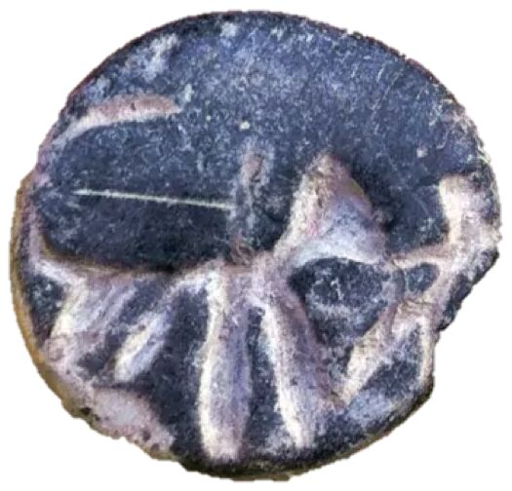
Lion/Samson Seal
12th century BC
Beth Shemesh

Slide 12
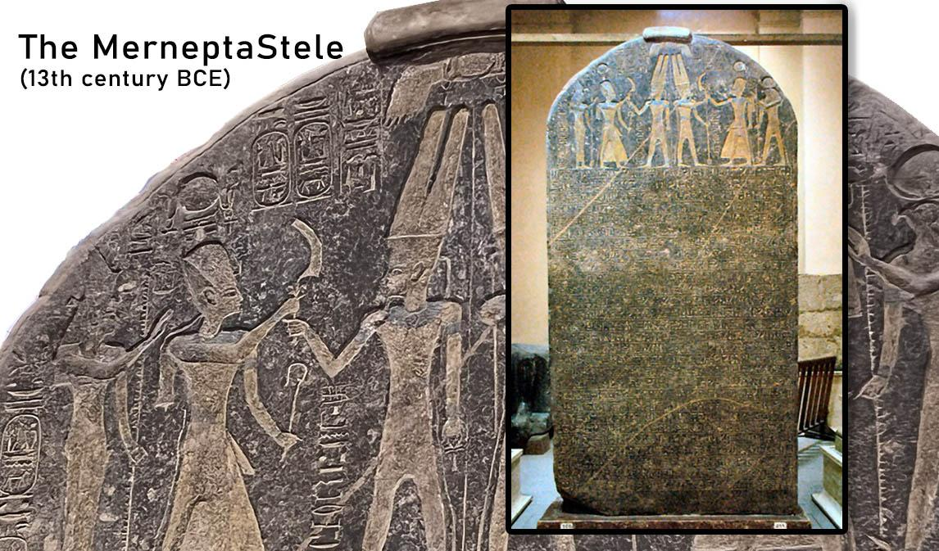

Slide 13
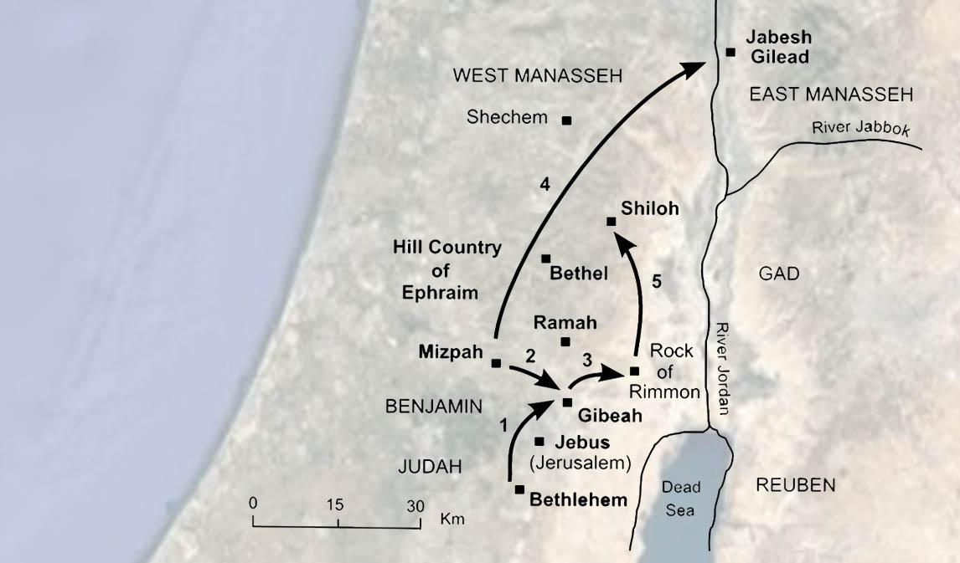

Slide 14
