Slide 1


Slide 2

Old Testament Survey:
The History of Israel
Monarchy
Dr. Keith Evan Schubert

Slide 3
Kingdom
Foretelling: Genesis 35:11, 36:31, 49:10, Numbers 24:7–9, Deuteronomy 28:36.
Rules: Deuteronomy 17:14–20
Israel Asks: I Samuel 8

Slide 4
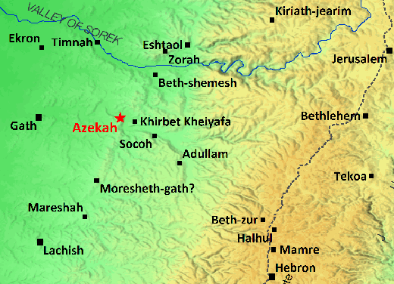
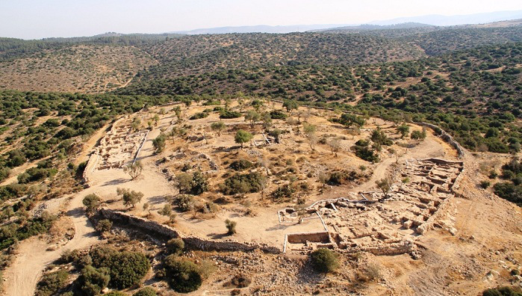
I Samuel
1 Samuel 17
Shaaraim – “Two Gates”

Slide 5
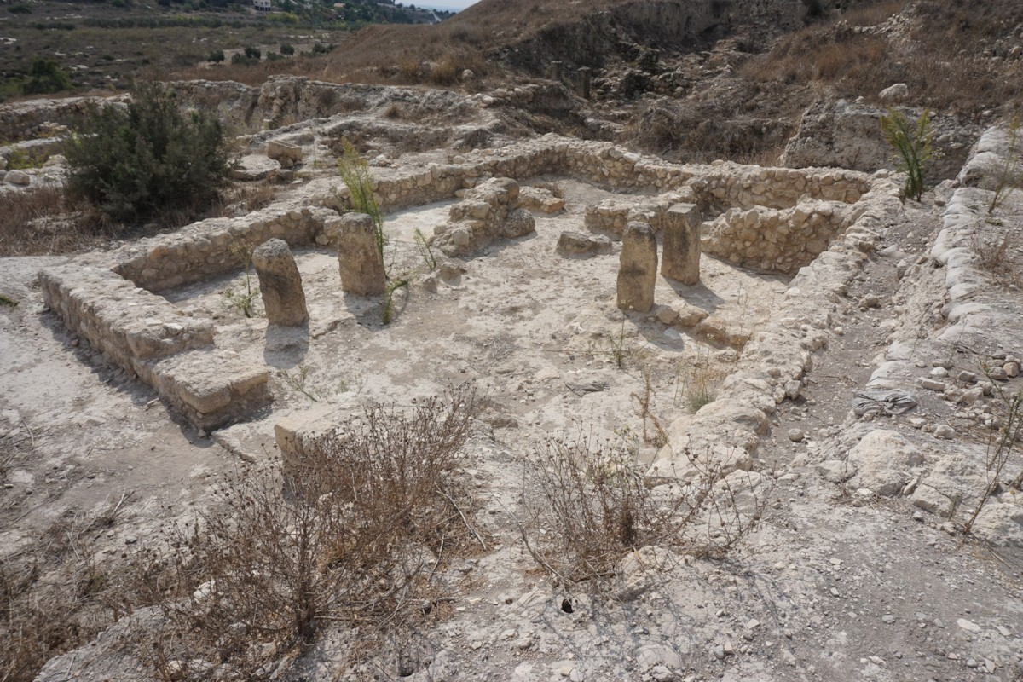
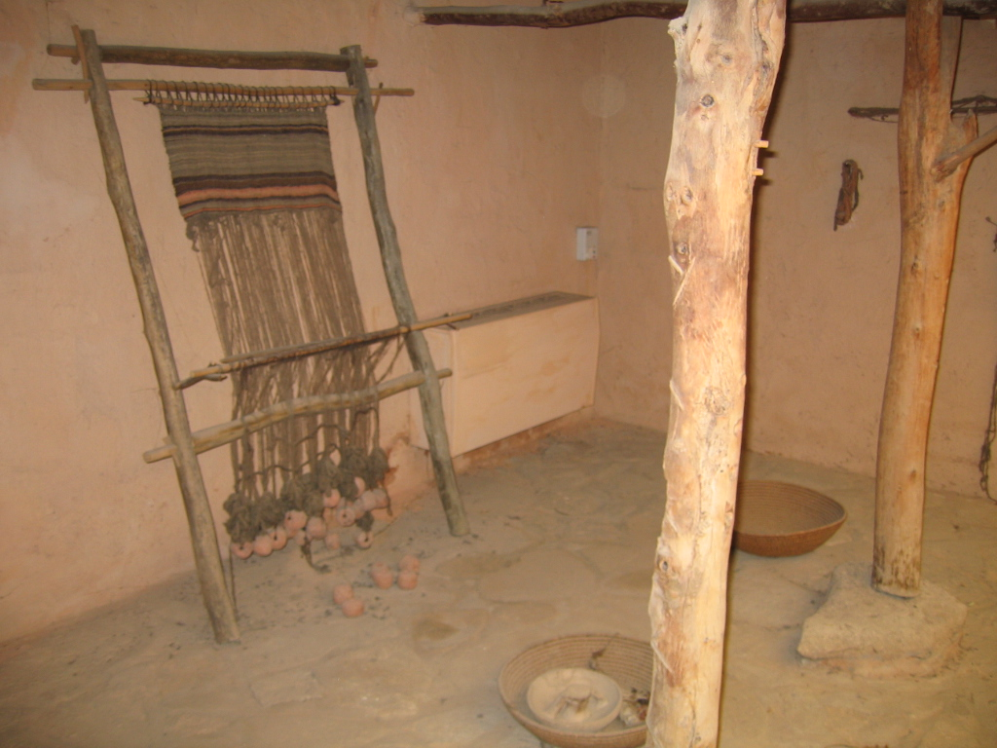
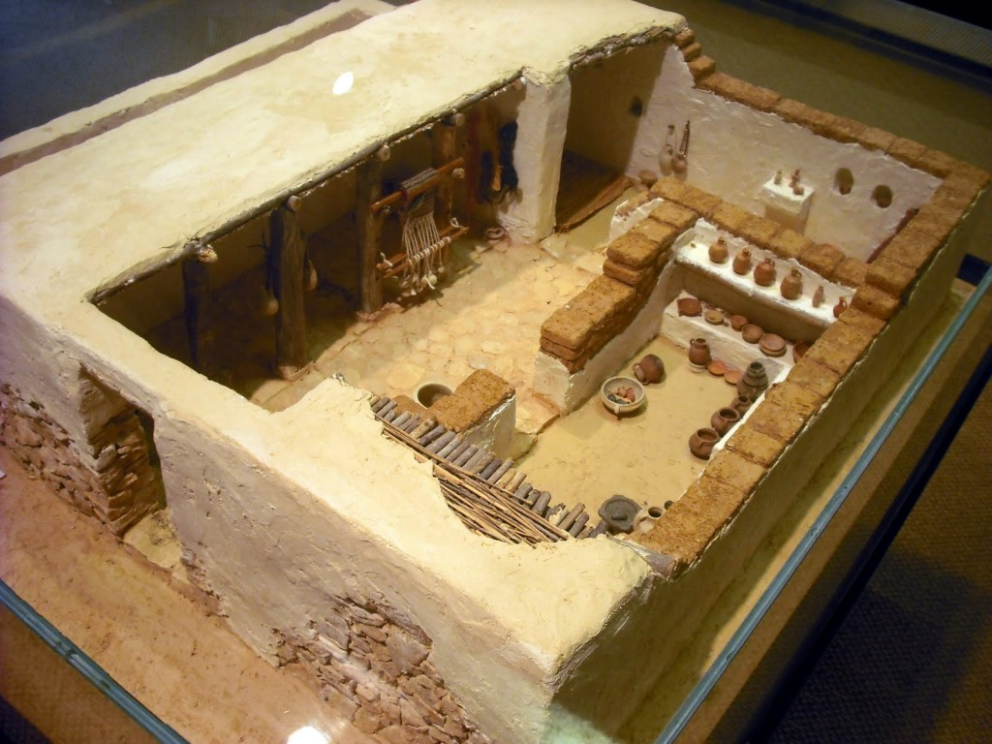
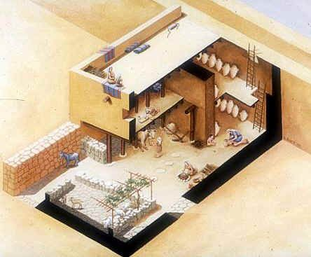
4 Room House

Slide 6
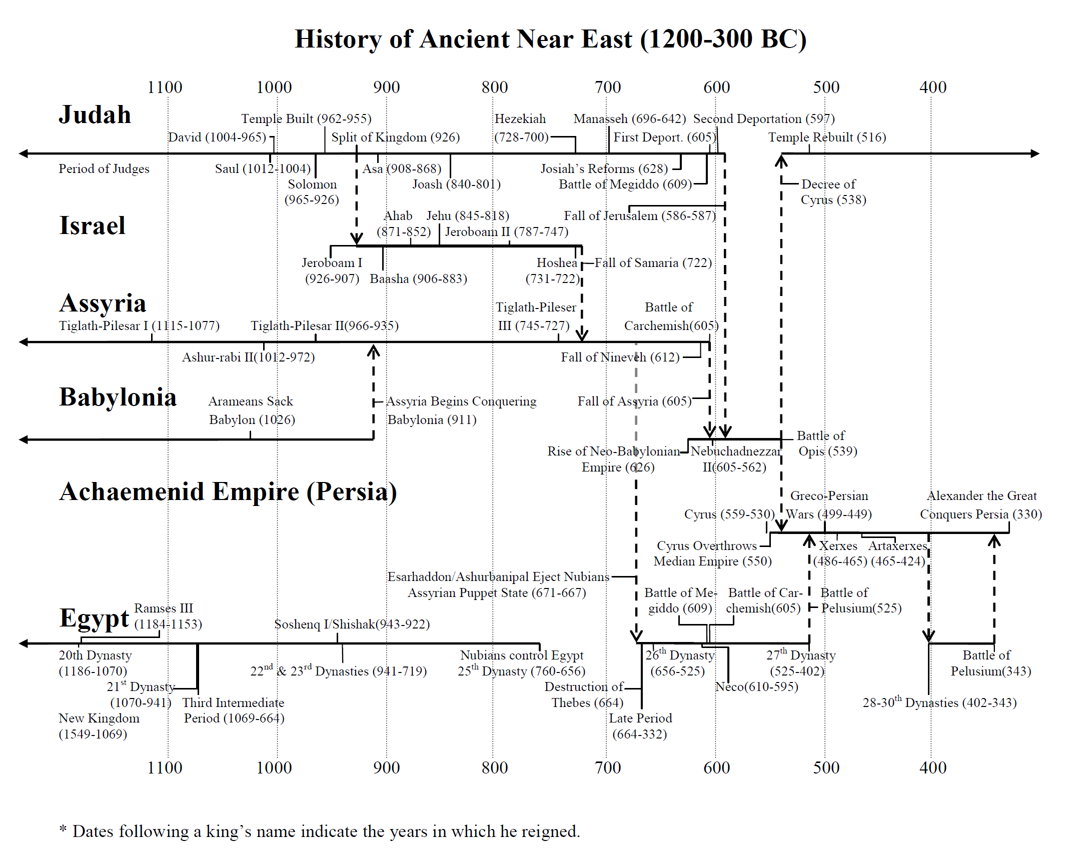

Slide 7
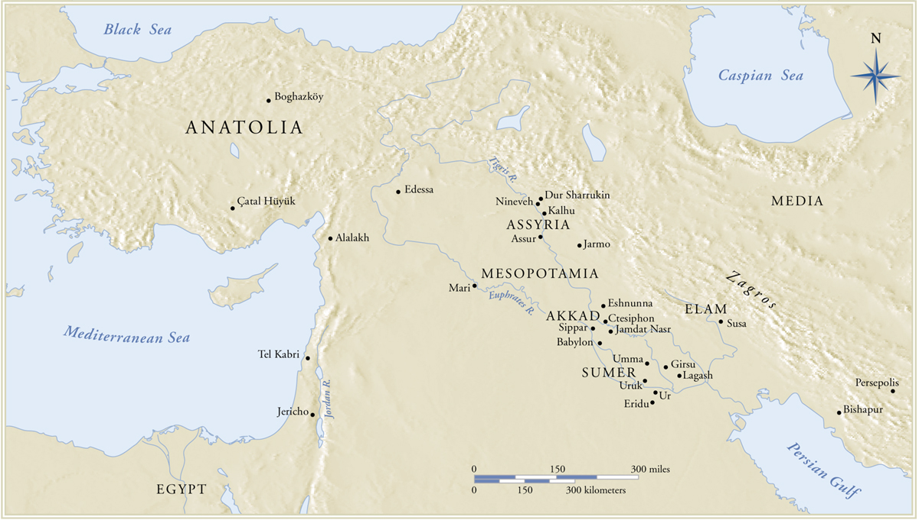

Slide 8
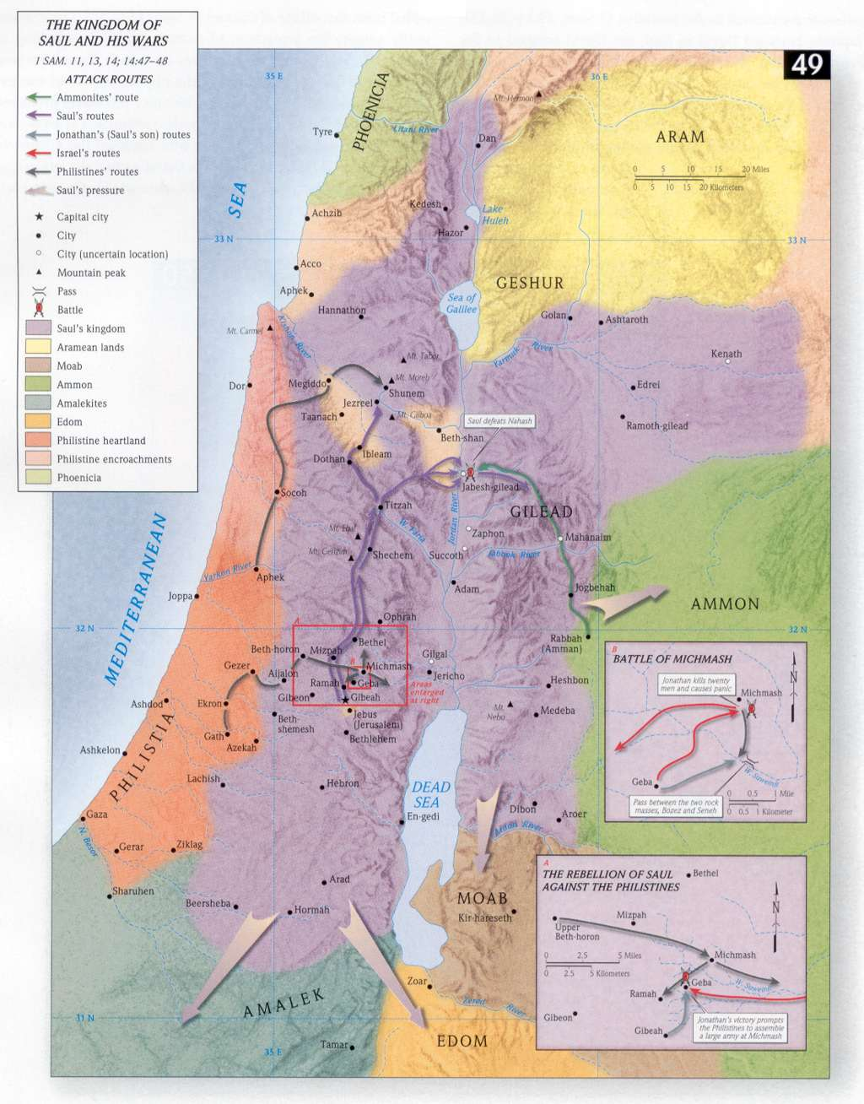
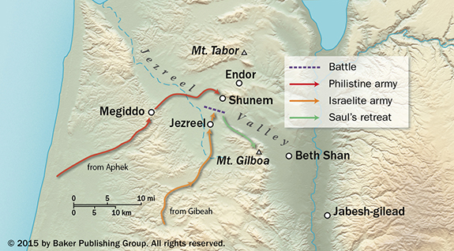
Rise of Saul

Slide 9
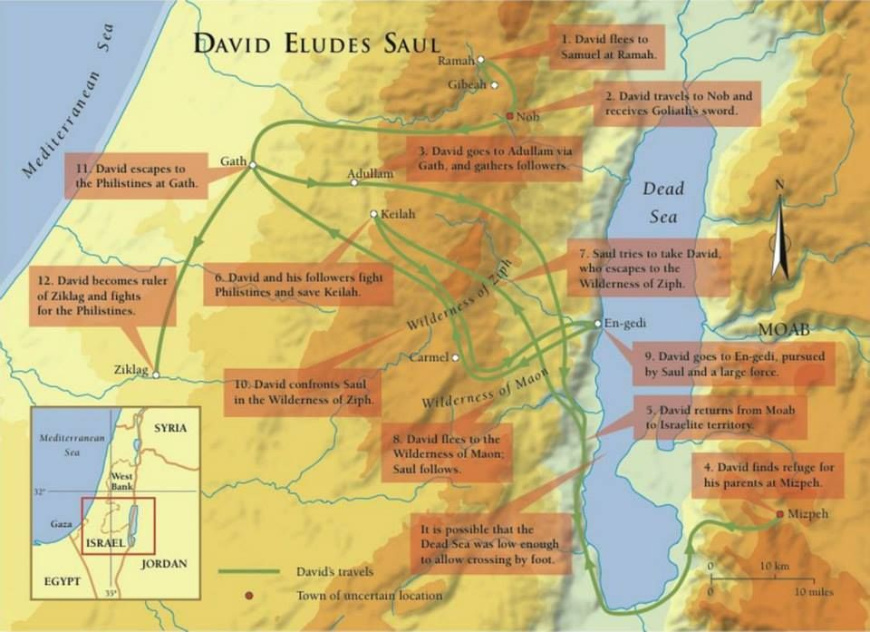
David

Slide 10
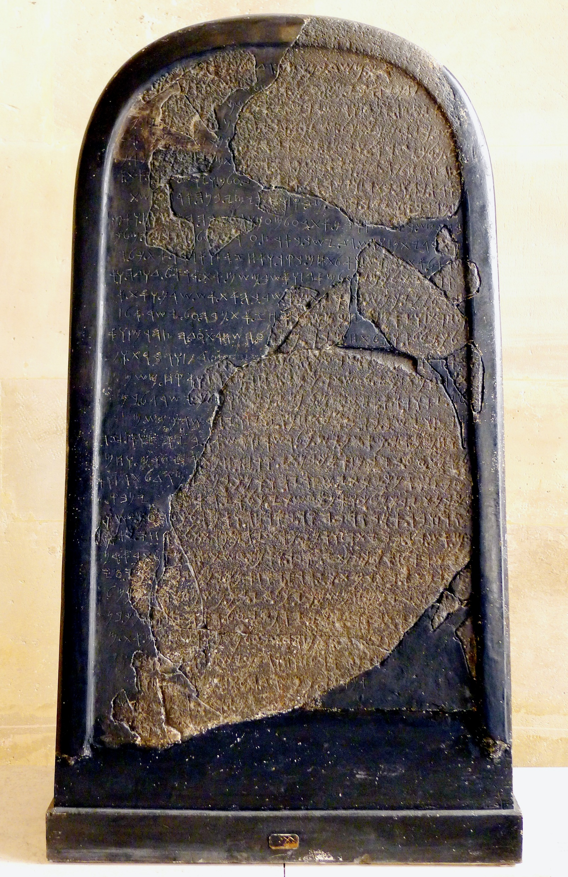
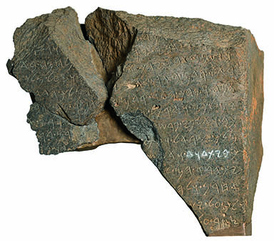
Mesha Stelle
840 BC
2 Kings 3
Tel Dan Stelle
870-750 BC
2 Kings 8

Slide 11
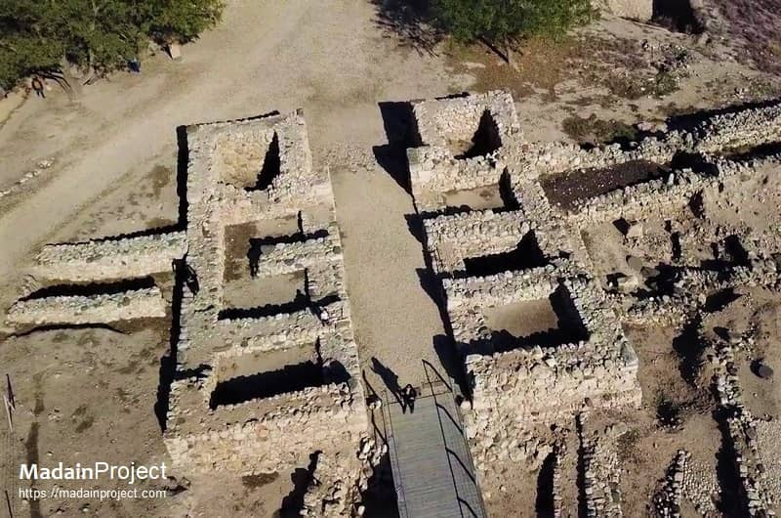
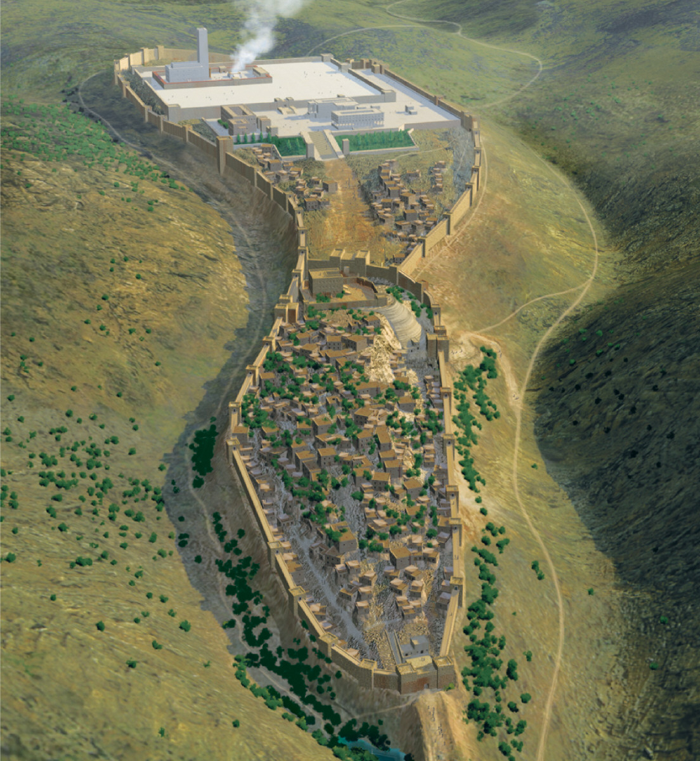
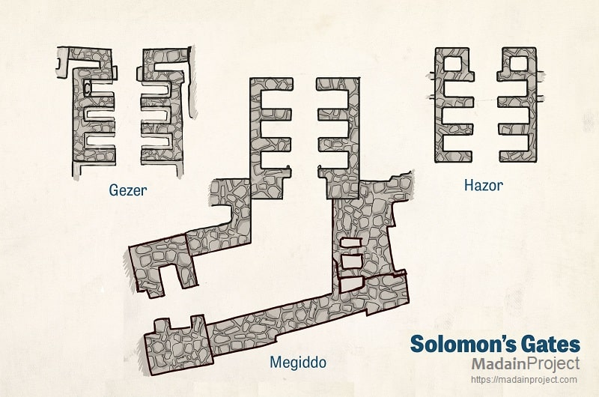
Solomon

Slide 12
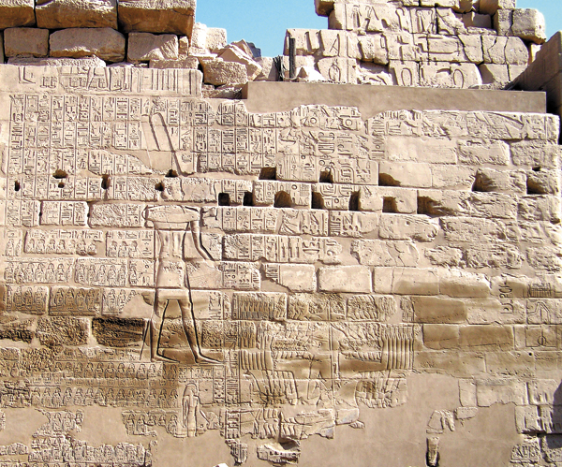
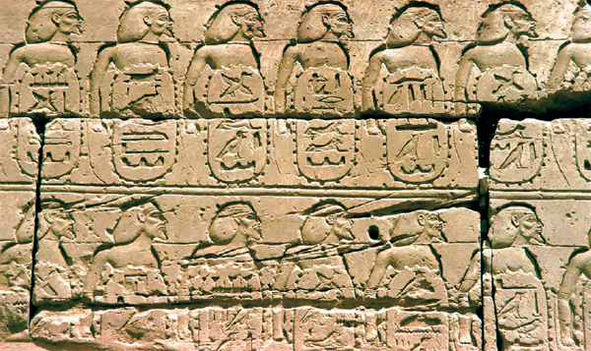
Rehoboam
1 Kings 14
~926 BC campaign
Support Jeroboam
Bubastite Portal at precinct of Amun-Ra in the Karnak temple complex
Lists 100’s of cities defeated, many well known

Slide 13
