Slide 1


https://cabcwaco.org/israel-class

Slide 2
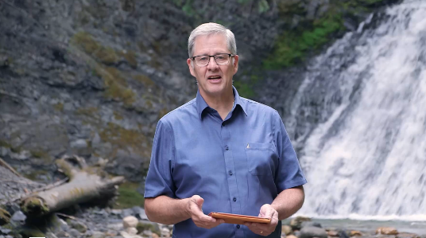

Bill Mounce at Baylor
WHO? Bill Mounce, author of “Why I Trust the Bible”, “Basics of Biblical Greek”, and member of the NIV & ESV Bible translations.
WHAT? Bill Mounce will give a lecture on Biblical Authority followed by a Q&A
WHEN? Tuesday October 10th at 8:00 pm
WHERE? Marrs McLean Science Rm. 101 at Baylor University
Please Join Ratio Christi in Welcoming Dr. Mounce to Baylor University! All are welcome.
First 100 people in the door will get a free Bible, 10 copies of Mounce’s book “Why I Trust the Bible” will be raffled at the first Ratio Christi Meeting Following the event!

Slide 3

Old Testament Survey:
The History of Israel
Divided Kingdom
Dr. Keith Evan Schubert

Slide 4
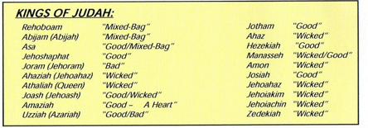
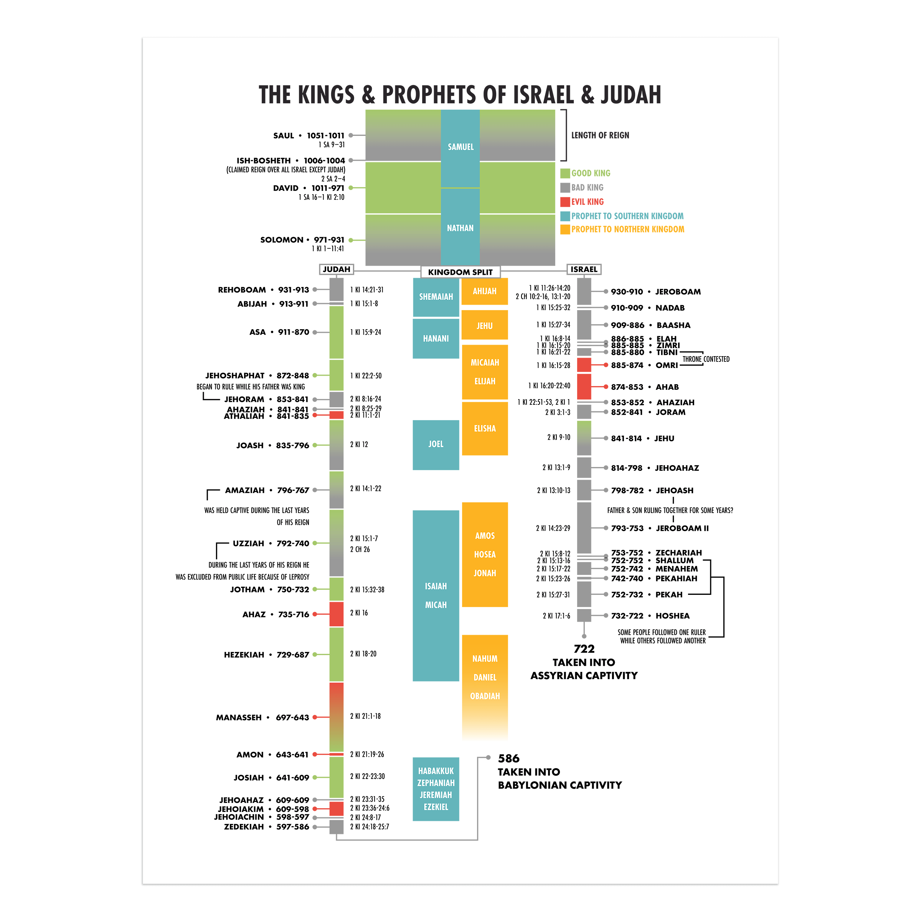

Timeline

Slide 5
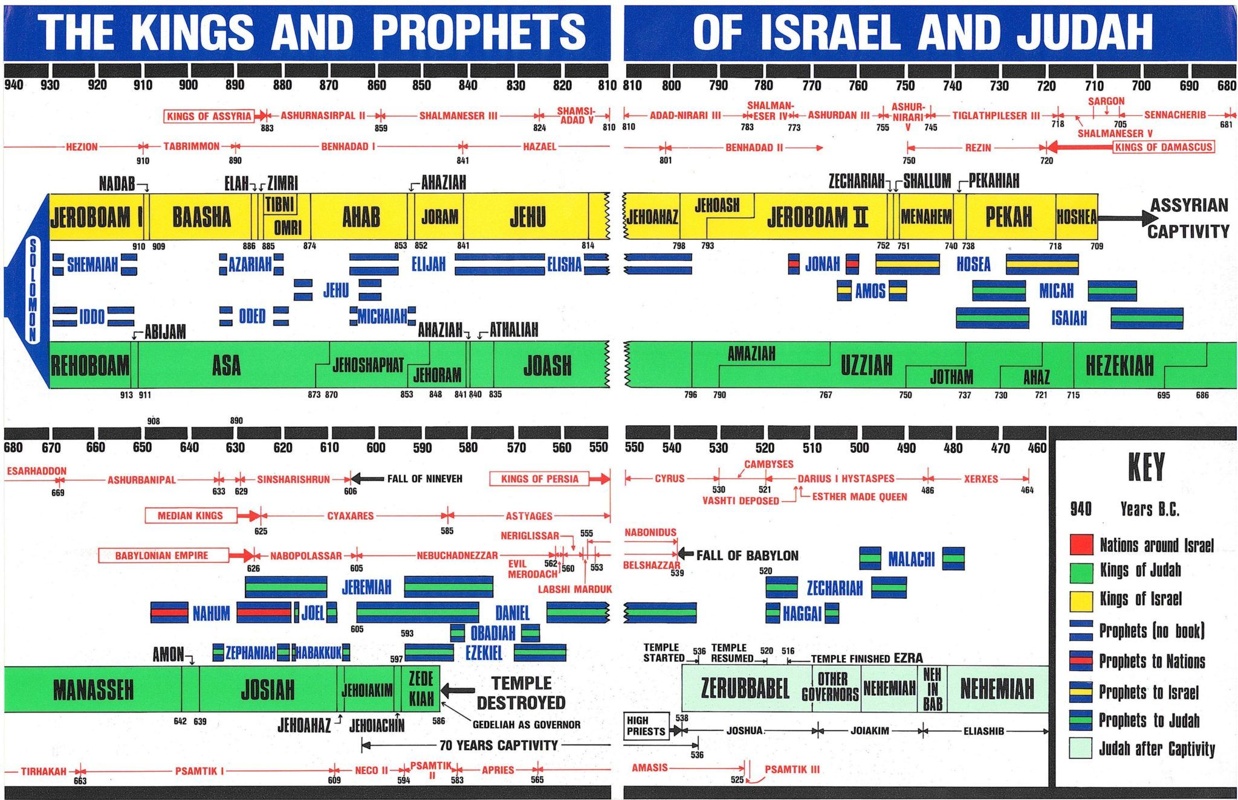

Slide 6
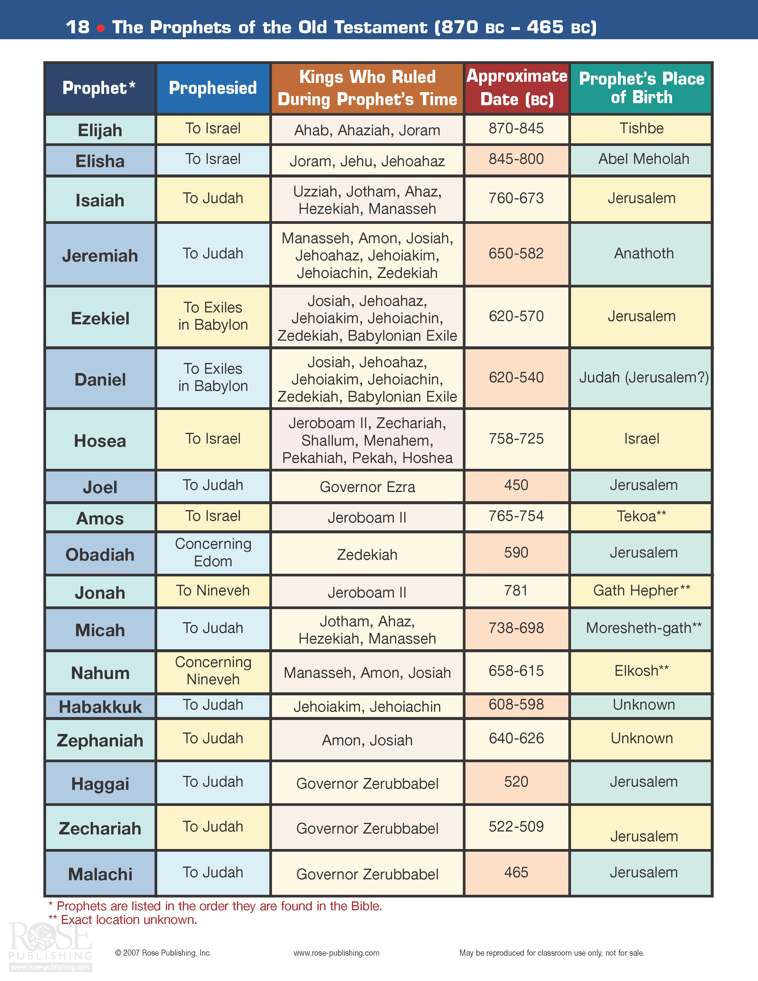
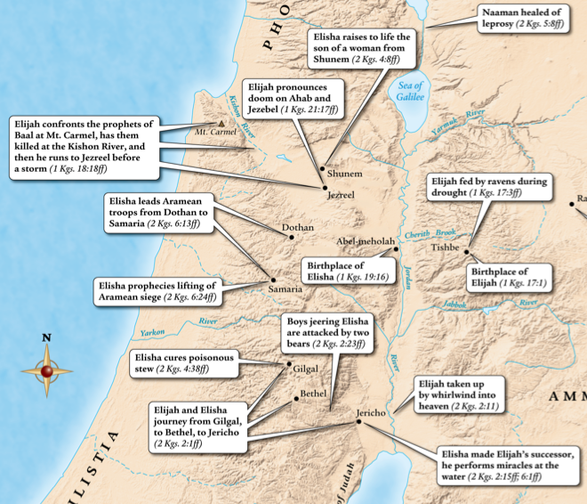
Prophets

Slide 7
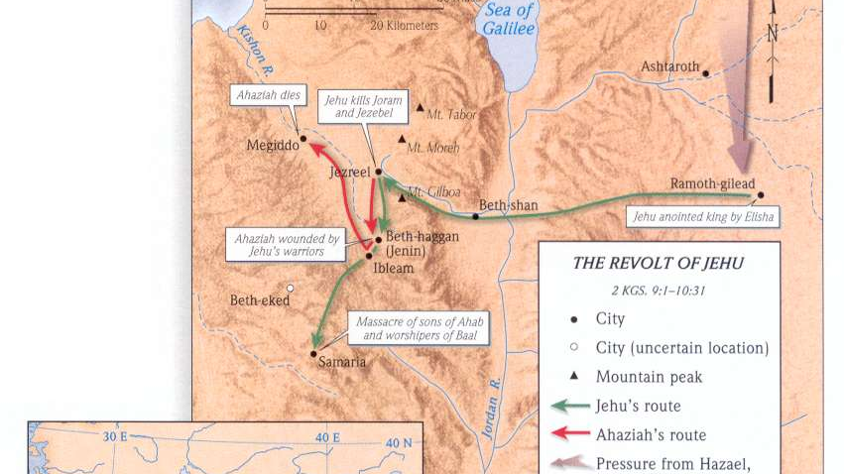

Slide 8
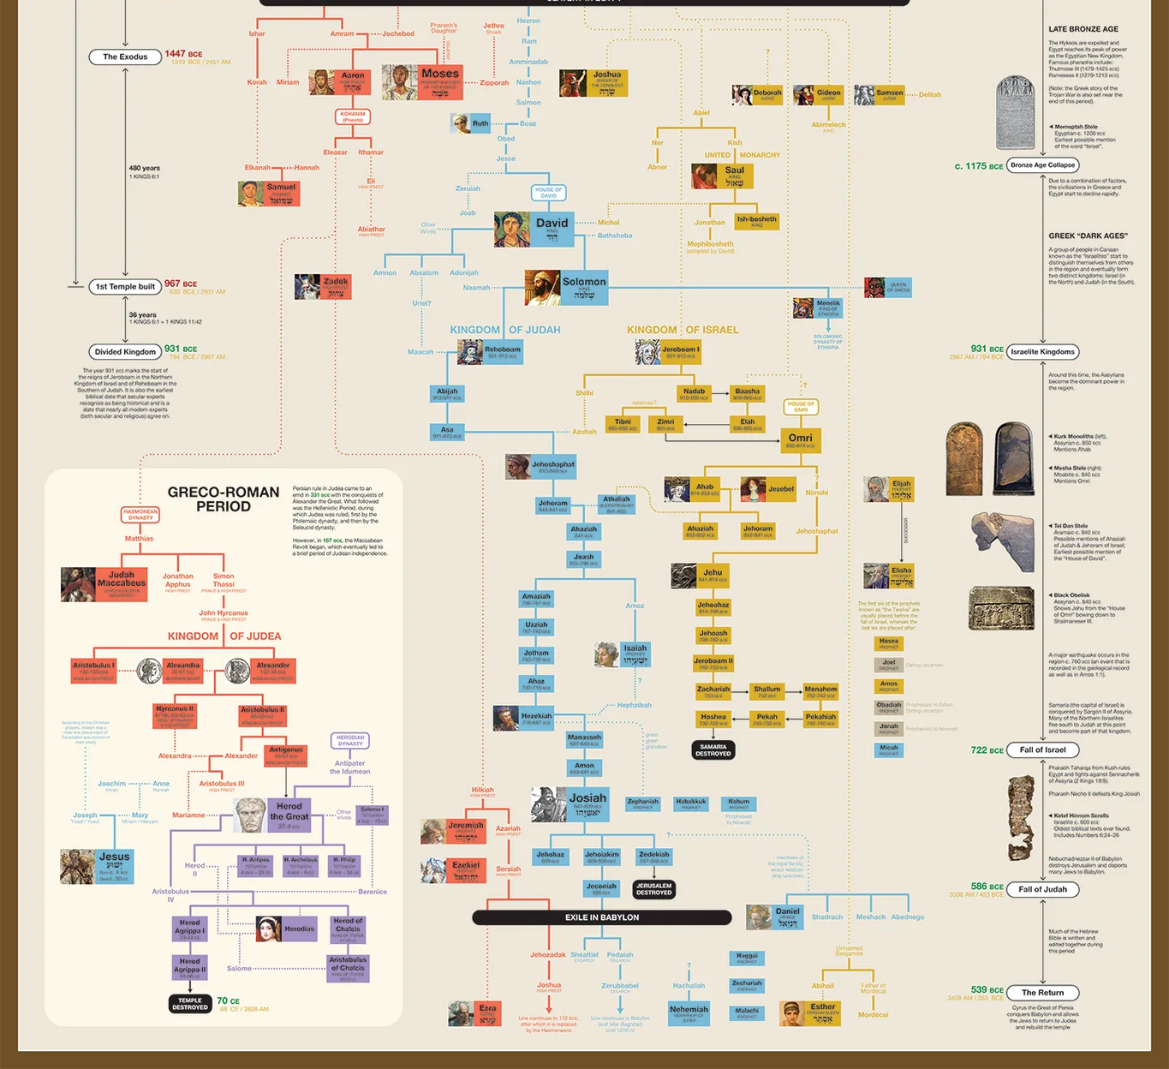
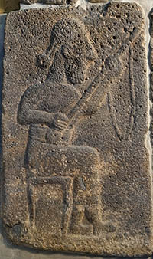
meditative, introverted lute player on this eighth-century B.C. relief from Samal in modern Turkey

Slide 9
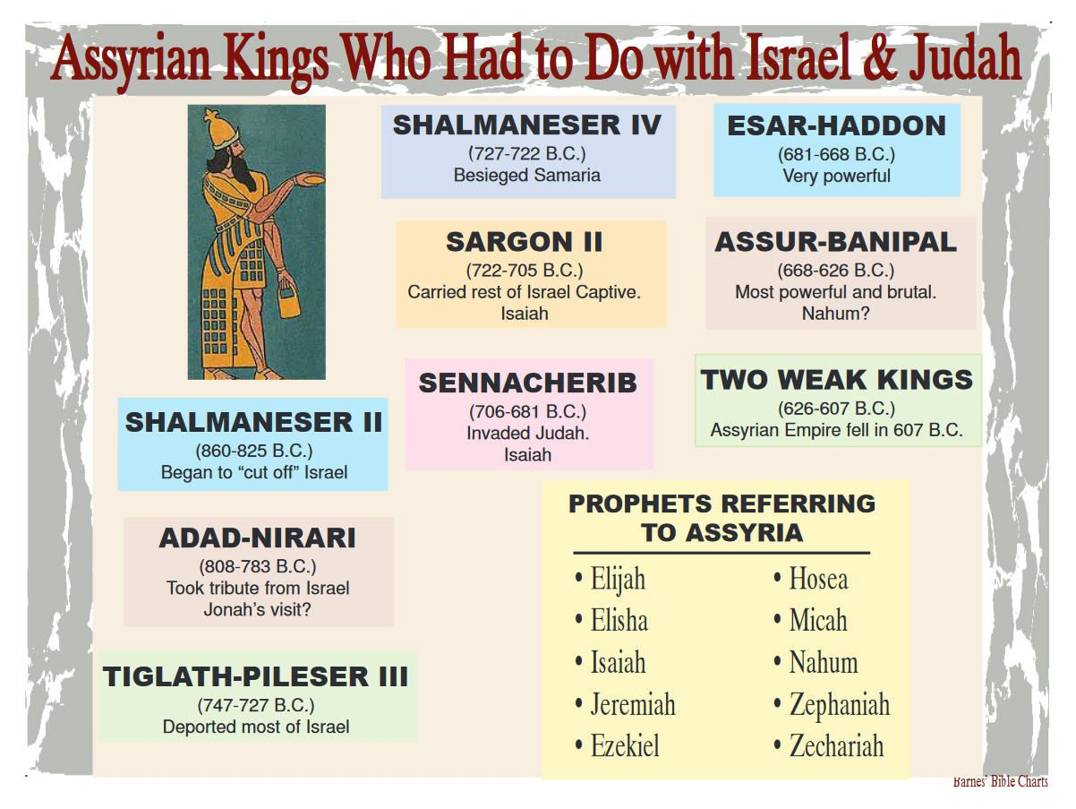
a

Slide 10
Name | Who was he? | When he reigned or flourished B.C.E. | Where in the Bible?
Egypt
1 | Shishak (= Sheshonq I) | pharaoh | 945–924 | 1 Kings 11:40, etc.
2 | So (= Osorkon IV) | pharaoh | 730–715 | 2 Kings 17:4
3 | Tirhakah (= Taharqa) | pharaoh | 690–664 | 2 Kings 19:9, etc.
4 | Necho II (= Neco II) | pharaoh | 610–595 | 2 Chronicles 35:20, etc.
5 | Hophra (= Apries) | pharaoh | 589–570 | Jeremiah 44:30
Moab
6 | Mesha | king | early to mid-ninth century | 2 Kings 3:4–27
Aram-Damascus
7 | Hadadezer | king | early ninth century to 844/842 | 1 Kings 11:23, etc.
8 | Ben-hadad, son of Hadadezer | king | 844/842 | 2 Kings 6:24, etc.
9 | Hazael | king | 844/842–c. 800 | 1 Kings 19:15, etc.
10 | Ben-hadad, son of Hazael | king | early eighth century | 2 Kings 13:3, etc.
11 | Rezin | king | mid-eighth century to 732 | 2 Kings 15:37, etc.

Slide 11
Northern Kingdom of Israel
12 | Omri | king | 884–873 | 1 Kings 16:16, etc.
13 | Ahab | king | 873–852 | 1 Kings 16:28, etc.
14 | Jehu | king | 842/841–815/814 | 1 Kings 19:16, etc.
15 | Joash (= Jehoash) | king | 805–790 | 2 Kings 13:9, etc.
16 | Jeroboam II | king | 790–750/749 | 2 Kings 13:13, etc.
17 | Menahem | king | 749–738 | 2 Kings 15:14, etc.
18 | Pekah | king | 750(?)–732/731 | 2 Kings 15:25, etc.
19 | Hoshea | king | 732/731–722 | 2 Kings 15:30, etc.
20 | Sanballat “I” | governor of Samaria under Persian rule | c. mid-fifth century | Nehemiah 2:10, etc.

Slide 12
Southern Kingdom of Judah
21 | David | king | c. 1010–970 | 1 Samuel 16:13, etc.
22 | Uzziah (= Azariah) | king | 788/787–736/735 | 2 Kings 14:21, etc.
23 | Ahaz (= Jehoahaz) | king | 742/741–726 | 2 Kings 15:38, etc.
24 | Hezekiah | king | 726–697/696 | 2 Kings 16:20, etc.
25 | Manasseh | king | 697/696–642/641 | 2 Kings 20:21, etc.
26 | Hilkiah | high priest during Josiah’s reign | within 640/639–609 | 2 Kings 22:4, etc.
27 | Shaphan | scribe during Josiah’s reign | within 640/639–609 | 2 Kings 22:3, etc.
28 | Azariah | high priest during Josiah’s reign | within 640/639–609 | 1 Chronicles 5:39, etc.
29 | Gemariah | official during Jehoiakim’s reign | within 609–598 | Jeremiah 36:10, etc.
30 | Jehoiachin (= Jeconiah = Coniah) | king | 598–597 | 2 Kings 24:6, etc.
31 | Shelemiah | father of Jehucal the royal official | late seventh century | Jeremiah 37:3, etc.
32 | Jehucal (= Jucal) | official during Zedekiah’s reign | within 597–586 | Jeremiah 37:3, etc.
33 | Pashhur | father of Gedaliah the royal official | late seventh century | Jeremiah 38:1
34 | Gedaliah | official during Zedekiah’s reign | within 597–586 | Jeremiah 38:1

Slide 13
Assyria
35 | Tiglath-pileser III (= Pul) | king | 744–727 | 2 Kings 15:19, etc.
36 | Shalmaneser V | king | 726–722 | 2 Kings 17:3, etc.
37 | Sargon II | king | 721–705 | Isaiah 20:1
38 | Sennacherib | king | 704–681 | 2 Kings 18:13, etc.
39 | Adrammelech (= Ardamullissu = Arad-mullissu) | son and assassin of Sennacherib | early seventh century | 2 Kings 19:37, etc.
40 | Esarhaddon | king | 680–669 | 2 Kings 19:37, etc.
Babylonia
41 | Merodach-baladan II | king | 721–710 and 703 | 2 Kings 20:12, etc.
42 | Nebuchadnezzar II | king | 604–562 | 2 Kings 24:1, etc.
43 | Nebo-sarsekim | official of Nebuchadnezzar II | early sixth century | Jeremiah 39:3
44 | Nergal-sharezer | officer of Nebuchadnezzar II | early sixth century | Jeremiah 39:3
45 | Nebuzaradan | a chief officer of Nebuchadnezzar II | early sixth century | 2 Kings 25:8, etc. & Jeremiah 39:9, etc.
46 | Evil-merodach (= Awel Marduk = Amel Marduk) | king | 561–560 | 2 Kings 25:27, etc.
47 | Belshazzar | son and co-regent of Nabonidus | c. 543?–540 | Daniel 5:1, etc.
Persia
48 | Cyrus II (= Cyrus the Great) | king | 559–530 | 2 Chronicles 36:22, etc.
49 | Darius I (= Darius the Great) | king | 520–486 | Ezra 4:5, etc.
50 | Tattenai | provincial governor of Trans-Euphrates | late sixth to early fifth century | Ezra 5:3, etc.
51 | Xerxes I (= Ahasuerus) | king | 486–465 | Esther 1:1, etc.
52 | Artaxerxes I Longimanus | king | 465-425/424 | Ezra 4:7, etc.
53 | Darius II Nothus | king | 425/424-405/404 | Nehemiah 12:22

Slide 14
https://cabcwaco.org/israel-class

