Slide 1


Slide 2

Old Testament Survey:
The History of Israel
Exile
Dr. Keith Evan Schubert

Slide 3
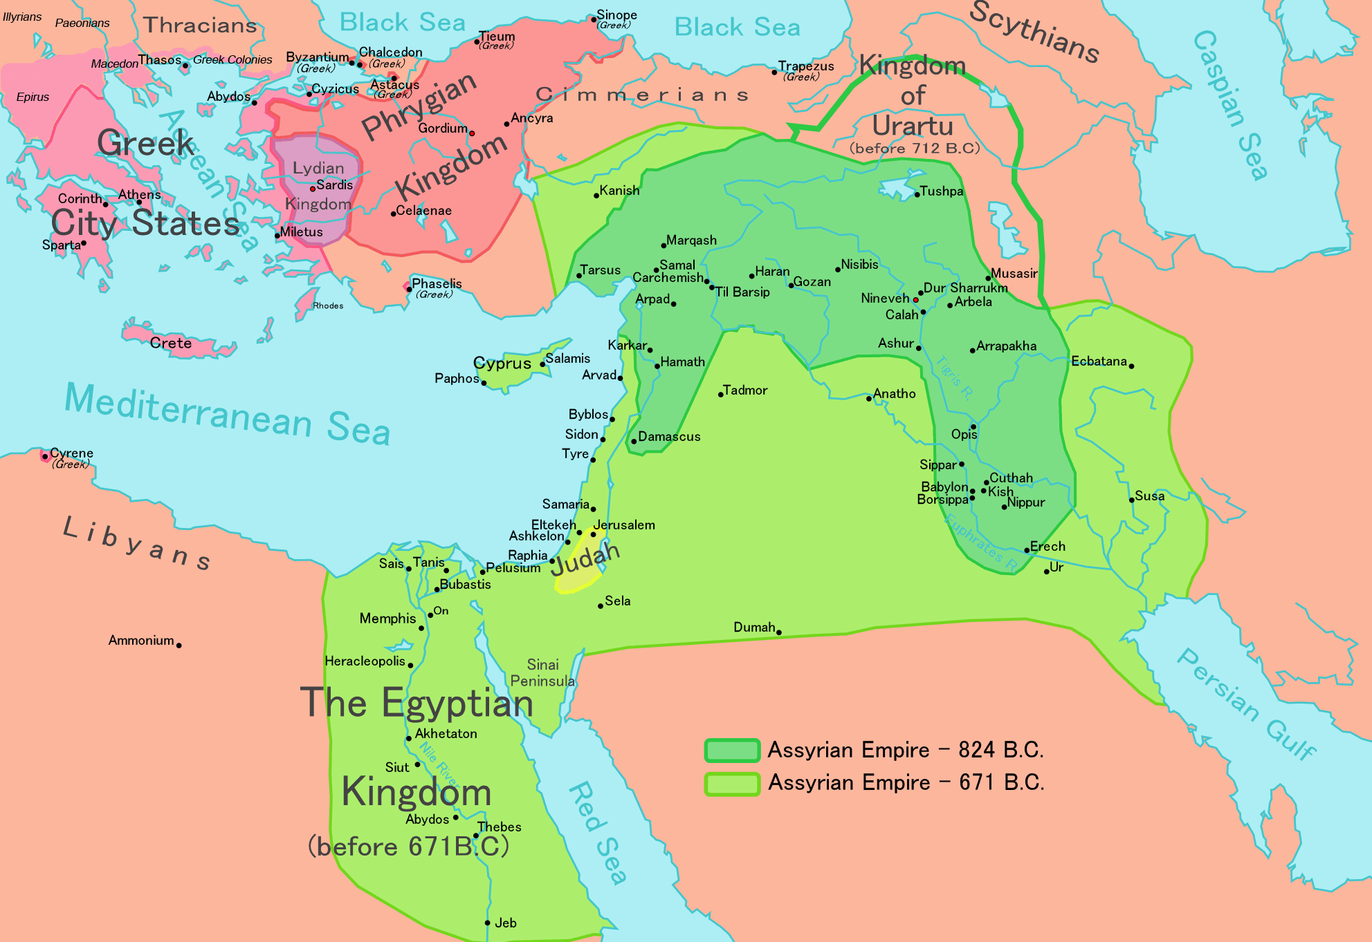
Prelude: Rise of Babylon
622
631 BC Ashurbanipal dies, struggle for power
626 BC Nabopolassar revolts and takes Nippur, Babylon, Uruk
620’s BC Cimmerians and Scythians invade, Cyaxares of Media assassinates leaders
623 BC Elam revolts
616 BC Assyria pushes most back but weakened

Slide 4
Prelude: Rise of Babylon
622
616 BC Egyptians send aid to Assyria
615 BC Babylon pushed back
615 BC Cyaxares aids Babylon, pushes to Tigris
614 BC Medes sack Ashur, Amytis marries Nebuchadnezzar
612 BC Fall of Nineveh
610 BC Fall of Haran
609 Pharoh Neco II slowed by Josiah
605 BC Egypt & Assyrian remnant defeated at Carchemish

Slide 5
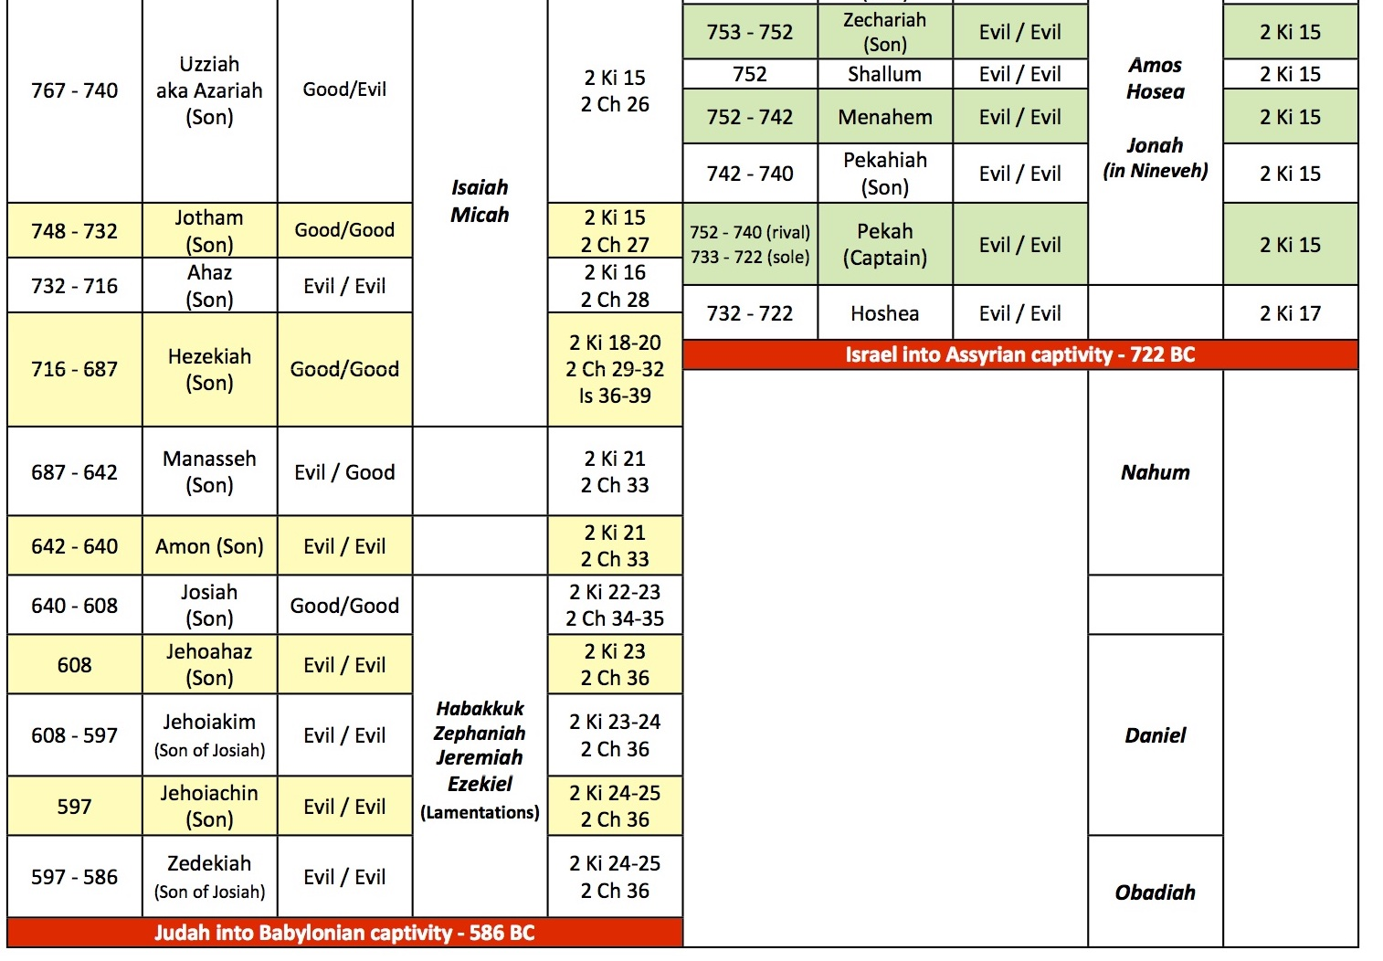

Slide 6
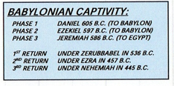
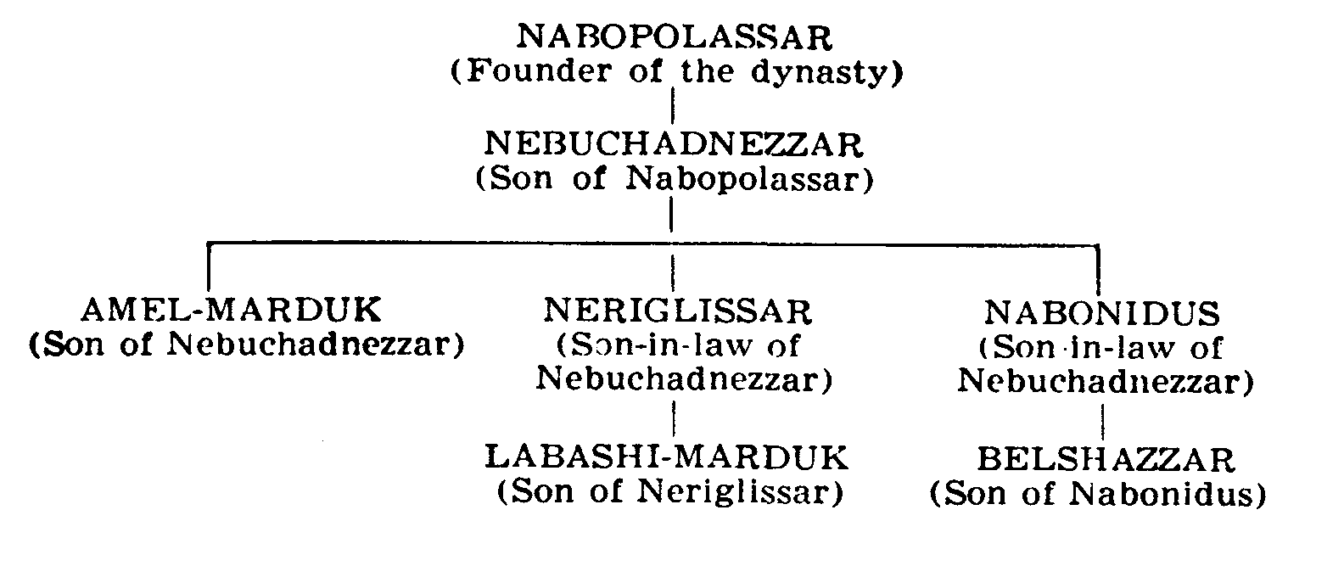
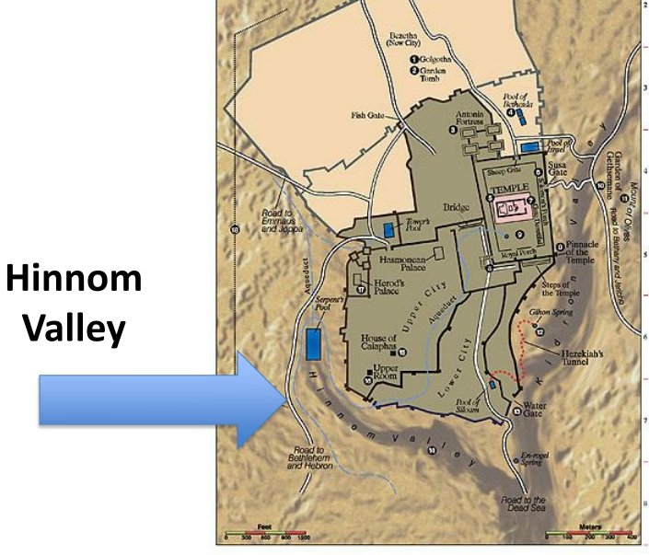
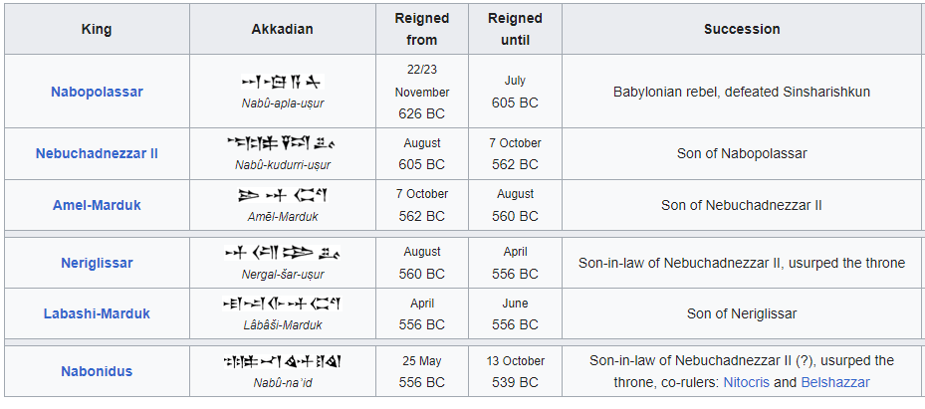

Slide 7
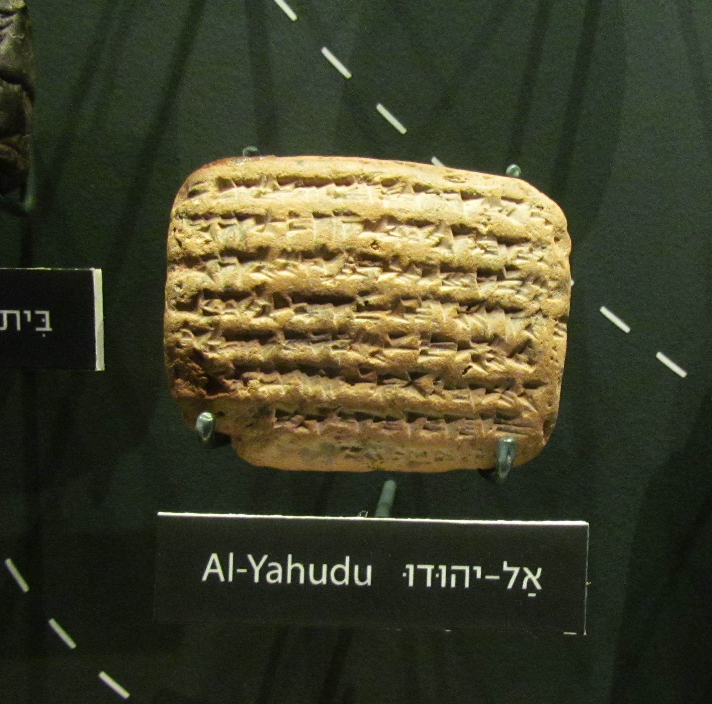
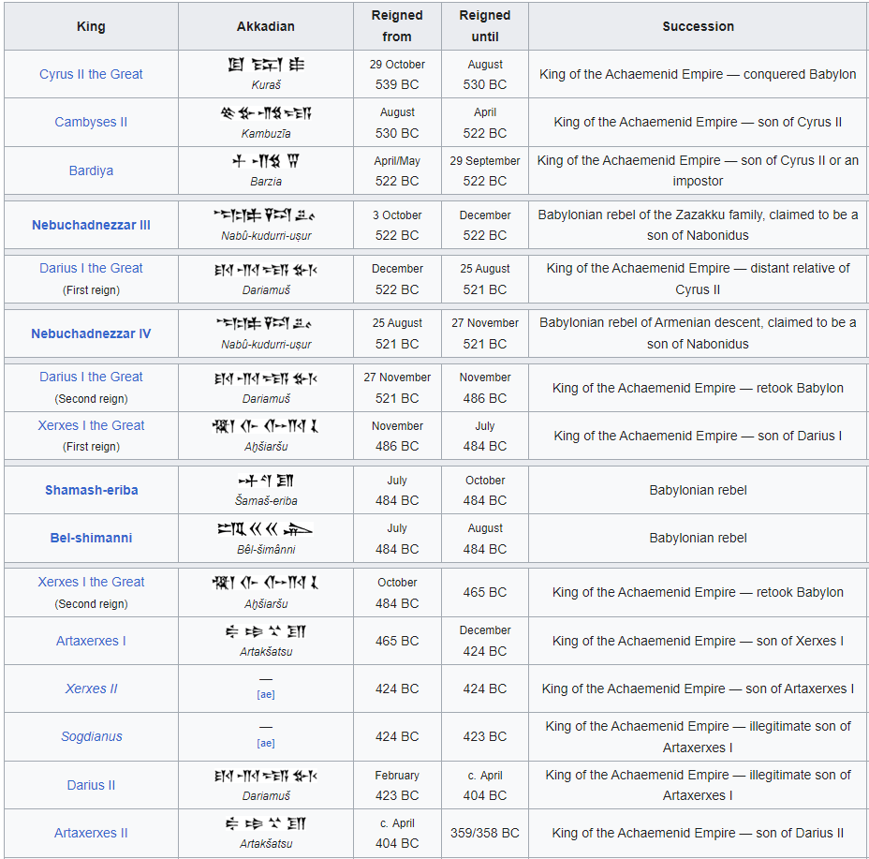
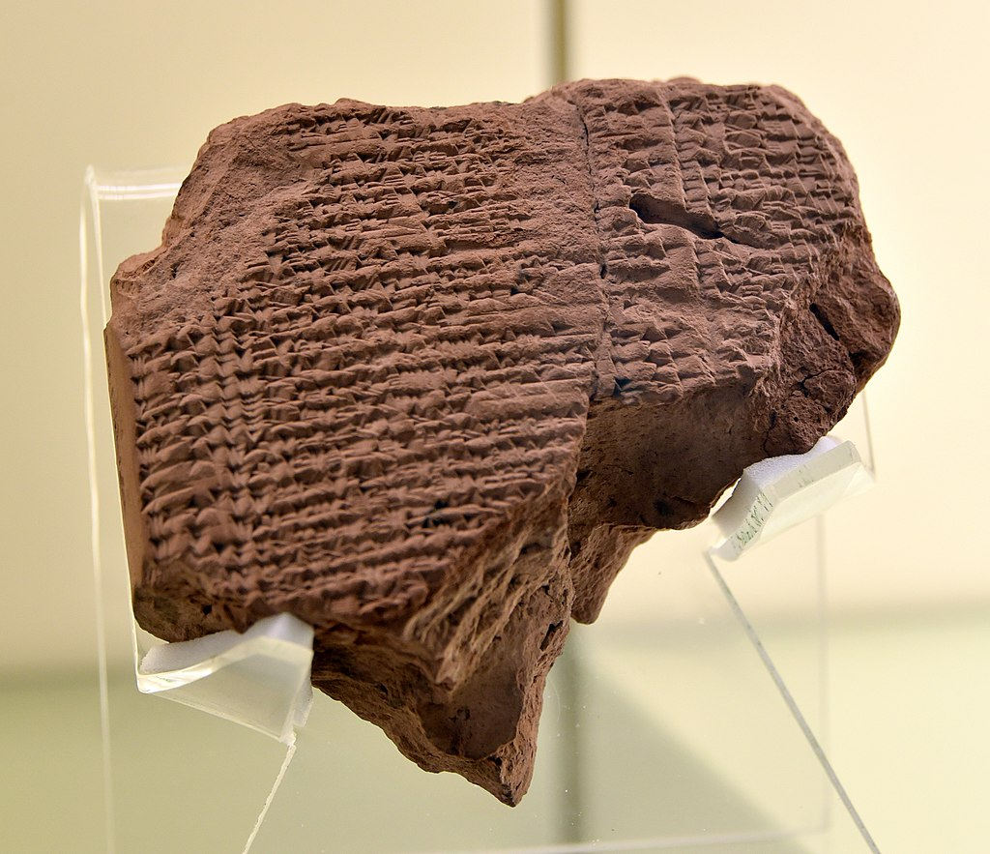
Clay tablet. The Akkadian cuneiform inscription lists certain rations and mentions the name of Jeconiah (Jehoiachin), King of Judah, and the Babylonian captivity. From Babylon, Iraq. Reign of Nebuchadnezzar II, circa 580 BCE. Vorderasiatisches Museum, Berlin

