Slide 1


Slide 2

Bill Mounce Video
https://youtu.be/_BdCH4B0hA0
https://www.youtube.com/@KeithSchubert_PhD

Slide 3

Old Testament Survey:
The History of Israel
Post-Exilic
Dr. Keith Evan Schubert

Slide 4
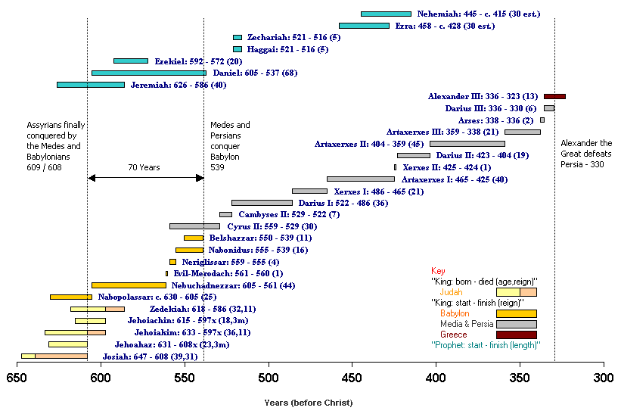

Slide 5
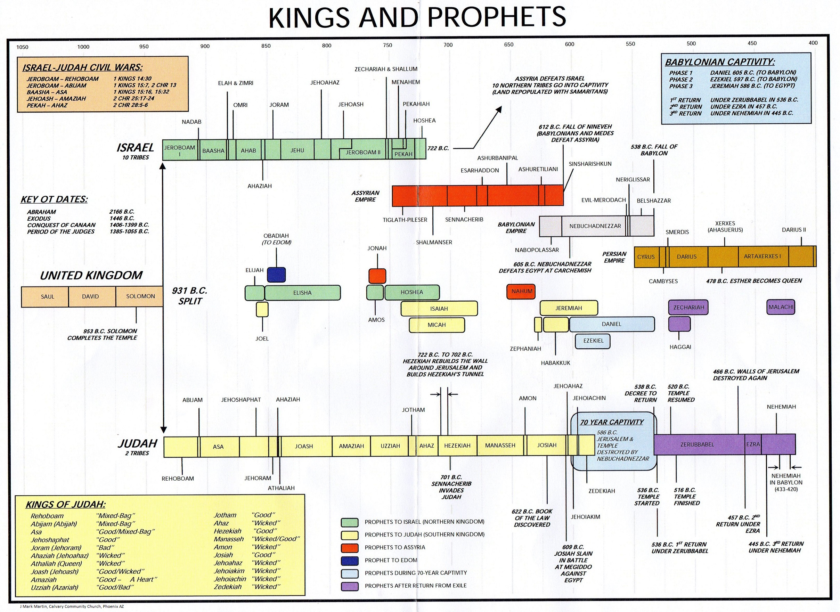

Slide 6
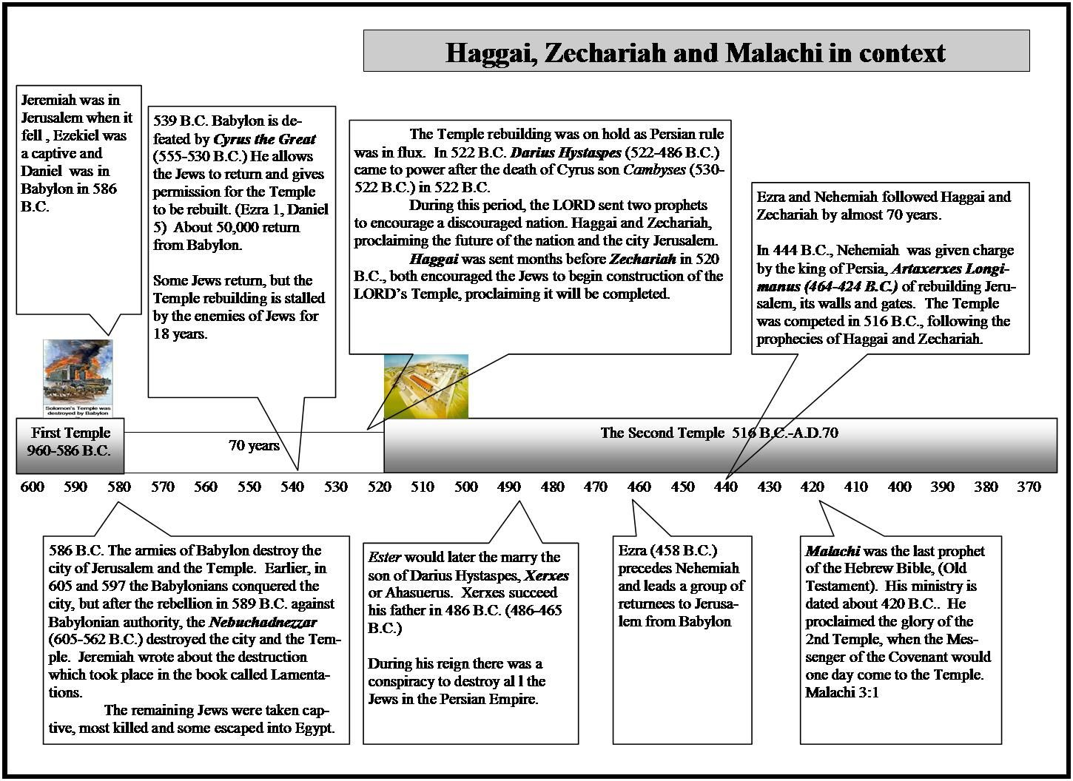

Slide 7
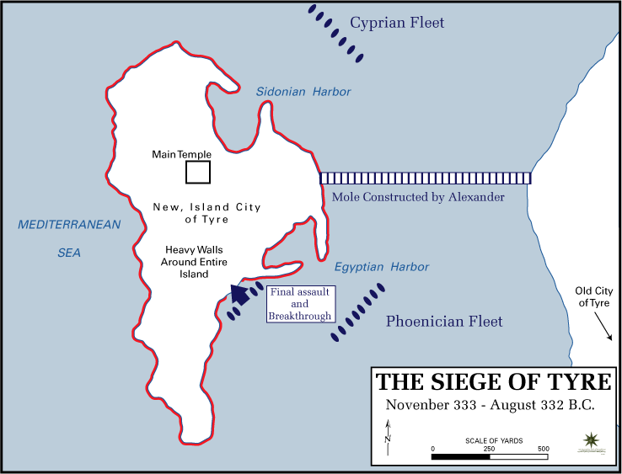
Destruction of Tyre
Ezekiel 26-28

Slide 8
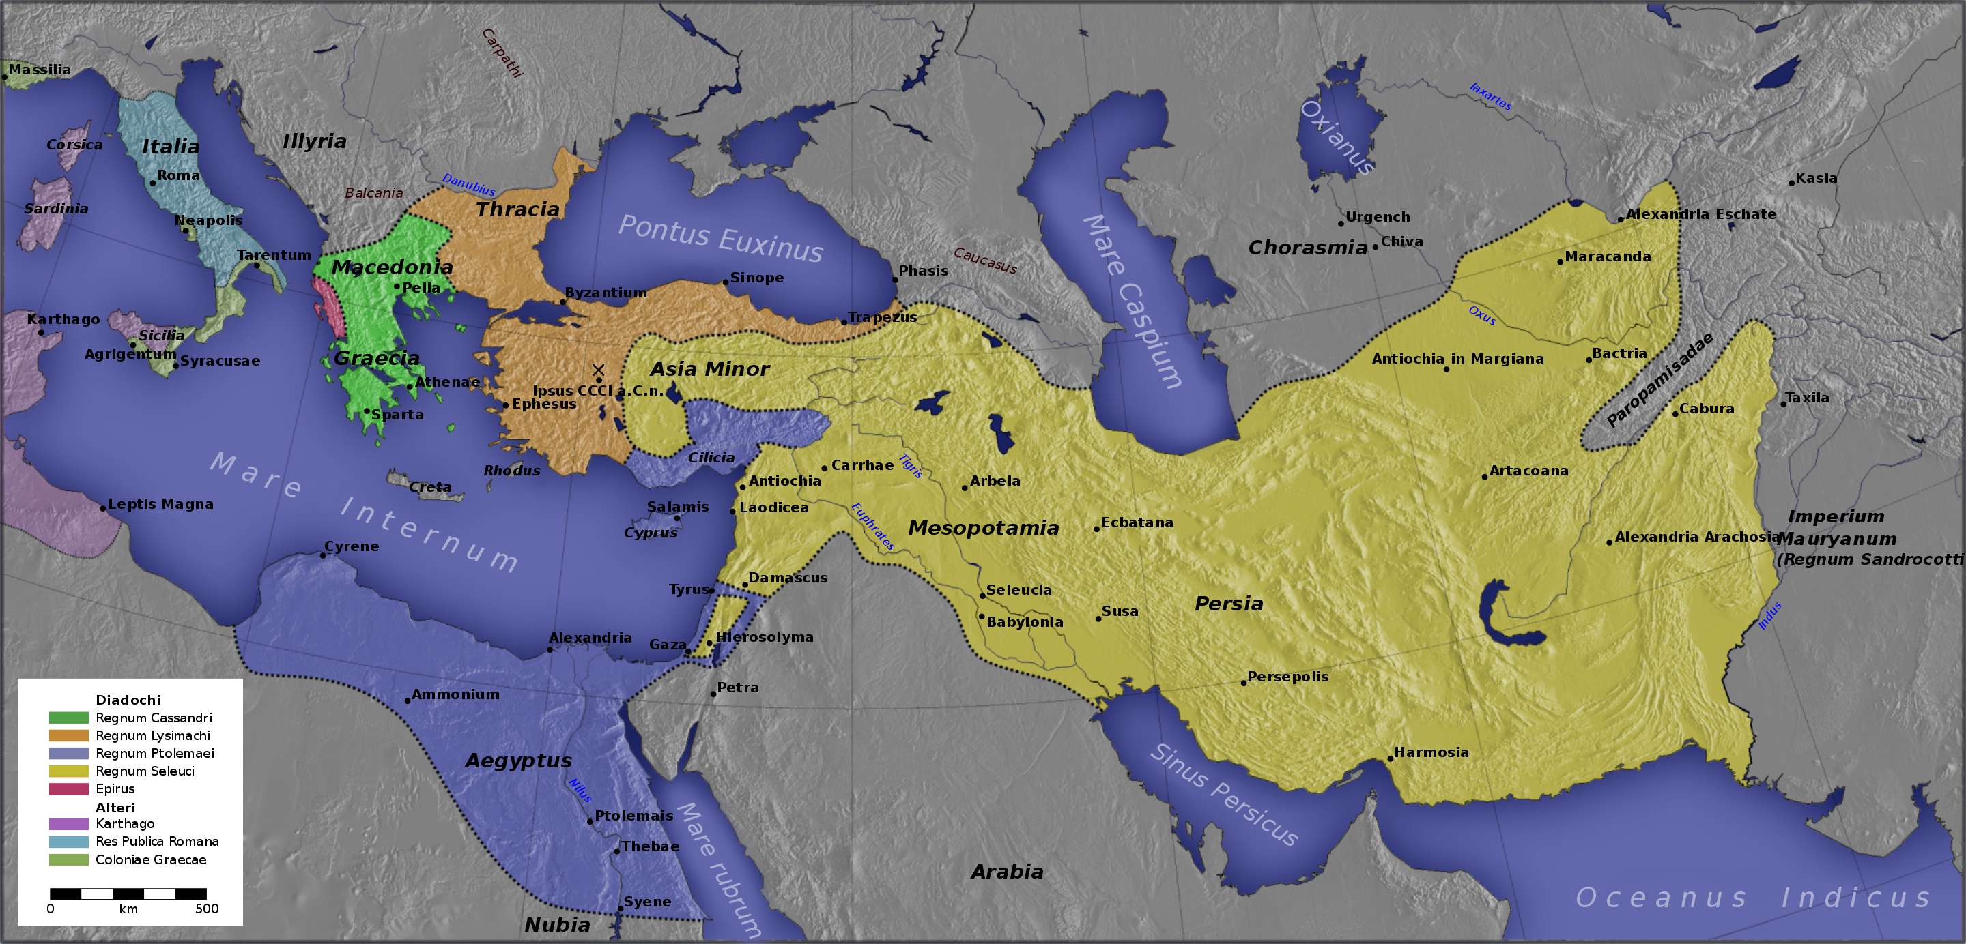
Alexander’s empire

Slide 9
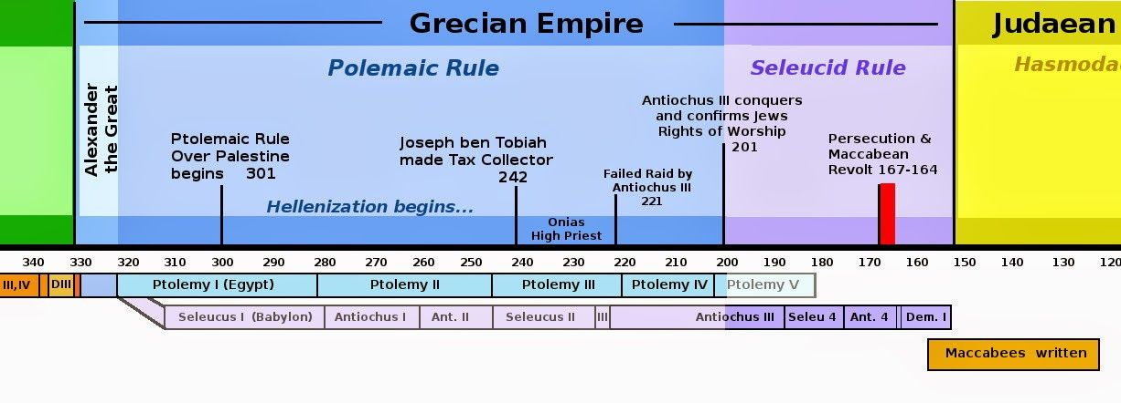

Slide 10
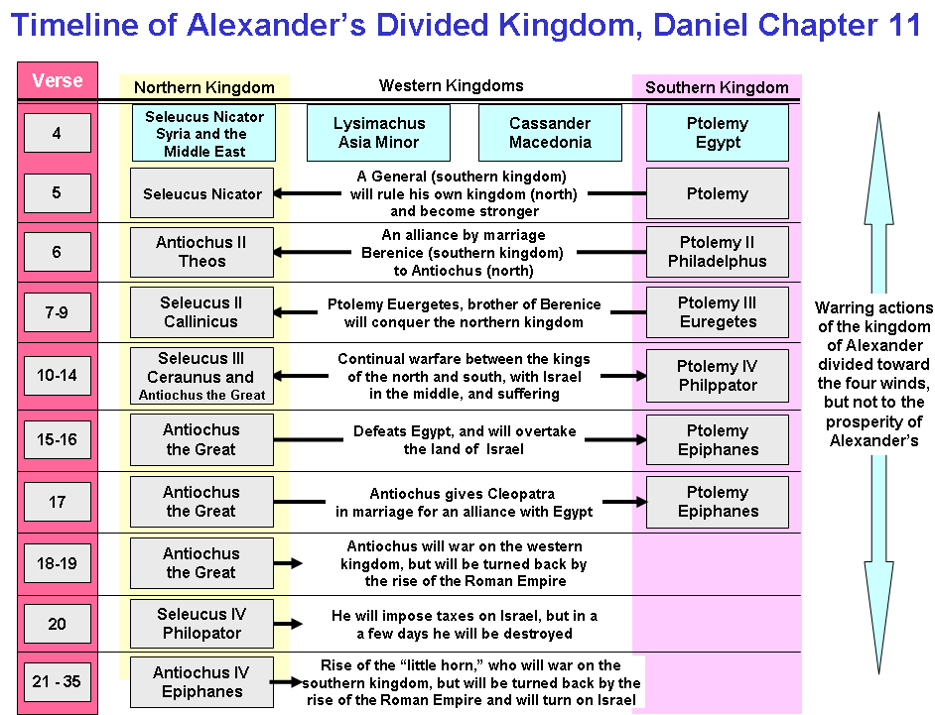

Slide 11
