Slide 1
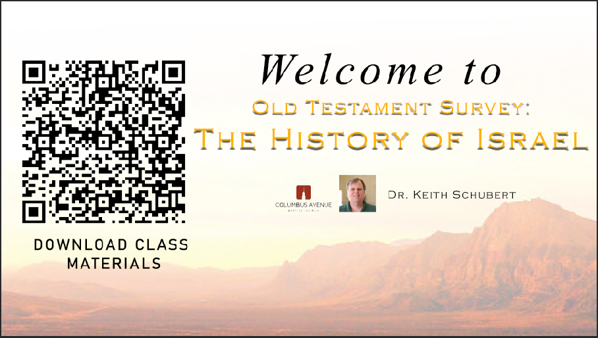

Slide 2

Old Testament Survey:
The History of Israel
Intertestamental
Dr. Keith Evan Schubert

