Slide 1

Old Testament Survey:
Literature
Genesis: Pre-Flood
Dr. Keith Evan Schubert

Slide 2
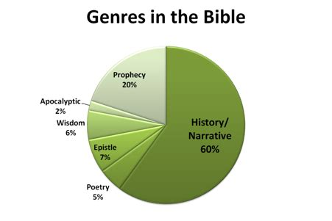
Literary Genres
Narrative/History
  Law
  Biography
  Parable
Poetry
Wisdom
  Lament
Letter/Epistle
Prophetic
Apocalyptic

Slide 3
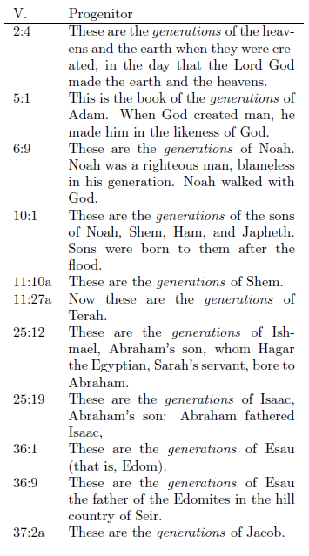
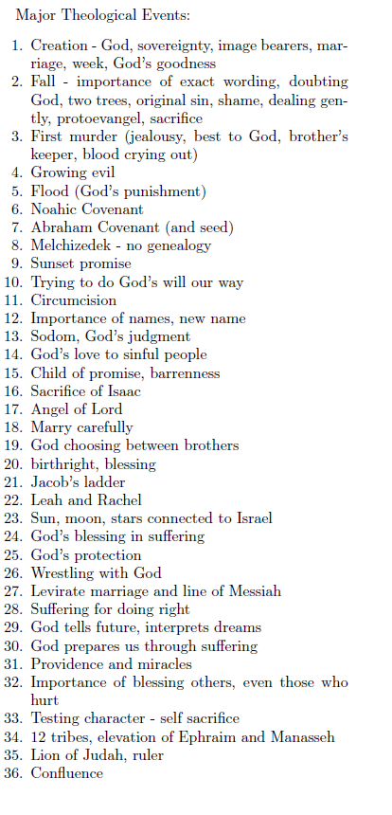
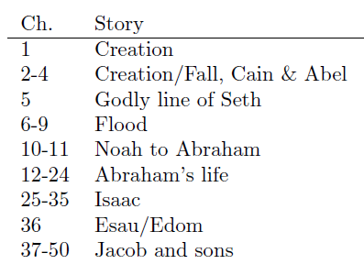
Structure of Genesis

Slide 4
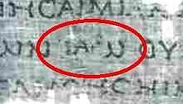
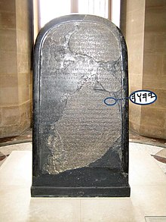
Who? Names Matter
Transcription of the divine name as ΙΑΩ in the 1st-century BCE Septuagint manuscript 4Q120
Chapter 1:1 In the beginning GOD created the heavens and the earth
אֱלֹהִ֑ים Elohim
  Masculine plural of Eloah
  God or the Mighty One
  Title
Chapter 2:4 These are the records of the heavens and the earth, concerning their creation. At the time that the Lord God made the earth and the heavens,
יהוה אֱלֹהִ֑ים
יהוה‎ YHWH pronounced Yahweh
  derived from a verb that means "to be", "to exist", "to cause to become", or "to come to pass
  אֶהְיֶה אֲשֶׁר אֶהְיֶה‎ (I am that/who I am) abbreviated with 3rd person masculine yod י at the start
    I will be with you
    I am without equal
  Name (Exodus 3:14)
The Mesha Stele bears one of the earliest known reference (840 BC) to Yahweh
Notes:
הָאָֽרֶץ׃ וְאֵ֥ת הַשָּׁמַ֖יִם אֵ֥ת אֱלֹהִ֑ים בָּרָ֣א בְּרֵאשִׁ֖ית
In the beginning GOD created the heavens and the earth

Slide 5
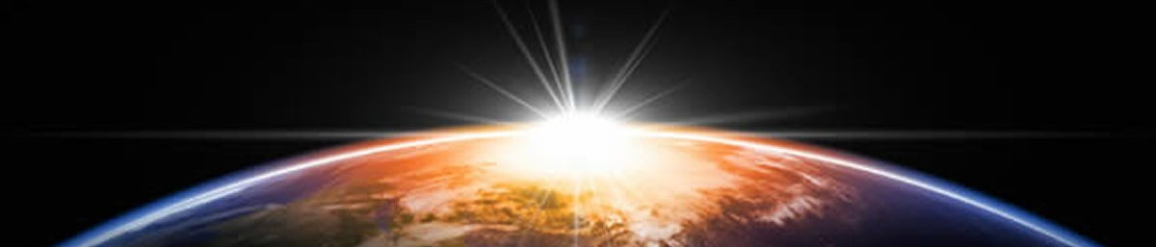
Genesis 1 structure
Initial State (v.2) | Preparation (days 1-3) | Population (days 4-6)
Darkness | Light, separate light/dark (day/night) | Sun Mon, stars
Watery Abyss | Firmament, separate water above/below | Birds Fish
Formlessness | Separate land/sea Create vegetation | Land animals Humans

Slide 6
Genesis 1
Pattern of Days
  And God said, “Let …
  Stuff happens
  God called the …
  And it was so.
  And God saw that it was good.
  And there was evening, and there was morning—the nth day.
Some differences in days:
  How are days 3 and 6 similar to each other but different from the rest?
  What is added on days 5, 6, and 7?
  What is missing on day 2? Day 5?
  Where is day 7?

Slide 7
Day 4
And God said, “Let there be lights in the vault of the sky to separate the day from the night, and let them serve as signs to mark sacred times, and days and years, ¹⁵ and let them be lights in the vault of the sky to give light on the earth.” And it was so. ¹⁶ God made two great lights—the greater light to govern the day and the lesser light to govern the night. He also made the stars. ¹⁷ God set them in the vault of the sky to give light on the earth, ¹⁸ to govern the day and the night, and to separate light from darkness. And God saw that it was good. ¹⁹ And there was evening, and there was morning—the fourth day.

Slide 8
Historic Narrative Introduction
These are the records of the heavens and the earth, concerning their creation. At the time that the Lord God made the earth and the heavens,

Slide 9
Poetic Structure: Chaism
These are the records of the heavens and the earth, concerning their creation. At the time that the Lord God made the earth and the heavens,
These are the records of the
heavens and the
  earth, concerning their
    creation. At the time that the
      Lord God
    made the
  earth and the
heavens,

Slide 10
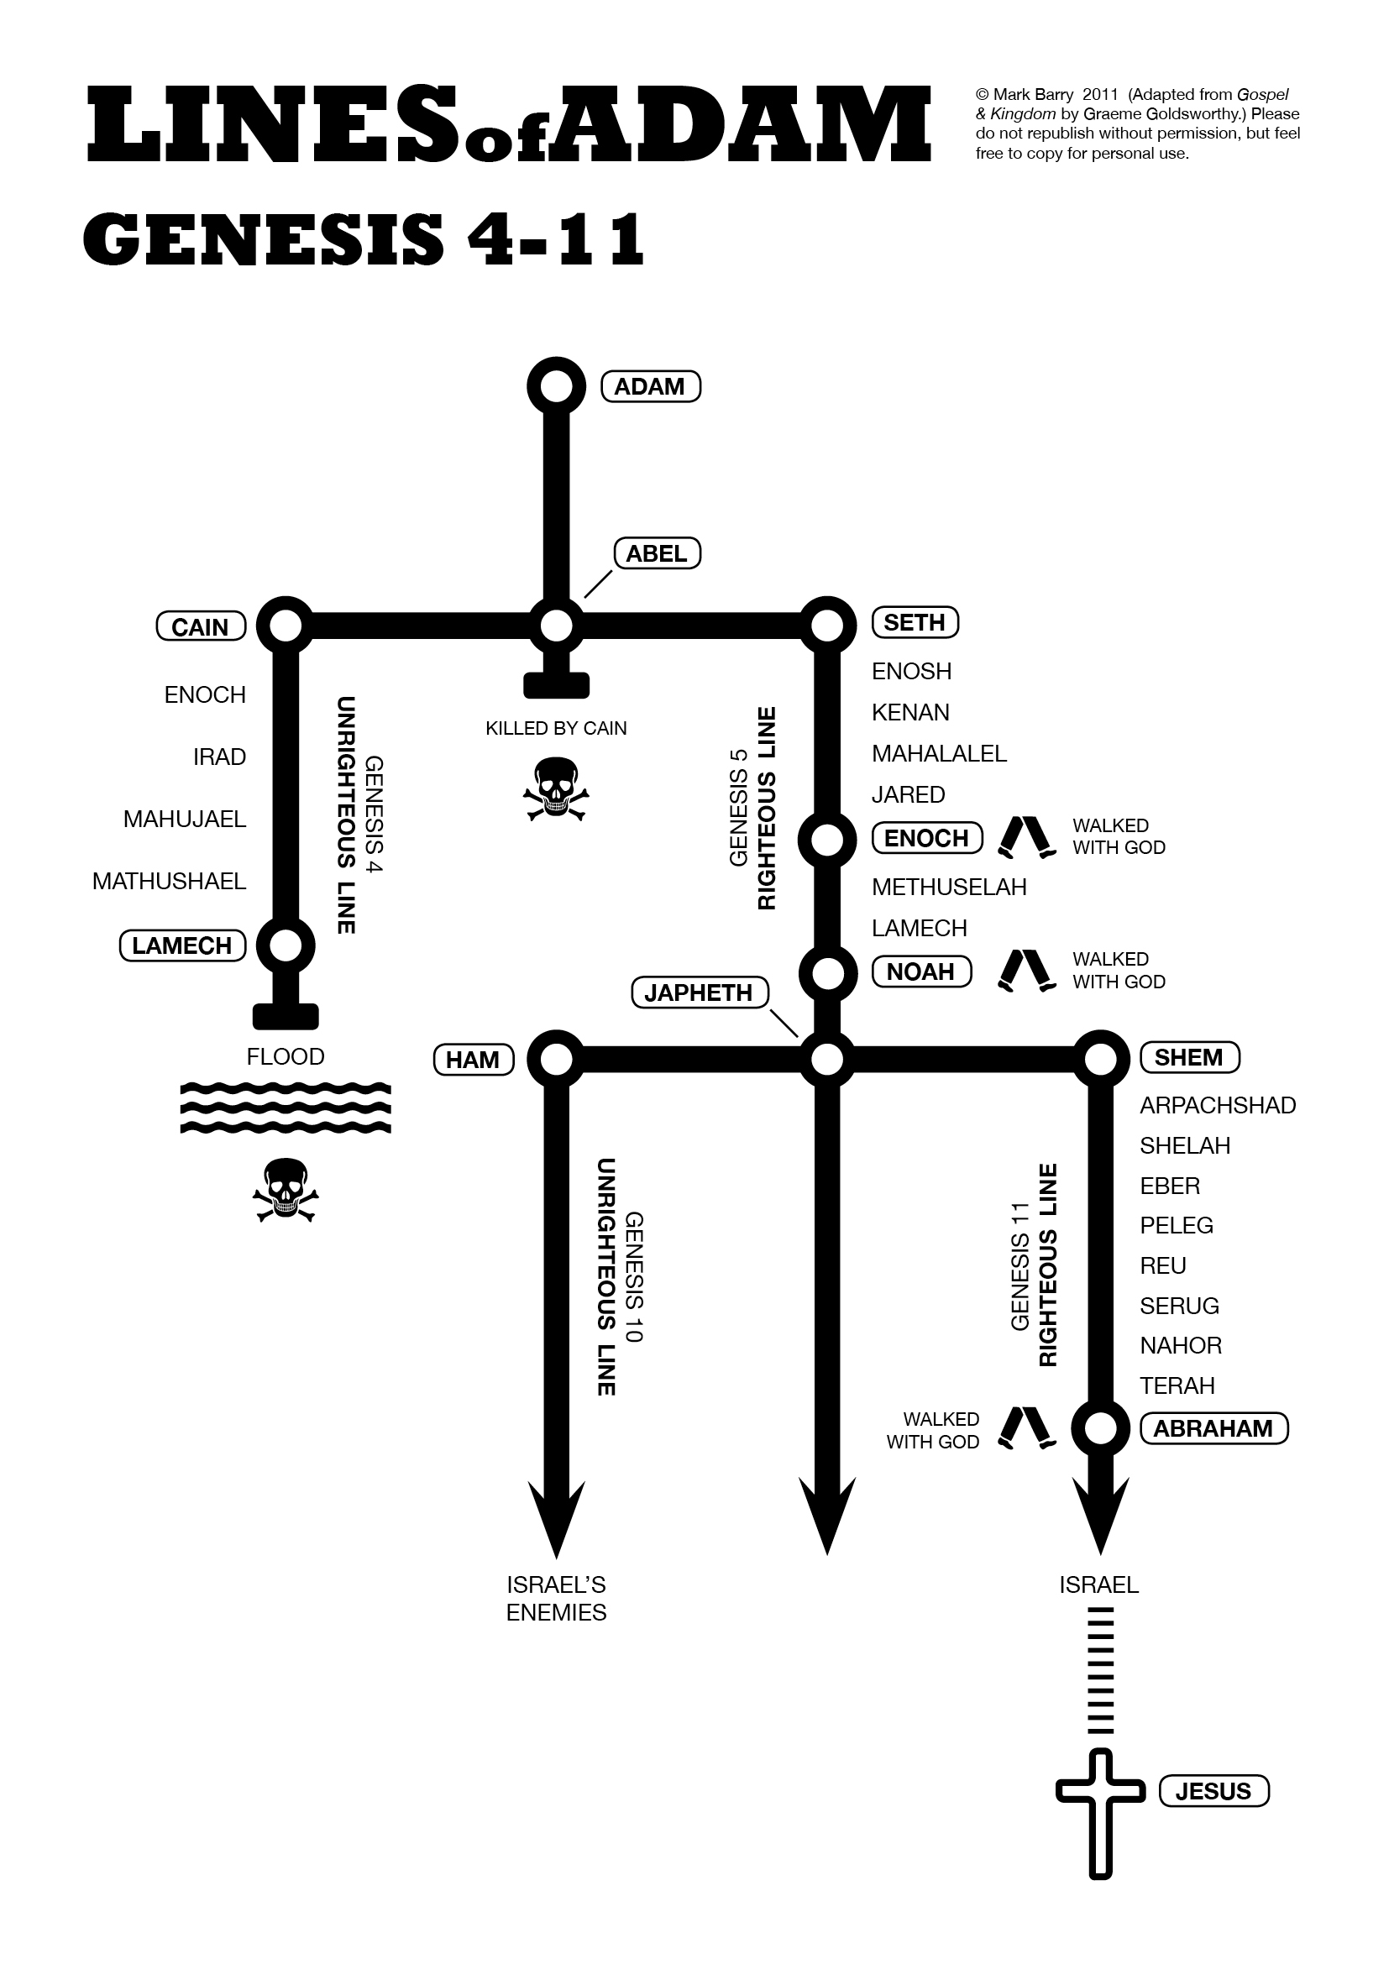
Fall to Flood
Read Genesis 3
  Who was there?
  What was God’s command
  What are the 3 curses
Read Genesis 4:1-7
  What does Eve say of Cain?
  What does God comment about the sacrifice?
Read Genesis 6:1-8

