Slide 1

Old Testament Survey:
Literature
Genesis
Dr. Keith Evan Schubert

Slide 2
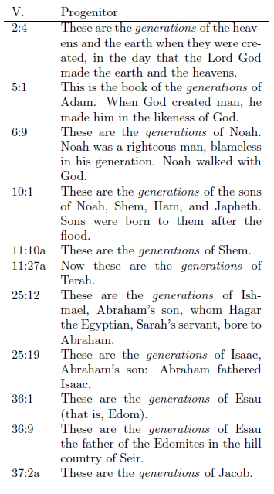
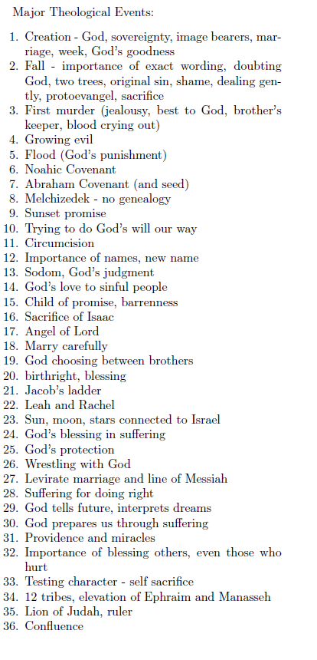
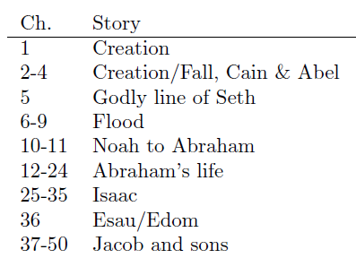
Structure of Genesis

Slide 3
Who are Nephilim?
Read Genesis 6:1-4
  Now it came about, when mankind began to multiply on the face of the land, and daughters were born to them, 2 that the sons of God saw that the daughters of mankind were beautiful; and they took wives for themselves, whomever they chose. 3 Then the Lord said, “My Spirit will not remain with man forever, because he is also flesh; nevertheless his days shall be 120 years.” 4 The Nephilim were on the earth in those days, and also afterward, when the sons of God came in to the daughters of mankind, and they bore children to them. Those were the mighty men who were of old, men of renown.
Nephilim comes from a root meaning to fall, and basically means either fallen ones or one who casts down, i.e. a person who throws others down.
What relationship is do the Nephilim have to others?
Where else do we see Nephilim? Num 13:26-33

Slide 4
Who are the sons & daughters?
Read Genesis 6:1-4
  Now it came about, when mankind began to multiply on the face of the land, and daughters were born to them, 2 that the sons of God saw that the daughters of mankind were beautiful; and they took wives for themselves, whomever they chose. 3 Then the Lord said, “My Spirit will not remain with man forever, because he is also flesh; nevertheless his days shall be 120 years.” 4 The Nephilim were on the earth in those days, and also afterward, when the sons of God came in to the daughters of mankind, and they bore children to them. Those were the mighty men who were of old, men of renown.
Sons of God is Benai Elohim
  Exact phase only in Job
  Similar phrases in several books with
Three typical interpretations:
  Angels
    Manifest bodies
    possession
  Line of Seth
  Ancient Kings

Slide 5
Who are the sons & daughters?
Read Genesis 6:1-4
  Now it came about, when mankind began to multiply on the face of the land, and daughters were born to them, 2 that the sons of God saw that the daughters of mankind were beautiful; and they took wives for themselves, whomever they chose. 3 Then the Lord said, “My Spirit will not remain with man forever, because he is also flesh; nevertheless his days shall be 120 years.” 4 The Nephilim were on the earth in those days, and also afterward, when the sons of God came in to the daughters of mankind, and they bore children to them. Those were the mighty men who were of old, men of renown.
Jude 6-7
2 Peter 2:4-6
1 Peter 3:19-20
Matthew 22:30
Luke 20:34-35
Matthew 8:28-34
Matthew 12:43-45
Luke 11:24-26

Slide 6
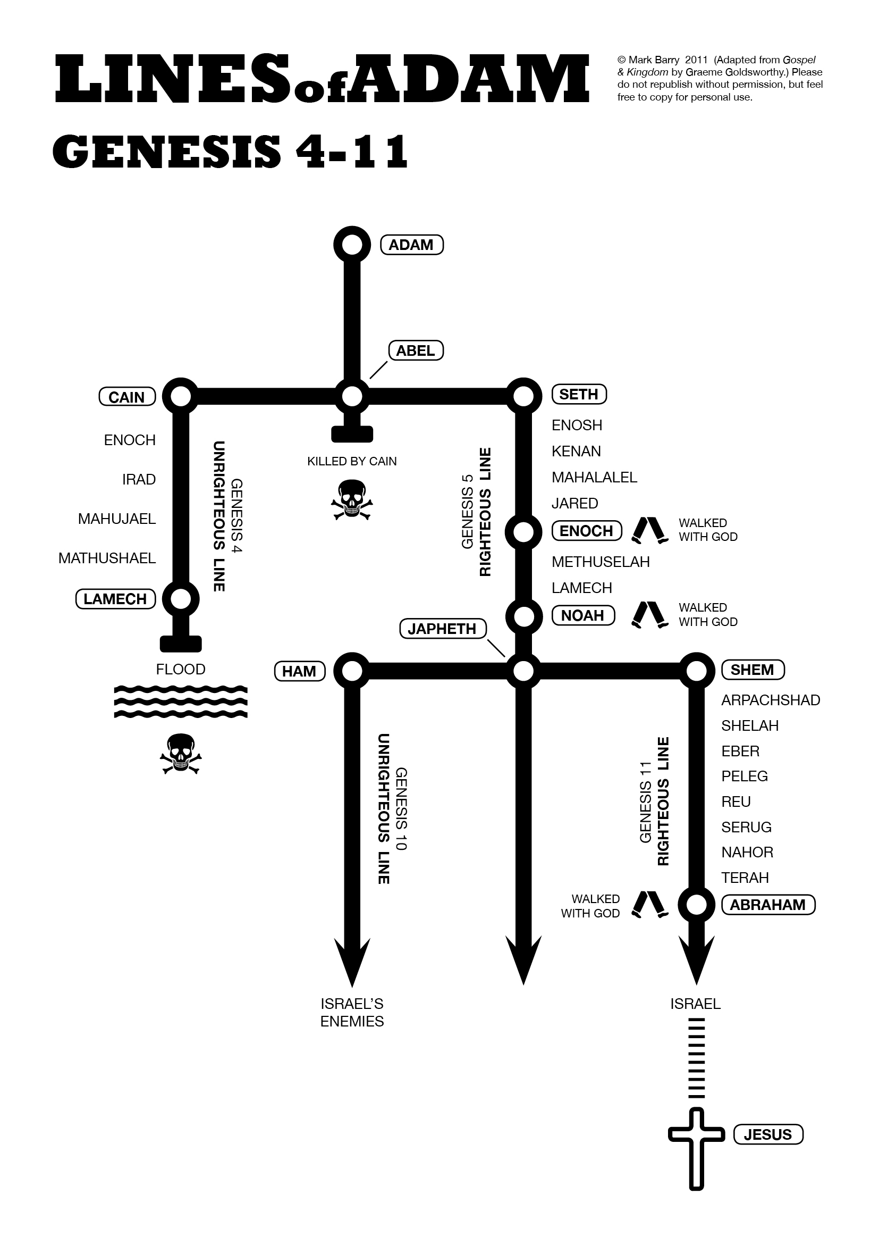
Who are Nephilim?
Read Genesis 6:1-4
  Now it came about, when mankind began to multiply on the face of the land, and daughters were born to them, 2 that the sons of God saw that the daughters of mankind were beautiful; and they took wives for themselves, whomever they chose. 3 Then the Lord said, “My Spirit will not remain with man forever, because he is also flesh; nevertheless his days shall be 120 years.” 4 The Nephilim were on the earth in those days, and also afterward, when the sons of God came in to the daughters of mankind, and they bore children to them. Those were the mighty men who were of old, men of renown.

Slide 7
What is the issue?
Read Genesis 6:1-4
  Now it came about, when mankind began to multiply on the face of the land, and daughters were born to them, 2 that the sons of God saw that the daughters of mankind were beautiful; and they took wives for themselves, whomever they chose. 3 Then the Lord said, “My Spirit will not remain with man forever, because he is also flesh; nevertheless his days shall be 120 years.” 4 The Nephilim were on the earth in those days, and also afterward, when the sons of God came in to the daughters of mankind, and they bore children to them. Those were the mighty men who were of old, men of renown.
What is God concerned about?
What was immediately before this passage?
What immediately follows?

Slide 8
Midrash
“That they were fair [tovot]” – Rabbi Yudan said: The word is written tovot [without vavs]. When they would adorn a woman for her [marriage to her] husband, the prominent man would enter and consort with her first, [before her husband]. That is what is written: “That they were fair [tovot]” – these are the unmarried girls. “They took for themselves wives from whomever they chose” – these are married women. “From whomever they chose” – these are males and animals. Rabbi Huna said in the name of Rabbi: The generation of the Flood was not obliterated from the world until they wrote marriage contracts for males and animals.

Slide 9
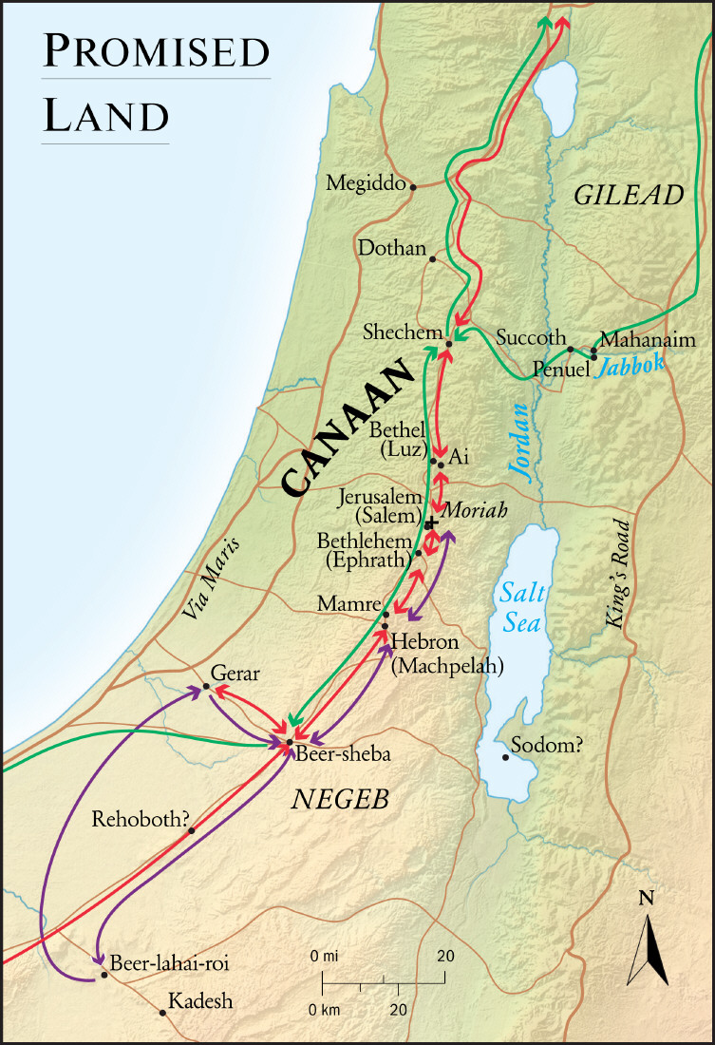
Abraham, Isaac, Jacob
Bethel
Salem/Moriah
Genesis 12:1-7
Genesis 28:10-22
Genesis 35:1-15
1 Samuel 7:16
1 Kings 12:25-33
Genesis 14
Genesis 22

Slide 10
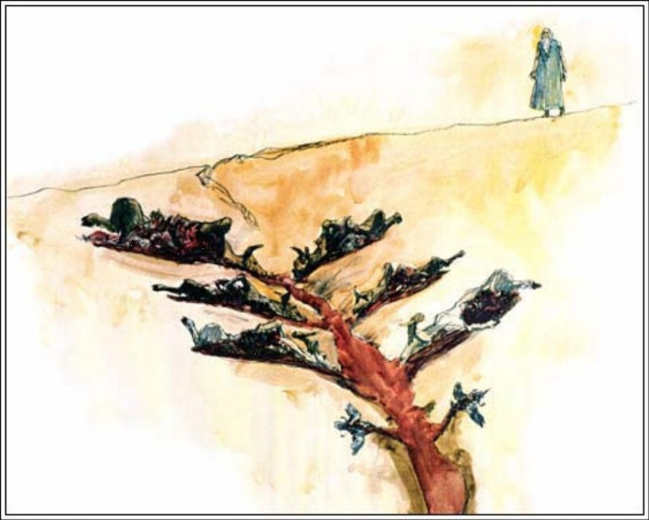
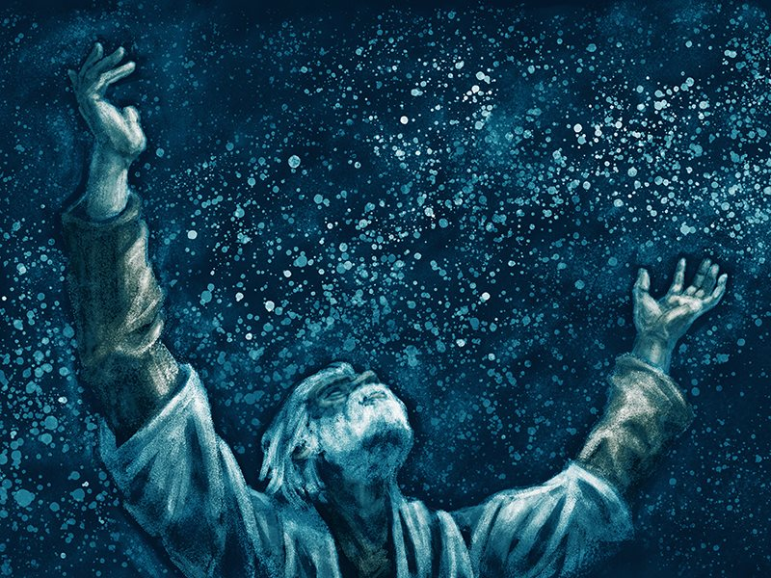
Cutting a covenant – Genesis 15

