Slide 1

Old Testament Survey:
Literature
Reading Laws
Dr. Keith Evan Schubert

Slide 2
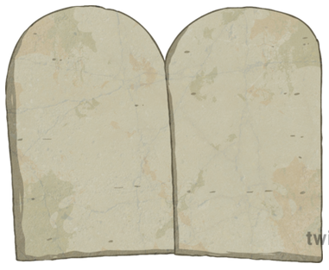
Ten words
Christian Breakdown
Honor your father and
Mother…
You shall have no gods
before me…
You shall not murder
You shall make no graven
images…
You shall not commit
adultery
You shall not take the
Name of the Lord thy God
In vain…
You shall not steal
You shall not bear false
witness…
Remember the Sabbath
Day, to keep it holy…
You shall not covet

Slide 3
Ten words
Christian Breakdown
Jewish Breakdown
Honor your father and
Mother…
I am the Lord your God…
You shall not murder
You shall have no gods
before me…
You shall not murder
You shall not commit
adultery
You shall have no gods…
You shall make no graven
images…
You shall not commit
adultery
You shall not take the
Name of the Lord thy God
In vain…
You shall not steal
You shall not take the
Name of the Lord thy God
In vain…
You shall not steal
Remember the Sabbath
Day, to keep it holy…
You shall not bear false
witness…
You shall not bear false
witness…
Remember the Sabbath
Day, to keep it holy…
Honor your father and
Mother…
You shall not covet
You shall not covet

Slide 4
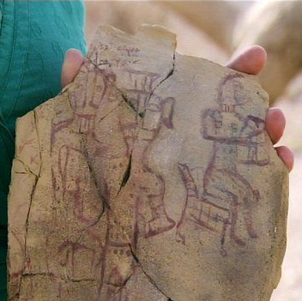
No god’s besides
The image on the stone is a direct violation of this command, it is putting the one true God with Asherah.

Slide 5
Chiastic Structure
Michael Morales, Who Shall Ascend the Mountain of the Lord?
Lev 1-7 Sacrifices
  Lev 8-10 Institution of Priesthood
    Lev 11-15 Clean/Unclean in Daily Life
      Lev 16 Day of Atonement
    Lev 17-20 Holy/Profane in Daily Life
  Lev 21-22 Legislation for Priesthood
Lev23-27 Festivals/Sacred Time

Slide 6
Sacrificial system
  Burnt offering (up, entire thing burnt)
  Grain offering (gift offering)
  Peace offering (fellowship)
  Sin offering (infractions of purity or ritual)
  Guilt offering (restitution or reparation)
Numbers 15:22-36
Levitcus 17

