Slide 1

Old Testament Survey:
Literature
Love
Dr. Keith Evan Schubert

Slide 2


Poetic Romantic Love & Imagery
Song of Solomon 1

Slide 3
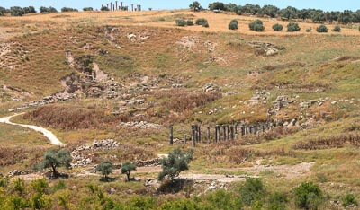
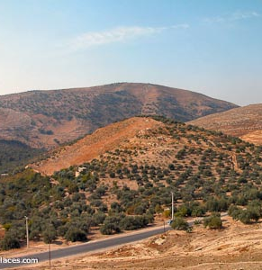
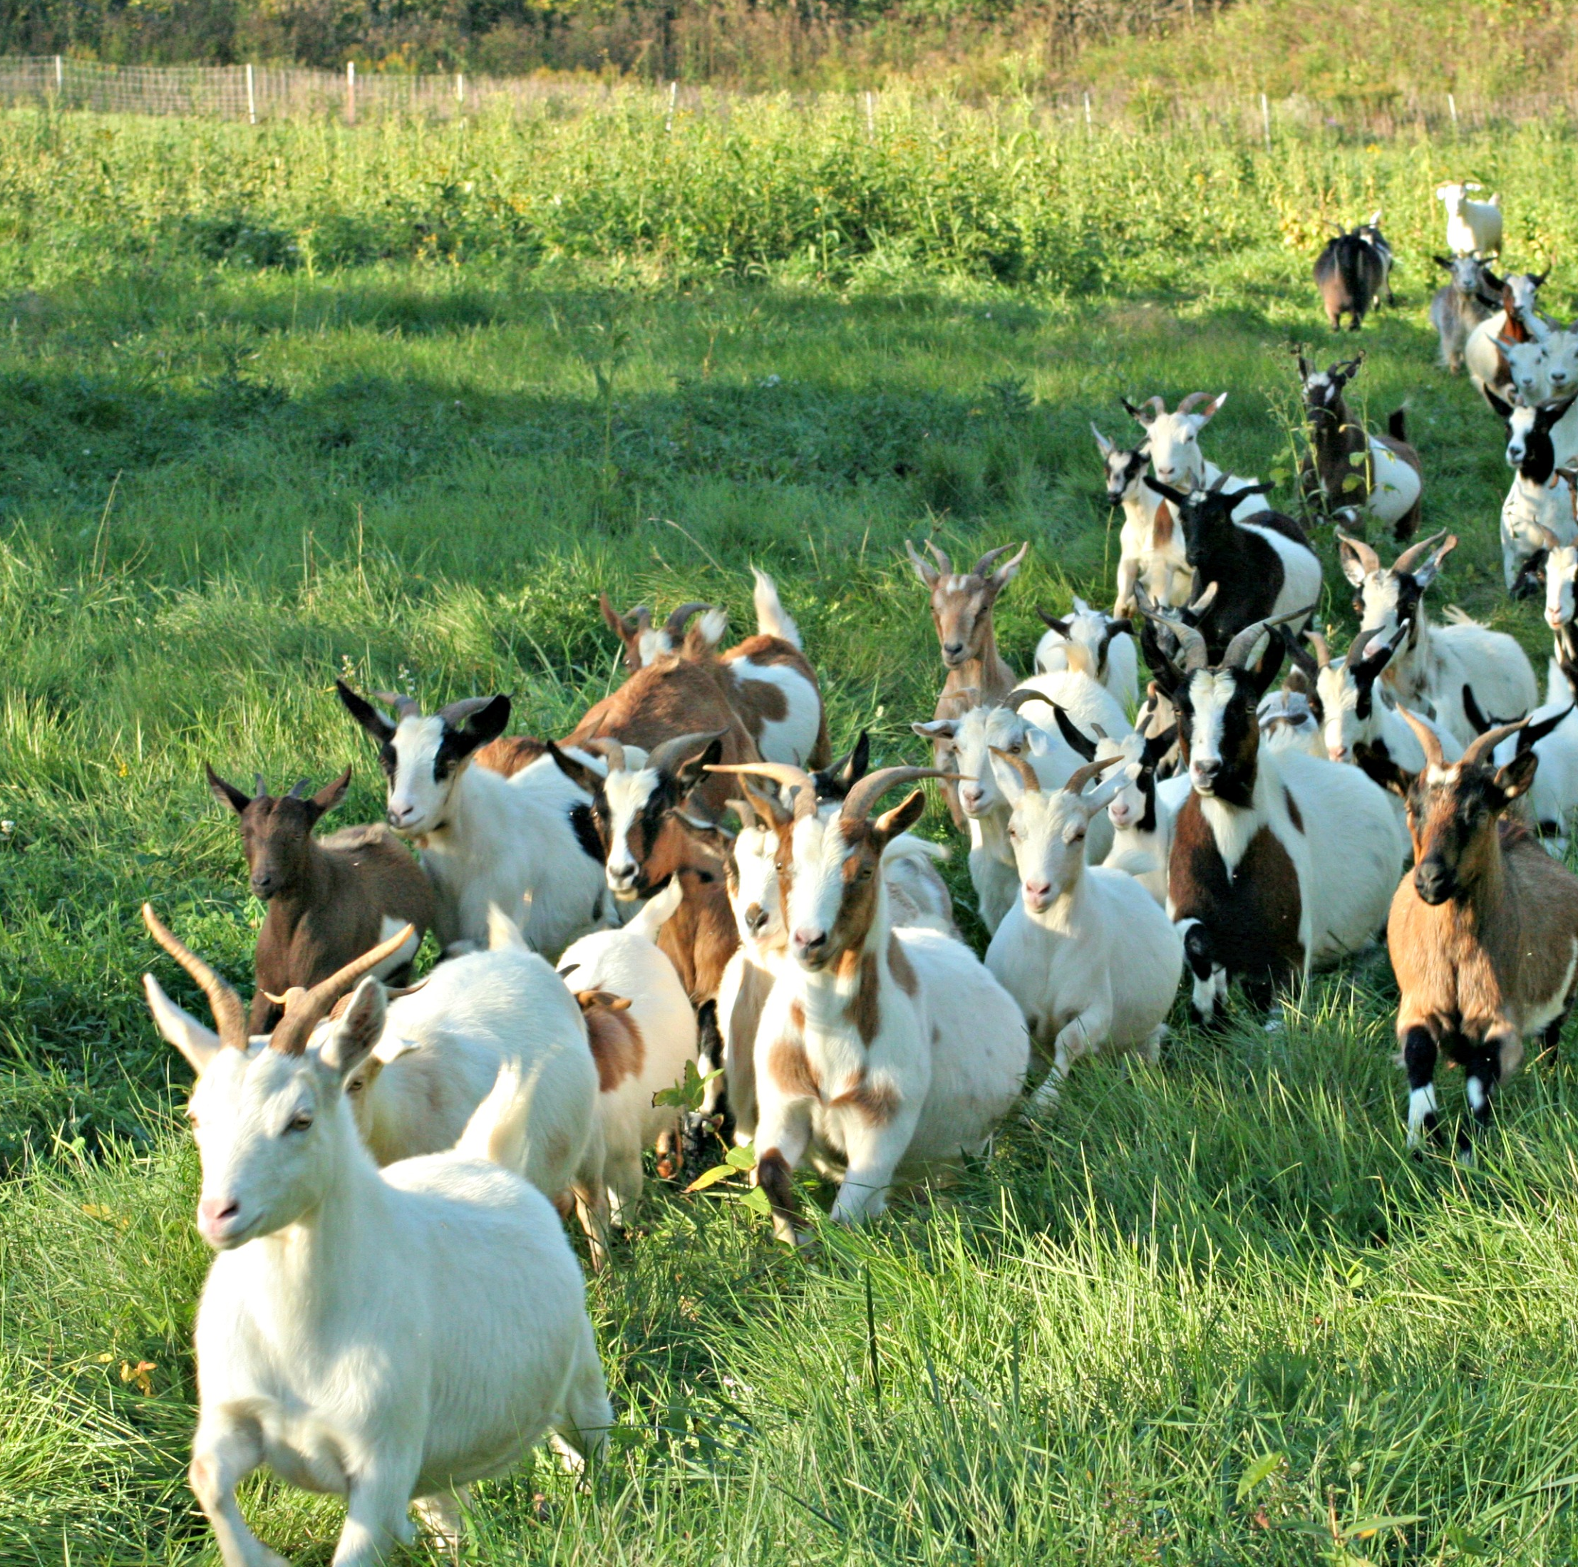
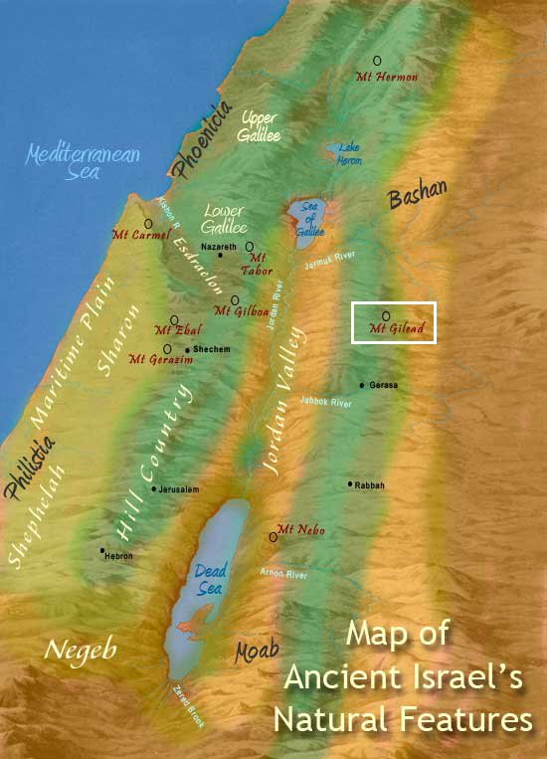

Poetic Romantic Love & Imagery
Song of Solomon 4

Slide 4
Wells and the Patriarchs
Gen 24: Isaac and Rebekah
Gen 29: Jacob and Rachel
Exodus 2:11-25: Moses and Zipporah

Slide 5

Imagery
Love
Proverbs
5:15-20
Proverbs 23 Saying 18
(v. 26-28)
Faith
Proverbs
25:25-26
Isaiah
1:29-31
Jeremiah 6:7
Salvation
Isaiah 12:3
Isaiah 58:11
Jeremiah
31:12

Slide 6
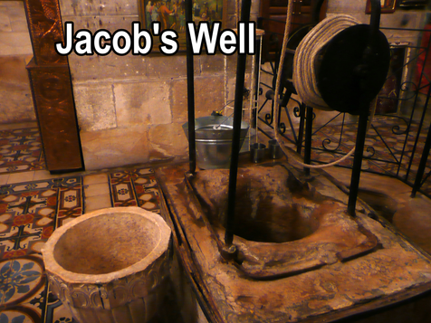
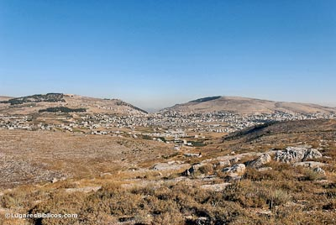
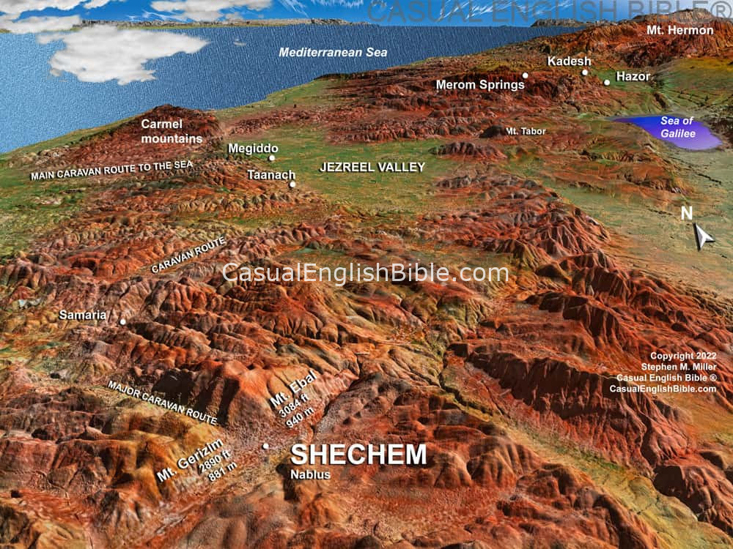
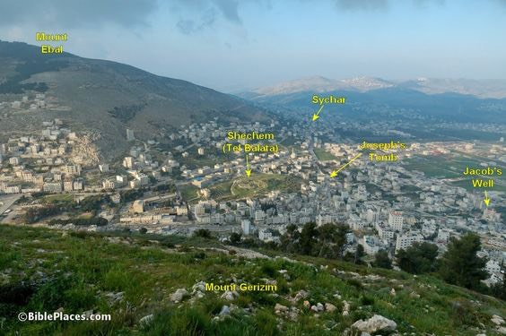
John 4: Jesus at the Well

